Slide 1
Plant Pathology and Plant Diseases
© Anne Marte Tronsmo, David B. Collinge, Annika Djurle, Lisa Munk, Jonathan Yuen and Arne Tronsmo 2020

Slide 2
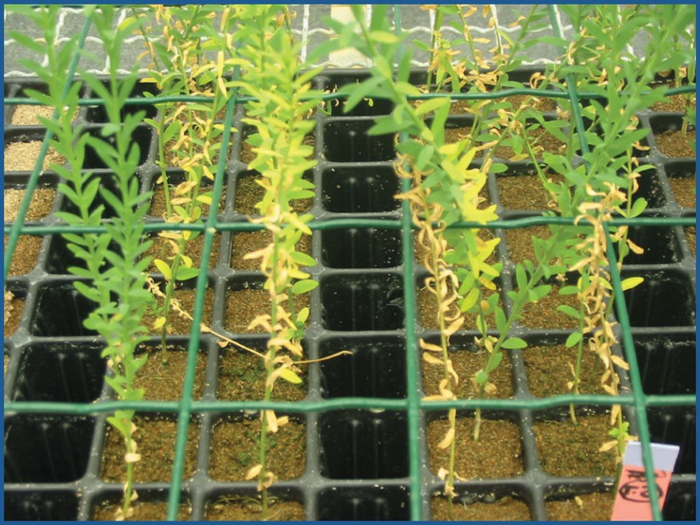
Fig. 17.1 Screening procedure conducted in soil. The potential antagonists are introduced in soil at sowing time in a mixture with the pathogen F. oxysporum f.sp. lini. (© C. Alabouvette.)
Plant Pathology and Plant Diseases © Anne Marte Tronsmo, David B. Collinge, Annika Djurle, Lisa Munk, Jonathan Yuen and Arne Tronsmo 2020

Slide 3
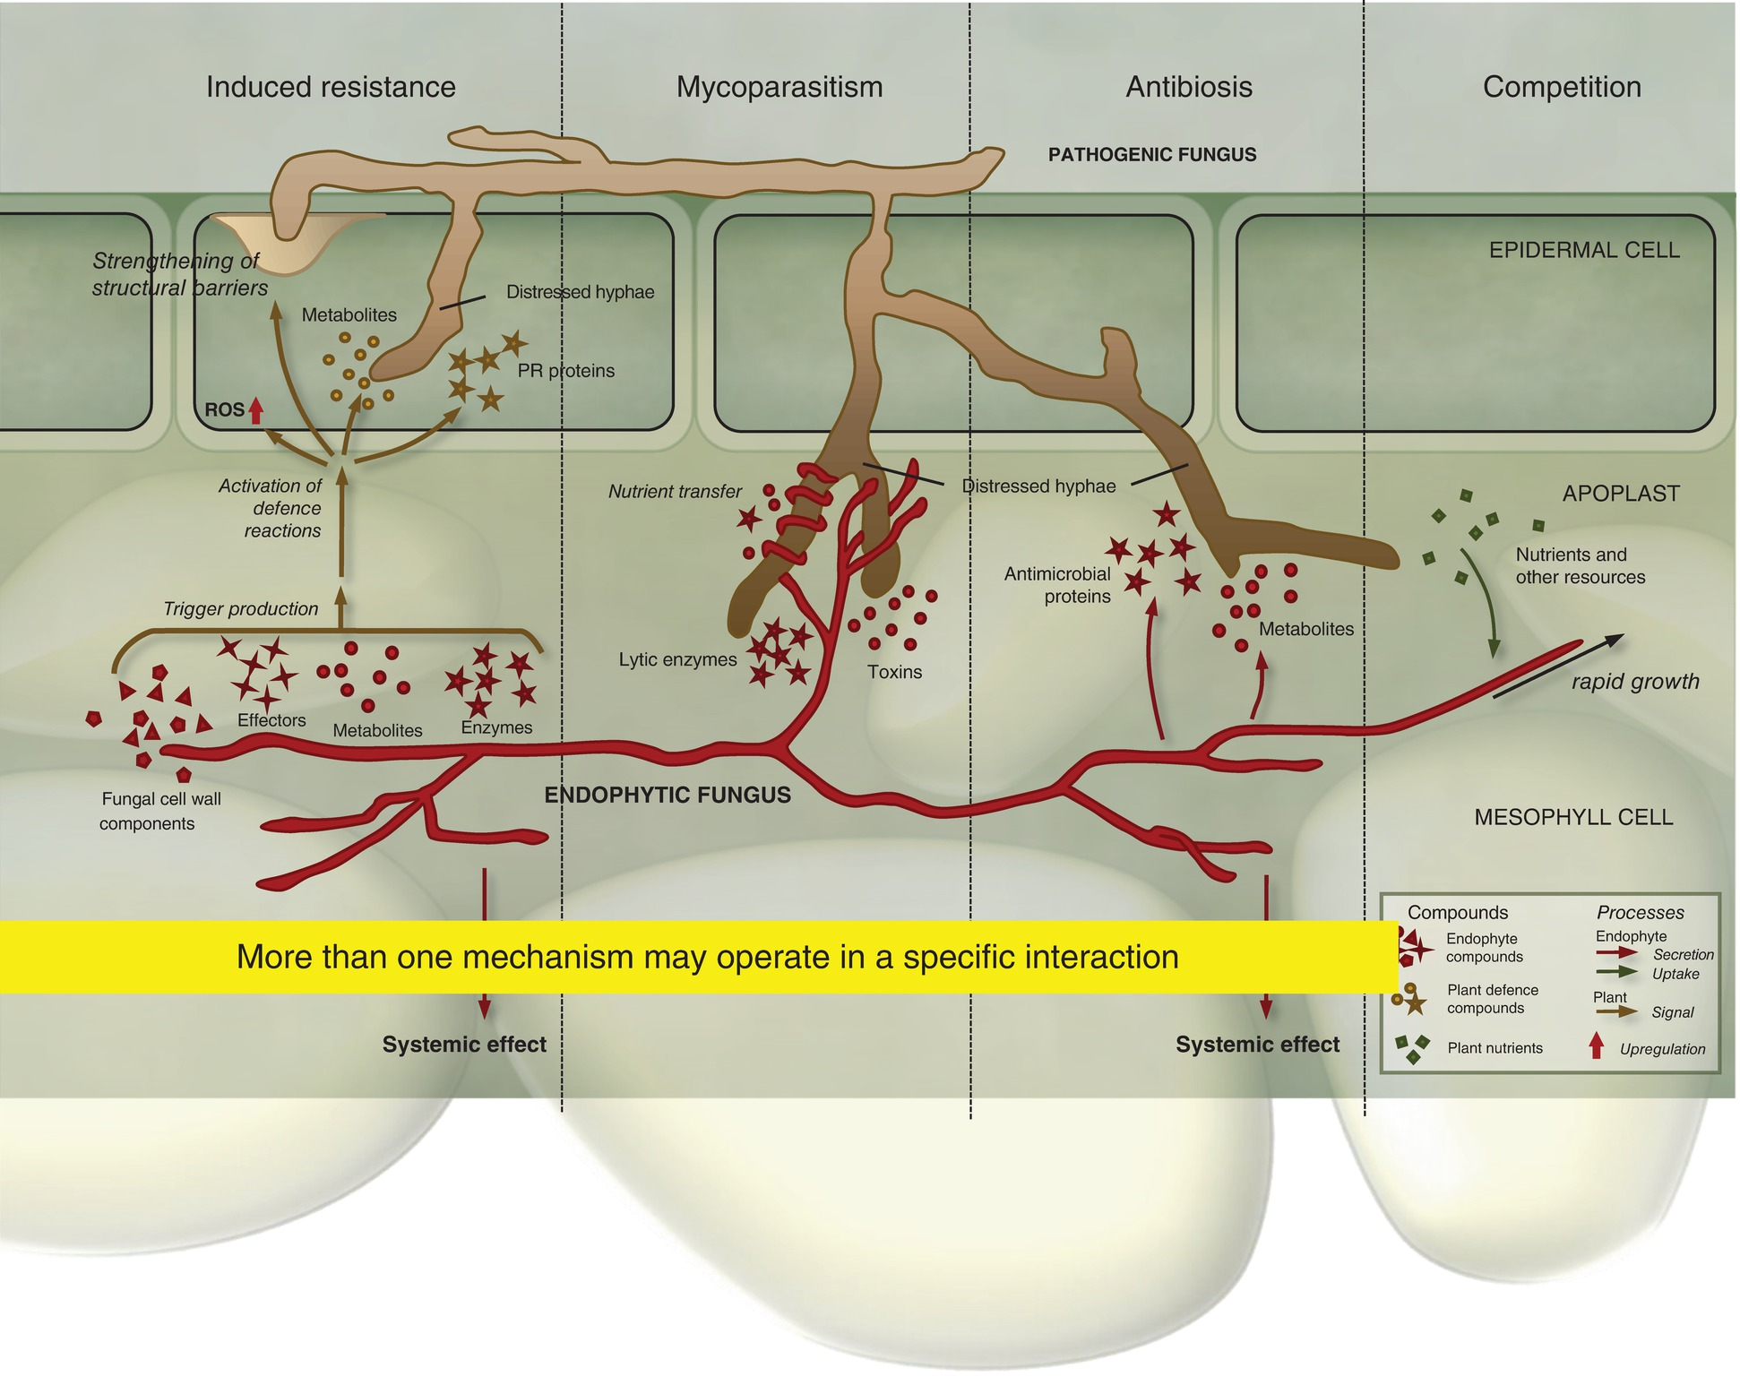
Fig. 17.2 Four mechanisms for pathogen control by endophytes. (© Latz, et al (2018) Plant Ecology & Diversity 11, 555–567)
Plant Pathology and Plant Diseases © Anne Marte Tronsmo, David B. Collinge, Annika Djurle, Lisa Munk, Jonathan Yuen and Arne Tronsmo 2020

Slide 4
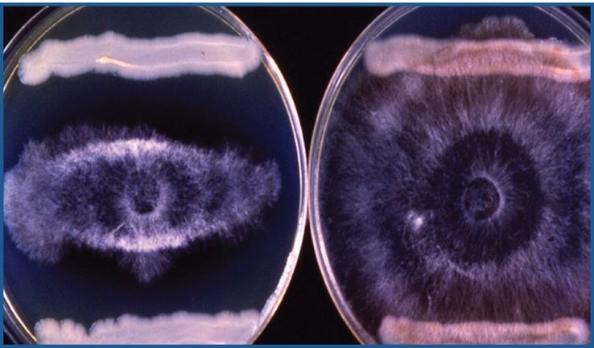
Fig. 17.3 Antibiosis by Pseudomonas sp. versus Pythium ultimum. One strain of Pseudomonas inhibits the growth of Pythium, the other has no effect, the pathogen grows over the bacteria. (© C. Alabouvette.)
Plant Pathology and Plant Diseases © Anne Marte Tronsmo, David B. Collinge, Annika Djurle, Lisa Munk, Jonathan Yuen and Arne Tronsmo 2020

Slide 5
Fig. 17.4A Hyperparasitism. (A) Thin hyphae of Trichodrerma, coiling around and penetrating into large hyphae of Rhizoctonia solani. (© C. Alabouvette)
Plant Pathology and Plant Diseases © Anne Marte Tronsmo, David B. Collinge, Annika Djurle, Lisa Munk, Jonathan Yuen and Arne Tronsmo 2020

Slide 6
Fig. 17.4B Hyperparasitism. (B) Powdery mildew (Sphaerotheca fuliginea) on cucumber. Leaf to the left treated with the biocontrol fungus Tilletiopsis minor, leaf to the right untreated control. (© J. S. Hansen.)
Plant Pathology and Plant Diseases © Anne Marte Tronsmo, David B. Collinge, Annika Djurle, Lisa Munk, Jonathan Yuen and Arne Tronsmo 2020

Slide 7
Fig. 17.4C Hyperparasitism. (C) Scanning micrograph of the cucumber leaf. T. minor is parasitizing the cucumber powdery mildew hyphae and conidiophore. (© J. S. Hansen.)
Plant Pathology and Plant Diseases © Anne Marte Tronsmo, David B. Collinge, Annika Djurle, Lisa Munk, Jonathan Yuen and Arne Tronsmo 2020

Slide 8
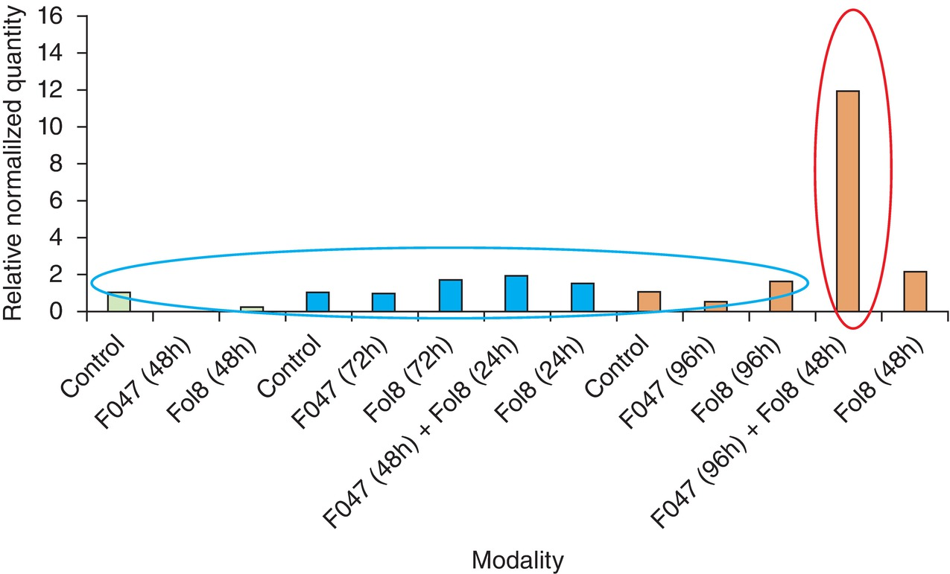
Fig. 17.5 The effect of priming: Chitinase 3 is over-expressed in tomato root first inoculated with Fo47 then by the pathogenic strain. (© C. Alabouvette.)
Plant Pathology and Plant Diseases © Anne Marte Tronsmo, David B. Collinge, Annika Djurle, Lisa Munk, Jonathan Yuen and Arne Tronsmo 2020

Slide 9
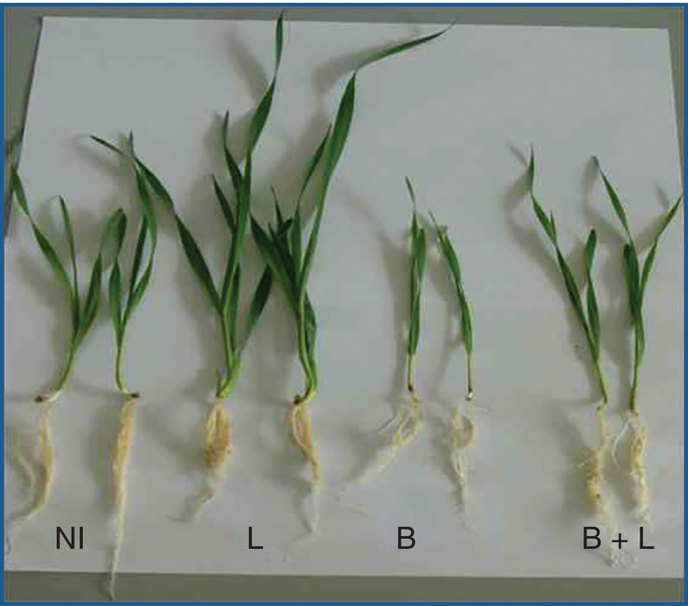
Fig. 17.6 The effect on growth of non-inoculated control plants (NI) and plants inoculated by two different strains (L and B) and the mixture of the two strains. Using two strains was not beneficial. (© C. Alabouvette.)
Plant Pathology and Plant Diseases © Anne Marte Tronsmo, David B. Collinge, Annika Djurle, Lisa Munk, Jonathan Yuen and Arne Tronsmo 2020

Slide 10
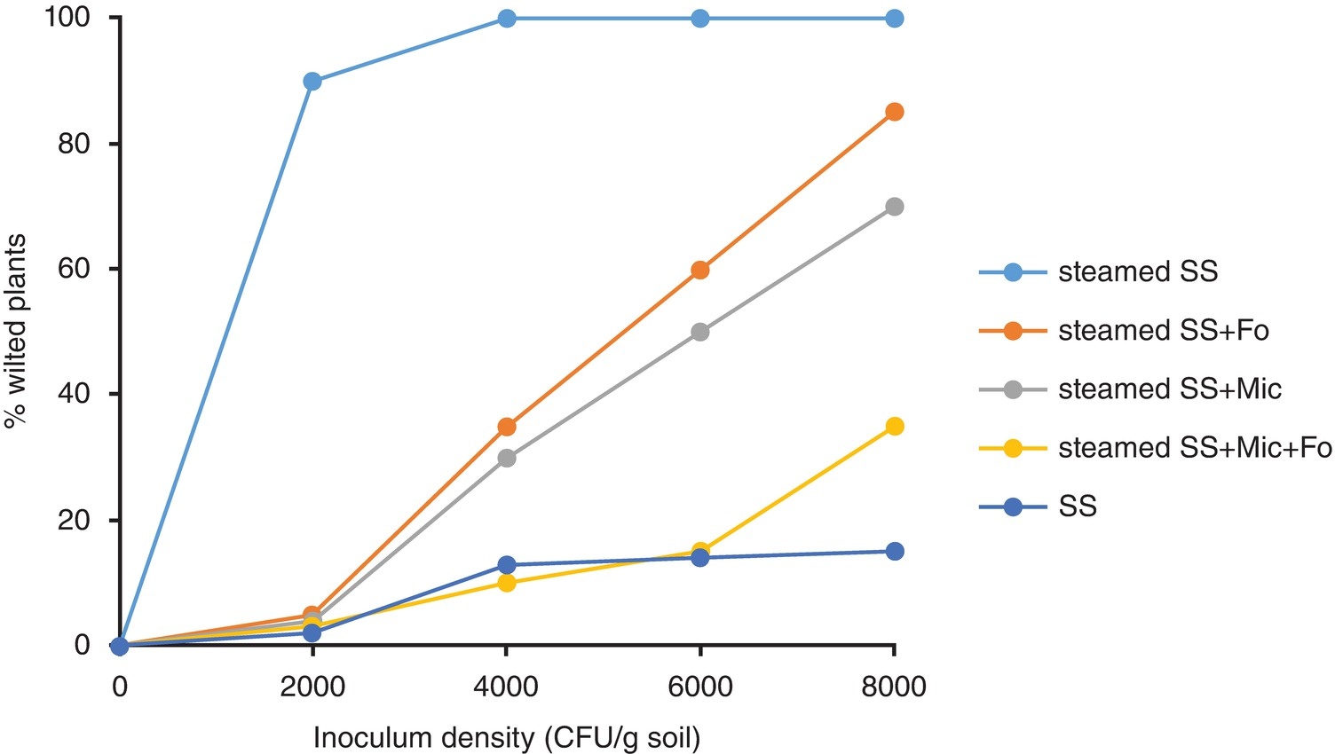
Fig. 17.7 Role of the soil microflora in the mechanisms of fusarium wilt suppressive soil. % of wilted plants in suppressive soil (SS), steamed SS, steamed SS with a strain of nonpathogenic F. oxysporum, (steamed +Fo), a consortium of bacteria and fungi isolated from the SS (steamed SS+Mic), and the consortium of microorganisms + the strain of F. oxysporum (steamed SS+Mic+Fo).
(© C. Alabouvette.)
Plant Pathology and Plant Diseases © Anne Marte Tronsmo, David B. Collinge, Annika Djurle, Lisa Munk, Jonathan Yuen and Arne Tronsmo 2020

Slide 11
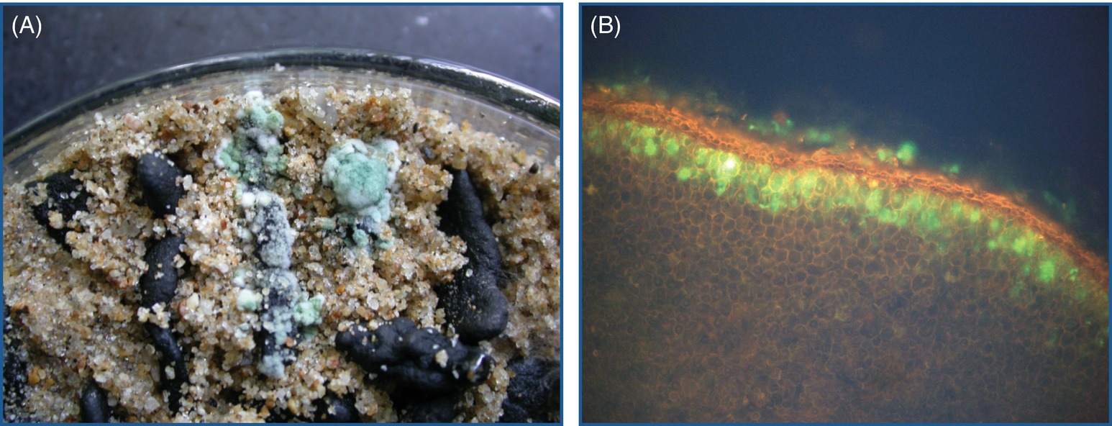
Fig. 17.8 Hyperparasitism. (A) Green Trichoderma sp. sporulating after infecting the black sclerotia of Sclerotinia sclerotiorum. (B) A fluorescent micrograph of colonization of Sclerotium rolfsii sclerotia by GFP transformed Trichoderma virens I10 3.4.10 GFP A. (A: © Daohong Jiang; B: © Sabrina Sarrocco.)
Plant Pathology and Plant Diseases © Anne Marte Tronsmo, David B. Collinge, Annika Djurle, Lisa Munk, Jonathan Yuen and Arne Tronsmo 2020

