Slide 1
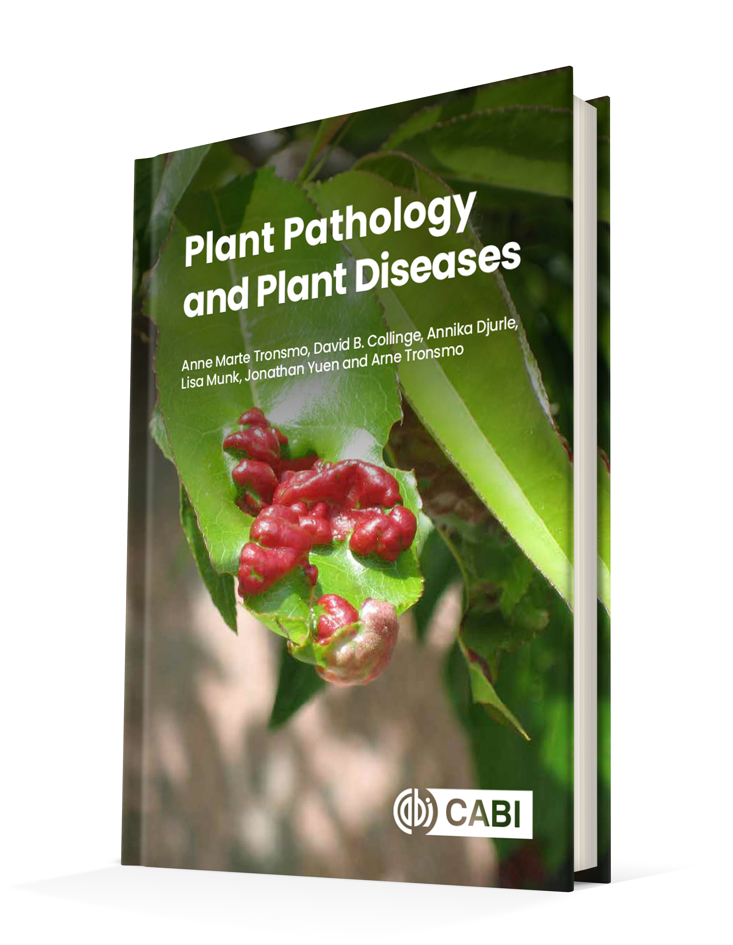
Plant Pathology and Plant Diseases
© Anne Marte Tronsmo, David B. Collinge, Annika Djurle, Lisa Munk, Jonathan Yuen and Arne Tronsmo 2020

Slide 2
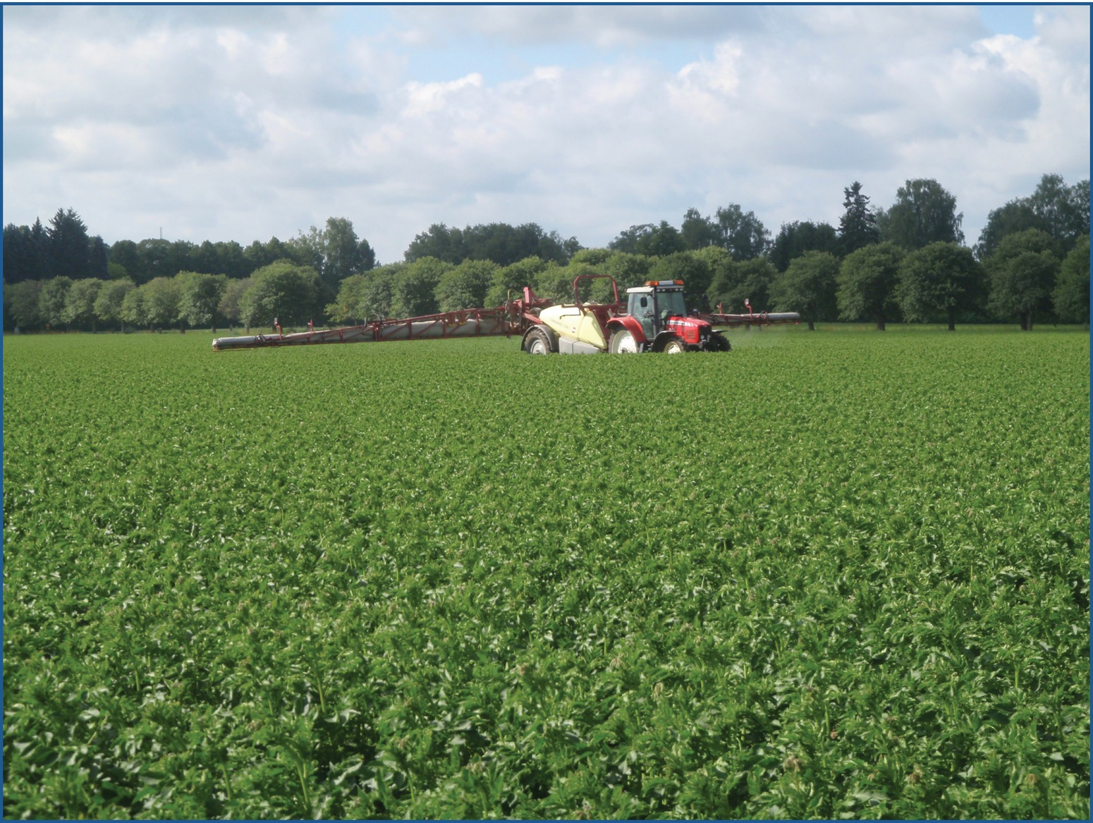
Fig. 16.1 Tractor-drawn sprayer treating the crop against potato late blight (Phytophthora infestans). (© Åsa Rölin.)
Plant Pathology and Plant Diseases
© Anne Marte Tronsmo, David B. Collinge, Annika Djurle, Lisa Munk, Jonathan Yuen and Arne Tronsmo 2020

Slide 3
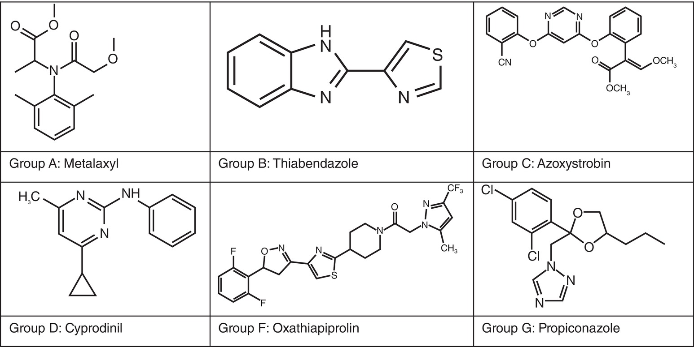
Fig. 16.2 Chemical structures of fungicides from major fungicide groups (Wikipedia)
Plant Pathology and Plant Diseases
© Anne Marte Tronsmo, David B. Collinge, Annika Djurle, Lisa Munk, Jonathan Yuen and Arne Tronsmo 2020

Slide 4
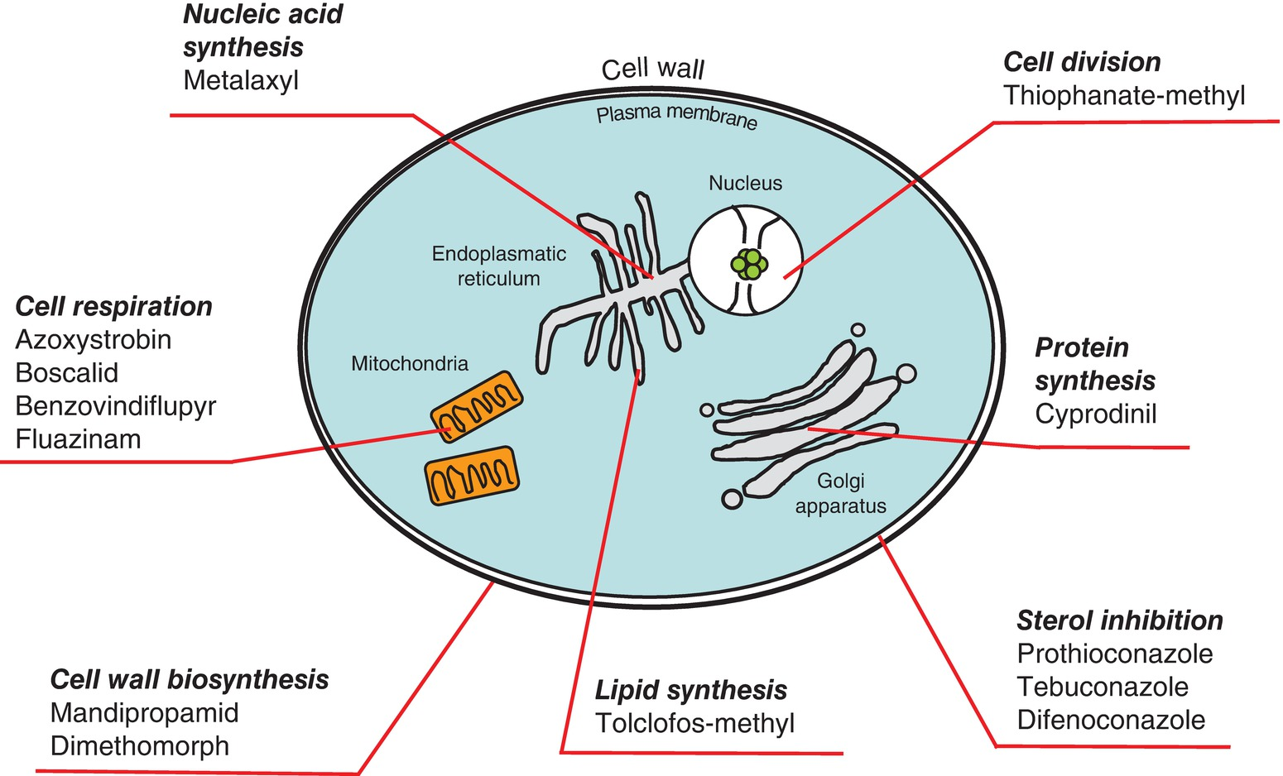
Fig. 16.3 Target cell functions for different fungicides with representative active ingredients. (© B. Andersson.)
Plant Pathology and Plant Diseases
© Anne Marte Tronsmo, David B. Collinge, Annika Djurle, Lisa Munk, Jonathan Yuen and Arne Tronsmo 2020

Slide 5
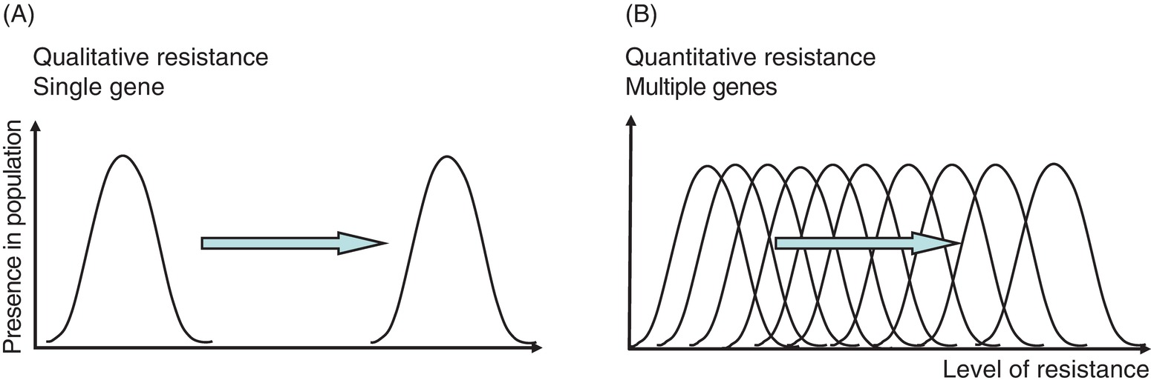
Fig. 16.4 (A) Qualitative fungicide resistance caused by a single mutation in the target fungal gene, resulting in a division of the pathogen population in one sensitive and one resistant part. (B) Quantitative fungicide resistance caused by multiple mutations in several target genes, resulting in a gradual shift in the pathogen population. (© B. Andersson.)
Plant Pathology and Plant Diseases
© Anne Marte Tronsmo, David B. Collinge, Annika Djurle, Lisa Munk, Jonathan Yuen and Arne Tronsmo 2020

Slide 6
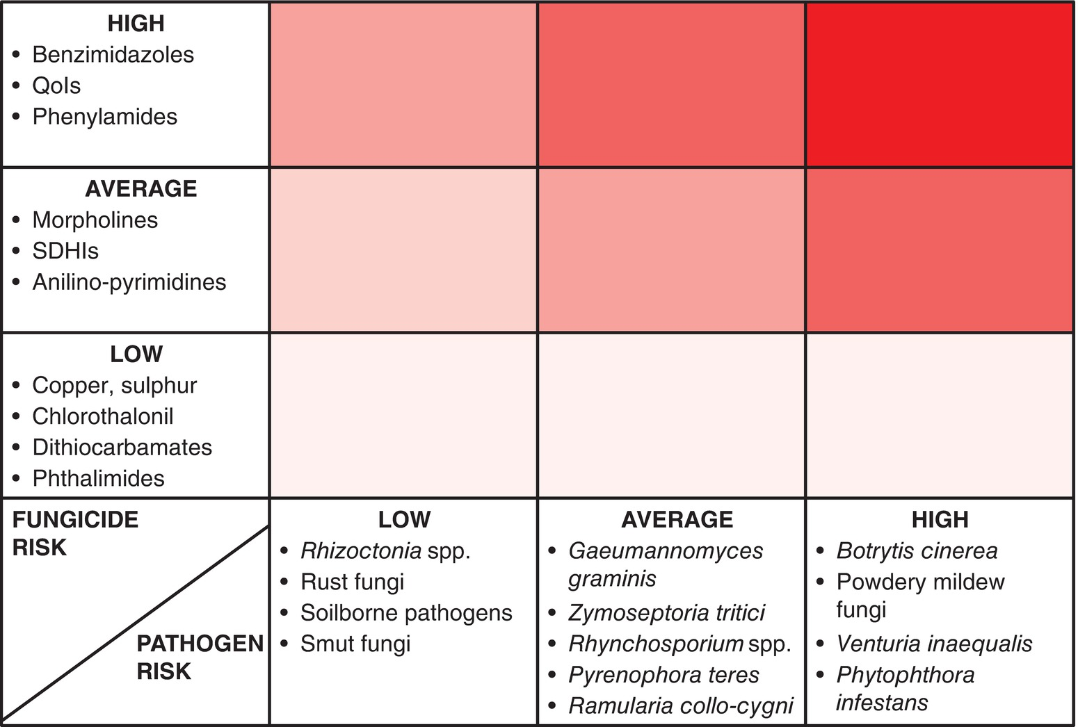
Fig. 16.5 Risk of fungicide resistance development for some combinations of fungicides and pathogens. A darker colour indicates higher risk. (© Swedish Board of Agriculture.)
Plant Pathology and Plant Diseases
© Anne Marte Tronsmo, David B. Collinge, Annika Djurle, Lisa Munk, Jonathan Yuen and Arne Tronsmo 2020

