Slide 1
Plant Pathology and Plant Diseases
© Anne Marte Tronsmo, David B. Collinge, Annika Djurle, Lisa Munk, Jonathan Yuen and Arne Tronsmo 2020

Slide 2
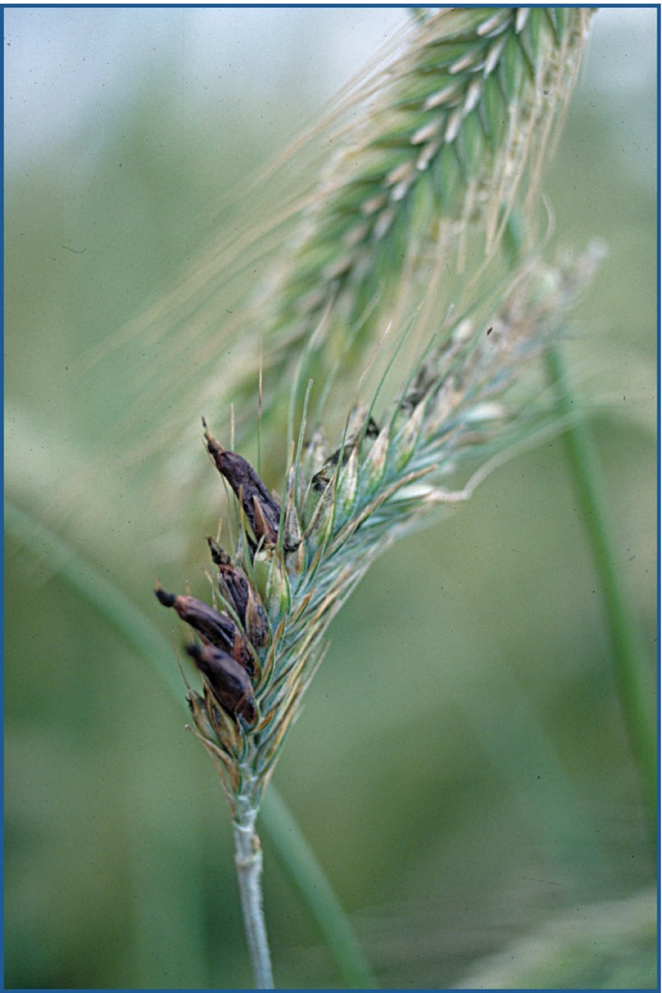
Fig. 15.1 Ergot caused by Claviceps purpurea, here in hybrid rye. (P. Waern, Courtesy of Swedish Board
of Agriculture.)
Plant Pathology and Plant Diseases © Anne Marte Tronsmo, David B. Collinge, Annika Djurle, Lisa Munk, Jonathan Yuen and Arne Tronsmo 2020

Slide 3
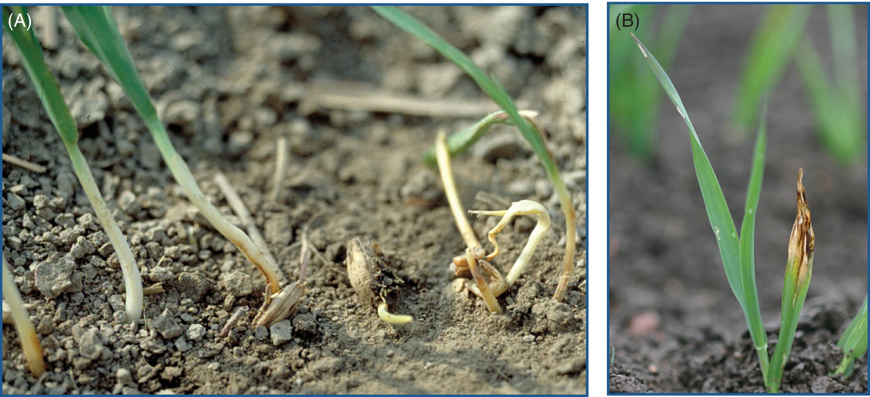
Fig. 15.2 Diseases in barley caused by seedborne pathogens. (A) Bipolaris root and foot rot caused by Bipolaris sorokiniana. (B) Net blotch caused by Pyrenophora teres. (P. Waern, Courtesy of Swedish Board
of Agriculture.)
Plant Pathology and Plant Diseases © Anne Marte Tronsmo, David B. Collinge, Annika Djurle, Lisa Munk, Jonathan Yuen and Arne Tronsmo 2020

Slide 4
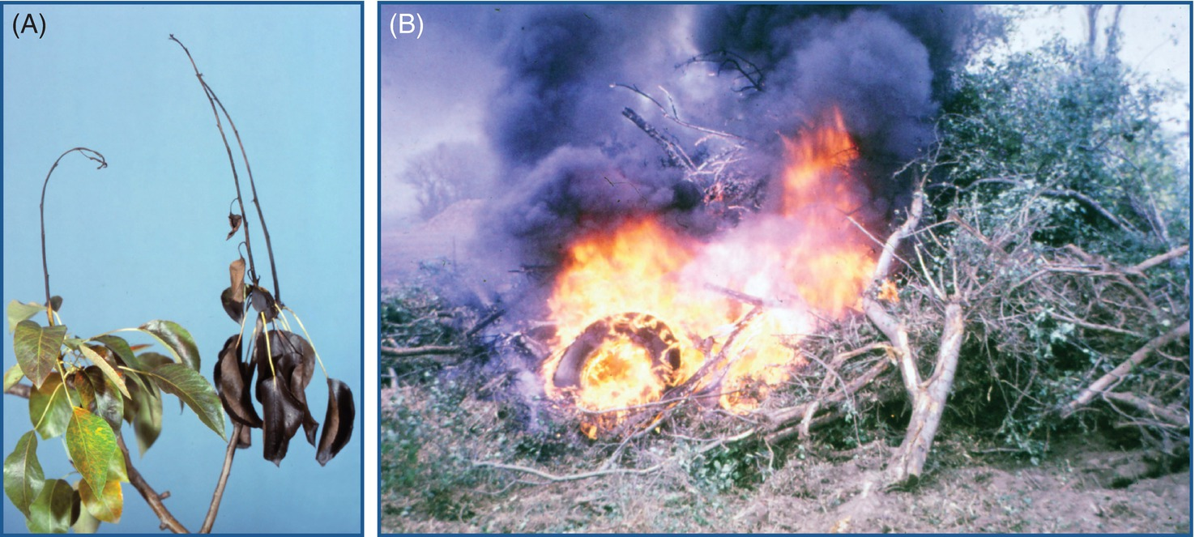
Fig. 15.3 (A) Fireblight (Erwinia amylovora) on pear (B) Incineration of trees with fireblight. (A,B; © Department of Plant Protection Biology, SLU, Alnarp.)
Plant Pathology and Plant Diseases © Anne Marte Tronsmo, David B. Collinge, Annika Djurle, Lisa Munk, Jonathan Yuen and Arne Tronsmo 2020

Slide 5
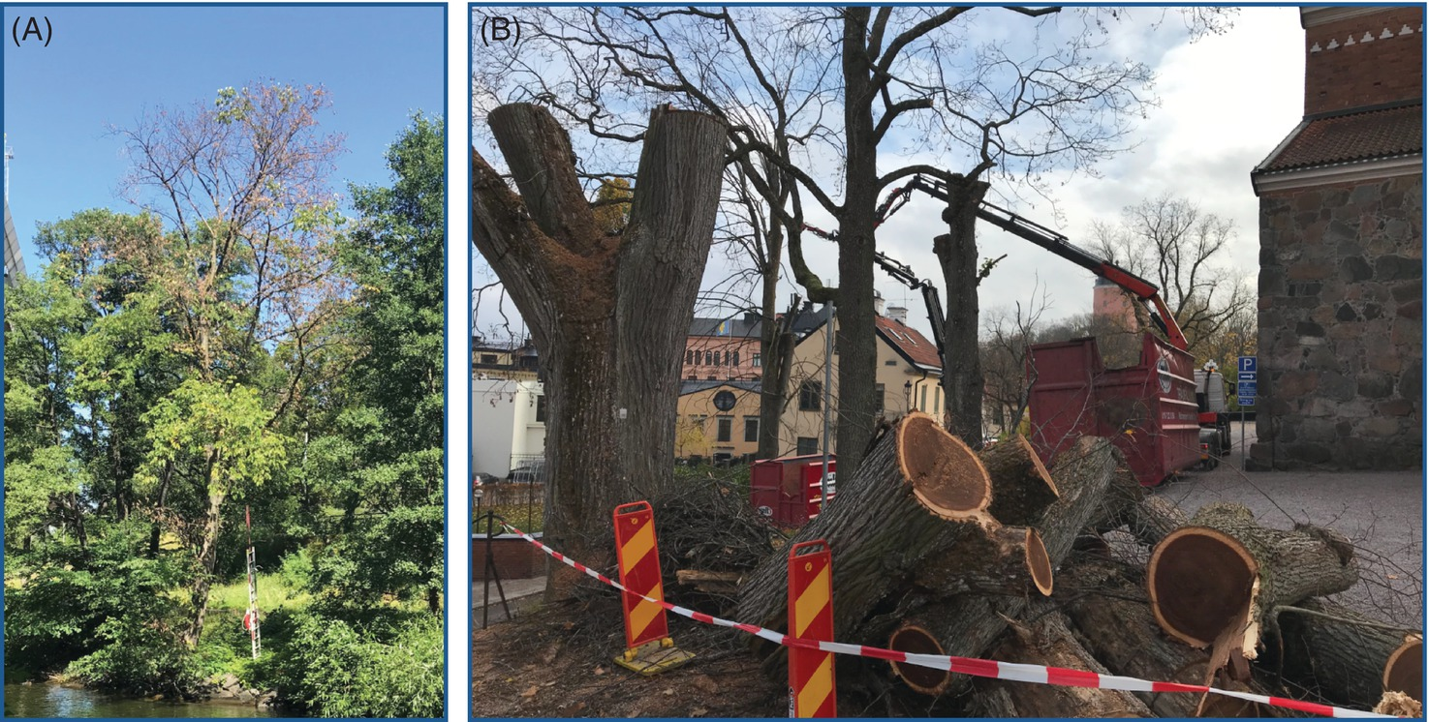
Fig. 15.4 (A) An elm tree slowly dying from Dutch elm disease. (B) Removal of dead elm trees. (© J. Stenlid.)
Plant Pathology and Plant Diseases © Anne Marte Tronsmo, David B. Collinge, Annika Djurle, Lisa Munk, Jonathan Yuen and Arne Tronsmo 2020

Slide 6
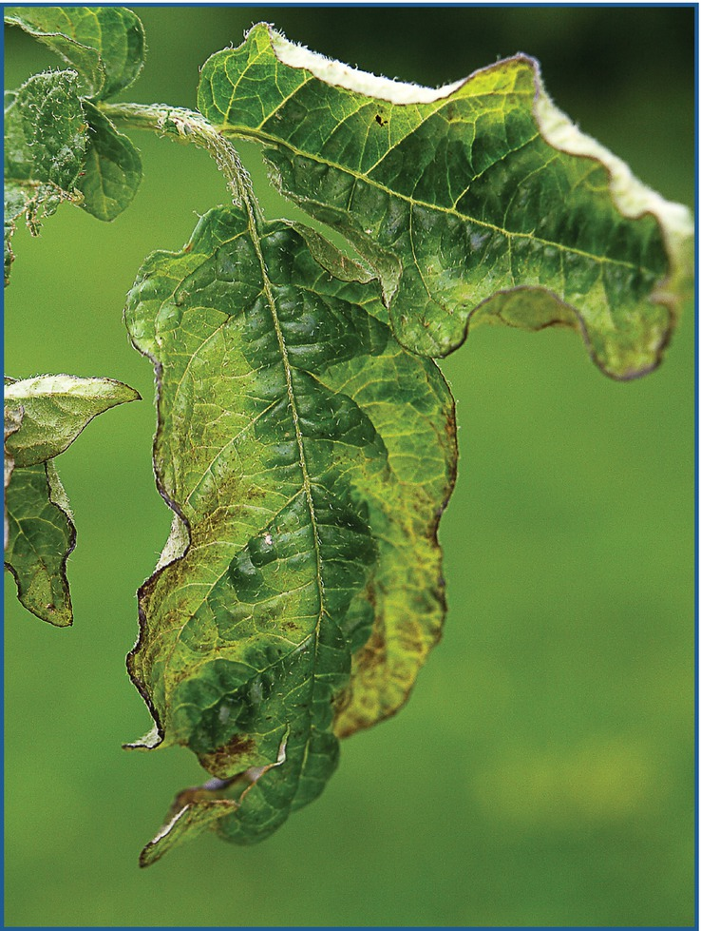
Fig. 15.5 Viral diseases in potato can cause huge yield losses. It is very important to remove infected plants in the seed potato fields. (© D-R. Blystad.)
Plant Pathology and Plant Diseases © Anne Marte Tronsmo, David B. Collinge, Annika Djurle, Lisa Munk, Jonathan Yuen and Arne Tronsmo 2020

Slide 7
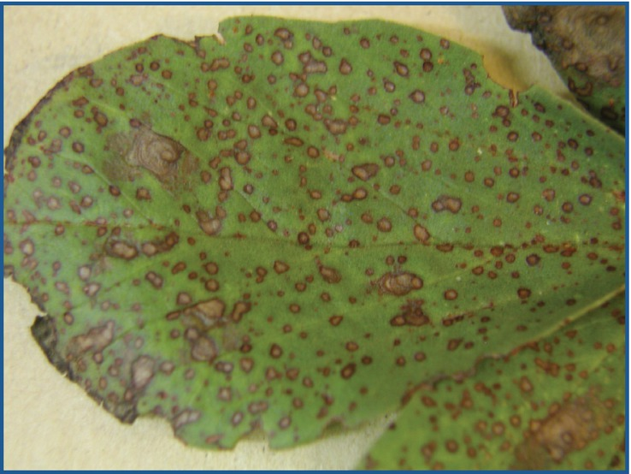
Fig. 15.6 Chocolate spot caused by Botrytis fabae in faba bean (Vicia faba). (©A. Djurle.)
Plant Pathology and Plant Diseases © Anne Marte Tronsmo, David B. Collinge, Annika Djurle, Lisa Munk, Jonathan Yuen and Arne Tronsmo 2020

Slide 8
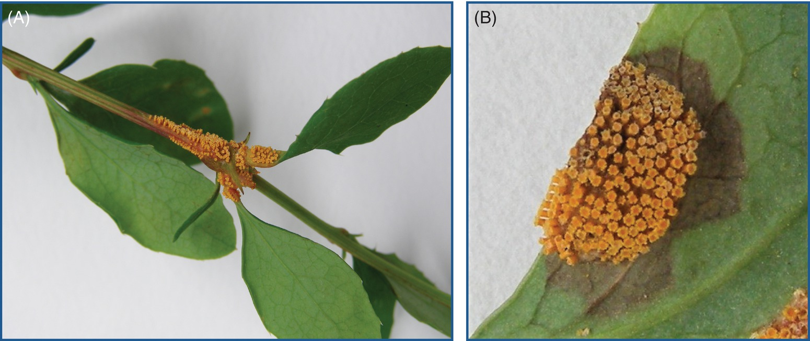
Fig. 15.7 Clusters of aecia on wild barberry (Berberis vulgaris), the alternate host of stem rust (Puccinia graminis) and stripe rust (P. striiformis). (A) Aecia on a shoot. (B) Aecial cups on the underside of a leaf. (©A. Djurle.)
Plant Pathology and Plant Diseases © Anne Marte Tronsmo, David B. Collinge, Annika Djurle, Lisa Munk, Jonathan Yuen and Arne Tronsmo 2020

Slide 9
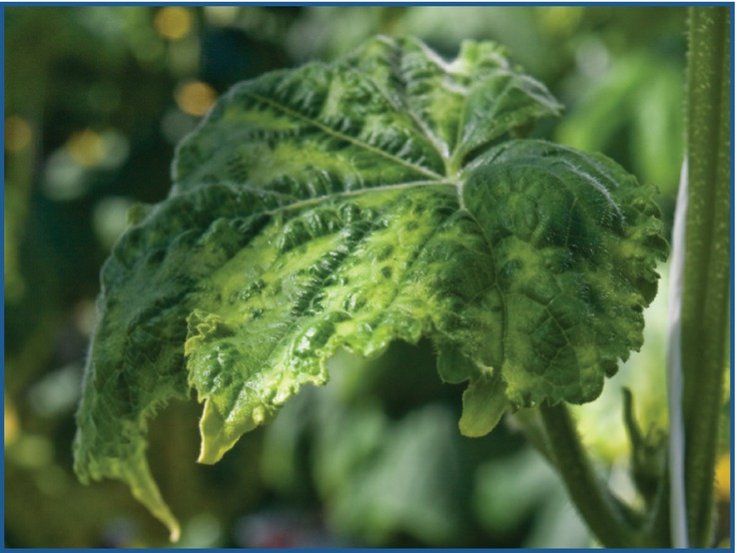
Fig. 15.8 Cucumber green mottle mosaic virus is very infectious. Infected plants should be recognized and removed at an early stage in the culture. (© D-R. Blystad.)
Plant Pathology and Plant Diseases © Anne Marte Tronsmo, David B. Collinge, Annika Djurle, Lisa Munk, Jonathan Yuen and Arne Tronsmo 2020

Slide 10
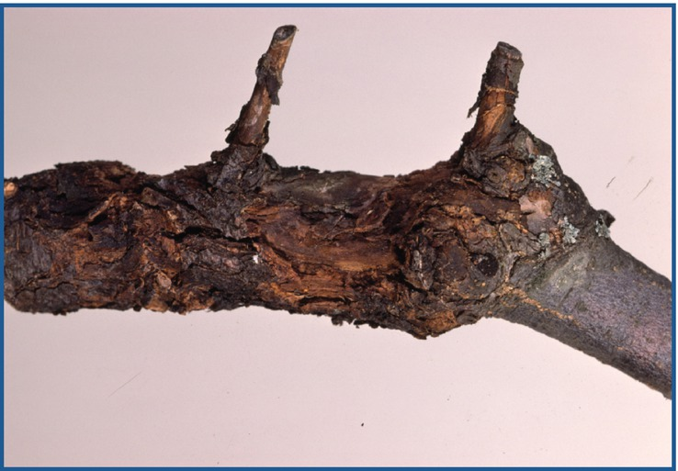
Fig. 15.9 Fruit tree with canker (Neonectria ditissima). (© SLU Alnarp.)
Plant Pathology and Plant Diseases © Anne Marte Tronsmo, David B. Collinge, Annika Djurle, Lisa Munk, Jonathan Yuen and Arne Tronsmo 2020

Slide 11
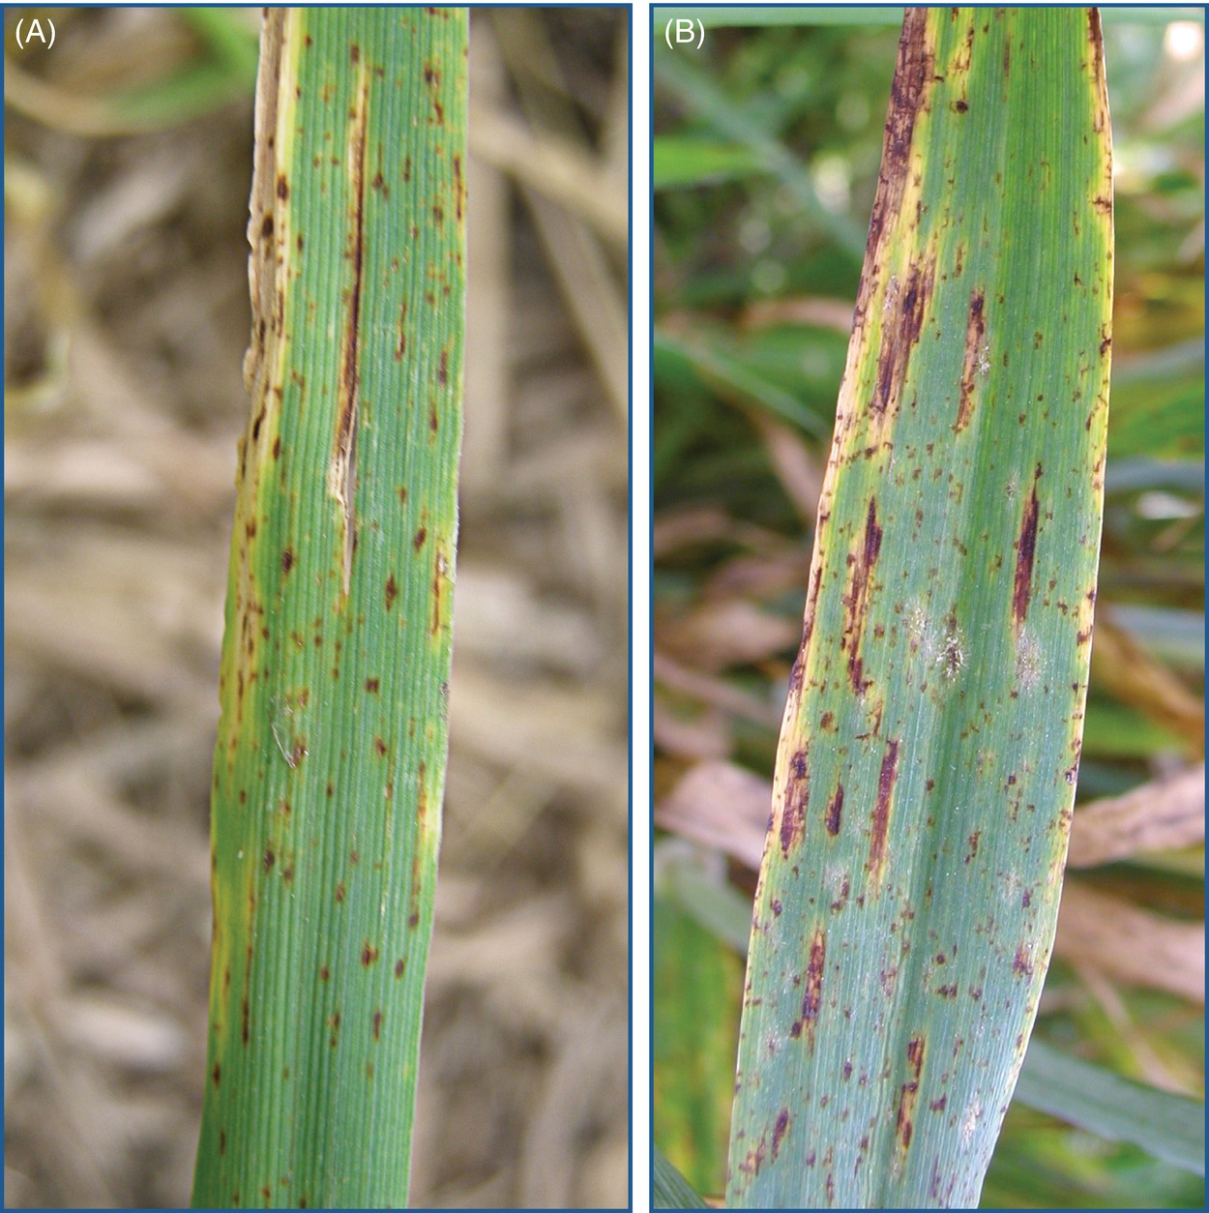
Fig. 15.10 Ramularia leaf spot in barley (Ramularia collo-cygni). (A) Slightly rhomboid 1–2 mm spots. (B) Ramularia leaf spot, net blotch and powdery mildew on the same leaf. (©A. Djurle.)
Plant Pathology and Plant Diseases © Anne Marte Tronsmo, David B. Collinge, Annika Djurle, Lisa Munk, Jonathan Yuen and Arne Tronsmo 2020

Slide 12
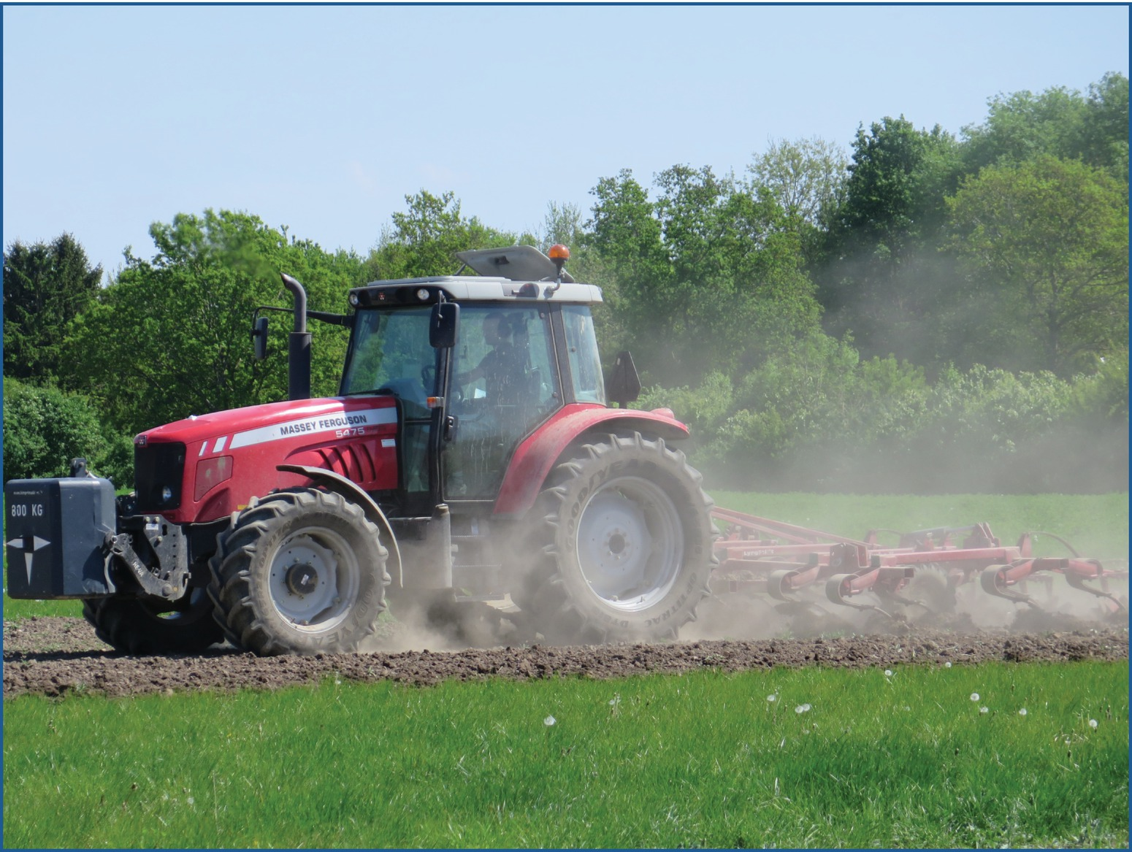
Fig. 15.11 Ploughing and other deep tillage methods have both ‘pros’ and ‘cons’. Buried crop residues, and pathogens on them, will decompose faster than on the ground surface. (© L. Munk.)
Plant Pathology and Plant Diseases © Anne Marte Tronsmo, David B. Collinge, Annika Djurle, Lisa Munk, Jonathan Yuen and Arne Tronsmo 2020

Slide 13
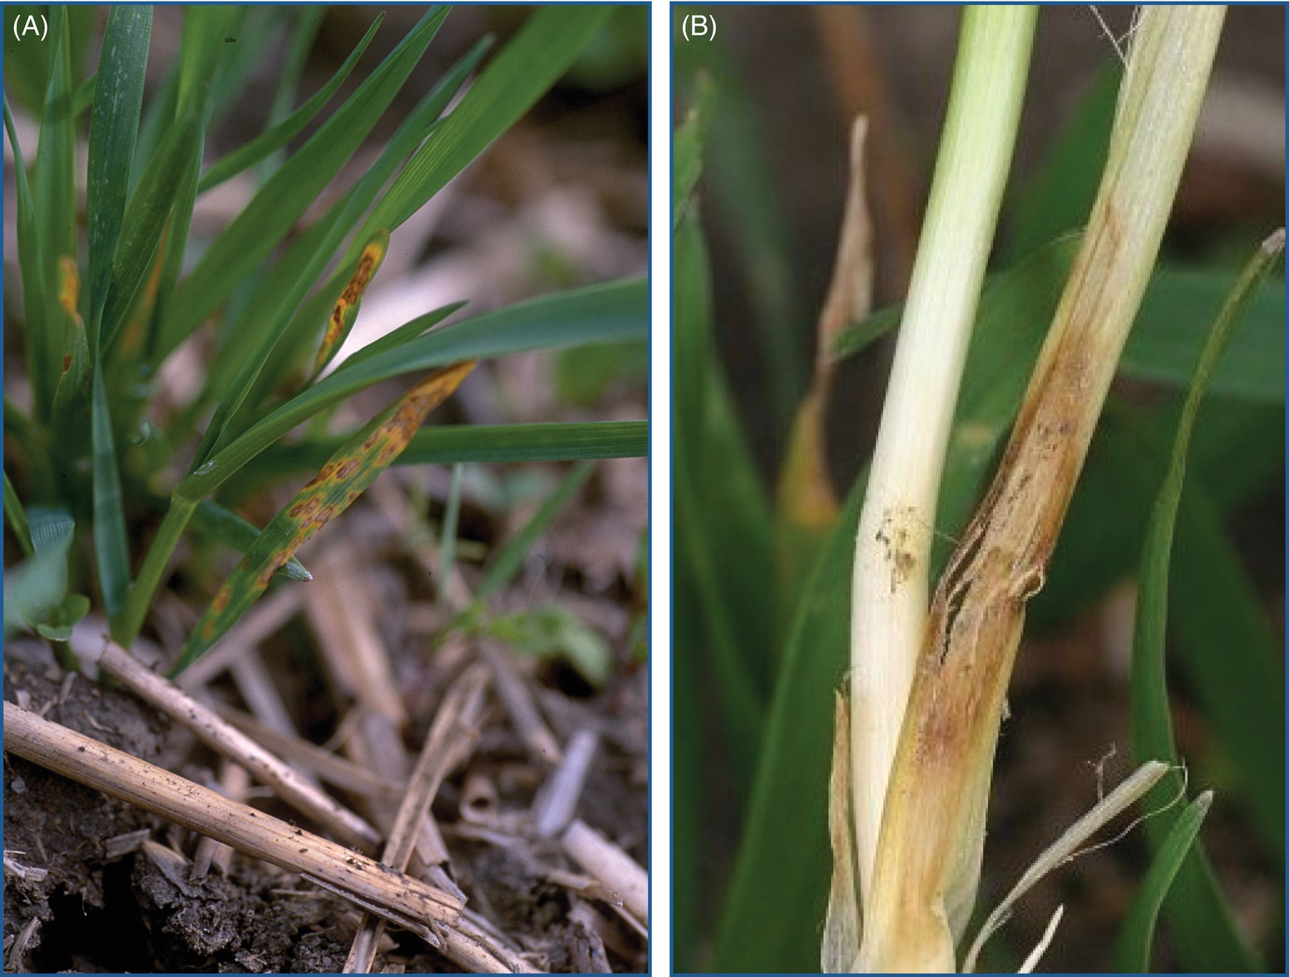
Fig. 15.12 (A) Winter wheat plants with tan spot (caused by Pyrenophora tritici-repentis) and straw residues with pseudothecia from the previous year's winter wheat crop. (B) Eyespot in winter wheat (caused by Oculimacula yallundae). (© Swedish Board of Agriculture, P. Waern.)
Plant Pathology and Plant Diseases © Anne Marte Tronsmo, David B. Collinge, Annika Djurle, Lisa Munk, Jonathan Yuen and Arne Tronsmo 2020

Slide 14
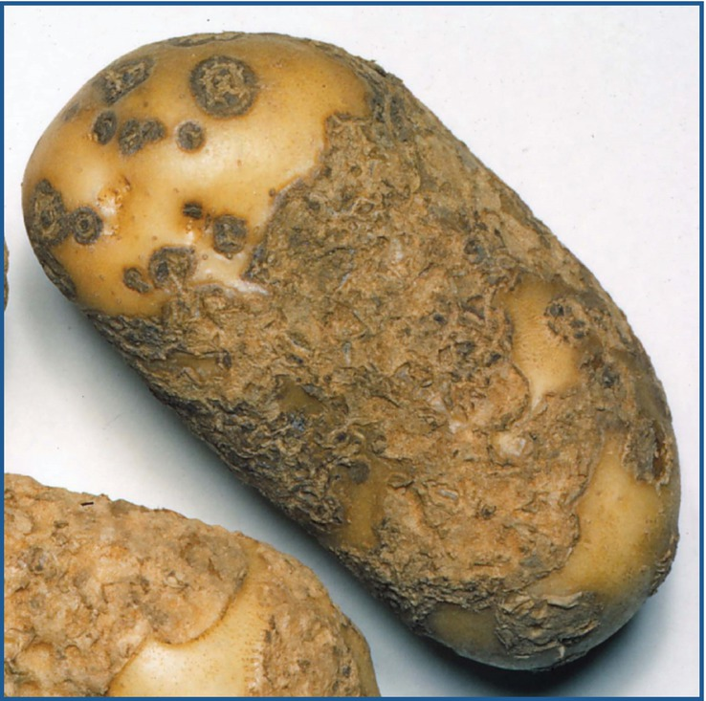
Fig. 15.13 A severe case of common scab caused by Streptomyces scabiei. (© Department of Plant Protection Biology, SLU, Alnarp.)
Plant Pathology and Plant Diseases © Anne Marte Tronsmo, David B. Collinge, Annika Djurle, Lisa Munk, Jonathan Yuen and Arne Tronsmo 2020

Slide 15
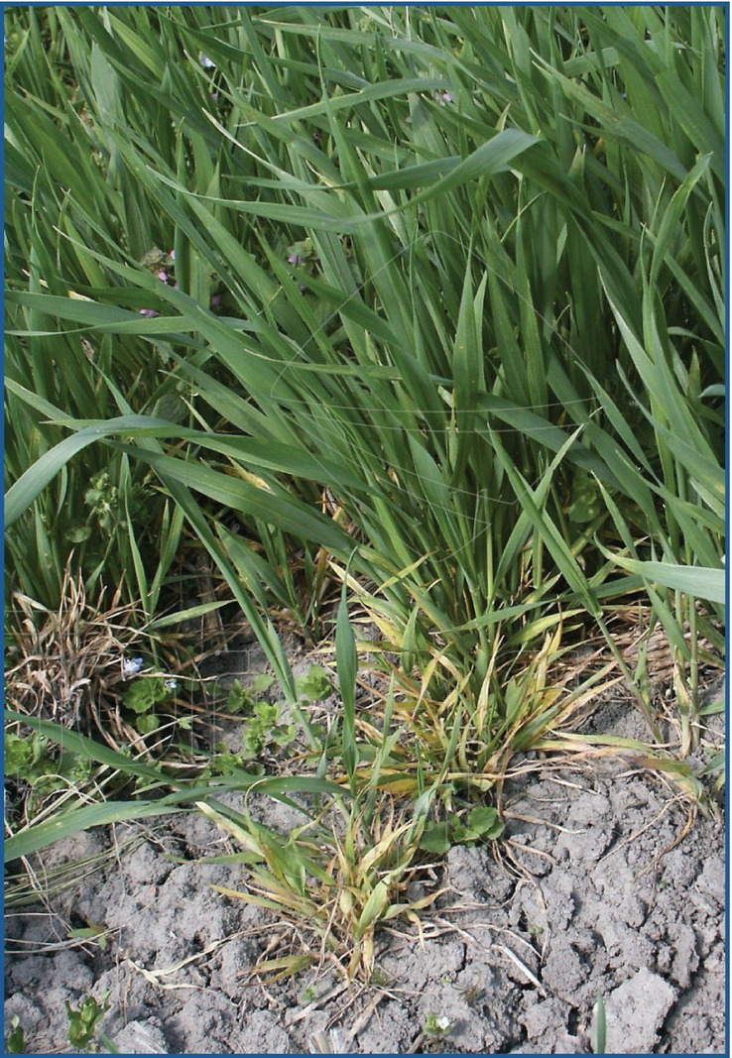
Fig. 15.14 Plants infected with wheat dwarf virus (WDV). An effect from early sowing of winter wheat when vectors were active. (A. Djurberg, Courtesy of Swedish Board of Agriculture.)
Plant Pathology and Plant Diseases © Anne Marte Tronsmo, David B. Collinge, Annika Djurle, Lisa Munk, Jonathan Yuen and Arne Tronsmo 2020

Slide 16
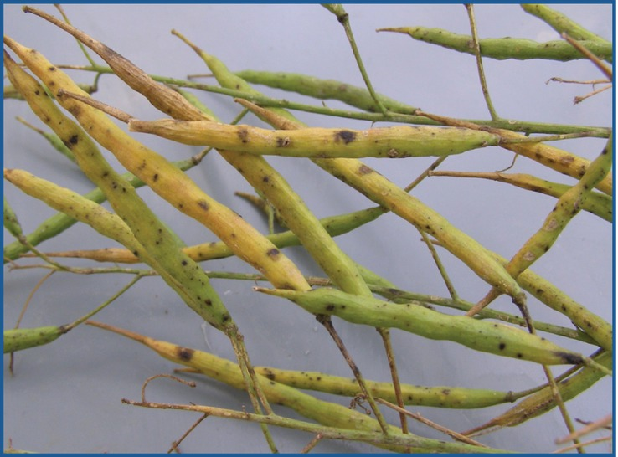
Fig. 15.15 Spring oilseed rape with black spot (Alternaria brassicae). (©A. Djurle.)
Plant Pathology and Plant Diseases © Anne Marte Tronsmo, David B. Collinge, Annika Djurle, Lisa Munk, Jonathan Yuen and Arne Tronsmo 2020

Slide 17
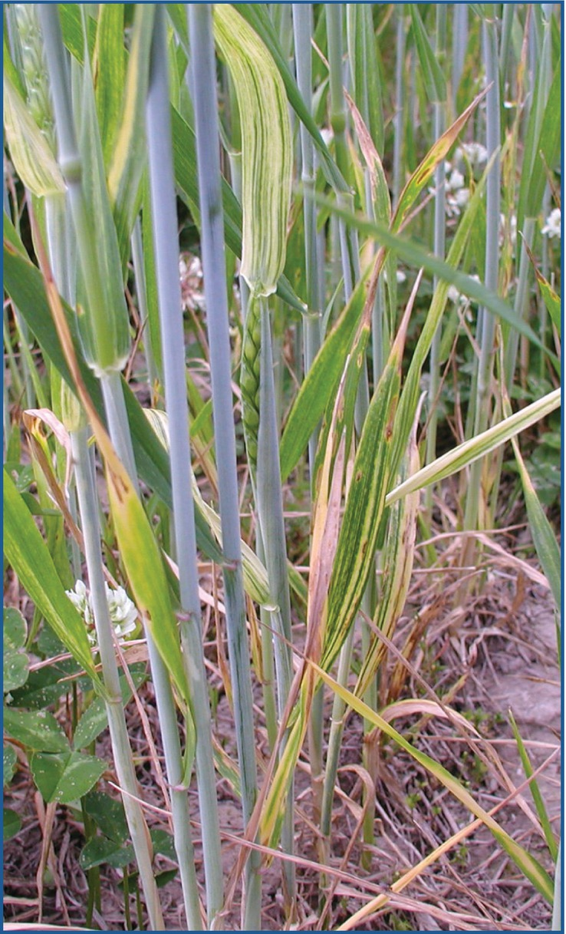
Fig. 15.16 Shallow sowing increases the risk for up-freezing of autumn-sown cereals. Cephalosporium stripe is caused by Hymenula cerealis that grows in the vascular system of the host plant. (©A. Djurle.)
Plant Pathology and Plant Diseases © Anne Marte Tronsmo, David B. Collinge, Annika Djurle, Lisa Munk, Jonathan Yuen and Arne Tronsmo 2020

Slide 18
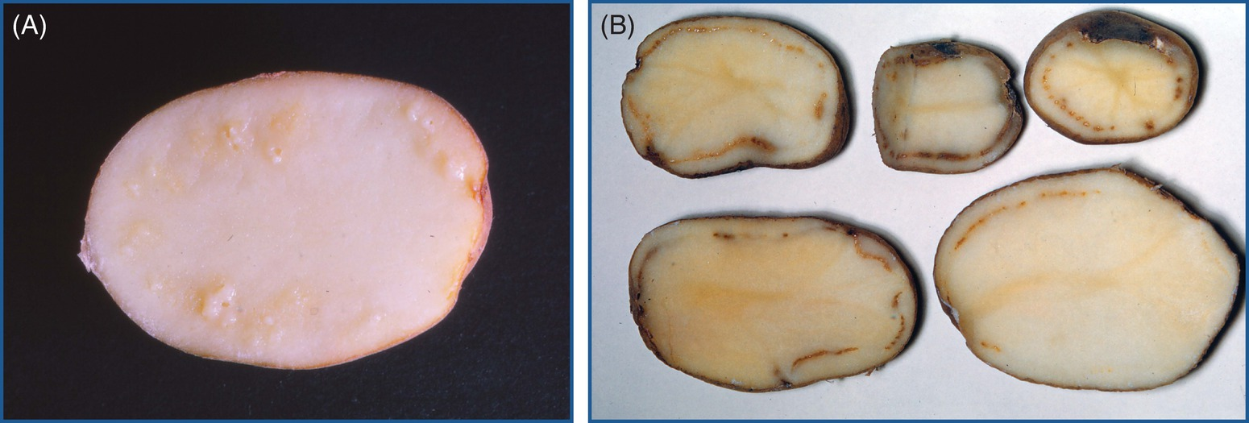
Fig. 15.17 Diseases caused by quarantine pathogens. (A) Ring rot in potato caused by Clavibacter sepedonicus. (B) Brown rot caused by Ralstonia solanacearum. (© Department of Plant Protection Biology, SLU, Alnarp.)
Plant Pathology and Plant Diseases © Anne Marte Tronsmo, David B. Collinge, Annika Djurle, Lisa Munk, Jonathan Yuen and Arne Tronsmo 2020

Slide 19
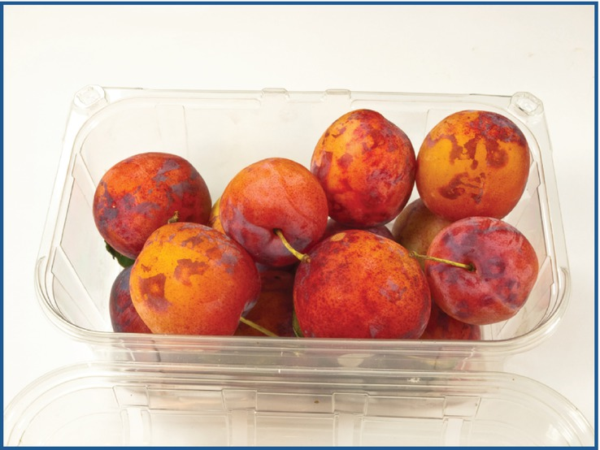
Fig. 15.18 Plum pox virus showing typical ringspot symptoms in plum (Prunus domestica). This virus directly affects fruit quality and yield and is considered as a quarantine virus in several countries. (© D-R. Blystad.)
Plant Pathology and Plant Diseases © Anne Marte Tronsmo, David B. Collinge, Annika Djurle, Lisa Munk, Jonathan Yuen and Arne Tronsmo 2020

