Slide 1
Plant Pathology and Plant Diseases
© Anne Marte Tronsmo, David B. Collinge, Annika Djurle, Lisa Munk, Jonathan Yuen and Arne Tronsmo 2020

Slide 2
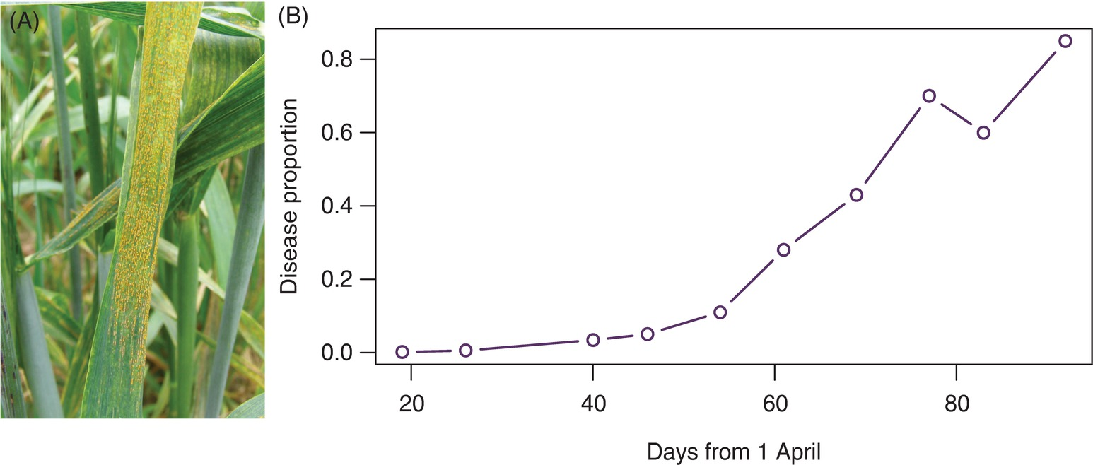
Fig. 14.1 (A) Yellow rust in wheat. (B) Disease progress of a yellow rust epidemic. (A: © A. Djurle; B: © J. Yuen.)
Plant Pathology and Plant Diseases © Anne Marte Tronsmo, David B. Collinge, Annika Djurle, Lisa Munk, Jonathan Yuen and Arne Tronsmo 2020

Slide 3
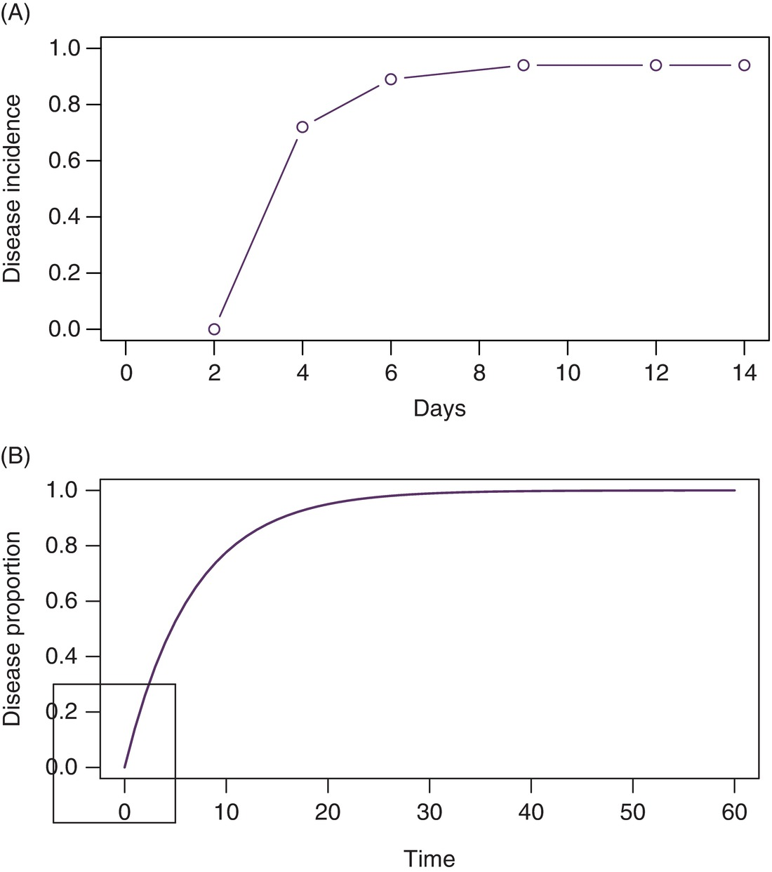
Fig. 14.2 (A) Development of rhizoctonia stem rot in peas. (B) Simple interest disease increase. (© J. Yuen.)
Plant Pathology and Plant Diseases © Anne Marte Tronsmo, David B. Collinge, Annika Djurle, Lisa Munk, Jonathan Yuen and Arne Tronsmo 2020

Slide 4
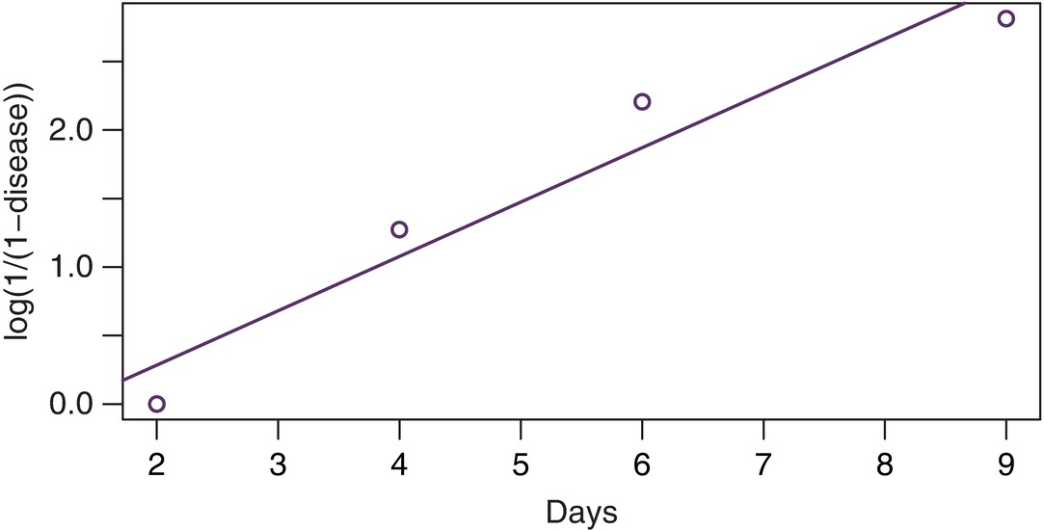
Fig. 14.3 Simple interest disease development using transformed values of disease. (© J. Yuen.)
Plant Pathology and Plant Diseases © Anne Marte Tronsmo, David B. Collinge, Annika Djurle, Lisa Munk, Jonathan Yuen and Arne Tronsmo 2020

Slide 5
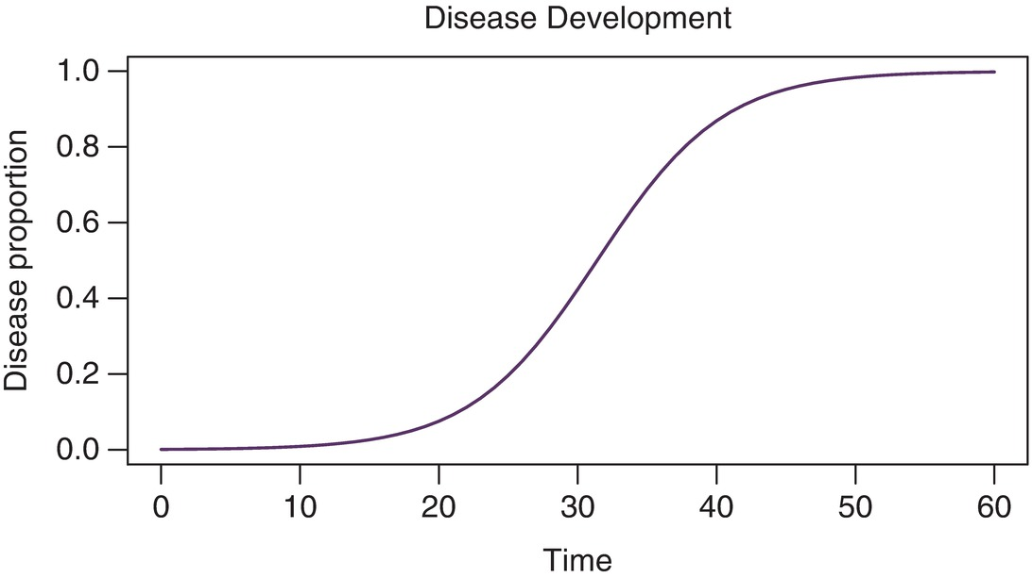
Fig. 14.4 Compound interest disease increase. (© J. Yuen).
Plant Pathology and Plant Diseases © Anne Marte Tronsmo, David B. Collinge, Annika Djurle, Lisa Munk, Jonathan Yuen and Arne Tronsmo 2020

Slide 6
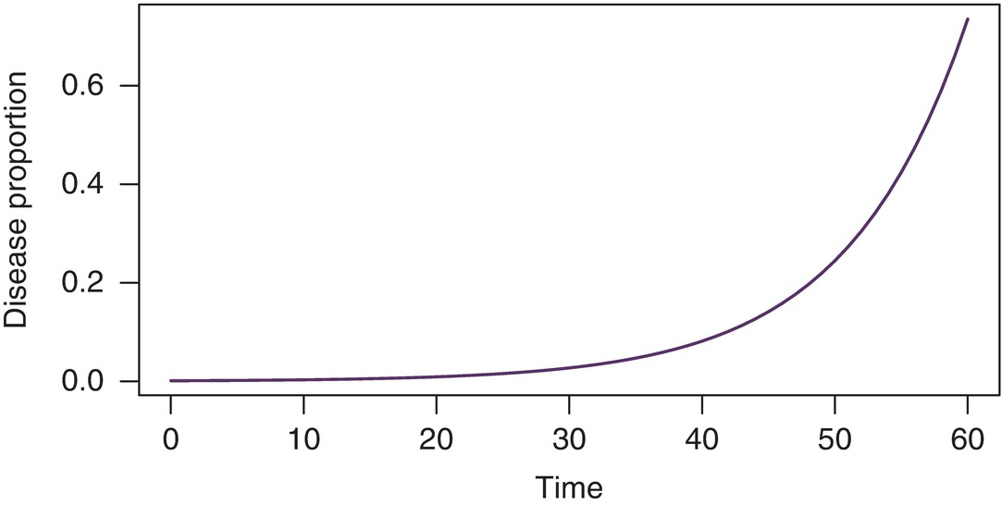
Fig. 14.5 Exponential disease increase (or logarithmic disease increase sensu Vanderplank). (© J. Yuen.)
Plant Pathology and Plant Diseases © Anne Marte Tronsmo, David B. Collinge, Annika Djurle, Lisa Munk, Jonathan Yuen and Arne Tronsmo 2020

Slide 7
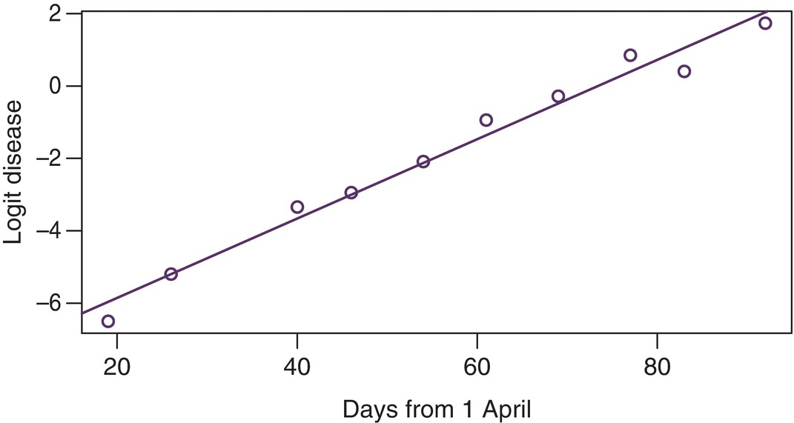
Fig. 14.6 Disease development of yellow rust (logit-transformed data as a function of day). Observed points and fitted line. (© J. Yuen.)
Plant Pathology and Plant Diseases © Anne Marte Tronsmo, David B. Collinge, Annika Djurle, Lisa Munk, Jonathan Yuen and Arne Tronsmo 2020

Slide 8
Fig. 14.7 Latency and infectious period in relation to events in the disease cycle. (© A. Djurle.)
Plant Pathology and Plant Diseases © Anne Marte Tronsmo, David B. Collinge, Annika Djurle, Lisa Munk, Jonathan Yuen and Arne Tronsmo 2020

Slide 9
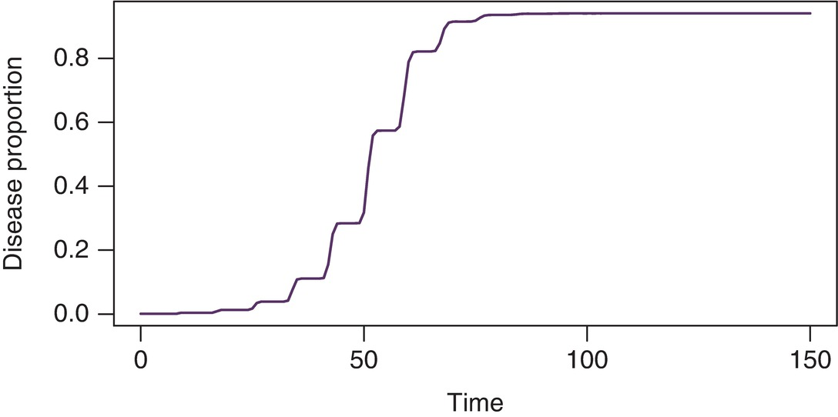
Fig. 14.8 A paralogistic disease progress curve. (© J. Yuen.)
Plant Pathology and Plant Diseases © Anne Marte Tronsmo, David B. Collinge, Annika Djurle, Lisa Munk, Jonathan Yuen and Arne Tronsmo 2020

Slide 10
Fig. 14.9 A flow diagram for an SEIR model. The boxes represent stages in the epidemic, and the valves represent the rates of change between stages. (©A. Djurle.)
Plant Pathology and Plant Diseases © Anne Marte Tronsmo, David B. Collinge, Annika Djurle, Lisa Munk, Jonathan Yuen and Arne Tronsmo 2020

Slide 11
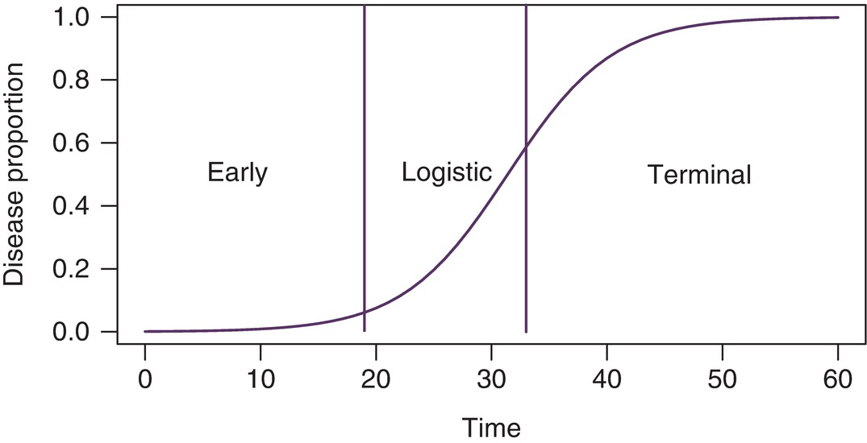
Fig. 14.10 The three phases of an epidemic. (© J. Yuen.)
Plant Pathology and Plant Diseases © Anne Marte Tronsmo, David B. Collinge, Annika Djurle, Lisa Munk, Jonathan Yuen and Arne Tronsmo 2020

Slide 12
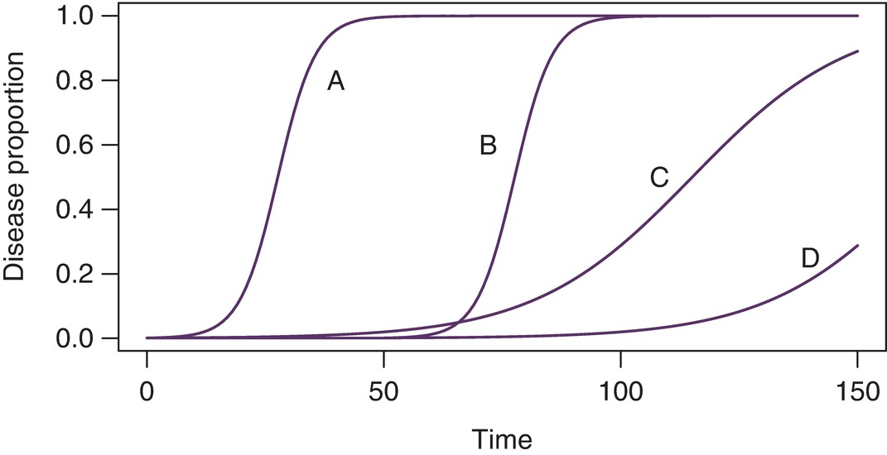
Fig. 14.11 Disease progress curves of a polycyclic pathogen. (A) No management; (B) reduction of initial inoculum; (C) reduction of the rate of disease increase; (D) combinations of (B) and (C) reducing both inoculum and rate. (© J. Yuen.)
Plant Pathology and Plant Diseases © Anne Marte Tronsmo, David B. Collinge, Annika Djurle, Lisa Munk, Jonathan Yuen and Arne Tronsmo 2020

