Slide 1

Plant Pathology and Plant Diseases
© Anne Marte Tronsmo, David B. Collinge, Annika Djurle, Lisa Munk, Jonathan Yuen and Arne Tronsmo 2020

Slide 2
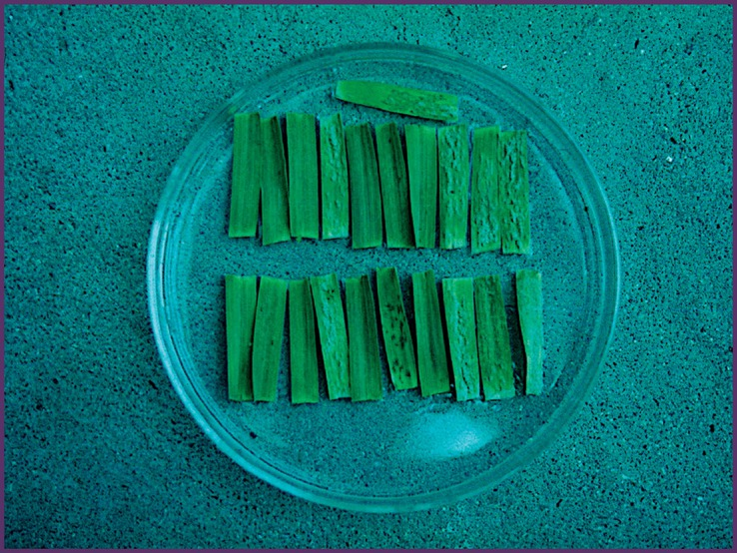
Fig. 13.1 A set of ten differential barley genotypes with different resistance genes to Blumeria graminis. (© L. Munk.)
Plant Pathology and Plant Diseases
© Anne Marte Tronsmo, David B. Collinge, Annika Djurle, Lisa Munk, Jonathan Yuen and Arne Tronsmo 2020

Slide 3
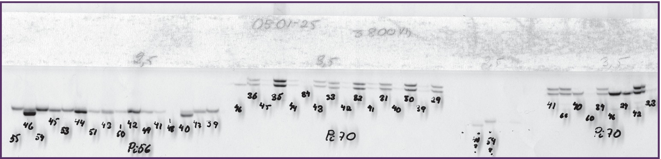
Fig. 13.2 The determination of the size of the PCR products when using microsatellites as genetic markers. (© A.K. Widmark.)
Plant Pathology and Plant Diseases
© Anne Marte Tronsmo, David B. Collinge, Annika Djurle, Lisa Munk, Jonathan Yuen and Arne Tronsmo 2020

Slide 4
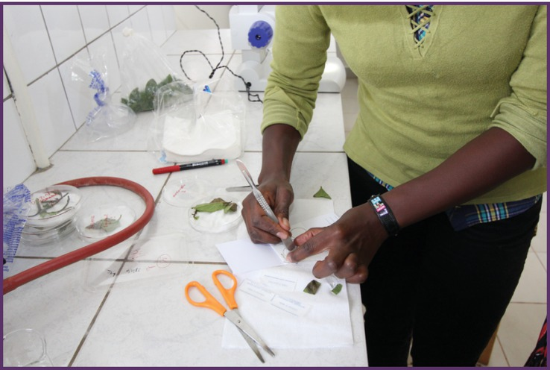
Fig. 13.3 FTA cards from Whatman can be used to stabilize the DNA from potato leaves infected with Phytophthora infestans, and subsequently analysed with microsatellite markers. (© J. Yuen.)
Plant Pathology and Plant Diseases
© Anne Marte Tronsmo, David B. Collinge, Annika Djurle, Lisa Munk, Jonathan Yuen and Arne Tronsmo 2020

Slide 5
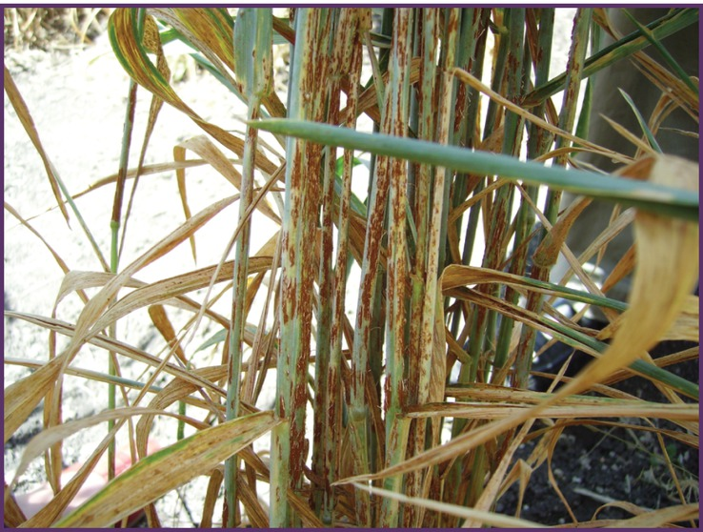
Fig. 13.4 UG 99 on wheat plants in Ethiopia. (© J. Yuen.)
Plant Pathology and Plant Diseases
© Anne Marte Tronsmo, David B. Collinge, Annika Djurle, Lisa Munk, Jonathan Yuen and Arne Tronsmo 2020

