Slide 1
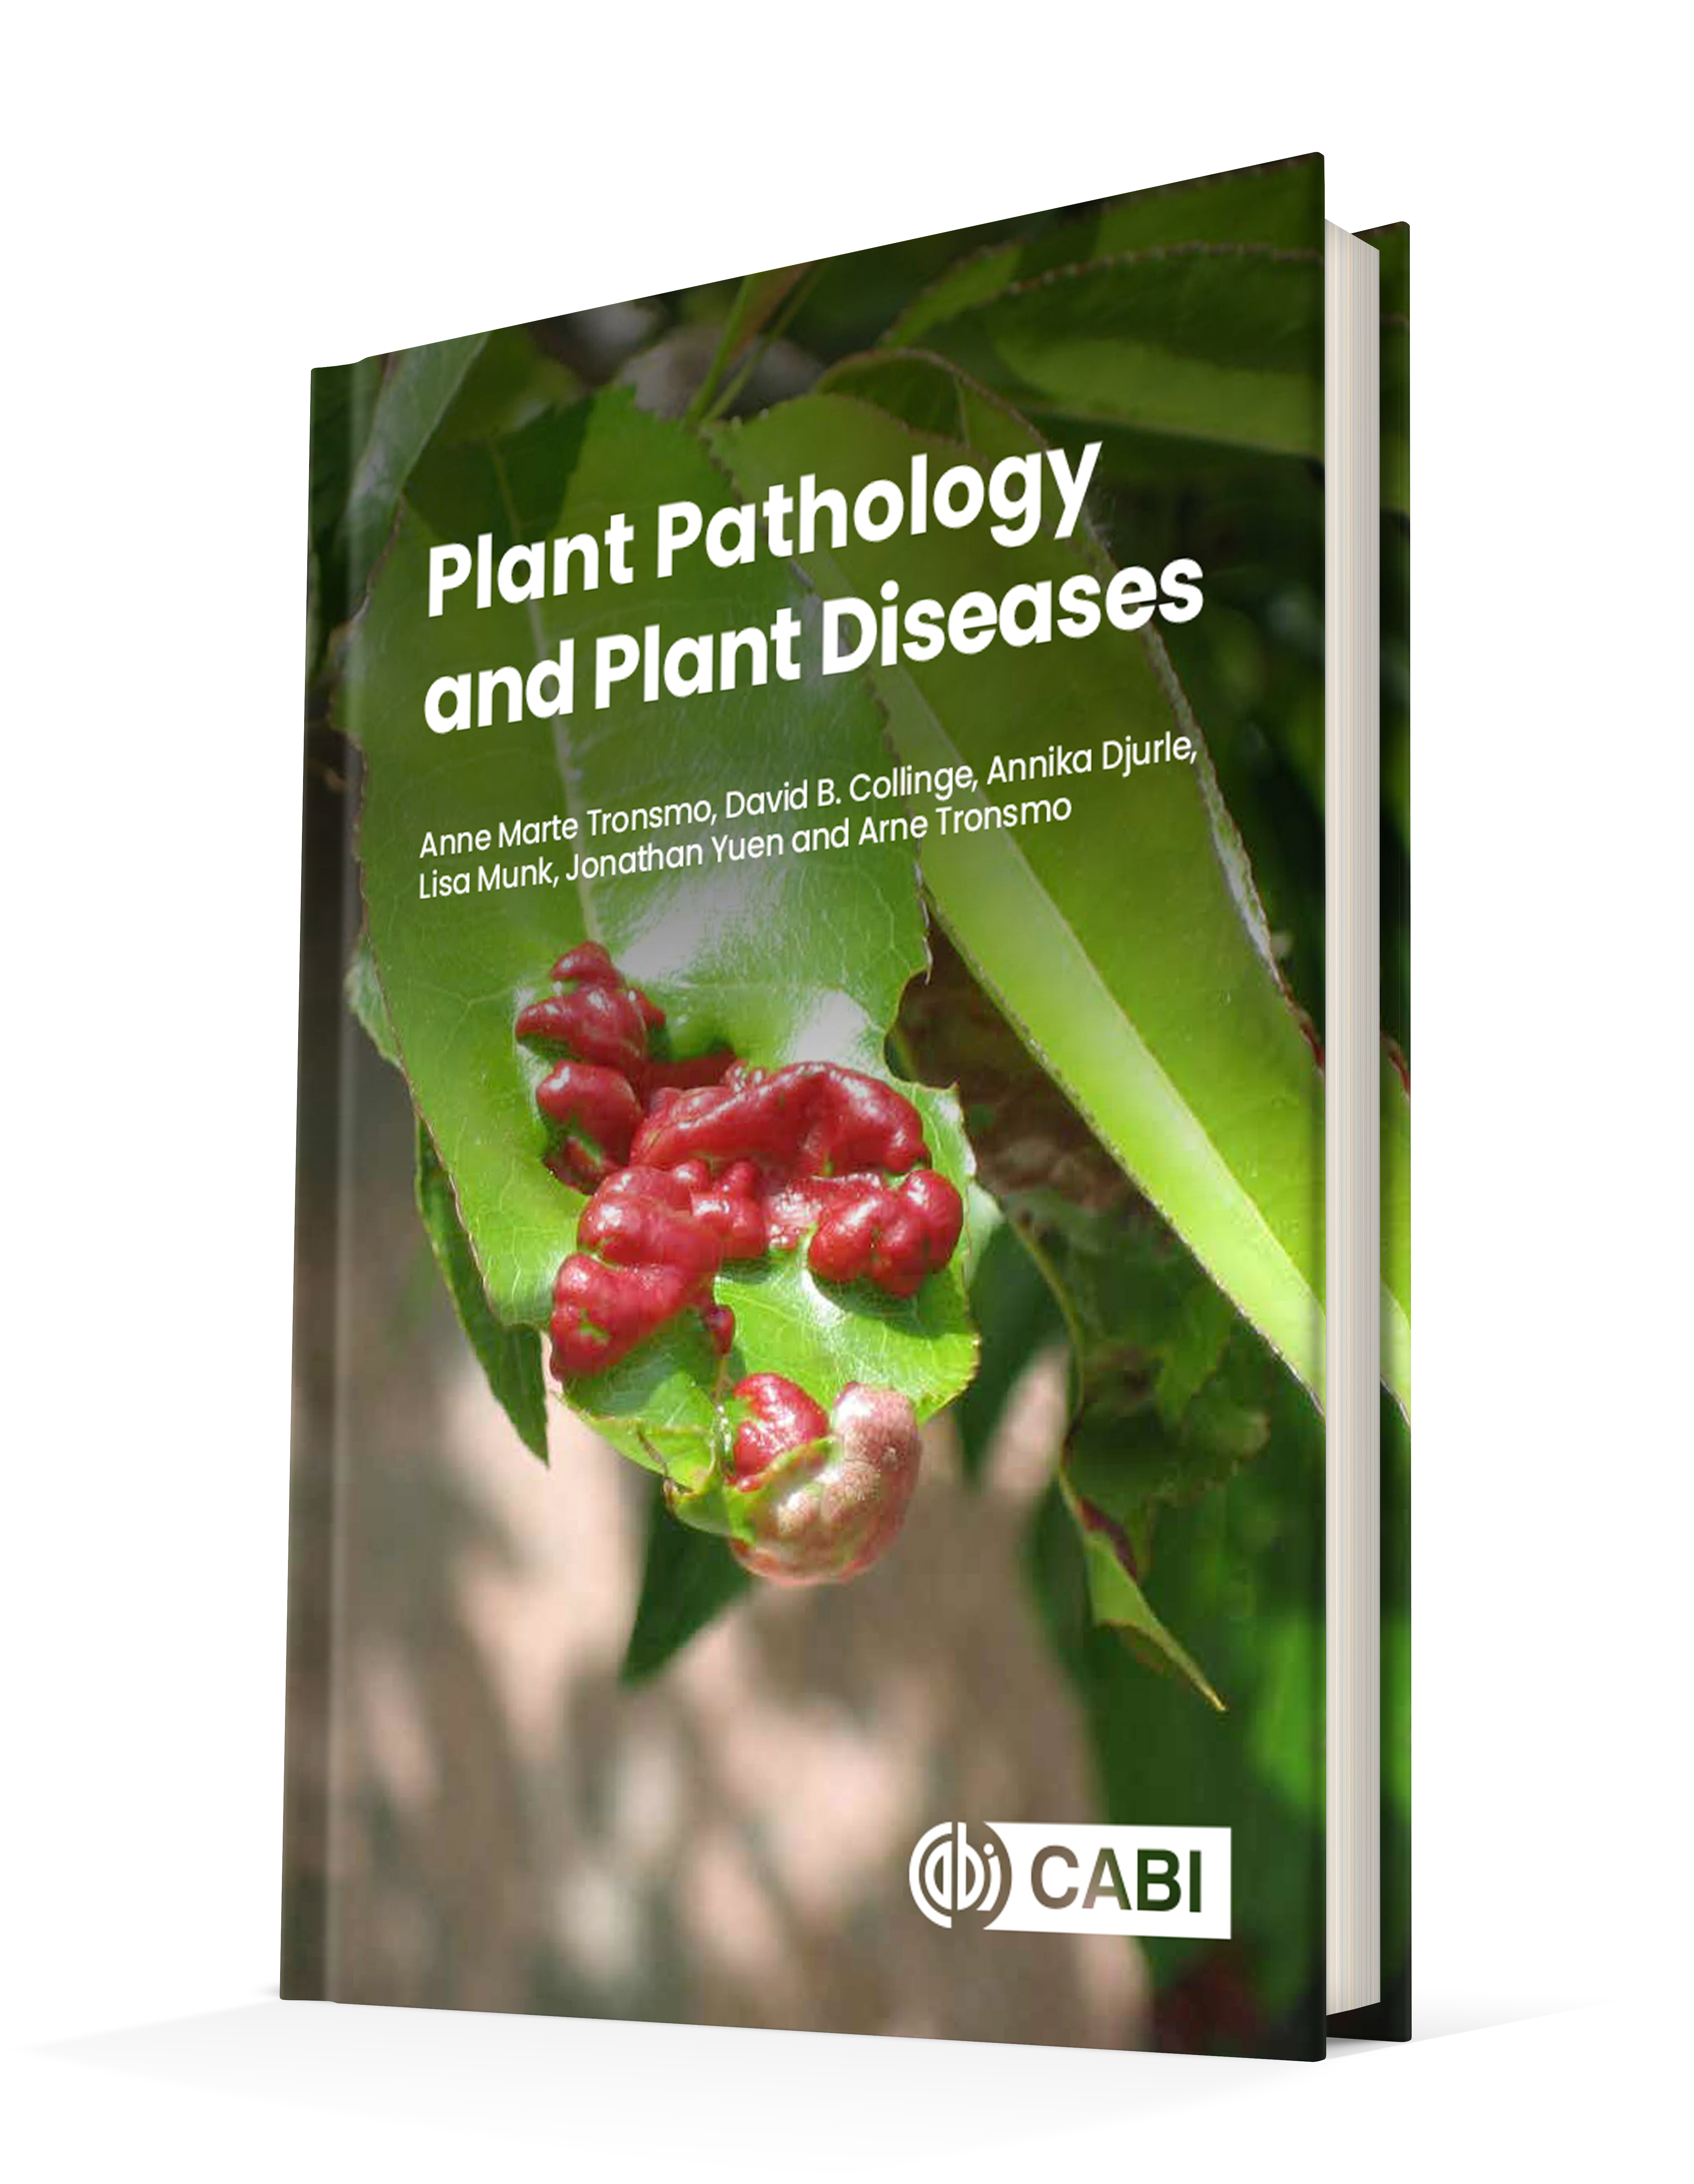
Plant Pathology and Plant Diseases
© Anne Marte Tronsmo, David B. Collinge, Annika Djurle, Lisa Munk, Jonathan Yuen and Arne Tronsmo 2020

Slide 2
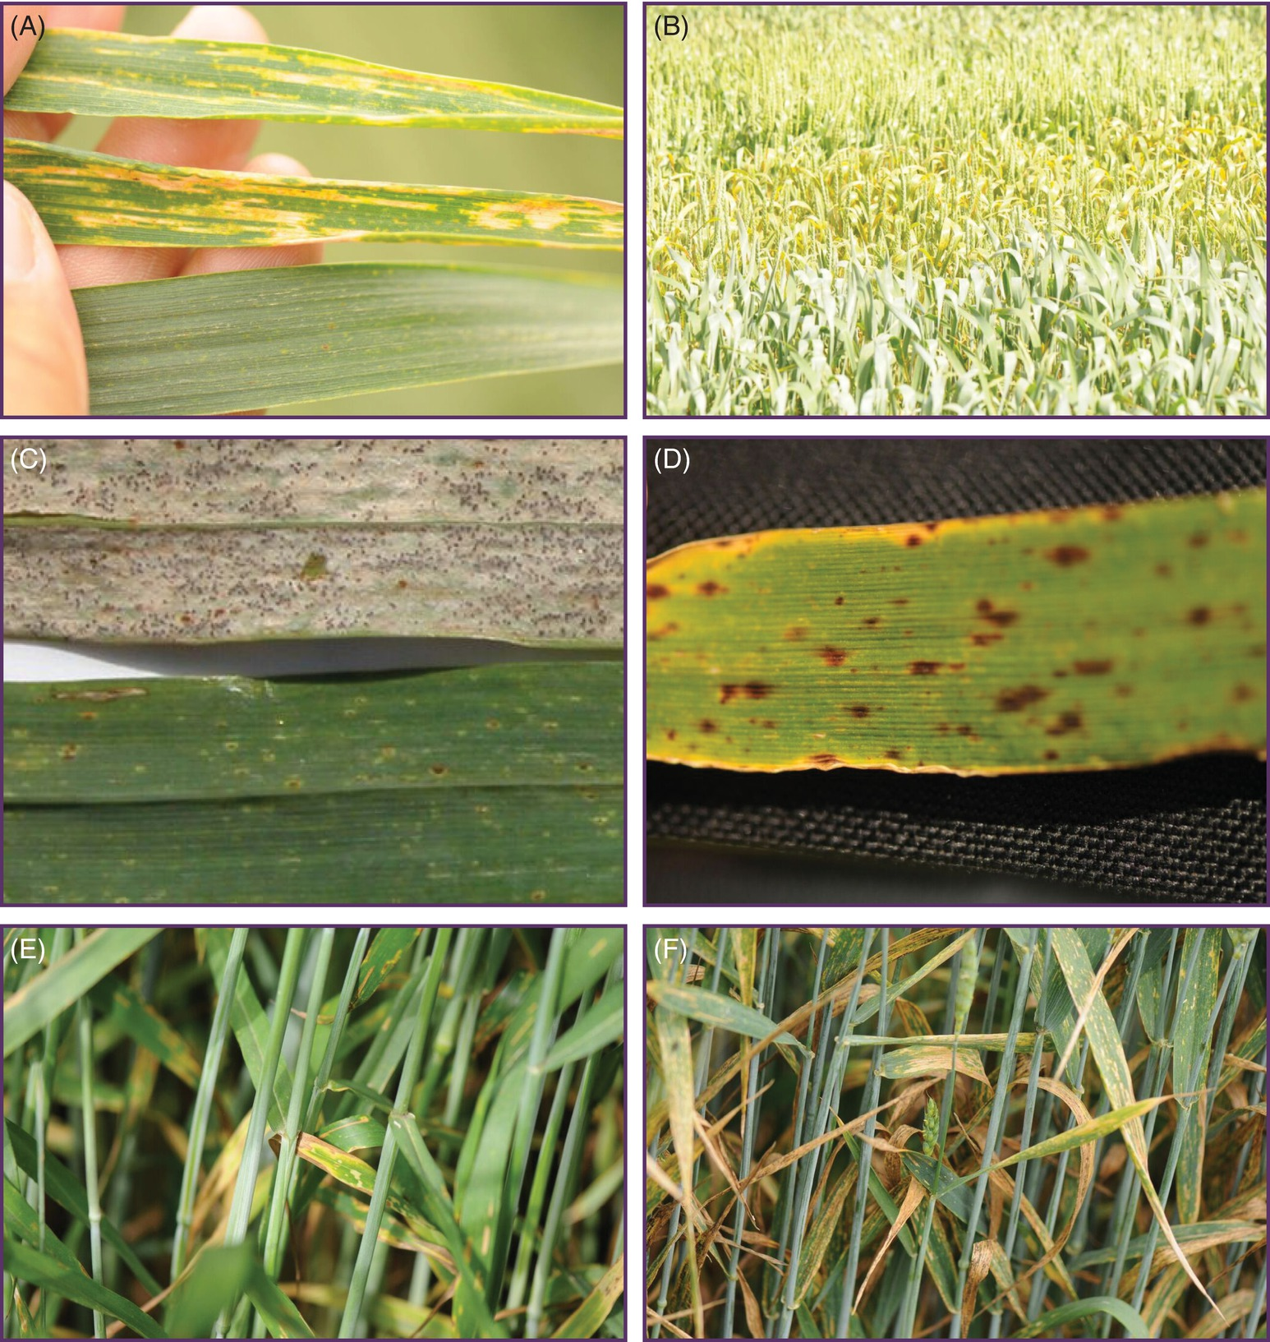
Fig. 12.1A-D Resistance genes. (A) and (B) Race specificity in wheat. against Puccinia striiformis (C) The recessive mutation mlo in barley (Hordeum vulgare) confers race non-specific resistance against Blumeria graminis f.sp. hordei causing powdery mildew. (D) Mlo plants are more susceptible to some hemibiotrophs and necrotrophs such as Ramularia collo-cygni. (© D.B. Collinge.)
Plant Pathology and Plant Diseases © Anne Marte Tronsmo, David B. Collinge, Annika Djurle, Lisa Munk, Jonathan Yuen and Arne Tronsmo 2020

Slide 3
Fig. 12.1 E-F Resistance genes. (E) and (F) Different varieties of wheat exhibit different levels of partial resistance against Zymoseptoria tritici. (© D.B. Collinge.)
Plant Pathology and Plant Diseases © Anne Marte Tronsmo, David B. Collinge, Annika Djurle, Lisa Munk, Jonathan Yuen and Arne Tronsmo 2020

Slide 4
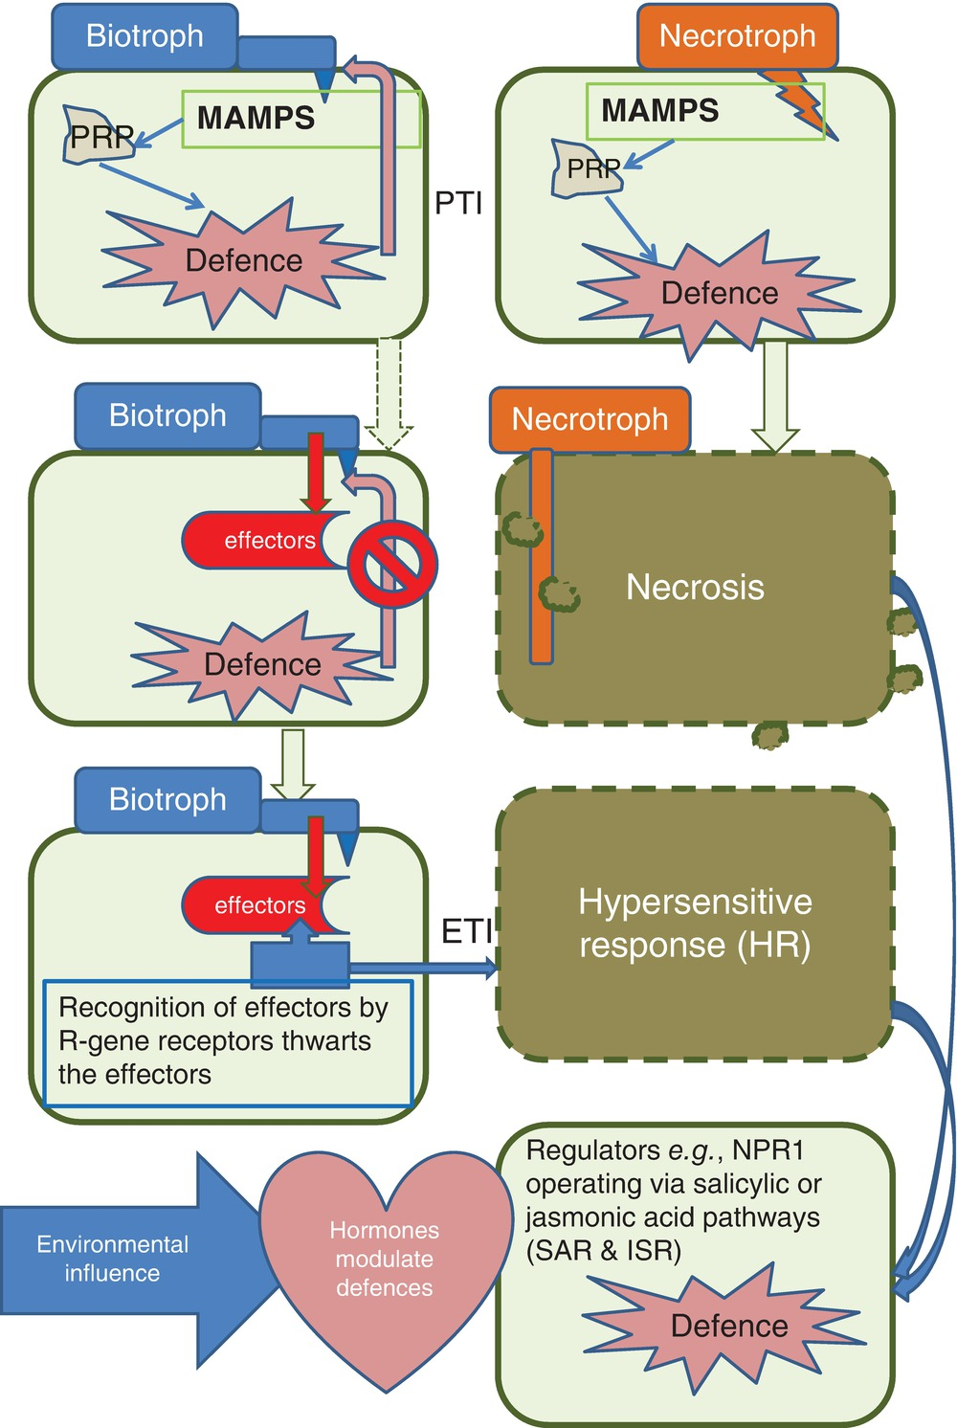
Fig. 12.2 Layers of plant immunity. (© D.B.Collinge).
Plant Pathology and Plant Diseases © Anne Marte Tronsmo, David B. Collinge, Annika Djurle, Lisa Munk, Jonathan Yuen and Arne Tronsmo 2020

Slide 5
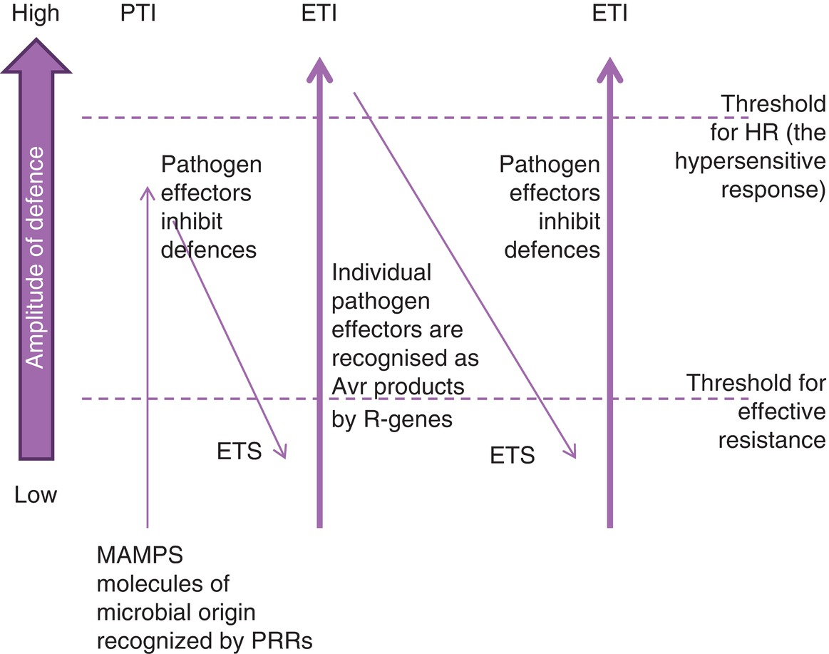
Fig. 12.3 Jones and Dangl (2006) zig-zag model. (D.B. Collinge)
Plant Pathology and Plant Diseases © Anne Marte Tronsmo, David B. Collinge, Annika Djurle, Lisa Munk, Jonathan Yuen and Arne Tronsmo 2020

Slide 6
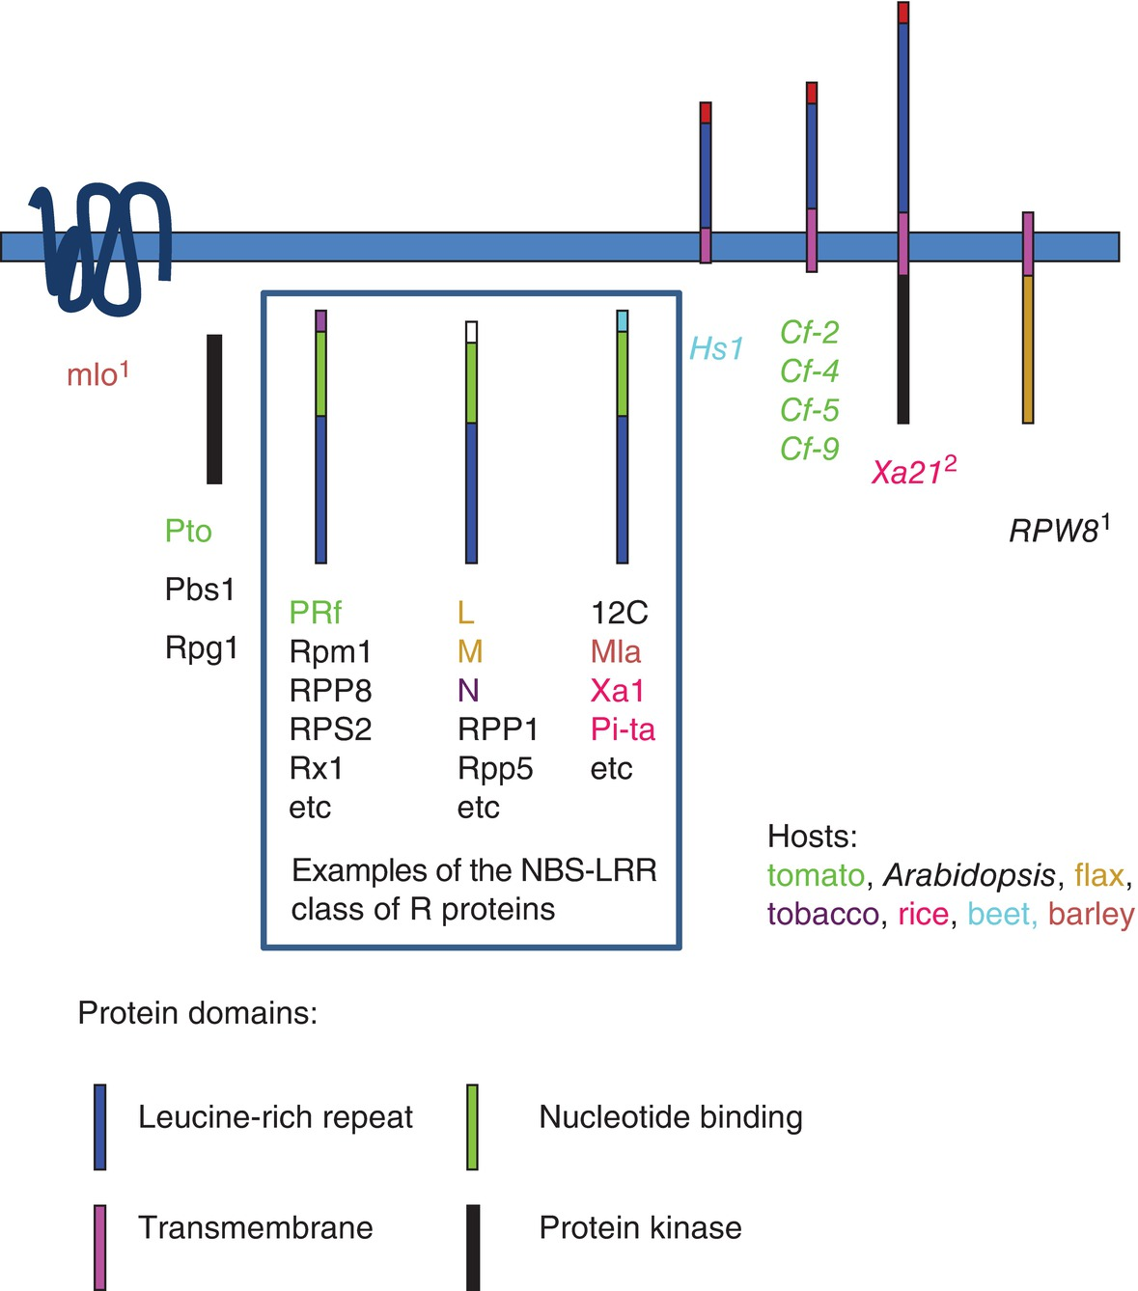
Fig. 12.4 Representative R genes illustrating their modular structures. (© D.B. Collinge).
Plant Pathology and Plant Diseases © Anne Marte Tronsmo, David B. Collinge, Annika Djurle, Lisa Munk, Jonathan Yuen and Arne Tronsmo 2020

Slide 7
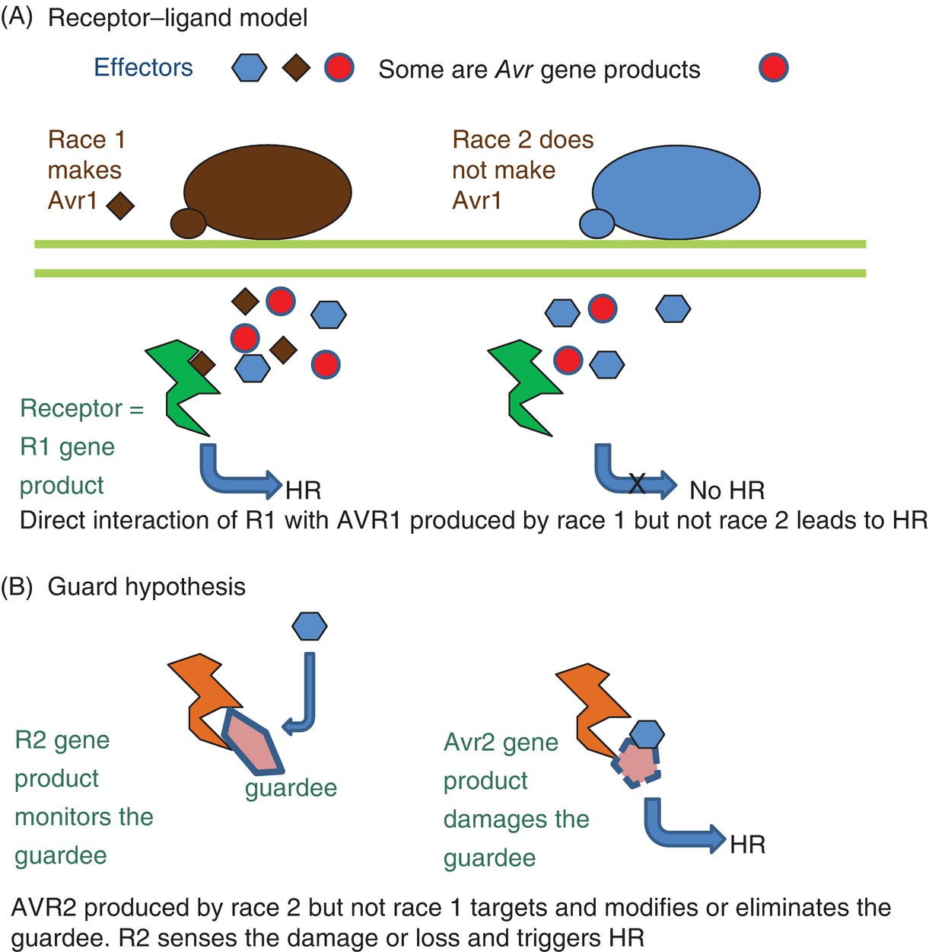
Fig. 12.5 Models for gene-for-gene interactions. (A) Receptor–ligand model. (B) Guard hypothesis. (© D.B. Collinge.)
Plant Pathology and Plant Diseases © Anne Marte Tronsmo, David B. Collinge, Annika Djurle, Lisa Munk, Jonathan Yuen and Arne Tronsmo 2020

Slide 8
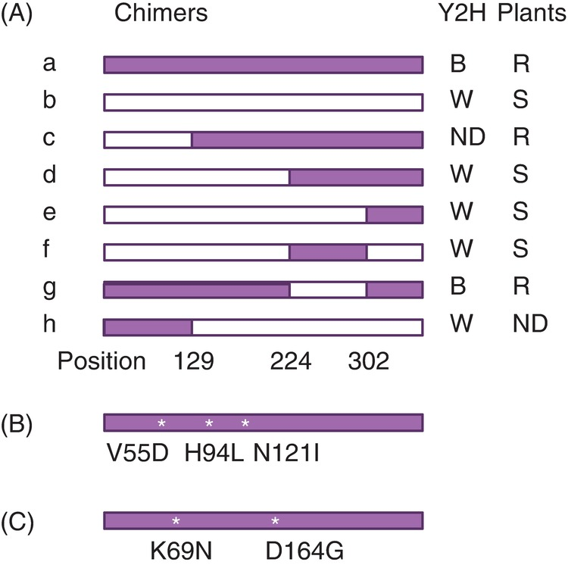
Fig. 12.6 Specificity in the Pto gene of tomato. (A) Pto (a) and Fen (b) genes; (B) Positions of three pto (susceptible) mutations eliminating binding activity in Y2H. (C) Positions of two mutations introduced into Pto eliminating binding activity in Y2H K69N. (A: adapted from Tang et al., 1996; B and C: adapted from Scofield et al., 1996.)
Plant Pathology and Plant Diseases © Anne Marte Tronsmo, David B. Collinge, Annika Djurle, Lisa Munk, Jonathan Yuen and Arne Tronsmo 2020

