Slide 1
Plant Pathology and Plant Diseases
© Anne Marte Tronsmo, David B. Collinge, Annika Djurle, Lisa Munk, Jonathan Yuen and Arne Tronsmo 2020

Slide 2
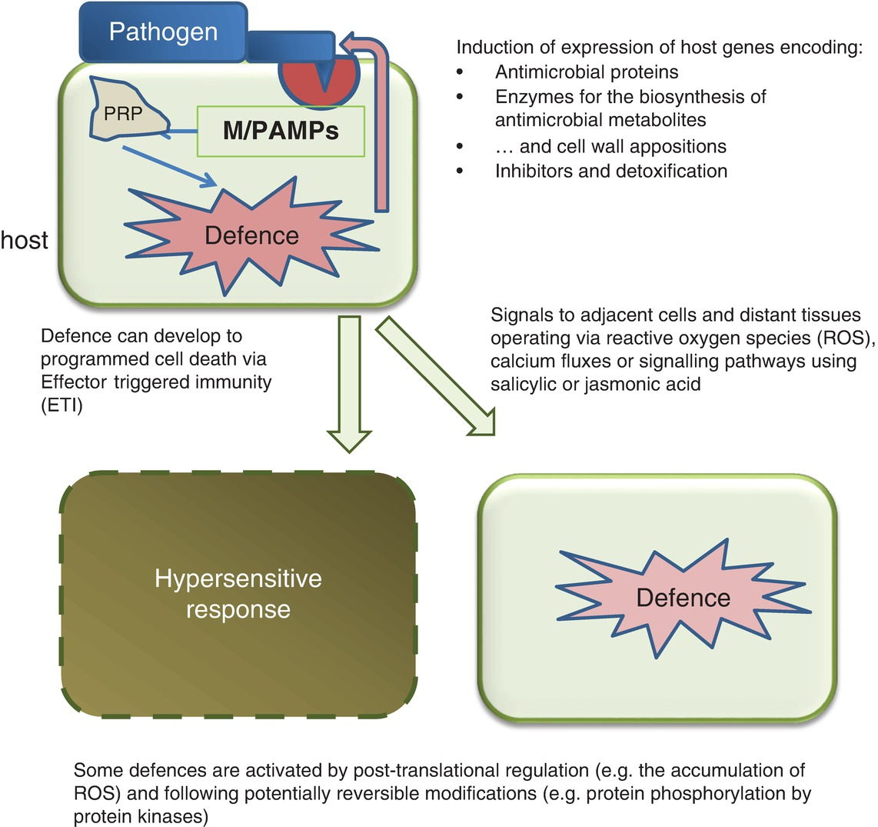
Fig. 11.1 Schematic model for of active defence. (© D.B.Collinge.)
Plant Pathology and Plant Diseases © Anne Marte Tronsmo, David B. Collinge, Annika Djurle, Lisa Munk, Jonathan Yuen and Arne Tronsmo 2020

Slide 3
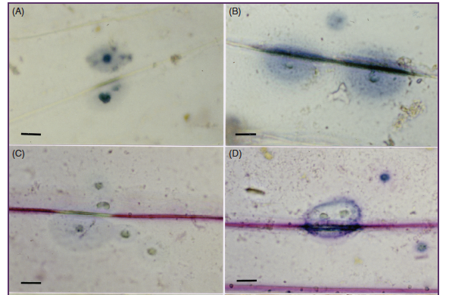
Fig. 11.2.A-D. Papillae (cell wall appositions) with different histochemical stains.
Epidermis of barley (left) and wheat
(right) both inoculated with the barley
powdery mildew fungus, Blumeria
graminis f.sp. hordei (24 hours after
inoculation). (A) and (B) stained
with lacmoid, indicating callose.
(From Wei et al., 1994. PMPP 45. 467-484.)
Plant Pathology and Plant Diseases © Anne Marte Tronsmo, David B. Collinge, Annika Djurle, Lisa Munk, Jonathan Yuen and Arne Tronsmo 2020

Slide 4
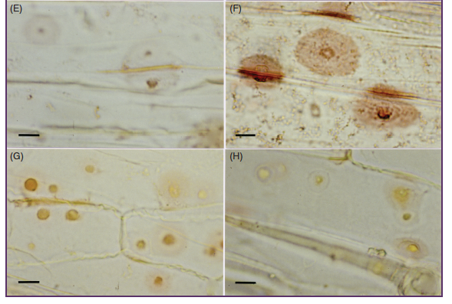
Fig. 11.2. E-H. Papillae (cell wall appositions) with different histochemical stains. Epidermis of barley (left) and wheat
(right) both inoculated with the barley powdery mildew fungus, Blumeria graminis f.sp. hordei (24 hours after inoculation). E and F Phloroglucinol-HCl, indicating lignin.
G and H. Sakaguchi staining method, indicating guanidine compounds. Bar= 20 μm.
(From Wei et al., 1994. PMPP 45. 467-484.)
Plant Pathology and Plant Diseases © Anne Marte Tronsmo, David B. Collinge, Annika Djurle, Lisa Munk, Jonathan Yuen and Arne Tronsmo 2020

Slide 5
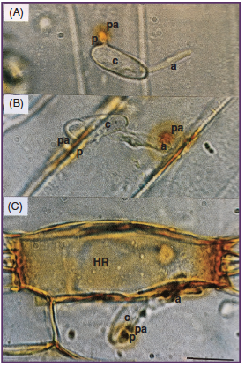
Fig. 11.3. DAB staining for papillae and the hypersensitive response (HR). Detection of reactive oxygen species using hydrogen peroxide in barley inoculated with the barley powdery mildew fungus, Blumeria graminis f.sp. hordei in papillae (A) 6 and (B) 24 hours after inoculation and (C) in cells exhibiting an HR 24 hours after inoculation. Diaminobenzidine (1 mg ml⁻¹) staining for 8 hours. P, primary germ tube; a, appresorial germ tube; pa, papilla; HR, hypersensitive response.
(From Thordal-Christensen et al., 1997.TPJ 11. 1187-1194)
Plant Pathology and Plant Diseases © Anne Marte Tronsmo, David B. Collinge, Annika Djurle, Lisa Munk, Jonathan Yuen and Arne Tronsmo 2020

Slide 6
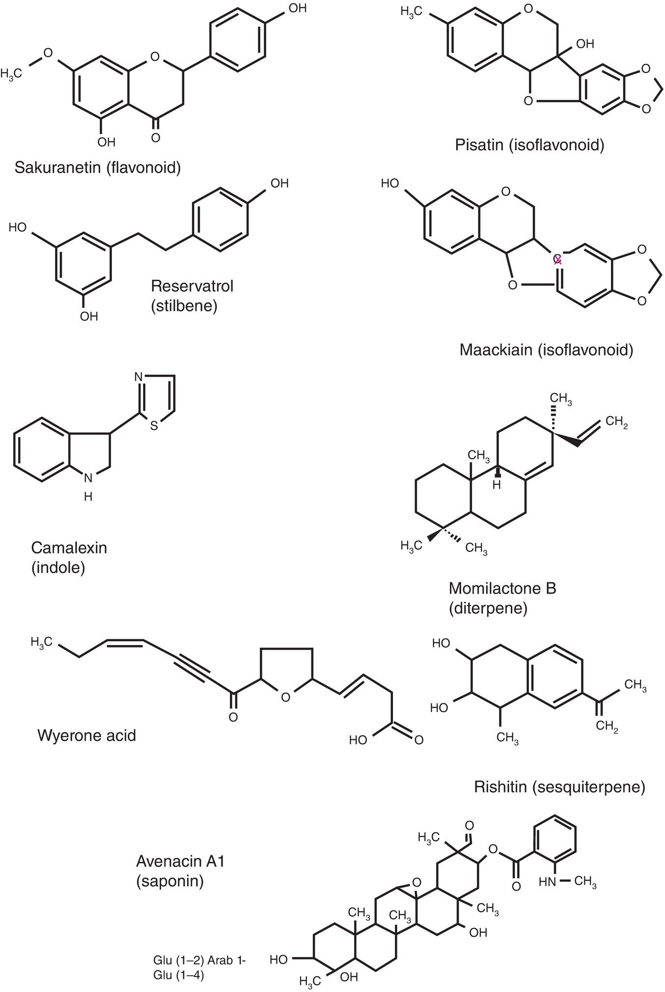
Fig. 11.4 Some structures of phytoalexins and phytoanticipins. (© D.B. Collinge.)
Plant Pathology and Plant Diseases © Anne Marte Tronsmo, David B. Collinge, Annika Djurle, Lisa Munk, Jonathan Yuen and Arne Tronsmo 2020

