Slide 1
Plant Pathology and Plant Diseases
© Anne Marte Tronsmo, David B. Collinge, Annika Djurle, Lisa Munk, Jonathan Yuen and Arne Tronsmo 2020

Slide 2
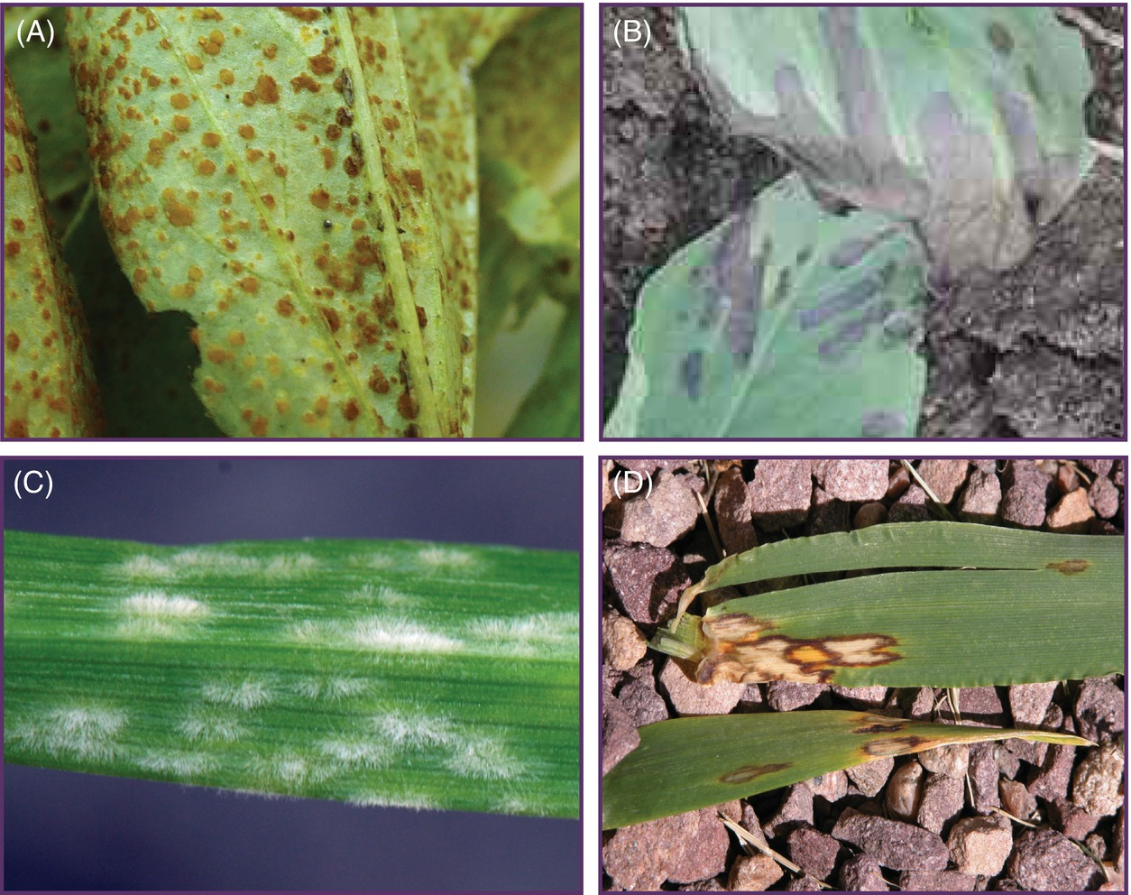
Fig. 10.1 Two different strategies for colonizing a host – biotrophy and necrotrophy. (A) Bean rust (Uromyces viciae-fabae) on Vicia faba. (B) Stemphylium blight (Stemphylium botryosum) on Vicia faba. (C) Barley powdery mildew (Blumeria graminis) and (D) scald (Rhynchosporium graminicola) both on Hordeum vulgare. (A) and (C). The rust and powdery mildew fungi have penetrated the host and are sporulating freely with no visible host reaction. (B) and (D) These necrotrophic pathogens have killed the host tissue and colonized the dead tissue. ( A, B, © P. Taylor; C, D, © D.B.Collinge.)
Plant Pathology and Plant Diseases © Anne Marte Tronsmo, David B. Collinge, Annika Djurle, Lisa Munk, Jonathan Yuen and Arne Tronsmo 2020

Slide 3
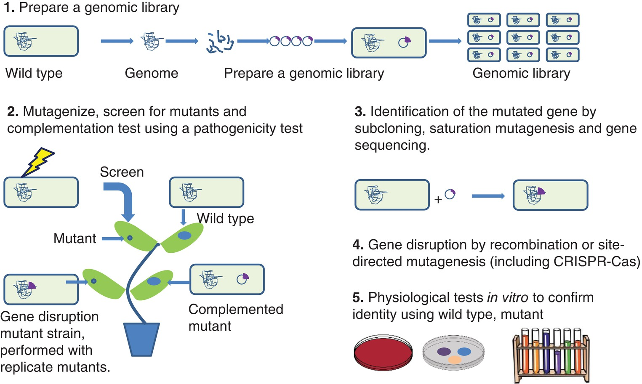
Fig. 10.2 Scheme for the identification and characterization of pathogenicity mutants.
(© D.B.Collinge.)
Plant Pathology and Plant Diseases © Anne Marte Tronsmo, David B. Collinge, Annika Djurle, Lisa Munk, Jonathan Yuen and Arne Tronsmo 2020

Slide 4
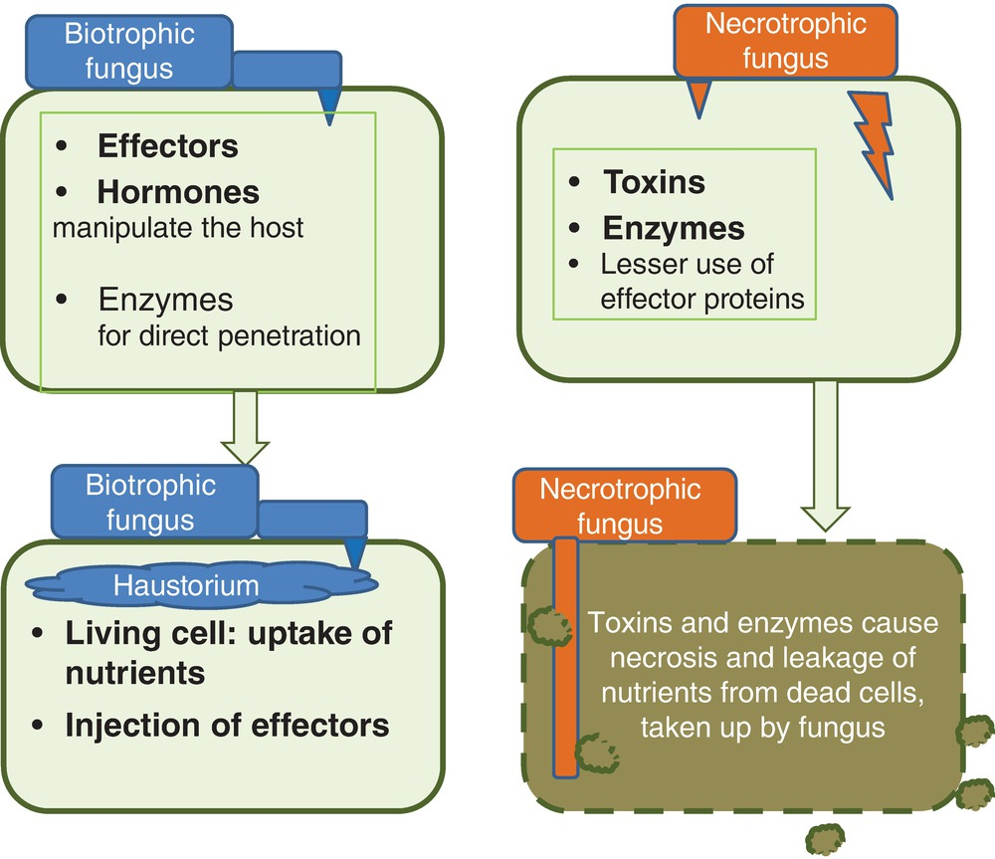
Fig. 10.3 Mechanisms of pathogenicity related to main lifestyle strategies of pathogens. (© D.B.Collinge.)
Plant Pathology and Plant Diseases © Anne Marte Tronsmo, David B. Collinge, Annika Djurle, Lisa Munk, Jonathan Yuen and Arne Tronsmo 2020

Slide 5
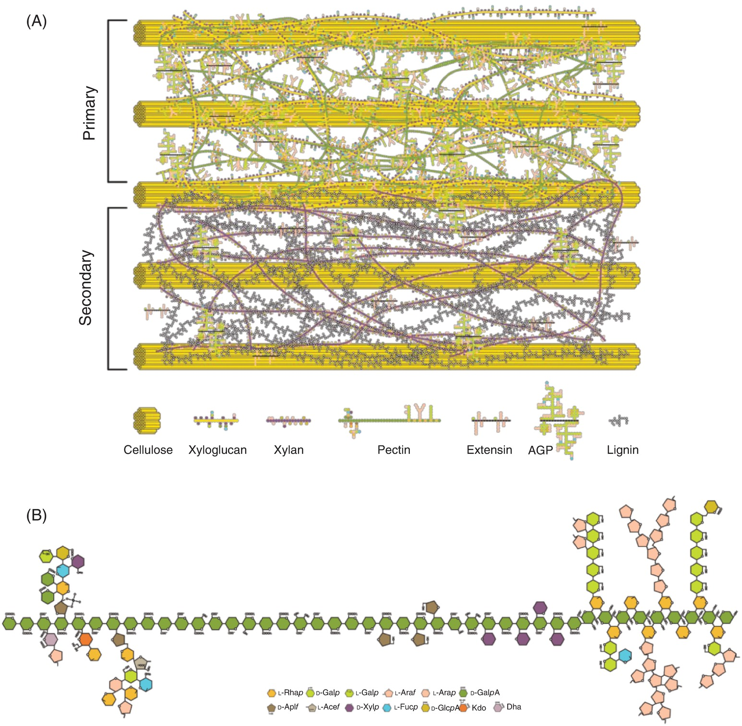
Fig. 10.4 Structure of a plant cell wall. (A) Structure of a cell wall illustrating the different components: cellulose fibrils, pectin, proteins. AGP, Arabinogalactan-proteins. (B) A pectin structure. (© J.U. Fangel.)
Plant Pathology and Plant Diseases © Anne Marte Tronsmo, David B. Collinge, Annika Djurle, Lisa Munk, Jonathan Yuen and Arne Tronsmo 2020

Slide 6
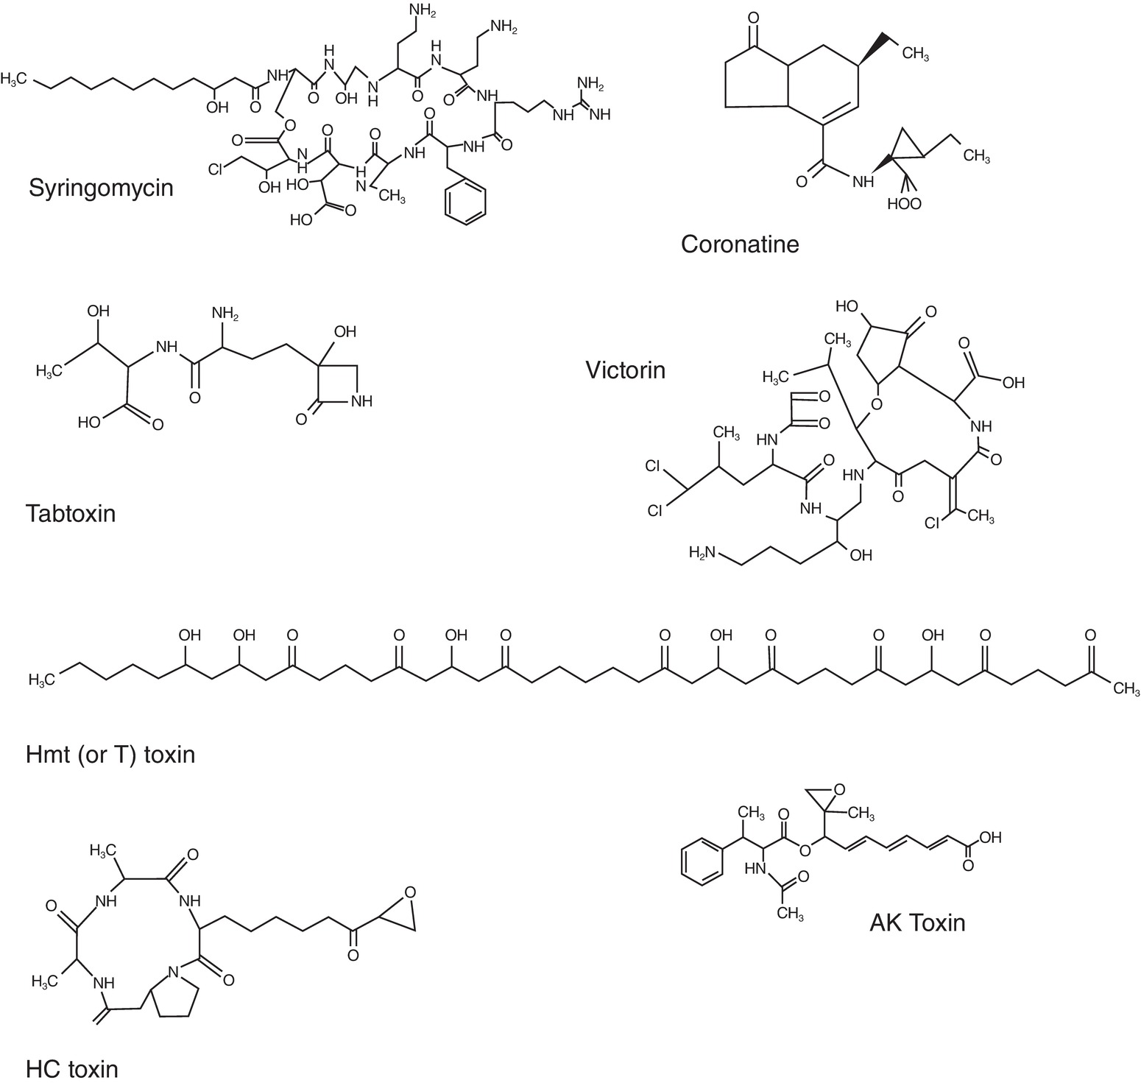
Fig. 10.5 Chemical structures of some important phytotoxins. (© D.B.Collinge.)
Plant Pathology and Plant Diseases © Anne Marte Tronsmo, David B. Collinge, Annika Djurle, Lisa Munk, Jonathan Yuen and Arne Tronsmo 2020

Slide 7
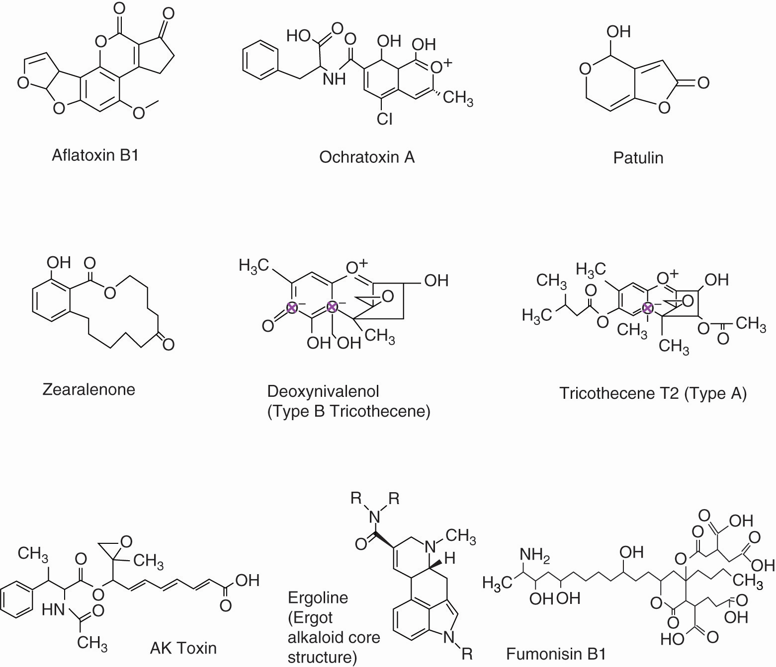
Fig. 10.6 Chemical structures of some important mycotoxins. (© D.B.Collinge.)
Plant Pathology and Plant Diseases © Anne Marte Tronsmo, David B. Collinge, Annika Djurle, Lisa Munk, Jonathan Yuen and Arne Tronsmo 2020

Slide 8
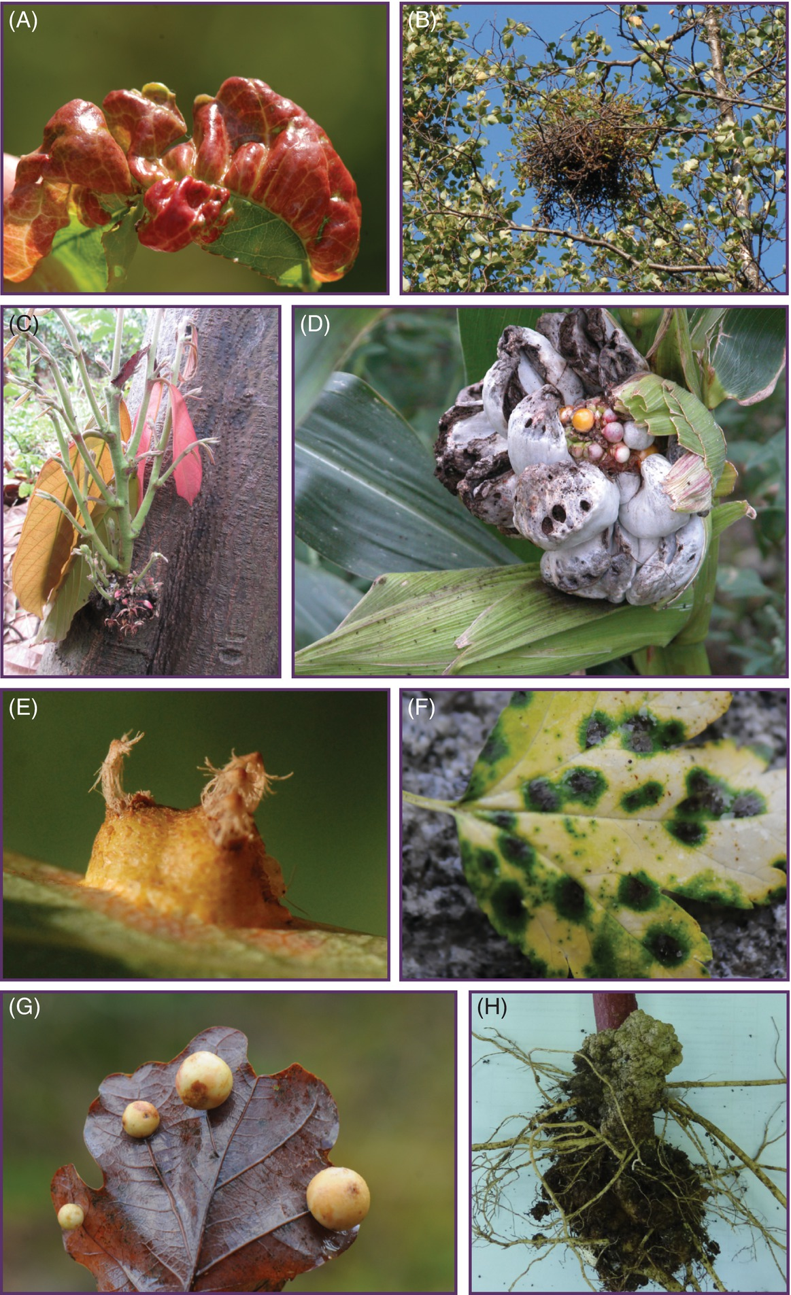
Fig. 10.7 A-D Examples of hormones in pathogenicity. (A) Taphrina deformans causes peach leaf curl by manipulating auxin levels. (B) Taphrina betulina causes witch’s broom on birch. (C) Moniliophthora perniciosa on cocoa. (D) Ustilago maydis causes maize smut by manipulating cytokinins and abscisic acid levels. (E) The aecia of Gymnosporangium sabinae on pear contain enhanced levels of cytokinins. (F) Green islands are a characteristic symptom reducing senescence associated with rust and mildew infections. Result of a cytokinin effect. (G) The gall wasp Cynips quercusfolii causes galls on oaks (H) Gall on Jamaican sorrel (Hibiscus sabdariffa) caused by A. tumefaciens. (A, B, D,: © D.B.Collinge; C: © P. Taylor.)
Plant Pathology and Plant Diseases © Anne Marte Tronsmo, David B. Collinge, Annika Djurle, Lisa Munk, Jonathan Yuen and Arne Tronsmo 2020

Slide 9
Fig. 10.7 E-H Examples of hormones in pathogenicity. (E) The aecia of Gymnosporangium sabinae on pear contain enhanced levels of cytokinins. (F) Green islands are a characteristic symptom reducing senescence associated with rust and mildew infections. Result of a cytokinin effect. (G) The gall wasp Cynips quercusfolii causes galls on oaks (H) Gall on Jamaican sorrel (Hibiscus sabdariffa) caused by A. tumefaciens. (E,F,G: © D.B.Collinge; H: © P. Taylor.)
Plant Pathology and Plant Diseases © Anne Marte Tronsmo, David B. Collinge, Annika Djurle, Lisa Munk, Jonathan Yuen and Arne Tronsmo 2020

Slide 10
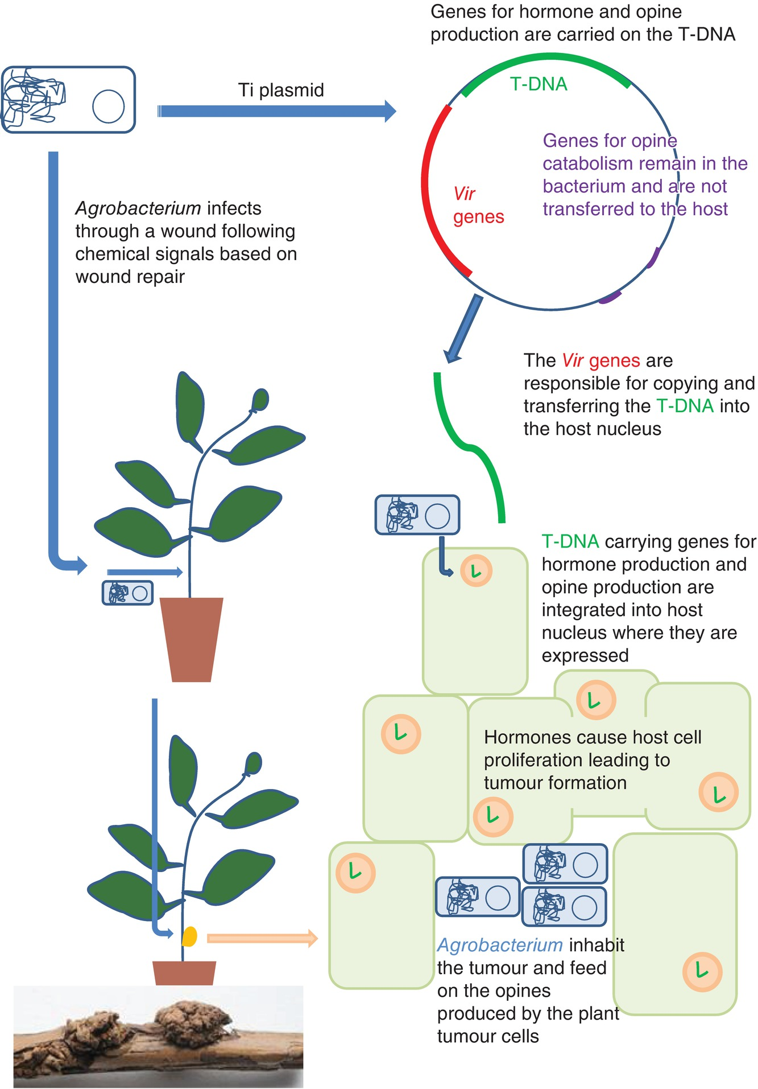
Fig. 10.8 Infection by Agrobacterium tumefaciens. Agrobacterium tumefaciens causes crown gall in strains carrying the Ti plasmid which transfers genes for the production of the hormones indole acetic acid (IAA, an auxin) and cytokinins to stimulate tumourgenesis. (© D.B.Collinge.)
Plant Pathology and Plant Diseases © Anne Marte Tronsmo, David B. Collinge, Annika Djurle, Lisa Munk, Jonathan Yuen and Arne Tronsmo 2020

