Slide 1
Tourism
2nd Edition
Peter Robinson, Michael Lück and Stephen L.J. Smith

Slide 2
PART THREE: CONSUMING TOURISM

Slide 3
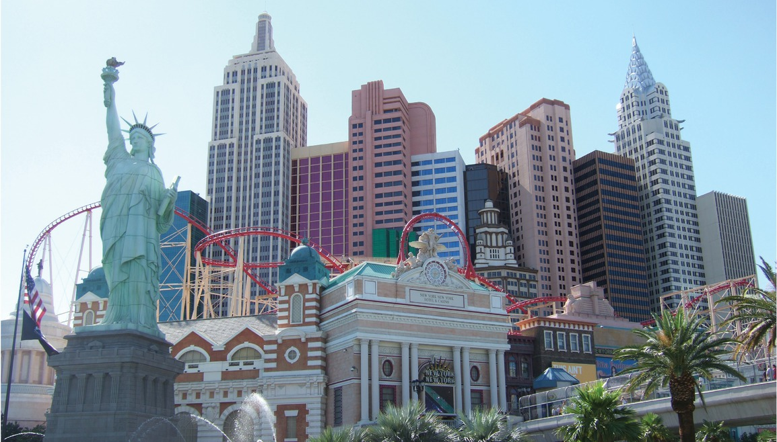

Slide 4
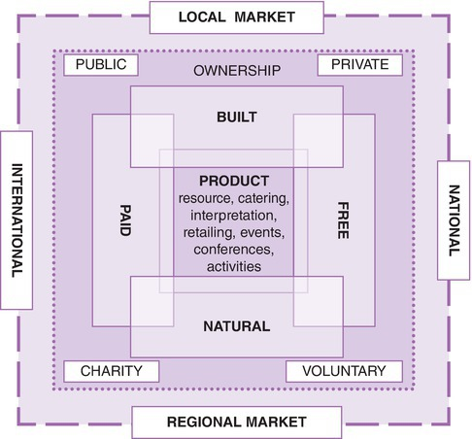
Fig. 9.1 Classification of visitor attractions. Adapted from Leask, 2003, p.7.)

Slide 5
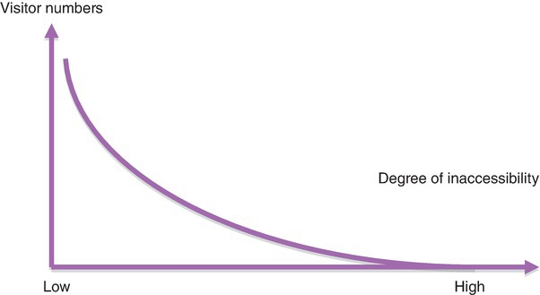
Fig. 9.5. Visitor access function. (Adapted from Cooper et al., 1998, p.297.)

Slide 6
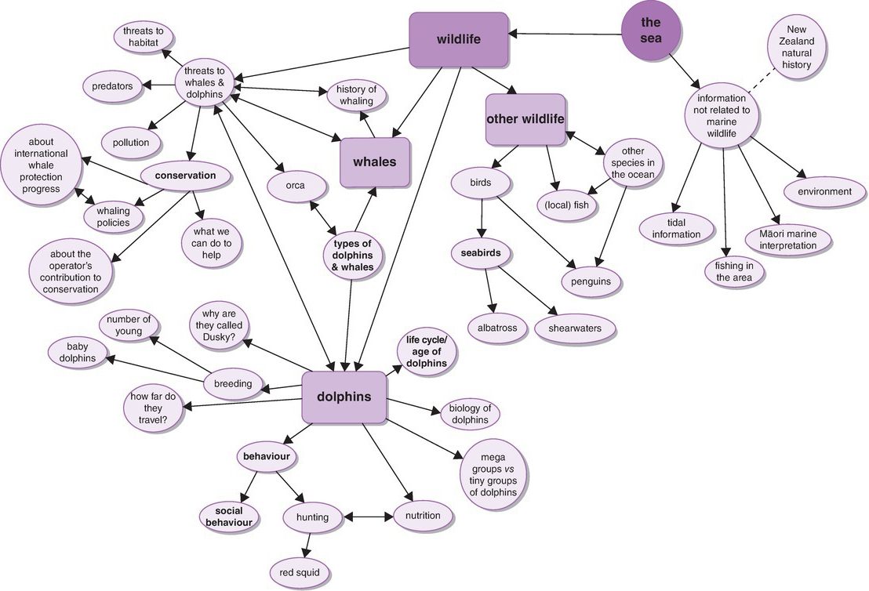
Fig 9.13. Themes of content dolphin and Whale watchers would like to learn about.

Slide 7
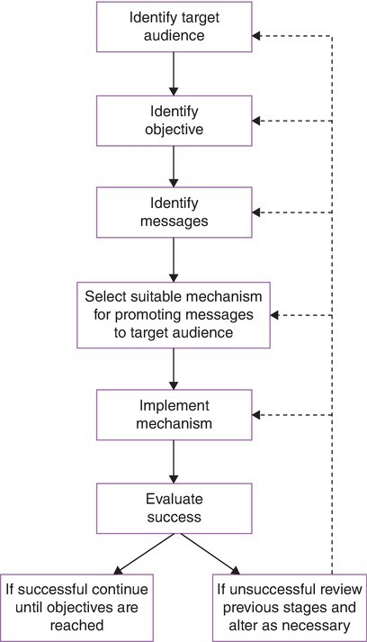
Fig. 9.14. Stages promoting (marine) conservation. (From Gubbay, 1989, p.171.)

