Slide 1
Tourism
2nd Edition
Peter Robinson, Michael Lück and Stephen L.J. Smith

Slide 2
PART THREE: CONSUMING TOURISM

Slide 3


Slide 4
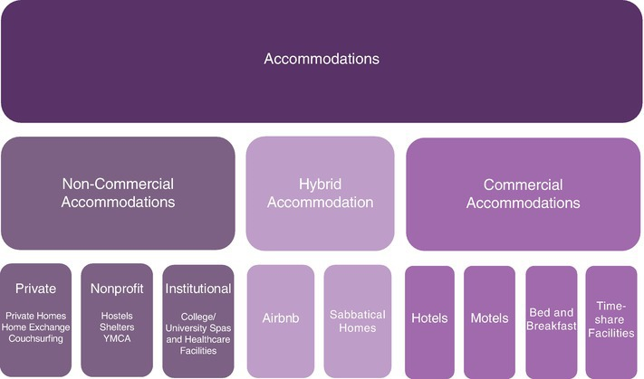
Fig. 7.1 Structure of the accommodation sector. (Adapted from Goeldner and Ritchie, 2009.)

