Slide 1
Tourism
2nd Edition
Peter Robinson, Michael Lück and Stephen L.J. Smith

Slide 2
PART THREE: CONSUMING TOURISM

Slide 3
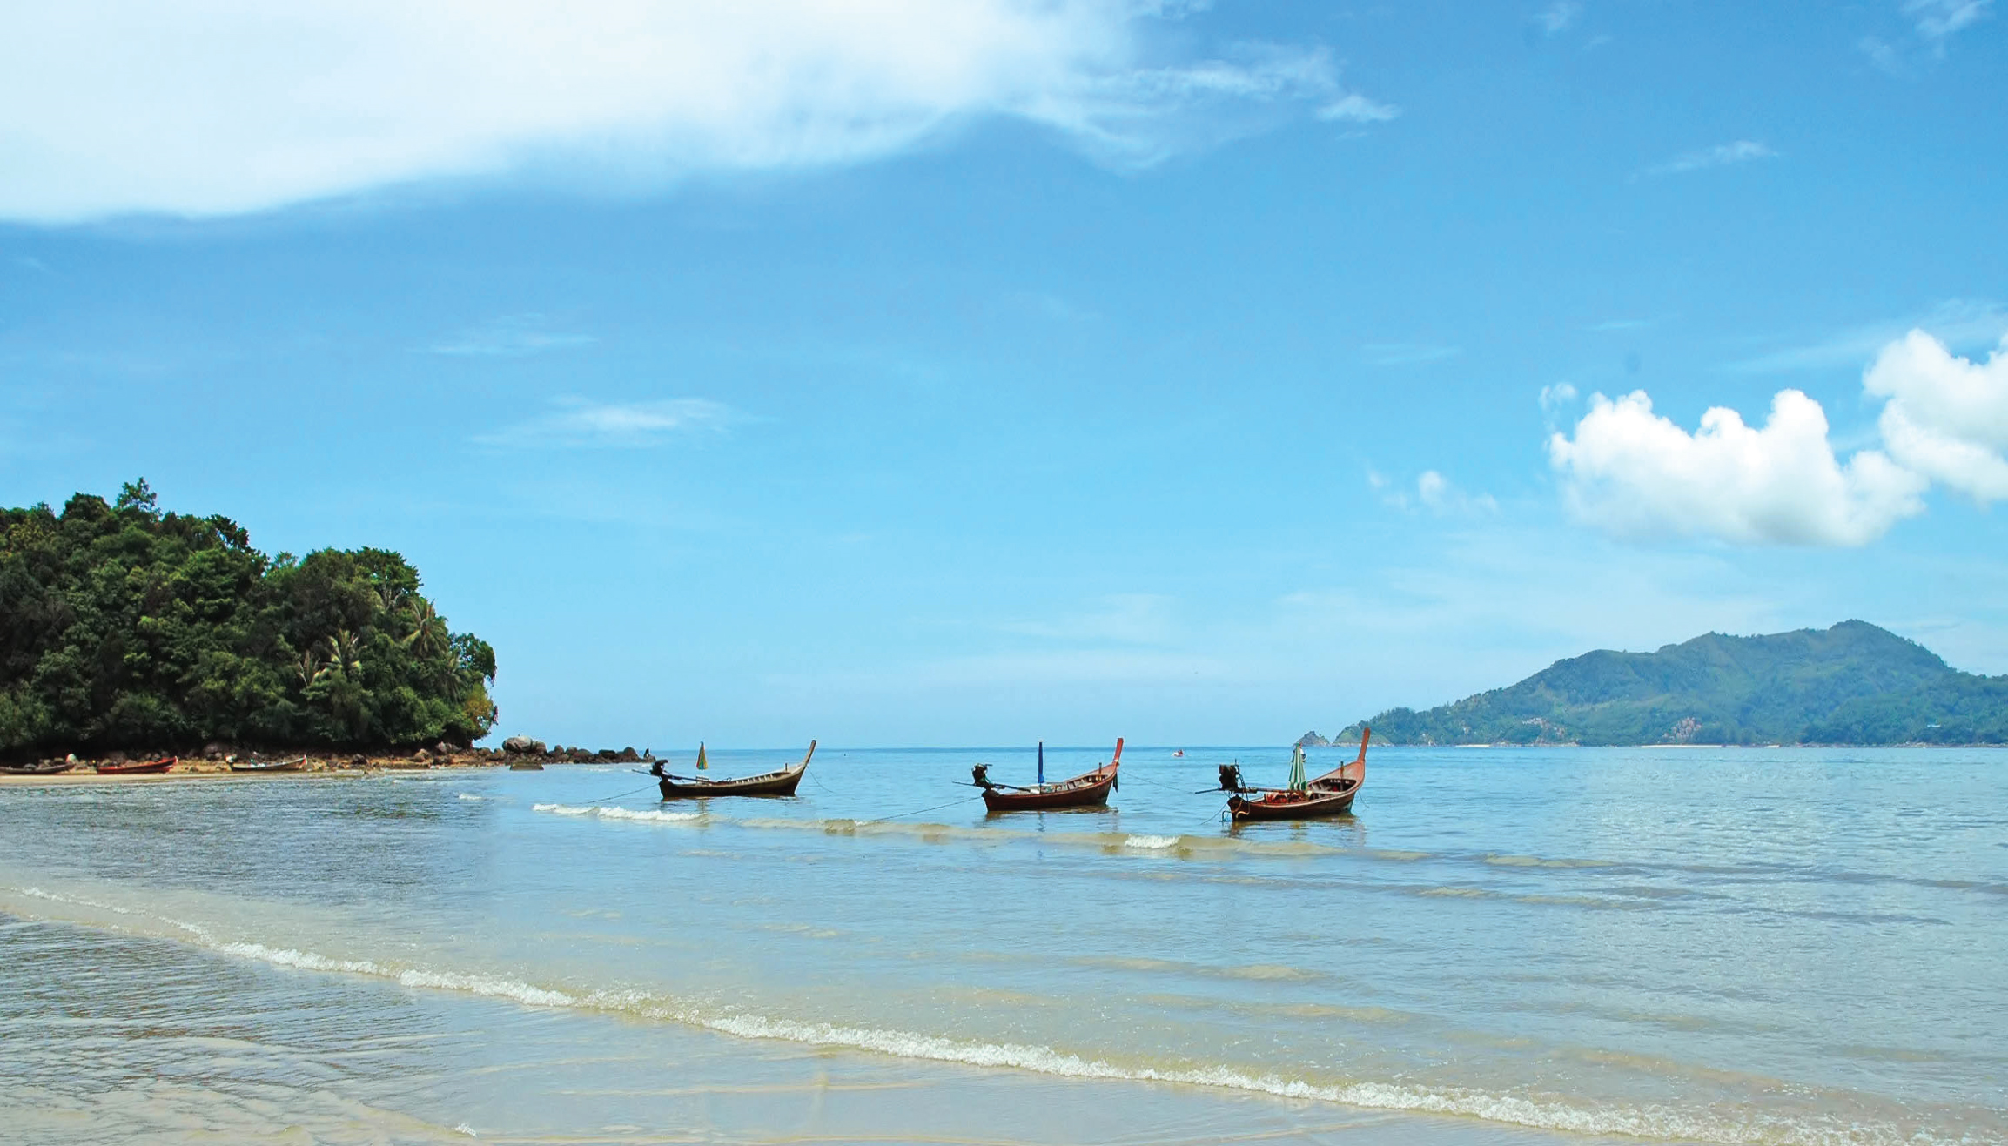

Slide 4
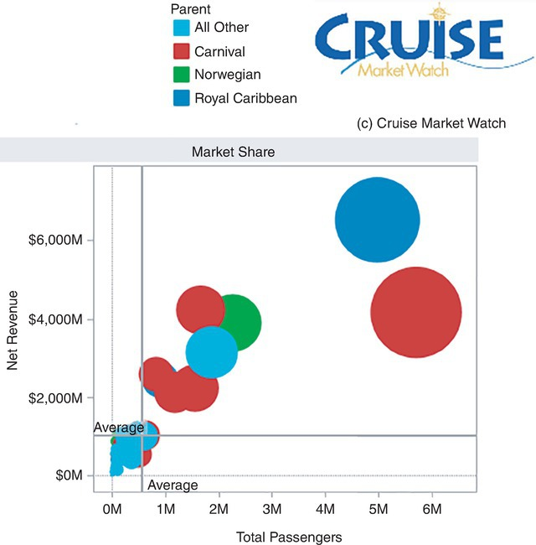
Fig. 6.8. Worldwide cruise line market share, 2018. (Cruise Market Watch, 2019).

