Slide 1
Tourism
2nd Edition
Peter Robinson, Michael Lück and Stephen L.J. Smith

Slide 2
PART THREE: CONSUMING TOURISM

Slide 3


Slide 4
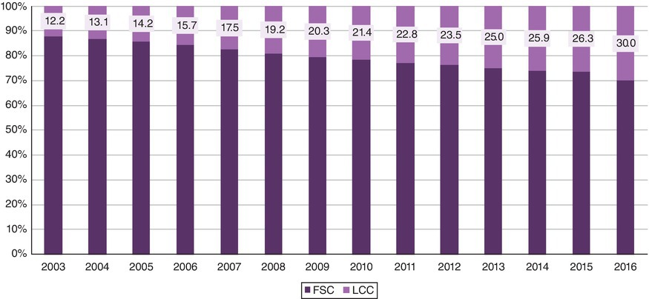
Fig. 4.2 Global market share of LCCs and full-service carriers (FSC). (Data from TR Business, 2017 and Eurocontrol, 2017)

Slide 5
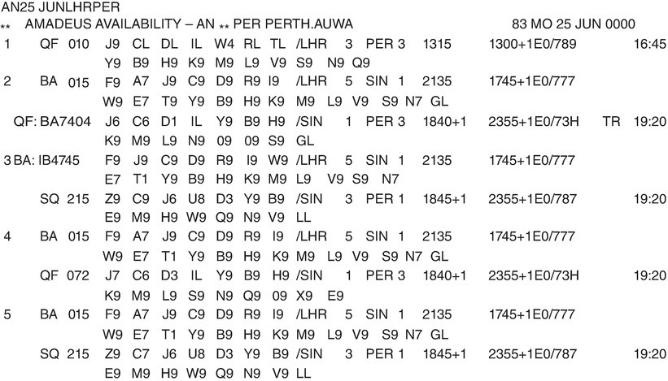
Fig. 4.7. AMADEUS query for London to Perth on 25 June.

Slide 6
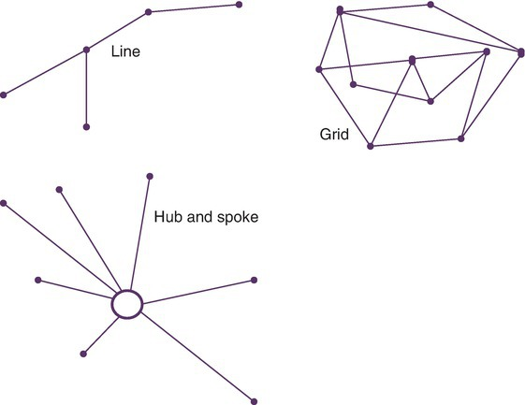
Fig. 4.9. Network patterns. (Adapted from Hanlon, 1999.)

Slide 7
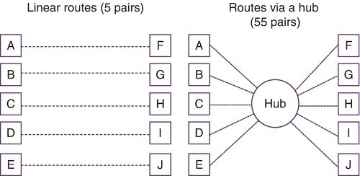
Fig. 4.10. Leverage of a hub. (Adapted from Hanlon, 1999.)

Slide 8
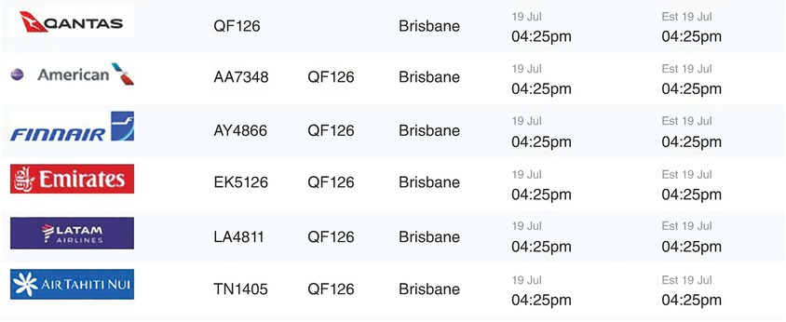
Fig. 4.11. Departure board at Auckland International Airport. (Courtesy of Auckland International Airport (AKL).)1999.)

