Slide 1
Tourism 2nd Edition
Peter Robinson, Michael Lück and Stephen L.J. Smith

Slide 2
PART TWO: TOURISM PEOPLE

Slide 3
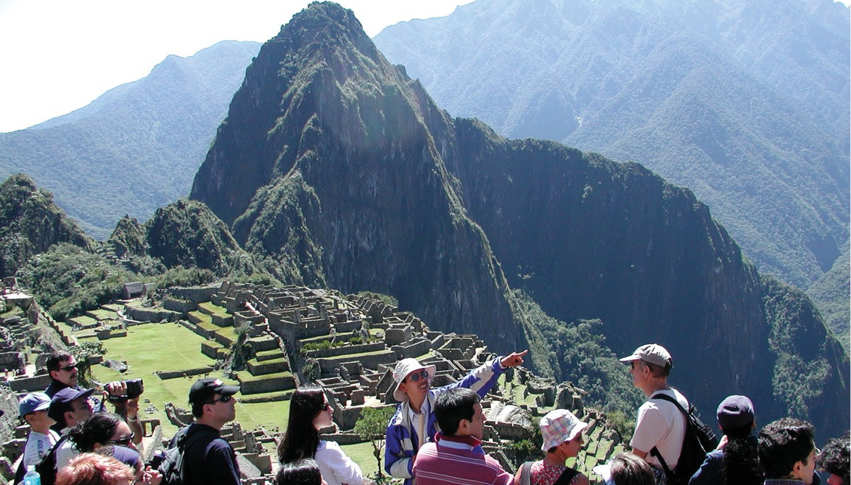

Slide 4
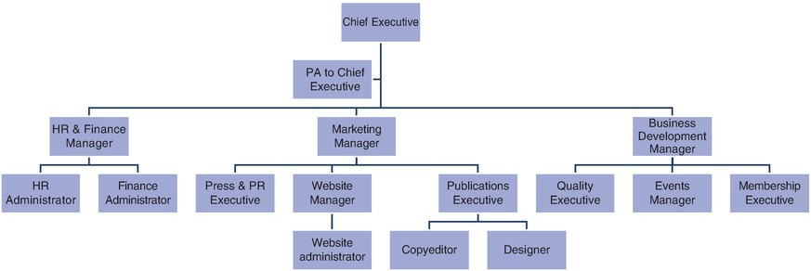
Fig. 3.4. Organizational structure for DMO

Slide 5
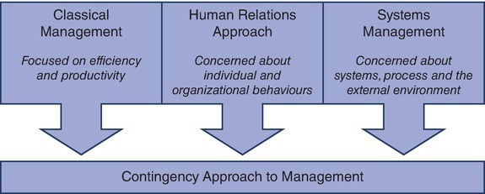
Fig. 3.5. Approaches to management

