Slide 1
Tourism 2nd Edition
Peter Robinson, Michael Lück and Stephen L.J. Smith

Slide 2
PART ONE: TOURISM PERSPECTIVES

Slide 3
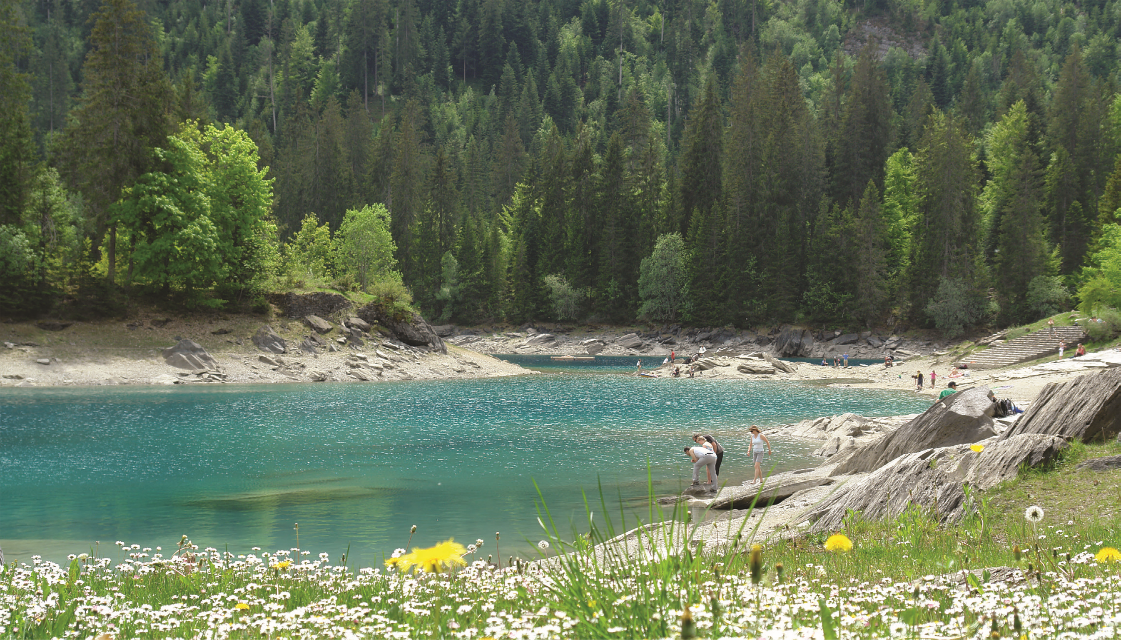

Slide 4
Fig 1.1. The tourism system. (From Leiper. 1979.)

Slide 5
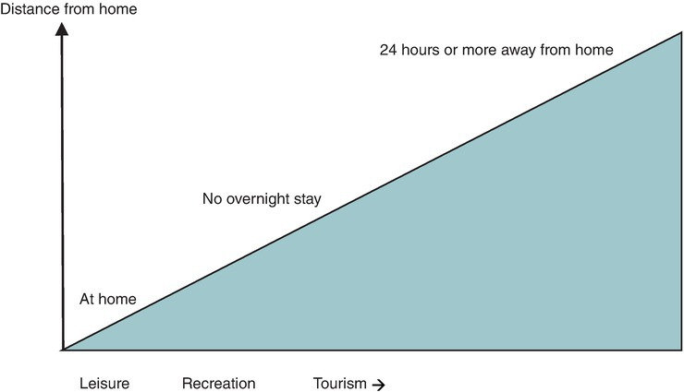
Fig. 1.2. The leisure spectrum. (Adapted from Page and Connell, 2009.)

Slide 6
Fig. 1.3. The 17 Sustainable Development Goals.

