Slide 1
Tourism
2nd Edition
Peter Robinson, Michael Lück and Stephen L.J. Smith

Slide 2
PART FIVE: TOURISM DEVELOPMENT

Slide 3


Slide 4
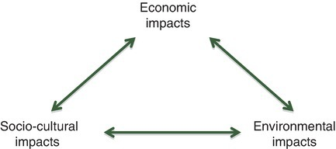
Fig. 16.1. The interrelationship of tourism impacts

Slide 5
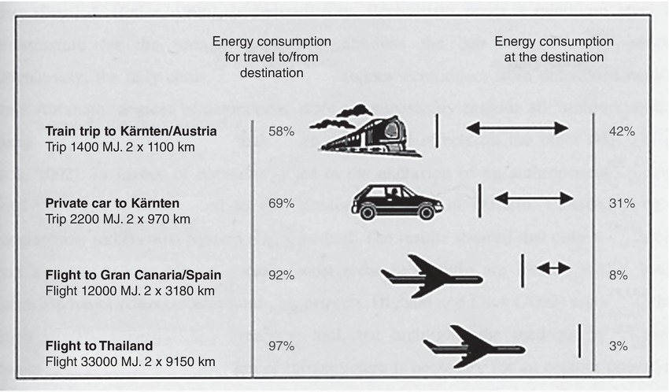
Fig. 16.3. Ratio of energy use between the travel to and from the destination, and the stay at the destination (Gwinner, 2001)

Slide 6
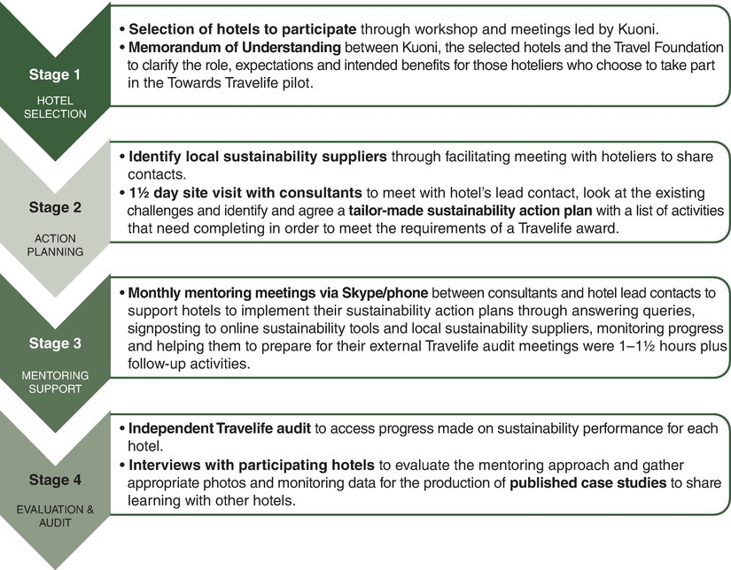
Fig. 16.4. 4-stage bespoke mentoring process.

Slide 7
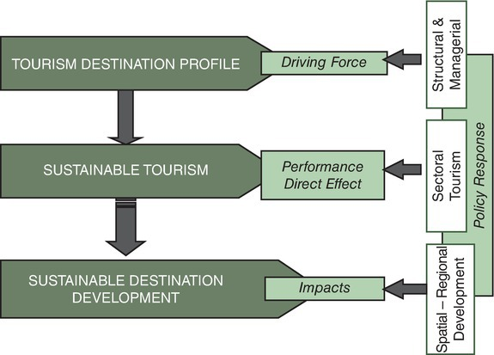
Fig 16.10. TSAT Conceptual Framework.

Slide 8
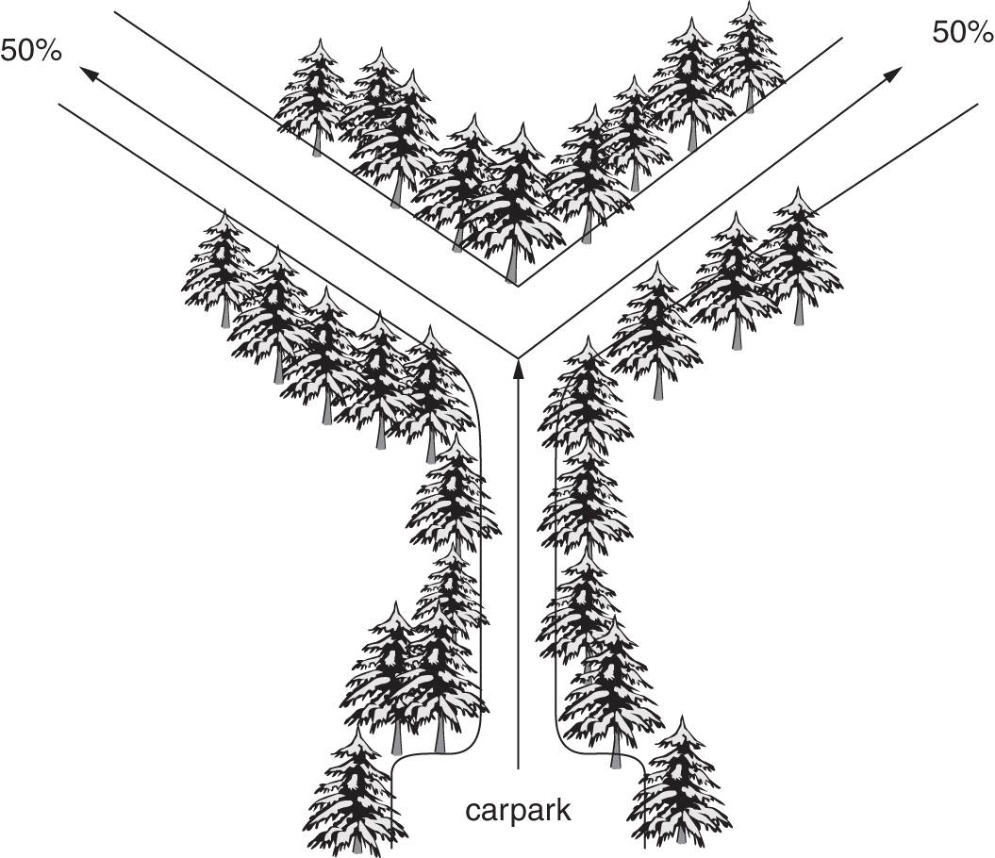
Fig. 16.11 Visitor Flow 1 (Harz National Park). (Adapted from Knolle, 1994.)

Slide 9
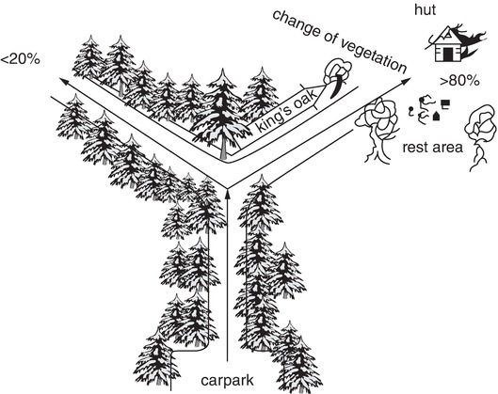
Fig. 16.12. Visitor Flow 2 (Harz National Park). (Adapted from Knolle, 1994.)

Slide 10
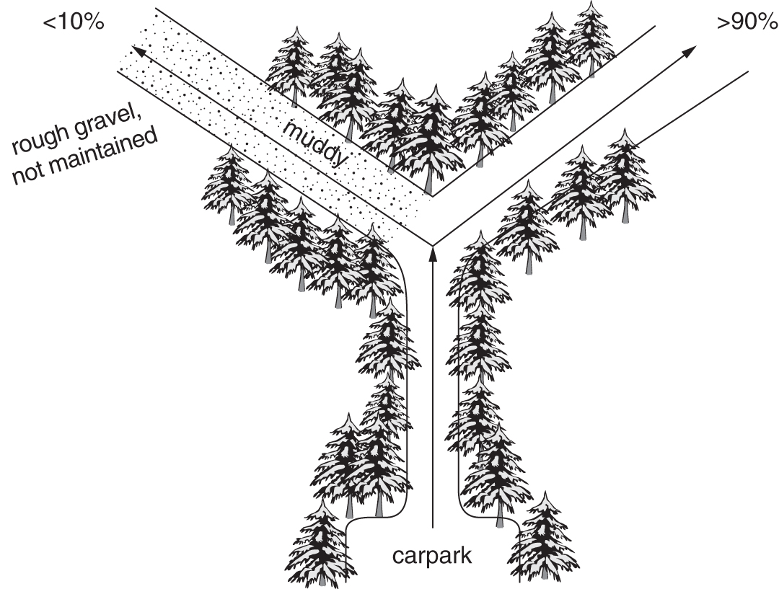
Fig. 16.13. Visitor Flow 3 (Harz National Park). (Adapted from Knolle, 1994.)

