Slide 1
Tourism
2nd Edition
Peter Robinson, Michael Lück and Stephen L.J. Smith

Slide 2
PART FIVE: TOURISM DEVELOPMENT

Slide 3
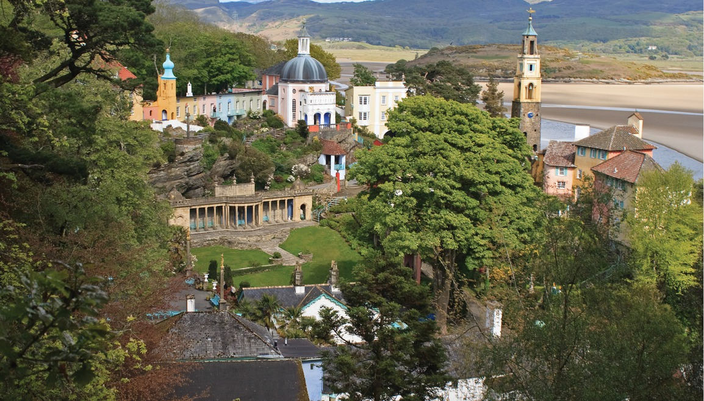

Slide 4
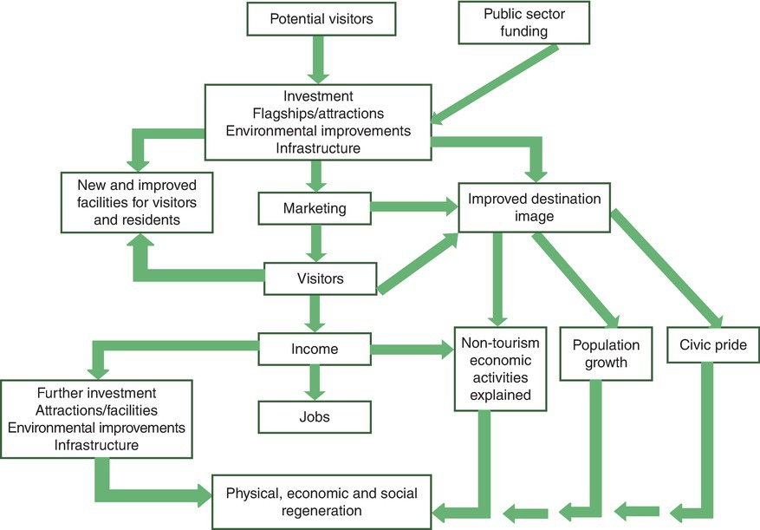
Fig. 15.1. Distribution of wealth through tourism. (Adapted from Davidson and Maitland, 1997.)

Slide 5
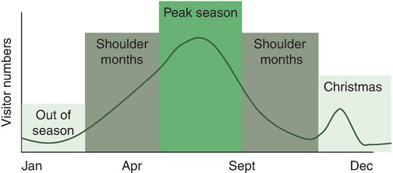
Fig. 15.2. Seasonality in the UK tourism industry.

Slide 6
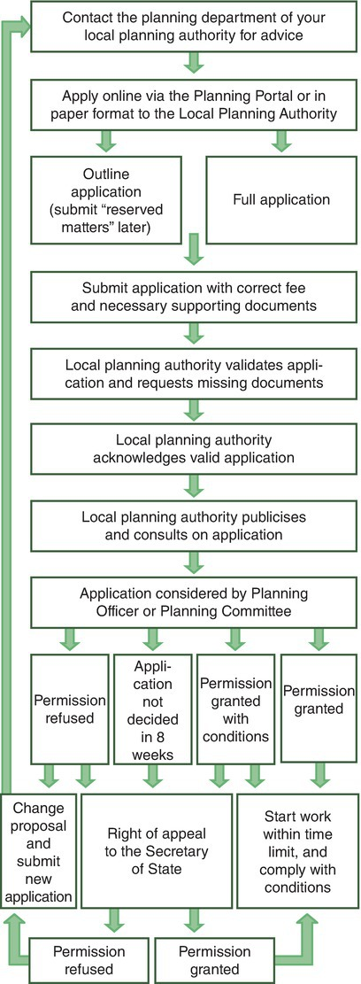
Fig. 15.4. Planning processes in the public sector: a UK example. (Image provided by The Planning Portal: www.planningportal.gov.uk/planning/applications/decisionmaking)

