Slide 1
Tourism
2nd Edition
Peter Robinson, Michael Lück and Stephen L.J. Smith

Slide 2
PART FOUR: TOURISM MANAGEMENT

Slide 3
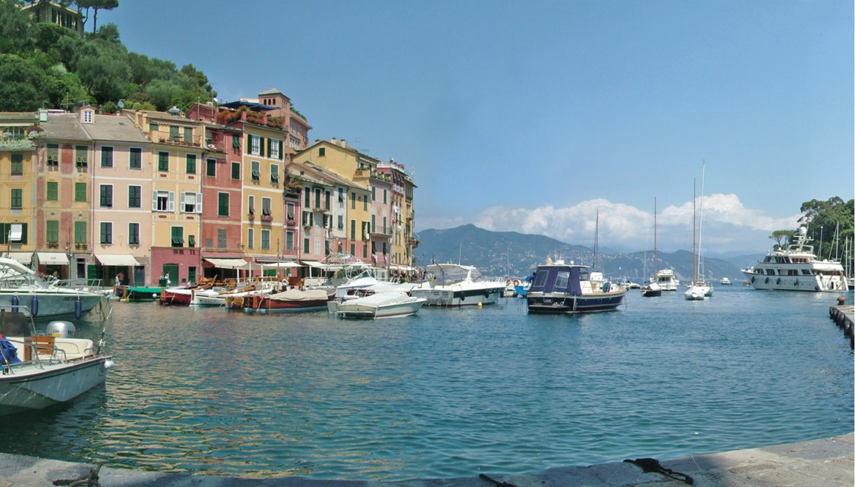

Slide 4
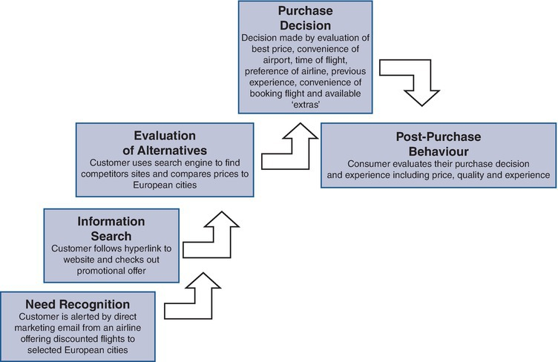
Fig. 14.1. Purchasing a holiday: the buyer decision process. (Adapted from Kotler, 2001; Wale, 2009.)

Slide 5
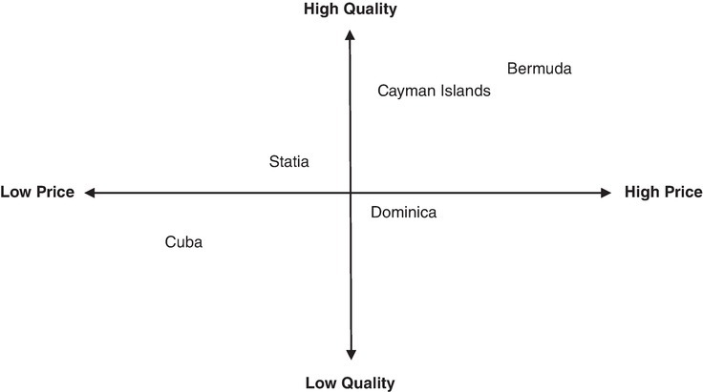
Fig. 14.3. Positioning map for selected Caribbean islands by quality and price (for illustrative purposes only).

Slide 6
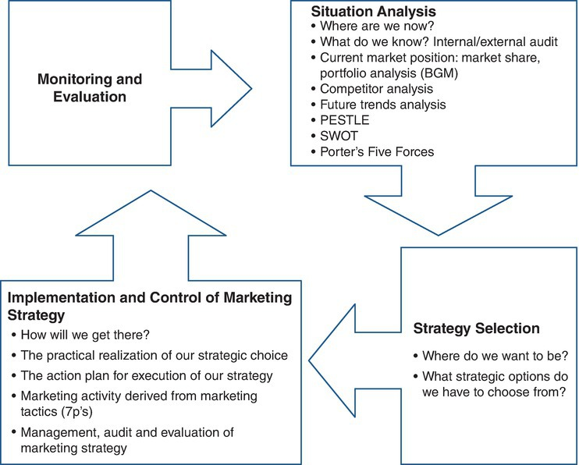
Fig. 14.4. The strategic marketing process. (Adapted from Middleton, 2001.)

