Slide 1
Tourism 2nd Edition
Peter Robinson, Michael Lück and Stephen L.J. Smith

Slide 2
PART FOUR: TOURISM MANAGEMENT

Slide 3


Slide 4
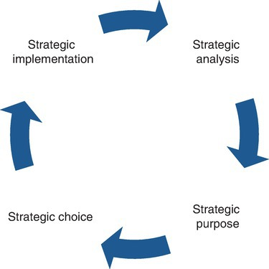
Fig. 13.1. The strategic management process. (Adapted from
Tribe, 1996.).

Slide 5
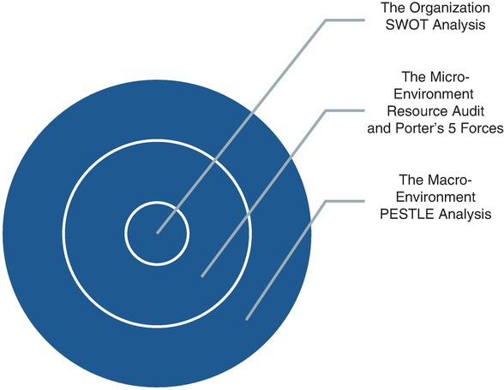
Fig. 13.2. The micro- and macro-environments.

Slide 6
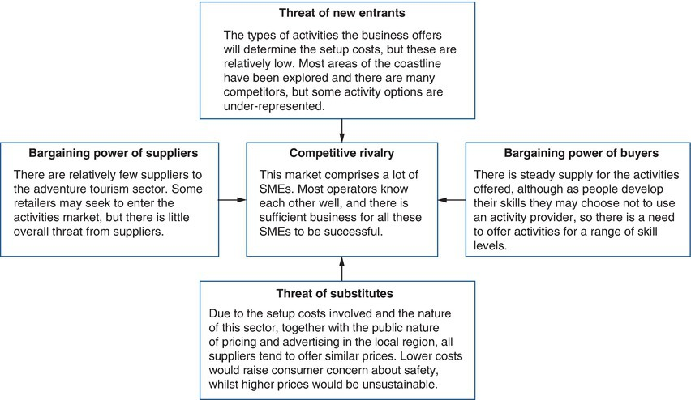
Fig. 13.3. Porter’s Five Forces, applied to an adventure tourism business. The Pembrokeshire coastline in Wales is home to numerous activity providers, offering activities including coasteering, abseiling, sailing and climbing to visitors to this popular holiday region. In this example, Porter’s Five Forces can be applied to any of these businesses.

Slide 7
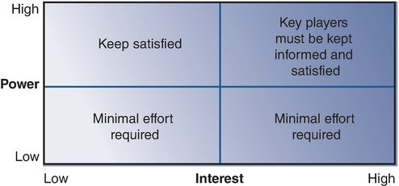
Fig. 13.4. Stakeholder analysis. (Dale, 2016.)

Slide 8
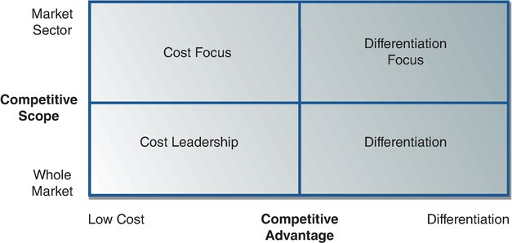
Fig. 13.5. Porter’s generic competitive strategies. (Dale, 2016.)

Slide 9
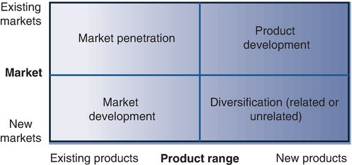
Fig. 13.6. Ansoff’s directional matrix. (Adapted from Ansoff, 1968.)

Slide 10
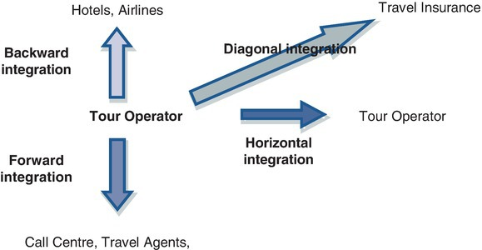
Fig. 13.7. Directional strategies for a tour operator. (Adapted from Dale, 2016.)

