Slide 1
Tourism
2nd Edition
Peter Robinson, Michael Lück and Stephen L.J. Smith

Slide 2
PART FOUR: TOURISM MANAGEMENT

Slide 3


Slide 4
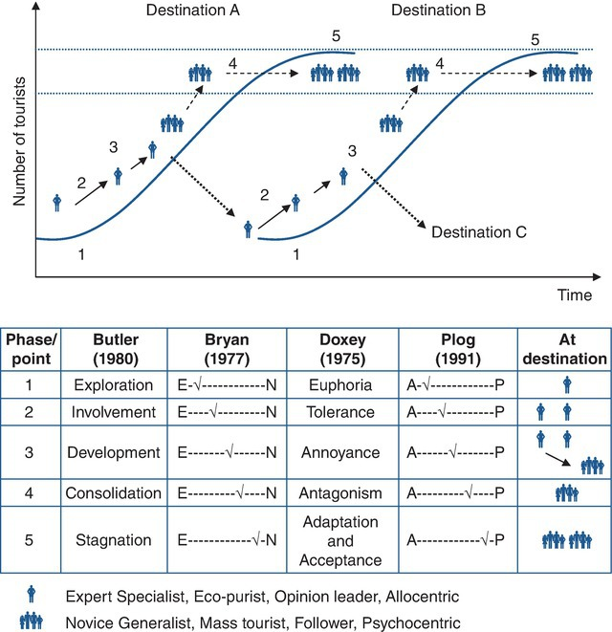
Fig. 12.1. The destination life cycle model.

Slide 5
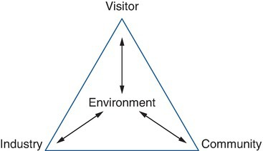
Fig. 12.2. The VICE Model. Source: The Tourism Management Institute Destination Management Handbook

