Slide 1
Tourism
2nd Edition
Peter Robinson, Michael Lück and Stephen L.J. Smith

Slide 2
PART FOUR: TOURISM MANAGEMENT

Slide 3
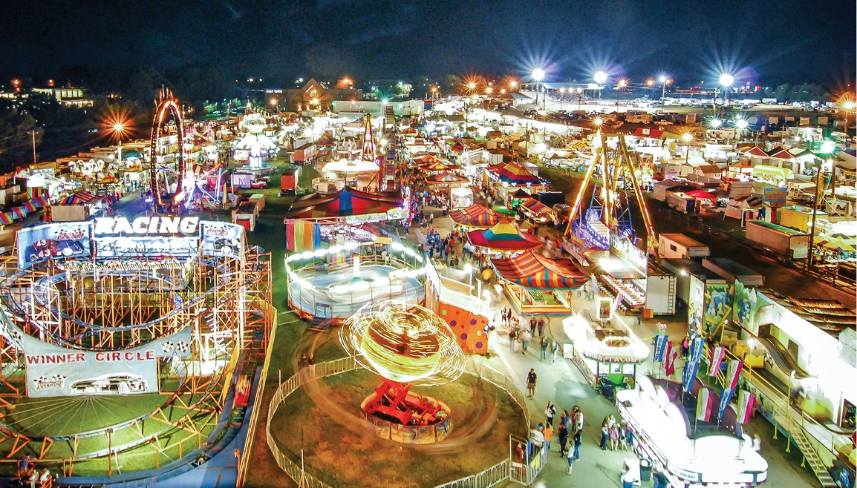

Slide 4
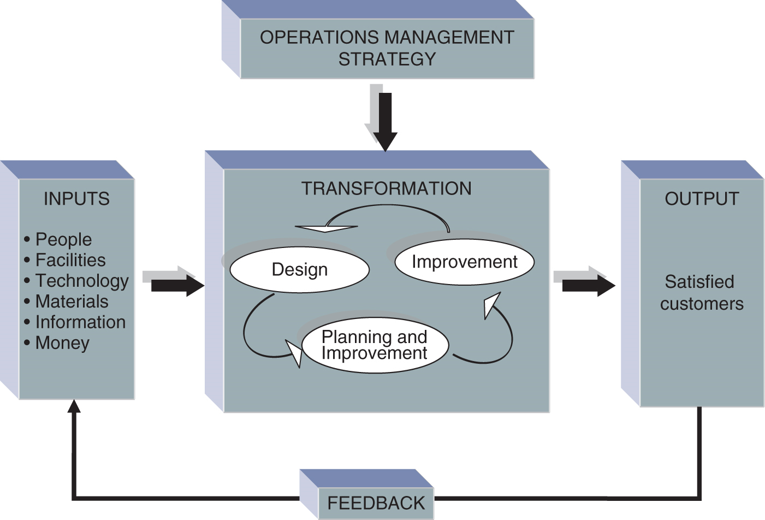
Fig. 11.1. The Operations Management Model. (Adapted from Slack et al., 2016.)

Slide 5
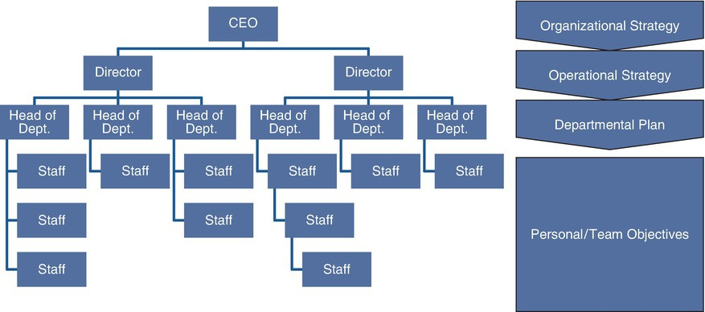
Fig. 11.2. Operations management through the organizational structure.

Slide 6
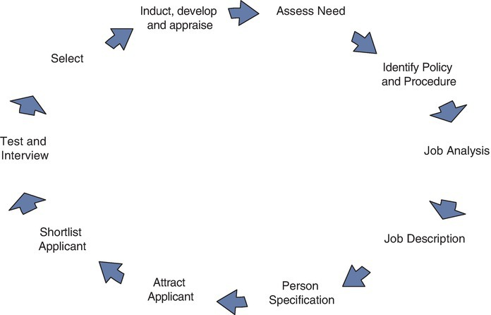
Fig. 11.3. Human resource process. (From Gill-McLure and Firth, 2016.)

Slide 7
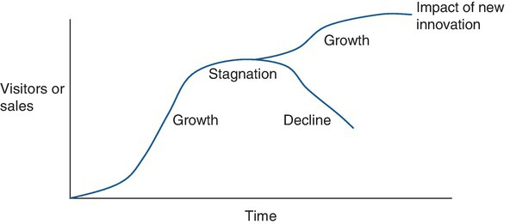
Fig. 11.4. The product life cycle.

Slide 8
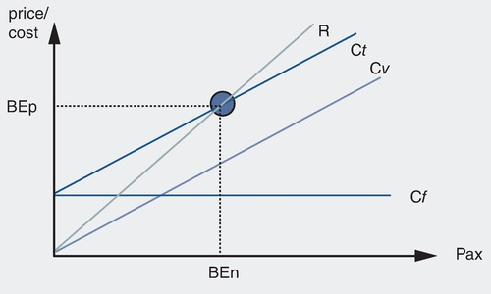
Fig. 11.6. Costs, revenue and break-even. BEp, break-even price; BEn, break-even number (Pax); R, revenue; Cf, fixed costs; Cv, variable costs; Ct, total costs (total variable costs plus fixed costs).

Slide 9
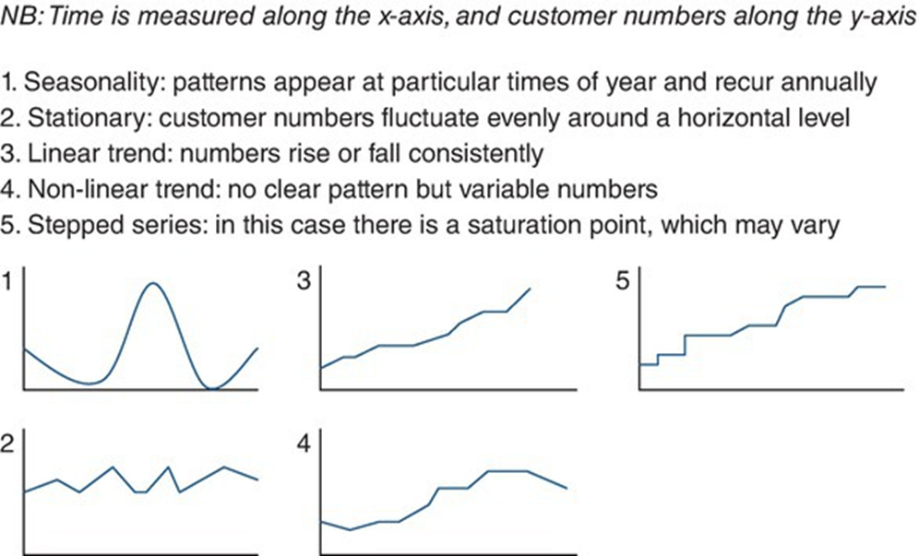
Fig. 11.7. Time series patterns. (From Robinson and Gelder, 2009.)

