Slide 1
Tourism
2nd Edition
Peter Robinson, Michael Lück and Stephen L.J. Smith

Slide 2
PART THREE: CONSUMING TOURISM

Slide 3
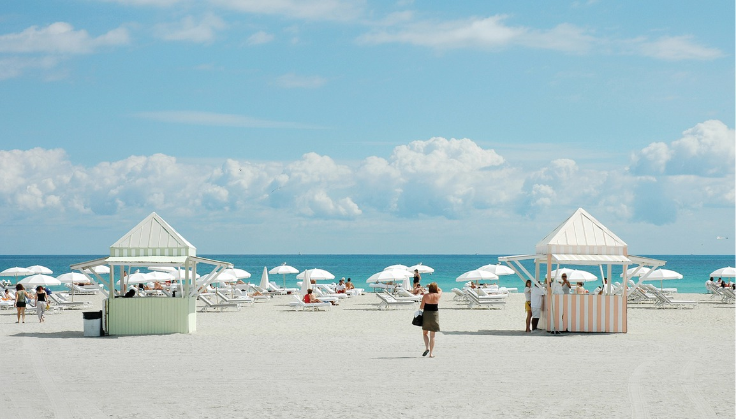

Slide 4
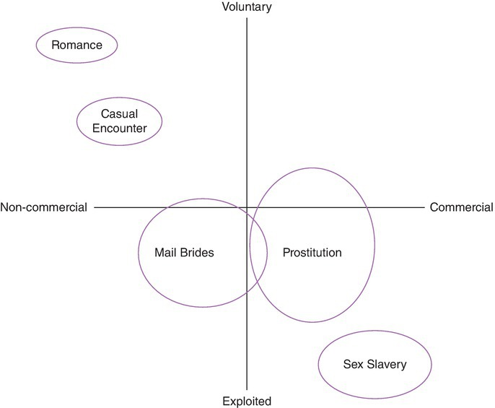
Fig. 10.17. Sex Tourism Paradigms. (Ryan, 2000, p. 35.)

