Slide 2
Chapter 9
Hospitality Information Systems

Slide 3
Chapter 9 Learning Objectives
After studying this chapter you should be able to:
Understand the nature of the hospitality industry and its unique applications of IT
Be able to explain how a hotel’s property management system works and connects to other systems in the hotel
Know the ways a hotel can service its guests better with IT applications throughout the hotel
Know how restaurants can use IT for improved operations
Understand how a hotel or restaurant can use IT for improved management and decision-making

Slide 4
Key Concepts
Front office and back office systems
Decision support system (DSS)
Electronic locking systems
Energy management system (EMS)
Expert information system (EIS)
Point-of-sale (POS)
Property management system (PMS)
Revenue management system (RMS)

Slide 5
Common IT Applications in Hospitality
Front-office applications: reservation system, check-in/check-out, room status and housekeeping, in-house guest information and guest accounting
Back office applications: personnel, purchasing, accounting, inventory, sales and catering and financial reports and statistics
Guest-related interface applications: call-accounting, electronic locking, energy management, guest-operated devices and auxiliary guest services
Restaurant and banquet management systems: menu management, recipe management, sales analysis and forecasting, menu-item pricing and cost control

Slide 6
Property Management System (PMS)
Handles the core functions of information processing for an accommodation property and is the hub for all interconnectivity with other systems in the hotel
Major functions:
Reservations Management
Guest Folio and Billing
Room Management
Specialized PMS Functions
Back Office Applications

Slide 7
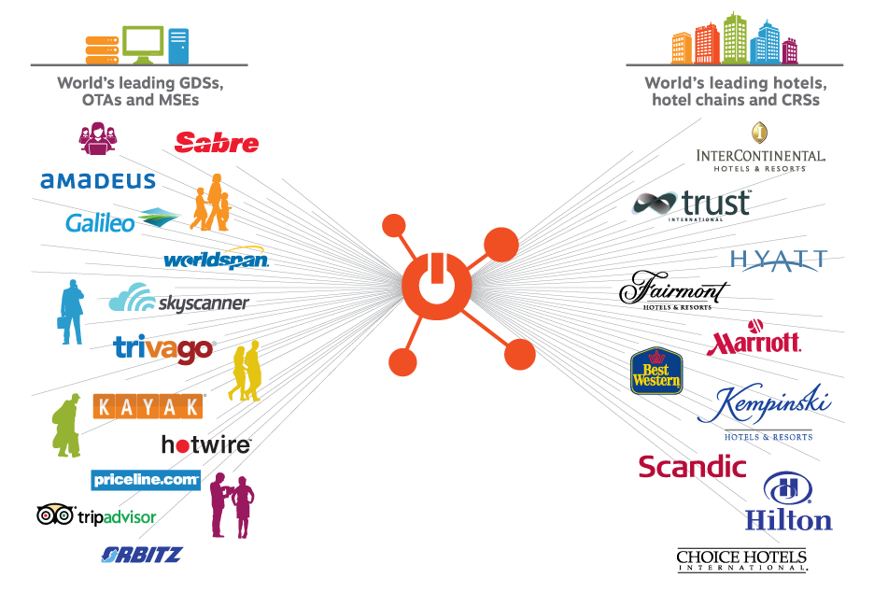
Figure 9.1 The DHISCO switch

Slide 8
Hotel Websites
Generate direct sales and provide greater control over inventory than other electronic booking channels
Avoid commissions
Features of successful hotel websites:
interactive and easily navigable
quality information
online booking capability
price comparison features
maps
multiple language support
links to local points of interest

Slide 9
Electronic Hotel Reservations
Online travel agents (OTAs)
Metasearch engines
Specialized accommodation search engines
TripAdvisor
Google Hotel Search
Channel managers
Mobile apps

Slide 10
Figure 9.2 Electronic Hotel Room Distribution
GUESTS
Property Website
Chain Website
Affiliate Websites
OTAs
Traditional Agents
Specialty Websites
Wholesalers Aggregators
GDSs
Switches
Computer Reservation Systems (CRSs)
HOTELS
(Adapted from: Carroll and Siguaw 2003)

Slide 11
Guest Applications
Customer relationship management
Guest history systems
Guest room amenities
Electronic locking system (ELS)
Guest information and entertainment devices
Guest services technology

Slide 12
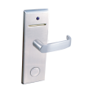
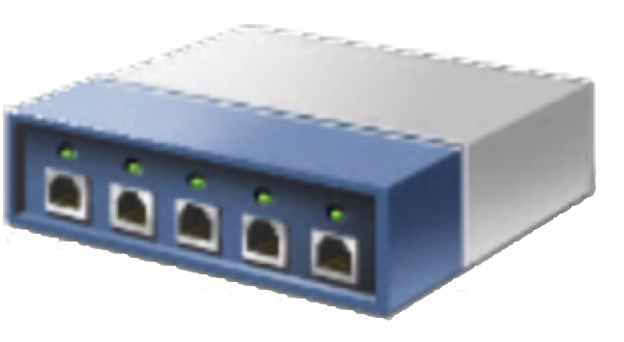
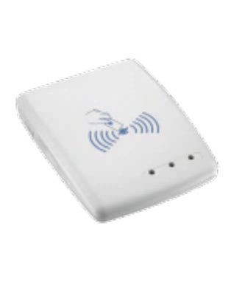
Figure 9.3 Hardware Configuration for an ELS
GCU Network
Door Locks
PMS
POS Area Verifiers
TNN
TNN
Key Encoder
Check In Area
TNN=Terminal Network Node | GCN=Group Controller Unit | POS=Point of Service
Notes:
6

Slide 13
Hotel Communications
Private Branch Exchange: control the connections of hotel telephone calls to the outside world for guests and employees
Call Accounting System (CAS): allows the hotel to route and track calls without using the local telephone company

Slide 14
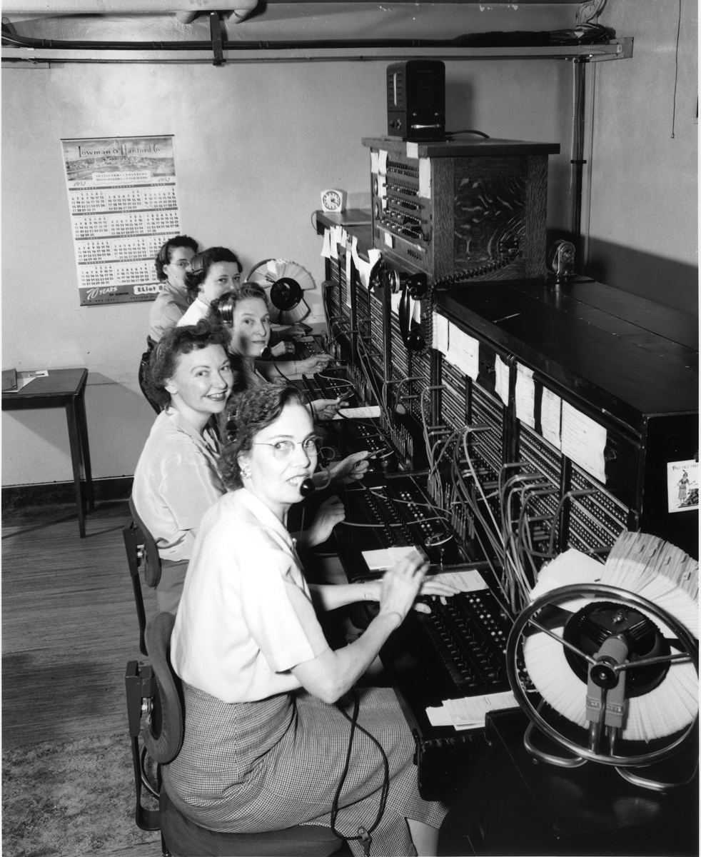
Figure 9.4 Analog telephone switch PBX (Source: Seattle Municipal Archives, 2008)
Notes:
8

Slide 15
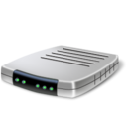
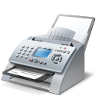
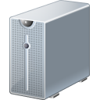
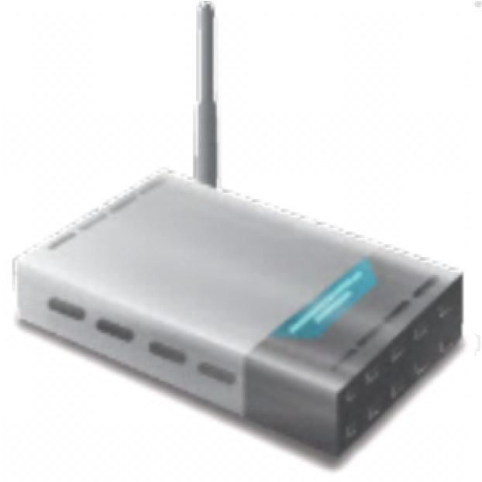
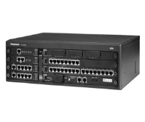
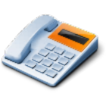
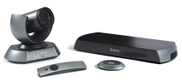
Figure 9.5 Example of a Digital PBX System
Printer | Fax
Scanner
CAS
PMS
Internet
Modem
Firewall
Voice Mail
Router
Guest Room Extensions
Automated Wake-up Call
Digital PBX
Reception Switchboard
Videoconferencing
Back Office Extensions
Notes:
8

Slide 16
Energy Management System
Monitor, control and optimize energy consumption in a hotel
Can link to ELS to determine whether a room is occupied and can automatically adjust air conditioning, lighting and heating
Infrared body scanners
Electronic bedside control panels and mobile apps

Slide 17
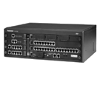
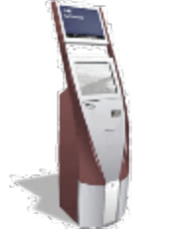
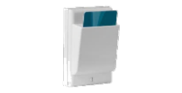
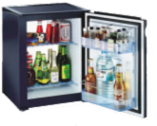
Figure 9.6 Property Management System (PMS) Interfaces
GUEST ROOMS
COMMUNICATIONS
Internet
CAS
Digital PBX
Router
Firewall
Modem
Internet
FRONT OFFICE
BACK OFFICE
Door Locking System
PMS
Reception
Sales & Marketing
CRS
Entertainment System
Self Check In
Revenue Management
EMS
POS
FOOD & BEVERAGE
Financial Accounting
Electronic Mini Bar
Inventory Control System
Pre-costing System
Menu Management
Payroll & HRM
Notes:
8

Slide 18
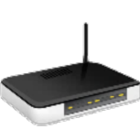
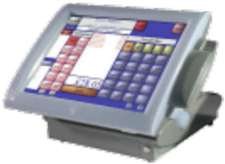
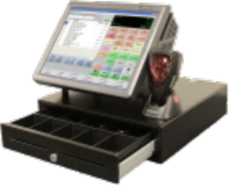
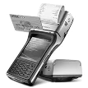
Figure 9.7 Food Service IT Applications
Payment
Authorization
PMS
Internet
Back Office
Order Entry
POS Server & Router
Restaurant Management
Handheld Devices
Print | Fax | Scan
Payment Systems
Bar
Kitchen Displays
Cash Register
Printers
Credit Card Terminal
Restaurant
Notes:
8

Slide 19
Discussion Questions
If you were the manager of a campsite in a national park with 30 cabins of different sizes and one restaurant, what functionality would you want from a PMS? Describe the kinds of technology that would be appropriate for this kind of lodging. Which channels would you use to sell your cabins? Why?
Compare and contrast the website of an international chain hotel with an independently owned and operated hotel site.
Describe all the ways that a restaurant or cafe could use mobile apps and technology to relate to its customers.
Visit a local restaurant and find out all you can about their POS and other technical applications.

Slide 20
Discussion Questions
Identify as many hotel booking websites as you can. Choose one hotel that you would like to visit and investigate how it is presented on all the various sites. Visit TripAdvisor and read some of the reviews for the hotel. What conclusions can you draw from this investigation?
OTAs have caused many hotels to lose control of their inventory and pricing and this has eroded not only profitability but also brand equity. Unlike hotels, airlines have not suffered from the same problems. Why are the airlines in a different position? If you were a hotelier, what strategies would you use to overcome this problem?

Slide 21
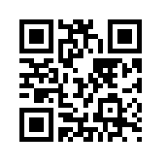
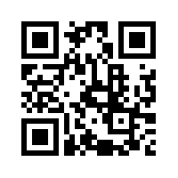
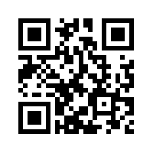
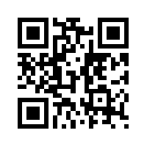
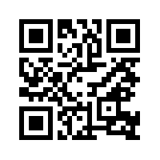
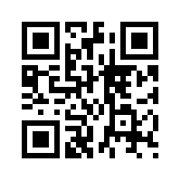
Useful Websites
 | Hospitality Information Technology Association (HITA) www.ihita.org |  | Hotel Electronic Distribution Network Association (HEDNA) www.hedna.org
 | Booking.com www.booking.com |  | WebRezPro www.webrezpro.com
 | Pegasus Solutions www.pegasus.io |  | Silverbyte Systems www.silverbyte.com

Slide 22
Case Study: Accor Hotels
A leading lodging company headquartered in Issy-les-Moulineaux, France, with over 3,700 properties in 95 countries with 250,000 employees.
Digital development strategy:
designing and implementing an innovative content marketing strategy
incorporating e-reputation as a core business objective
creating and/or adapting organizational structures
TARS online booking platform handles 329 million annual visits and is available in 18 languages
MobileFirst app
view hotel details
book rooms
modify bookings
online payment and online check-in
communicate with individual properties
city guides and other supplementary information
Accor’s Revenue Management System (RMS) evaluates demand fluctuations and changes in rates of competitors and other accommodations options such as AirBnB

