Slide 2
Chapter 8
Surface Transport and Information Technology

Slide 3
Chapter 8 Learning Objectives
After studying this chapter you should be able to:
Explain the components an Intelligent Transportation System (ITS) and how they are applied to surface transport
Describe the different IT applications in road, rail and water transport
Evaluate how technology facilitates the connection of systems in intermodal transport

Slide 4
Key Concepts
Automated traffic management system (ATMS)
Automated vehicle location (AVL)
Car/bike sharing
Driverless cars
e-tolls and electronic road pricing (ERP)
Geographic Information System (GIS)
Intelligent transport system (ITS)
Smart cars
Vehicle information & communication system (VICS)

Slide 5
Intelligent Transport Systems (ITSs)
A broad range of information and communications technologies that improve the safety, efficiency, and performance of the transport system
ITSs can help reduce congestion, improve mobility, save lives and optimize our existing infrastructure
Industry Insight: Qatar’s ITS
tunnel management systems
incident detection and weather sensors
lane and speed control signs
connected vehicles and car-sharing systems
automated payment mechanisms
intelligent parking management

Slide 6
ITS Benefits
Detecting hazards and informing drivers before they are visible
Keeping vehicles at a safe distance
Allowing vehicles to communicate with infrastructure
Route planning and warnings of congestion and accidents
Keeping drivers informed of the local speed limit
Monitoring drivers for signs of fatigue
Real time service information for public transport users
Smart and seamless ticketing solutions
Integrating public transport into traffic management systems
Improved efficiency has obvious benefits for the environment
Reliable real-time travel and traffic information

Slide 7
Source: European Telecommunications Standards Institute (2012)

Slide 8
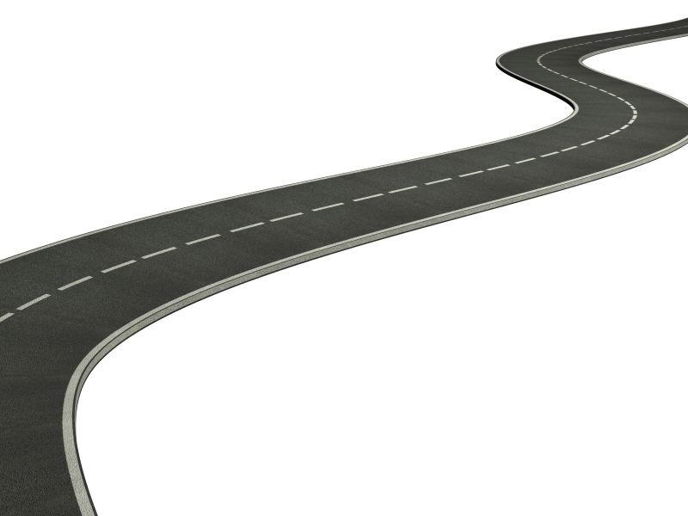
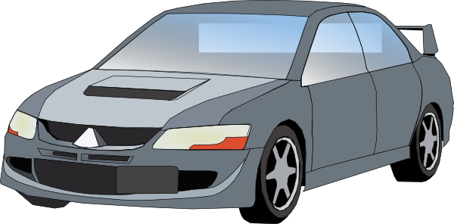
Information Transfer in ITSs
1
2
In-vehicle systems
Vehicle-to-vehicle systems
Vehicle-to-infrastructure systems
3

Slide 9
ITS Applications
Automated Traffic Management Systems (ATMSs): manage the flow of road traffic using a variety of technologies.
e-tolls: electronic toll booths deduct toll payments without stopping
Electronic Road Pricing (ERP): requires drivers to pay different tolls at different times
Traveler Information Systems: provide online, real-time information on road conditions
Route guidance system: helps a driver navigate the best routes to a given location

Slide 10
Vehicle Technology
Smart cars
Connected cars
Driverless cars

Slide 11
Vehicle Rentals & Taxis
IT Applications
Reservation Systems
Vehicle Inventory Control
Car and bicycle sharing systems
Ride-sharing systems

Slide 12
Rail Transport
IT Applications
Web-based computer reservation systems
GDS connectivity
Smartphone apps
Smart cards
Electronic ticketing systems
Departure control systems
Inter-modal booking systems

Slide 13
Water Transport
IT Applications
Computerized reservation systems
Cruise booking systems (e.g. CruiseMatch)
Electronic ticketing systems
Guest technologies (smart cards, on board navigation, mobile apps, entertainment, tablets)
Global Navigation Systems and Maritime Distress and Safety Systems
Point of sale systems
Inventory control systems

Slide 14
Integrated Public Transport Systems
IT Applications
Intermodal systems
Smart cards and contactless ticketing using RFID or NFC (e.g. London’s Oyster Card)

Slide 15
Discussion Questions
Which of the transport developments discussed in this chapter are most important for tourists (as opposed to residents)? Why?
Explain what is meant by collaborative mobility. Describe different modalities for this type of transport. Are there any disadvantages that would prevent you from using this type of transport as a tourist? What are its benefits?
Research the various national rail networks other than those in Europe. What type of IT applications are they using? How easy is it for passengers to make cross-border reservations in that part of the world.
Spend some time researching driverless cars more. What do you see as the real advantages? How relevant are these advantages to tourists? Are there some types of tourists for which they would not be relevant?

Slide 16
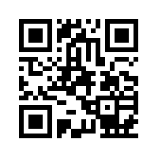
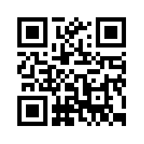
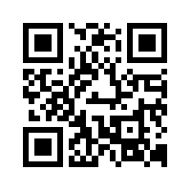
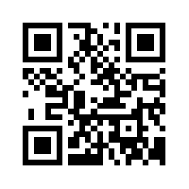
Useful Websites
 | Intelligent Transportation Society of America www.itsa.org |  | Intelligent Transport Systems Australia www.its-australia.com.au
 | CruiseMatch www.cruisematch.com |  | Intelligent Transportation Systems Society www.sites.ieee.org/itss
 | US Dept of Transportation ITS Joint Program www.its.dot.gov |  | Waymo waymo.com
 | ERTICO www.ertico.com

Slide 17
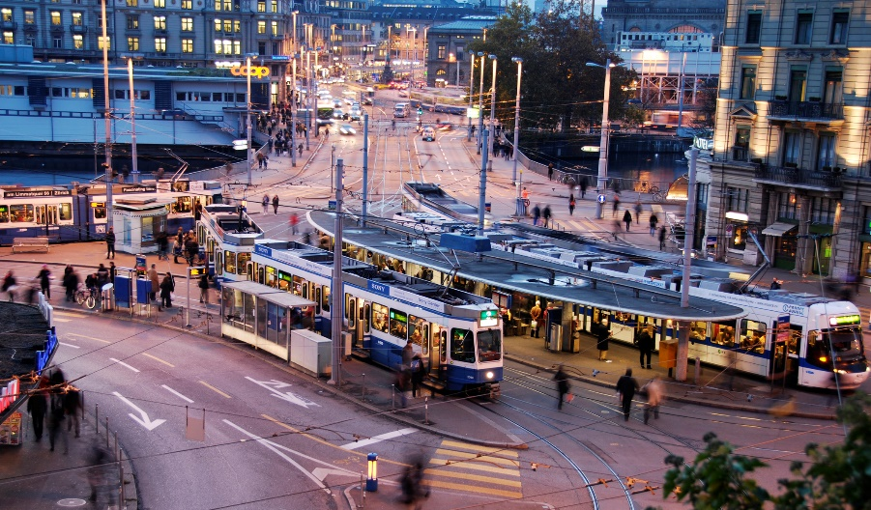
Case Study: Zurich’s Transport System
Intelligent Transport System
Consolidated ticketing for 313 trams, 80 trolleybuses and 261 urban buses
50% trips by scheduled public transport;12% by bicycle or walking
ITS Applications
Operations Management including incident management
Traffic signal priority for public transport and pedestrians
Real-time passenger information pre-trip, at stations and in vehicles
Automated vehicle location
Electronic fare collection (smart cards)
Automated passenger counting
Timetabling
Vehicle and driver scheduling

