Slide 2
Chapter 7
Aviation and Information Technology

Slide 3
Chapter 7 Learning Objectives
After studying this chapter you should be able to:
Analyze the impact of IT on airlines and air travelers;
Explain how airline reservation systems work and how they connect with other information systems;
Understand how information systems support management decision making in airlines;
Examine how information technologies are used by airports to streamline the passenger experience; and
Evaluate the present and future information technology applications in airport operations.

Slide 4
Key Concepts
Airline reservation system (ARS)
Baggage handling system (BHS)
Customer relationship system (CRS)
Fare Quote System
Flight Information Display Systems (FIDS)
New Distribution Capability (NDC)
Passenger name record (PNR)
Passenger Service System (PSS)
Revenue management system (RMS)
Safety Management System (SMS)

Slide 5
Types of Airlines
National flag carriers
Commercial airlines
Low Cost Carriers (LCCs)
Charter airlines
Types of Airlines

Slide 6
FIGURE 7.1 Key IT systems used by airlines
AIRLINE RESERVATION SYSTEM
DECISION SUPPORT SYSTEMS
DEPARTURE SYSTEMS
Schedules & Availability
Fleet Management
Departure Control System
Fare Quotes & Rules
Schedule Optimization
Gate Control
Passenger Information
Revenue Management
Flight Dispatch
Ticketing
Flight Operations Systems
MARKETING & CRM SYSTEMS
TRAVEL INTERMEDIARIES
GLOBAL DISTRIBUTION SYSTEM
Direct Bookings
Traditional Agents & OTAs
Availability: Schedules
Loyalty Programs
Travel Management Companies
Pricing: Fare Quotes & Rules
Customer Service
Tour Operators & Wholesalers
Distribution: Booking & Ticketing
TRAVELLERS
IN FLIGHT TECHNOLOGIES
Business & Leisure
Entertainment
Groups
Communications
Frequent Flyers
Crew Support Systems

Slide 7
Airline Reservation Systems
Key Components:
Flight schedules and availability: availability display
Fare quotes and rules: fare quote system, fare rules, cabin classes, booking codes, fare basis code
Passenger information: passenger name record, record locator, special service requests
Electronic ticketing: e-ticket, boarding pass

Slide 8
Fleet Management Systems
Fleet Acquisition
Fleet Assignment
Fleet Maintenance

Slide 9
Flight Scheduling Systems
Scheduling systems must be able to handle:
Strategic Goals
Route Network
Passenger Demand
Aircraft Type
Human Resources
Environmental & Safety Regulations
Airport Restrictions
Contingency Planning

Slide 10
Revenue Management Systems (RMS) Capabilities
Historical data
Forecasting
Modeling
Decision support

Slide 11
Departure Control Systems (DCS) Capabilities
Check in
Boarding passes
Seat Allocation
Checked Baggage
Load Control
Passenger Identification
Denied Boarding
No shows and Standby Passengers
Interline Connections
Interoperability

Slide 12
In-flight Technologies
Passengers
In flight entertainment (IFE) system
Geographic information system (GIS)
Communication systems
Crew
Tablets
Navigation, communication and flight logs
Point-of-sale devices

Slide 13
FIGURE 7.2 Stages of the Passenger Journey
ORIGIN AIRPORT
TRANSIT
DESTINATION
Pre- arrival
Check in
Security
Pre-boarding
Boarding
Stopover
Arrival

Slide 14
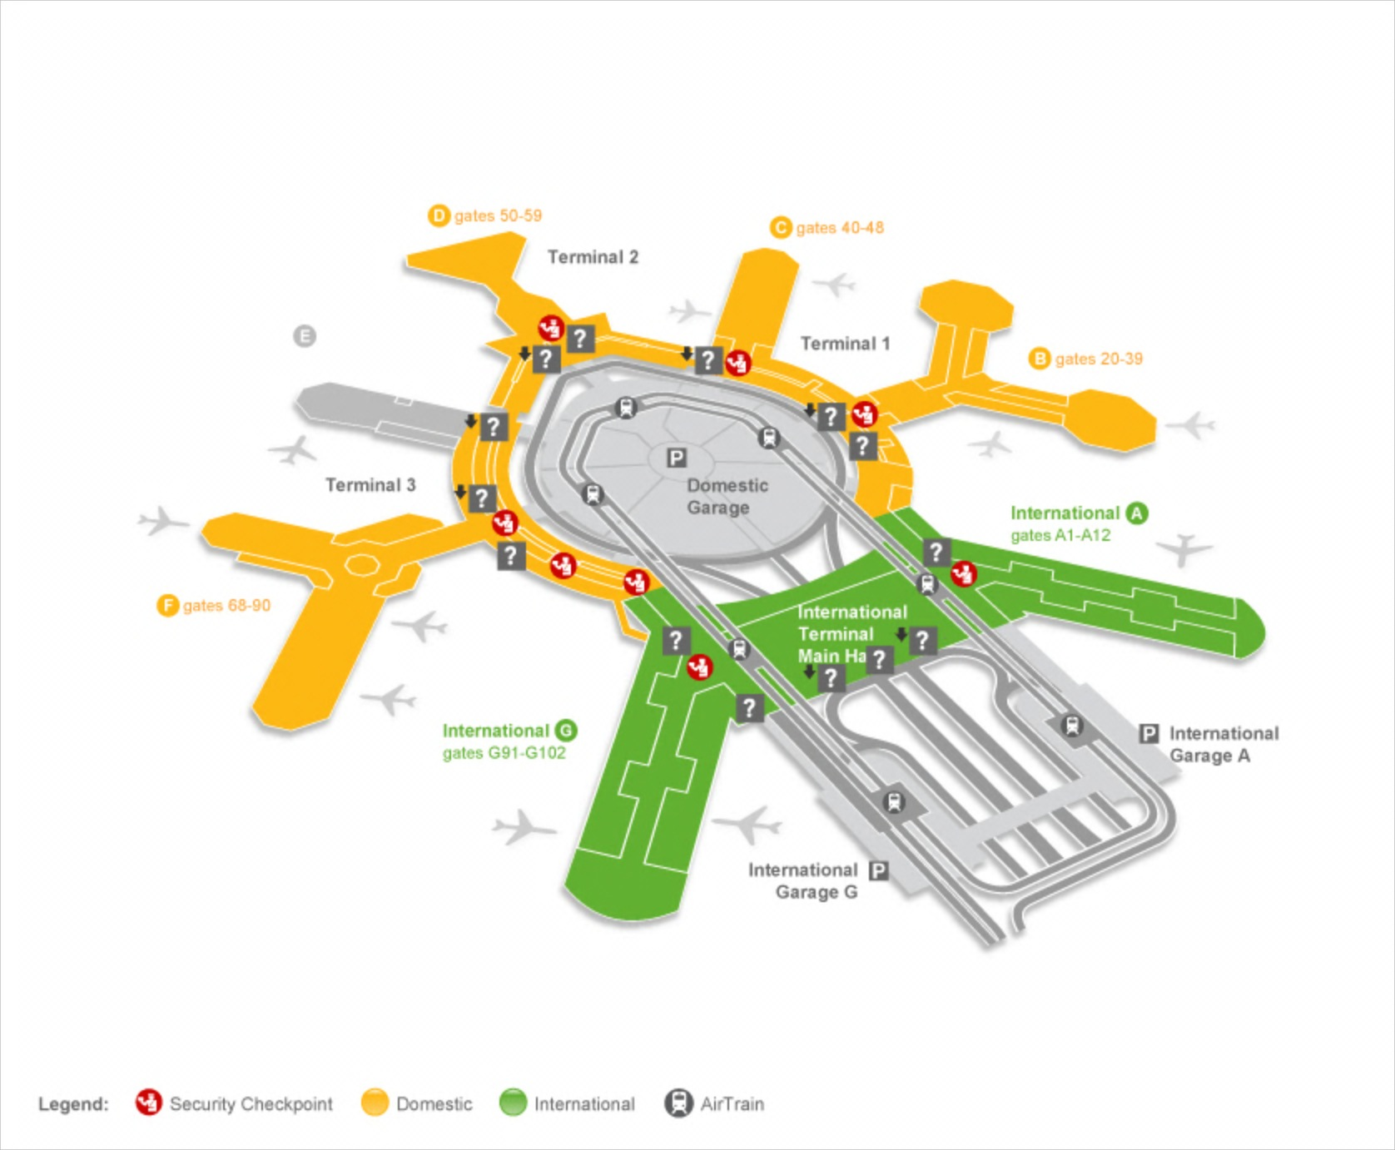
Automated parking entry
Automatic check in upon entry to terminal
Parking availability
Directions to terminal
Notification & offer to book later flight if late
FIGURE 7.3 Example of geofencing around an airport

Slide 15
Check in Options
Online check-in
Self-service kiosks
Auto check in using geofencing and smartphones
Check in counters

Slide 16
Key Steps in Security Scanning
Confirming traveler identity
X-ray baggage screening
Body screening

Slide 17
Pre-boarding technologies
Passengers
Flight information display systems (FIDS)
WiFi hotspots
Recharge stations
Mobile apps (e.g. airport navigation, GateGuru)
Airports
Business intelligence tools (passenger volumes, queues, dwell times)
Point-of-sale (POS) systems
Alerts and notifications

Slide 18
Arrival
Immigration databases (e.g. ‘No Fly List’)
e-passports
Scanners and cameras
Passenger Identification: biometrics systems and future systems that will analyze walking gait, body language, heart rhythms or DNA profiles to identify passengers

Slide 19
Baggage and Cargo Handling
Baggage handling systems (BHSs)
Bag tags with optical bar codes
Conveyer belts and robotic systems for sorting
Baggage tracking systems (e.g. Bagtrac)
Lost baggage systems (e.g. World Tracer)
Self-service bag drops
RFID bag tags and chips in luggage

Slide 20
Safety and Security Systems
Communications Systems
Navigation Systems
Surveillance Systems
Flight and Weather Information Systems

Slide 21
Environmental Management Systems (EMS)
Technology Applications
Environmental Monitoring
Energy Use
Noise Reduction
Carbon Emission Reduction
Water Quality

Slide 22
Discussion Questions
How will advances in smartphones and apps impact the marketing, distribution and delivery of aviation products?
Throughout this chapter we have identified a number of applications allowing airlines and airports to track passengers by using signalling technologies such as NFC, RFID and BLE embedded in baggage tags and smartphones. What are the pros and cons of these applications? What privacy or ethical issues might arise? How can airlines and airports overcome these issues?
Visit the FFP website for an airline you know. Look for information about redeeming and earning FF points (miles). List all the ways in which members can earn and redeem points. How does the technology on the website support the FFP? What improvements would you like to see?

Slide 23
Discussion Questions
By 2035 the global airline fleet is expected to be twice as large as in 2018 and by 2030 passenger numbers are expected to be double. How can information technology help airlines and airports cope with the challenges of this expected growth?
Visit the website for Changi Airport in Singapore and browse through the pages about terminal facilities and services. Note down examples requiring use of information technology. What IT inspired airport services do you expect to see in ten years?
How might airports and airlines use new technologies such as augmented reality, predictive analytics and the Internet of Things to streamline and improve the passenger experience?

Slide 24
Useful Websites
 | SITA www.sita.aero |  | Amadeus IT Solutions www.amadeus.com/airlineit
 | Boeing www.boeing.com |  | Changi Airport www.changiairport.com
 | GateGuru www.gateguru.com |  | Future Travel Experience www.futuretravelexperience.com
 | SkyTrax www.airlinequality.com

Slide 25
Case Study SITA
Société Internationale de Télécommunications Aéronautiques
Formed in 1949 by a consortium of European & British airlines
Developed world’s first business packet switching network
Employs 4,700+ staff in over 200 countries
Key solutions include:
Sector | Solutions
Communications & Infrastructure | Voice, data, messaging, mobility and desktop applications to support aircraft operations, air-ground communications, air traffic control and flight operations
Airports | Passenger processing, baggage management and operations management
Airlines | Passenger management, reservations, e-commerce solutions, fare and ancillary services
Government | Border management, biometrics, risk assessment and identity verification

