Slide 2
Chapter 6
Mobilities and Information Technology

Slide 3
Chapter 6 Learning Objectives
After studying this chapter you should be able to:
Apply the mobilities paradigm to the understanding of mobile technologies and travel;
Explain the key elements of mobile devices using the mobile technologies ecosystem;
Know what a context-aware tourism system is and how it can facilitate the tourist experience;
Explain how the various mobile functions described in this chapter can be used to enhance travel experiences; and
Appreciate some of the opportunities and challenges in implementing mobile technologies.

Slide 4
Key Concepts
Mobilities paradigm - convergence, digital elasticity, fluidity, ubiquity, hybridization, saturation creativity
Sensing and signaling technologies
Bluetooth low energy (BLE)
Near Field Communication (NFC)
Radio-frequency identification (RFID)
Gamification
Location-based services (LBS)
Ubiquitous and wearable technologies
TILES model

Slide 5
Mobilities Concepts
The mobilities paradigm explores the movement of people, ideas and things, as well as the broader social implications of those movements (Sheller, 2011)
Mobile technologies enable the fluidity and liquidity of experiences by softening the links between activities, space and time (Green, 2002; Uriely, 2005)
Technology creates occasional, imagined and virtual co-presence where travelers enjoy an experience not just for themselves but also for others (Urry, 2002)
Digital elasticity describes how travelers remain electronically linked with everyday life as they explore other places (Pearce, 2011)
The technologies of mobility are characterized by convergence, saturation, hybridization and ubiquity (Pellegrino, 2009)
Mobile technologies also empower travelers to create new engaging, interactive experiences (Richards & Wilson, 2006)

Slide 6
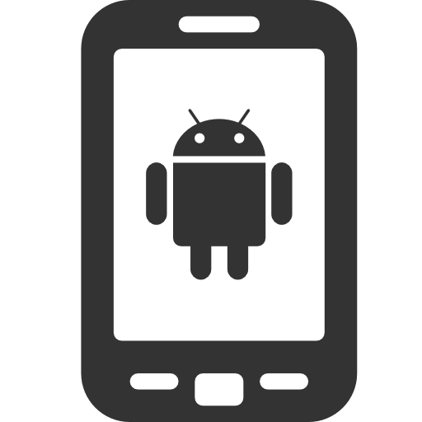
FIGURE 6.1 Mobile Technologies Ecosystem
Content Providers
Companions Friends
QR
NFC
OS
BLE
Mobile Devices
Context
WiFi
Signals
Sensors
Apps
Network Providers
Traveler
GPS

Slide 7
Mobile Devices
Smartphones & Tablets
GPS Devices
Digital Cameras
Wearable Devices
Portable Computers

Slide 8
Mobile Signals & Sensors
Signaling Technologies
Sensing Technologies
Touchscreens
RFID
NFC
BLE
WiFi
LiFi
Cellular Network
GPS
Gyroscopes
Digital cameras
Ambient light sensors
Temperature & humidity
Microphones
Magnetometers
Accelerometers
Pressure sensors

Slide 9
CABI TOURISM TEXTS
Chip/Transmitter
NFC < 7in
BLE < 30ft
WiFi ~65ft
Cellular Network 1-5mi
GPS Global
FIGURE 6.2 Typical range of various mobile signaling technologies

Slide 10
Functions of Mobile Technologies in Travel
Informing
Contextualizing
Personalizing
Socializing
Managing
Translating
Purchasing
Entertaining
Gamifying
Reflecting

Slide 11
Informing…
Type | Description
Functional | Tourists need information to learn, add value to the trip, improve efficiency and reduce uncertainty.
Innovation | Tourists need information to inspire novel, spontaneous and creative experiences.
Hedonic | Tourists need information to be excited, enjoy the destination and experience the local culture and life.
Aesthetic | Tourists need information to imagine destinations and form expectations.
Social | Tourists need information to give advice to others, share their experience and be valuable for their friends.
(Adapted from Wang et al., 2012)

Slide 12
Informing …
Augmented Reality (AR) as an information channel:
Enhances the surroundings of the user with virtual information that is rendered so that it appears to coexist with the real world
Apps overlay a mobile device’s real world camera view with virtual information
Travel applications
Marketing
Visitor information
Translation
Interpretation
Gamification

Slide 13
High
Video podcast
Video sharing
Location-based service
Video telephony
3D Games
Augmented Reality
Virtual Worlds
Fidelity
Multimedia Message Service (MMS)
Podcast
Mobile Website
Photo sharing
Virtual tour
2D Games
Short Message Service (SMS)
Voicemail
Status updates
Push notifications
Translation tools
Voice telephony
Instant messaging
Low
Interactivity
Low
Medium
High
FIGURE 6.3 Typology of mobile-mediated virtual experiences
(Adapted from Hyun et al., 2009)

Slide 14
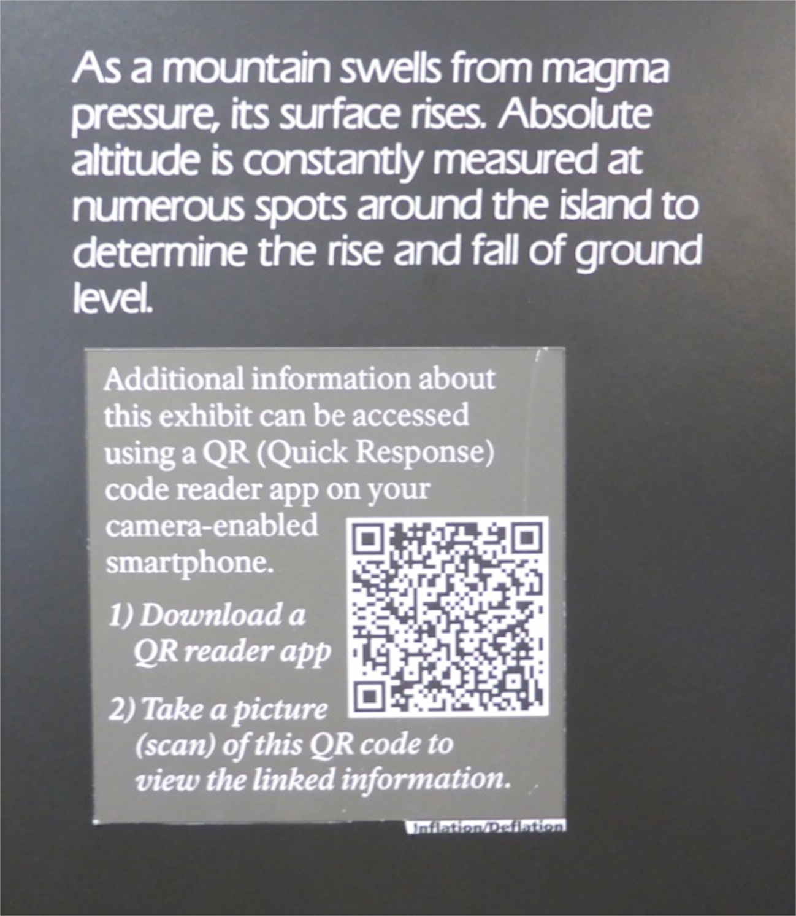
FIGURE 6.4 Example of a QR Code used for Interpretation

Slide 15
TILES Model of Contextual Data
T | Temporal | Content contextualized according to time (e.g. current time and day of the year, current events, seasons, itinerary)
I | Identity | Content contextualized based on the user’s identity (e.g. interests, demographics, motives, food and activity preferences, activities already completed, language, budget, trip characteristics).
L | Location | Content contextualized based on the user’s movement and location (e.g. current location, nearby attractions, travelling speed and direction, mode of transport).
E | Environment | Content contextualized according to the user’s environment (e.g. weather, traffic conditions, congestion and availability, waiting times).
S | Social | Content contextualized according to the user’s social setting (travel companions, group interests, nearby friends and family, recommendations, social media activity).
Source: Tan, et al. (2009)

Slide 16
Personalizing Experiences
Individuals provide organizations with personal information in exchange for better services or benefits
Contextual data can be combined with personal information and used to provide personal recommendations and customize content delivery
Sources of personal information:
details stored on the mobile device (e.g. personal records, apps, photos, email and calendar)
information from social media profiles
usage data such as search histories and device habits
Privacy issues – use permission based marketing

Slide 17
Mobile Social Media Applications
 | Location Sensitive | Location Agnostic
Instantaneous | Space-timers Exchange of messages with relevance to one location at one specific point in time (e.g. Facebook Places, Foursquare) | Quick-timers Transfer of traditional social media to mobile devices to increase immediacy (e.g. Tweets, Facebook status updates)
Time Delay | Space-locators Exchange of messages with relevance to one location, which are tagged to a certain place and read later by others (e.g. Urbanspoon, TripAdvisor) | Slow-timers Transfer of traditional social media to mobile devices (e.g. YouTube, Wikipedia).
Adapted from Kaplan (2012)

Slide 18
“Four I’s” of Mobile Social Media
Integrate | activities into your users' life to avoid being a nuisance
Individualize | activities to take account of user preferences & interests
Involve | the user through engaging conversations
Initiate | the creation of user-generated content
Source: Tan, et al. (2009)

Slide 19
Visitor Management
Gretzel et al. 2015
Smart Destinations: Integration of real-time, real-world data and use of complex analytics, modelling, optimization and visualization to manage visitors
Visitor tracking: catchments, routes, dwell times, activity patterns
Social media activity: feedback, sharing content, sentiment
Management interventions:
special offers
notifications about wait times
travel times
weather, safety and security alerts

Slide 20
Gamification
The use of game design elements in non-game contexts to improve user experience and user engagement
Travel applications
Earning badges (e.g. TripAdvisor)
Challenges and quests (e.g. geocaching, collecting clues, competitions)
Augmented reality games (e.g. Ingress, Pokemon Go, Wizards Unite)
Could be used instead of a tour or to disperse visitors across a destination

Slide 21
Challenges
Connectivity
Cross-platform compatibility
Analytic systems lack sophistication
Product complexity
Legal, security and privacy issues
Maintenance and replacement of hardware
Visitor awareness and behaviour

Slide 22
Discussion Questions
In the introduction we suggest that mobile technologies enable the fluidity and liquidity of experiences. Read some of the mobilities literature dealing with technology and write a paragraph to explain what this statement means.
In the past a holiday meant being away from home, both physiologically and psychologically. But it seems that mobile devices are making it more difficult to separate our everyday lives from our travel experiences. Do you think this is a problem? What does this suggest about future travel experiences?
In previous chapters we have discussed how the Internet has eroded the influence of traditional travel intermediaries. Arguably mobile devices go further by automating many of the functions performed by travel intermediaries by providing a management tool for the entire travel experience. Do you think that mobile devices will mean the end of traditional intermediaries?

Slide 23
Discussion Questions
We have identified that mobile devices can use a range of contextual data to customize and personalize travel experiences. But frameworks like the TILES model require access to a lot of data, some of which may raise privacy concerns. How might app designers overcome these challenges?
Many younger generations have grown up in a culture where games and rewards incentivize performance. How do you feel about the idea of gamification in travel? Would you participate in a virtual ‘Amazing Race’ powered by your mobile phone if you could earn virtual or real prizes? Select a city you are familiar with and design a mobile app based on the concept of gamifying the travel experience.
This book was published in 2019. What advances have taken place in mobile technologies since this time? How can these technologies be used by travel organizations and destinations? What opportunities are created by advances in wearable and ubiquitous technologies?

Slide 24
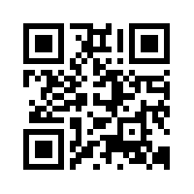
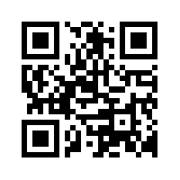
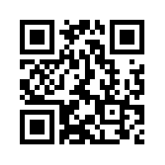
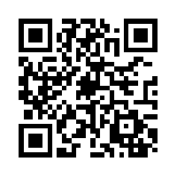
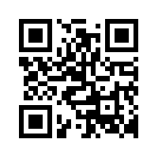
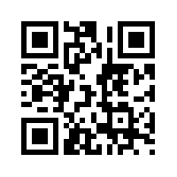
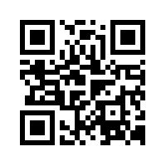
Useful Websites
 | Geocaching www.geocaching.com |  | NXP Semiconductors www.nxp.com
 | EpicMix www.epicmix.com |  | 6th Sense Transport www.sixthsensetransport.com
 | GPS.gov www.gps.gov |  | Ingress www.ingress.com
 | Bluetooth www.bluetooth.com

Slide 25
Case Study Tourism Tracer
Smartphone app used to record accurate, real-time data of visitors’ travel patterns in a destination
Pop-up surveys used to capture the personal insights of participants
Data and insights are accessed online using the Tourism Tracer Dashboard
These insights have a number of applications for destinations:
identifying infrastructure gaps
evaluating the success of marketing campaigns
understanding the visitor flows and dispersal of different market segments
identifying emerging market trends
informing strategies designed to increase length of stay and visitor spend
improving the visitor experience by allowing the provision of more timely and relevant tourist information

