Slide 2
Chapter 5
Social Media and Tourism

Slide 3
Chapter 5 Learning Objectives
After studying this chapter you should be able to:
Understand the types and functions of social media;
Explain why electronic word of mouth is important to travel organizations;
Analyze the advantages and disadvantages of different social media platforms;
Discuss how different social media platforms can be used to engage with travelers; and
Adopt a strategic approach to using social media for a range of applications in travel organizations.

Slide 4
Key Concepts
User Generated Content (UGC)
Web 2.0
Electronic Word of Mouth (eWOM)
Social Network Sites (SNSs)
Blogs, wikis and product review sites
Forums and discussion boards
Media sharing
Crowdsourcing

Slide 5
High
Blogs
Social
Networking
Virtual Social
Worlds
SELF PRESENTATION/DISCLOSURE
Collaborative
Platforms
Content
Sharing
Virtual Gaming
Worlds
Low
SOCIAL PRESENCE/MEDIA RICHNESS
Low
Medium
High
FIGURE 5.1 Classification of Social Media
Adapted from: Kaplan & Haenlein, 2010

Slide 6
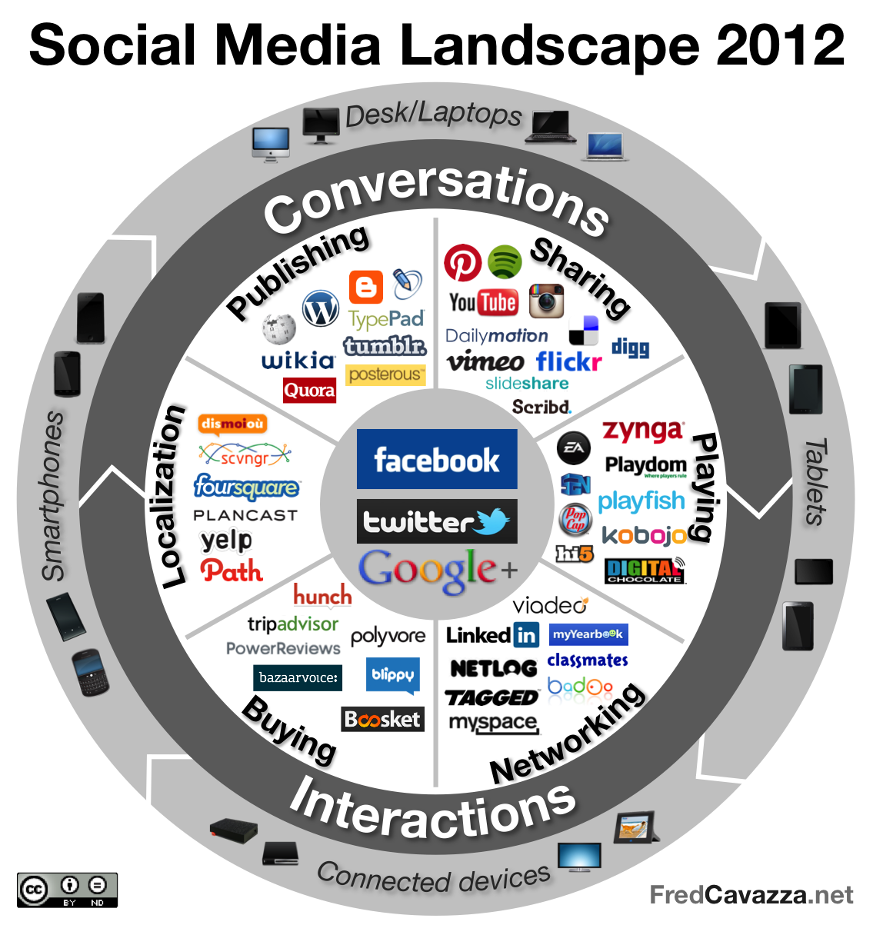
FIGURE 5.2 The Social Media Landscape
Source: Cavazza, 2012

Slide 7
Western and Chinese Social Media Platforms
Platform | Western Examples | Chinese Examples
Blogs | Blogger, Wordpress | Blogbus
Microblogs | Twitter | Sina Weibo, Tencent Weibo
Wikis | Wikipedia | Baidu Baike
Social Networks | Facebook | Qzone, Renren, Pengyou
Video Sharing | Youtube | Youku, Tudou
Location-based | Foursquare | Jiepang
Review Sites | TripAdvisor | DaoDao
Messaging | Facebook Messenger, WhatsApp | WeChat

Slide 8
PRESENCE
The extent to which users know if others are available
SHARING
The extent to which users exchange, distribute & receive content
RELATIONSHIPS
The extent to which users relate to each other
IDENTITY
The extent to which users reveal themselves
CONVERSATIONS
The extent to which users communicate with each other
REPUTATION
The extent to which users know the social standing of others & content
GROUPS
The extent to which users are ordered or form communities
FIGURE 5.3 The seven functional blocks of social media
Adapted from: Kietzmann et al., 2011

Slide 9
Characteristics of eWOM
Scale
Relationships
Anonymity
Durability
Variety

Slide 10
Blogs & Wikis
Virtual Social Worlds
Media Sharing
Social Networks
Websites & Review Sites
One-to-one | One-to-many | Many-to-many
COMMUNICATION SCOPE
Chatrooms & Forums
Instant Messaging
Email
Asynchronous
Synchronous
LEVEL OF INTERACTIVITY
FIGURE 5.4 Typology of various eWOM channels
(Source: Litvin et al., 2008)

Slide 11
SENDER
Motives
Appearance
Credibility
Expertise
MESSAGE
Relevance
Accuracy
Timeliness
Completeness
RECEIVER
Characteristics
Experience
Cognition
Response
RELATIONSHIP
Tie Strength
Homophily
Trust
FIGURE 5.5 Communication Factors Influencing eWOM

Slide 12
Social Media Platforms in Tourism
Social network sites
Wikis, blogs and product review sites
Forums
Media sharing
Crowdsourcing
Virtual worlds
Travel Podcasts

Slide 13
Social Network Sites
Social Network Sites (SNSs) are defined as “web-based services that allow individuals to:
construct a public or semi-public profile within a bounded system,
articulate a list of other users with whom they share a connection, and
view and traverse their connections and those made by others within the system (boyd and Ellison, 2007)
Types of SNSs
Universal
Professional
Regional
Niche

Slide 14
Wikis, Blogs and Product Review Sites
Definitions
Wiki: is a real time editable website that helps users create content through cooperative development and ownership (Bean & Hott, 2005)
Blog: a personal website or web page which allows an individual to present content and opinions
Product Review Site: a website devoted to providing subjective consumer feedback on products and services

Slide 15
Types of Blogs
Traditional blogs
Microblogs
Multi-author blogs
Video blogs
Curated blogs

Slide 16
Other Social Media Platforms
Forums: a website where members can post comments and respond to posts from others
Media Sharing: platforms that allow users to to share, rate and leave comments about visual content
Crowdsourcing: using the Internet to “find people to perform tasks that computers are generally lousy at” (Howe, 2006, p. 5)
Virtual Worlds: three-dimensional, computer-based simulated environments through which users can interact using avatars

Slide 17
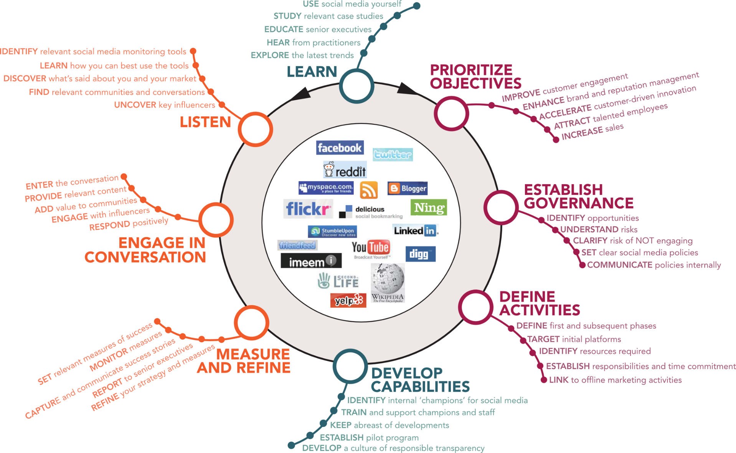
FIGURE 5.5 Communication Factors Influencing eWOM
Source: Advanced Human Technologies, 2013

Slide 18
Strategic use of different media
Strategy | Objective | Media | Metrics
Exposure | Generate awareness | Traditional media, blogs, microblogs, media sharing | Number of visits, views, followers
Engagement | Connect with travelers | Social network sites, microblogs, forums | Repeat visitors, re-tweets, shares, comments, replies
Influence | Change attitudes | Social network sites, blogs, media sharing, reviews | Click through rates, message recall, sentiment, ratings
Acquisition | Facilitate bookings | Website, booking engine | Conversion rates, sales, visitor numbers, length of stay, expenditure

Slide 19
Strategic Applications of Social Media
Marketing & Sales
Customer Service
Market Intelligence
Reputation Management
Recruitment and Partnerships

Slide 20
Discussion Questions
What features of social media make them different to other media? Provide some examples to illustrate your answer.
China has a number of parallel social media platforms that serve the same purpose as mainstream social media in the Western world. What are the implications of this? If you were working for a destination keen to attract the Chinese market, how could you harness the potential of these sites?
Brainstorm as many examples of social media as you can and write these down in a list. Use Cavazza’s (2012) Social Media Landscape model to categorize each of the examples you have listed. Which of these platforms do you use the most? Why?
Use the honeycomb model to map out the key strengths of SNSs, blogs, wikis, product review sites and media sharing sites you are familiar with.

Slide 21
Discussion Questions
Form a group with 4-5 other students and create a list of different ways in which you have used electronic World-of-Mouth (eWOM) to find out about places and destinations. Compare your group’s answers with the rest of your class. What are the advantages and disadvantages of the eWOM information sources you have identified for (a) travelers and (b) travel organizations?
Visit TripAdvisor and search for five star hotels in London, UK that would be suitable for a business trip. Read some of the reviews for these hotels and summarize the most common positive and negative themes. Do you think any of the reviews are fake? Take a look at some of the images that accompany the reviews. Observe whether management has responded to some of these reviews. If you were the GM of a hotel, how would you respond to some of the negative themes you have identified? What strategies would you use to deal with fake reviews? How would you encourage positive reviews?
What is your opinion about the role of virtual worlds in travel? Do you think they offer a supplement or substitute for real travel experiences? How can travel companies use a virtual presence to enhance their reputation?

Slide 22
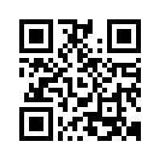
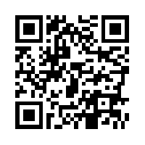
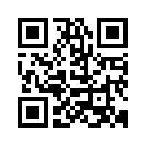
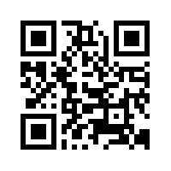
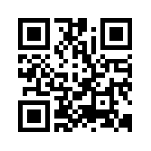
Useful Websites
 | TripAdvisor www.tripavisor.com |  | LonelyPlanet’s Thorn Tree www.lonelyplanet.com/thorntree
 | TravelBlog www.travelblog.org |  | SecondLife www.secondlife.com
 | WikiTravel.com www.wikitravel.org

Slide 23
Case Study Wechat (Weixin)
Developed by Tencent
Over 1 billion active users
App for everything:
Messaging (text, voice, broadcast, video conferencing)
Content sharing
Gaming
Location sharing
Social feed (‘Moments’)
Payment system (WeChat Pay)
Business applications
Marketing and communications
E-commerce (bookings, payment, confirmation)
Gamification

