Slide 2
Chapter 4
The Internet and the Tourist

Slide 3
Chapter 4 Learning Objectives
After studying this chapter you should be able to:
Understand the historical evolution and key terms related to the Internet;
Explain how the Internet can be used by travelers and travel organizations and categorize different types of travel sites found on the Internet;
Explain the online information search process and analyze the factors that influence search rankings and online search behavior; and
Apply an understanding of communications, marketing and user experience design to the development of successful tourism websites.

Slide 4
Key Concepts
Internet Service Provider (ISP)
Servers and firewalls
Intranet, extranet, Internet
World Wide Web (WWW)
Web 2.0
Domains, protocols, languages, formats
eCommerce
Search Engine Reply Page (SERP)
Search Engine Optimization (SEO) and Metatags
Intelligent Agents and Recommender Systems

Slide 5
Evolution of the Internet
Six Degrees (SNS), Google Search
Ethernet
WWW
YouTube
ARPANet
SITA
First Domain Name
Web Crawlers
Baidu
WeChat
Oculus Rift
LinkedIn
Weibo
1969
1980
1990
2000
2010
Email
Internet
First ISP
Mosaic
Browser
Paypal
Twitter
Pinterest
Airbnb
Google Glass
Hotmail,
Broadband
Facebook,
Skype

Slide 6
FIGURE 4.1 Percentages of Internet Users in the World
Source: International Telecommunication Union (2018)

Slide 7
EXTRANET
Public
Suppliers
Partners
VPN/
Firewall
Remote Users (VPN Client)
VPN/
Firewall
INTERNET
INTRANET
Databases
Server
Printer | Fax
Scanner
Wireless Devices
Workstations
FIGURE 4.2 Internet, intranet and extranet configuration

Slide 8
WWW Standards
Domains
Uniform Resource Locator (URL)
Top-level domains (e.g. .com, .gov)
Country domains (e.g. .uk, .cn)
Protocols
a set of rules governing the format of data sent over the Internet or other network
Programming Languages
e.g. HTML, XML, Java, etc.

Slide 9
Top Level Domain Names
Domain | Description
.edu | Educational institutions
.com | Commercial institutions
.org | Organizations
.net | Networked organizations
.gov | Governmental Organizations
.mil | Military organizations
.travel | Travel organizations
.au | Country domains, in this case Australia

Slide 10
Protocols
Protocol | Description
TCP/IP | Transmission Control Protocol/Internet Protocol
SMTP | Simple Mail Transfer Protocol
FTP | File Transfer Protocol
HTTP | Hypertext Transfer Protocol
HTTPS | Hypertext Transfer Protocol Secure

Slide 11
Common Languages and Formats
Format | Description
HTML | Hypertext markup language
XML | Extensible Markup Language
SMIL | Synchronized Multimedia Integration Language
Java | Environment for running online applications
MP3 | Music and audio format
Flash | Interactive media format developed by Adobe

Slide 12
Functionality of Travel Websites
Global information dissemination
Integration
Mass Customization
Interactive communication
Transactional support
Disintermediation

Slide 13
Types of E-Commerce in Tourism
Term | Description | Example
B2C | Business to consumer | A traveler purchases a flight on Lufthansa’s website
B2B | Business to business | A tour operator purchases a block of rooms from a hotel using the Internet
C2B | Consumer to business | A tourist offers their services as an attorney to a hotel where they are staying
C2C | Consumer to consumer | A tourist sells souvenirs to another tourist on eBay
G2C | Government to consumer | A tourist applies for a passport online
G2B | Government to business | A museum applies for a building permit to a government agency online
G2G | Government to government | Two governments negotiate a bilateral air service agreement using the Internet

Slide 14
A Typology of Travel Websites
Category | Examples
Travel Intermediaries | expedia.com, kayak.com
Travel Suppliers | ihg.com, singaporeair.com
Social Media | tripadvisor.com, travelpod.com, wikitravel.org
Online Travel Portals | virtualtourist.com
Online Travel Guides | lonelyplanet.com, frommers.com
Trip Planning | desti.com, mygola.com
Destinations | australia.com, tourism.australia.com, visit-queensland.com, visitbrisbane.com.au
Government | tourism.gov.in, smartraveller.gov.au, usa.embassy.gov.au
Education | tim.hawaii.edu
Non-government organizations (NGOs) | unwto.org, tourismconcern.org.uk, ecotourism.org

Slide 15
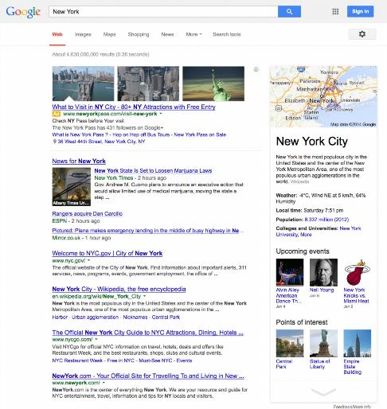
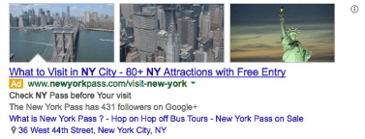
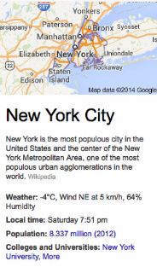
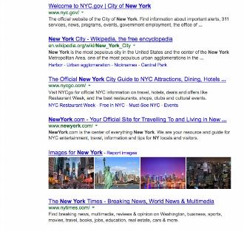
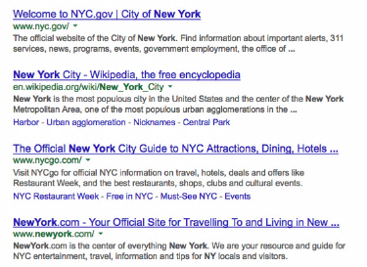
PAID LISTING
KNOWLEDGE GRAPH
ORGANIC LISTING
FIGURE 4.3 Google SERP for ‘New York’

Slide 16
Determinants of SERP Rankings
Whether or not the keywords are in the URL of that page
The frequency and size of the keywords on a webpage
The keywords in the link anchor text (those pieces of text which contain a link)
Alternative text for images
Metatags, keywords in titles and descriptions embedded on a webpage

Slide 17
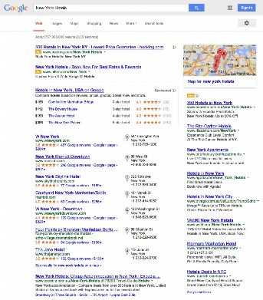
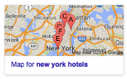
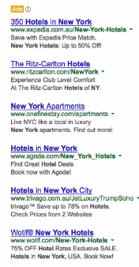
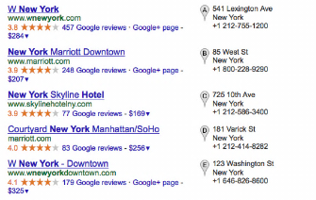
PAID LISTINGS
GOOGLE MAPS
HOTELFINDER
GOOGLE MAPS
PAID LISTINGS
ORGANIC LISTINGS
FIGURE 4.4 Google SERP for ‘New York Hotels’

Slide 18
Pre-search Conditions
Search Process
Overall Evaluation
Information search activities
Usefulness of Internet tools
Use of search engine for travel planning
First planning task
Task specificity
Search queries
SERPs evaluation
Overall satisfaction
Ease of use
Plan quality
Trust
FIGURE 4.5 General Framework of Search Engine Use for Travel Planning
Source: Fesenmaier, Xiang, Pan, and Law (2011).

Slide 19
Elements of Successful Tourism Websites
Planning
Evaluation
Design
Delivery
Management
Usability
Utility
Maintenance
Resourcing
Generate Traffic & Repeat Visitors
Strategies and Goals
Integrated Marketing Communications
Navigation & Interaction
Aesthetics & Functionality
Cross-platform compatibility
Readability, credibility, accuracy
Personalization
Marketing Mix

Slide 20
Marketing Mix and Travel Websites
Product
Price
Promotion
Point-of-sale
People
Programming
Packaging
Partnerships
Website Elements

Slide 21
Discussion Questions
Identify a travel enterprise that uses an Intranet. What features does it provide? Can you suggest other ways that the enterprise could use the Intranet?
Find one specific example each of a G2G, G2B and G2C networks in the tourism industry. Explain in detail.
In this chapter we present a typology of travel websites. Conduct a search to find your own examples of sites for each category. Were there any sites that do not fit into this typology?
Identify two search engines (e.g. Bing and Google) and compare and contrast how they deal with travel requests. Do this by choosing a specific trip you would like to go on.
We have presented a number of elements that make tourism websites successful. Visit the travel website for your local region and conduct your own assessment of the quality of this website based on the elements we have presented. Prepare a set of recommendations to improve this website.

Slide 22
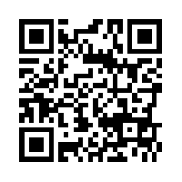
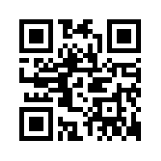
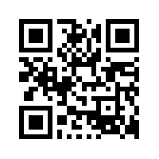
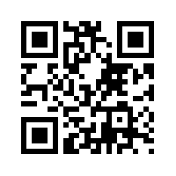
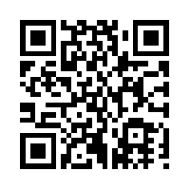
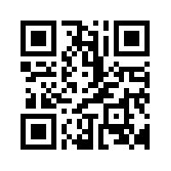
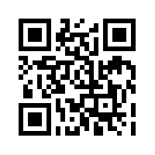
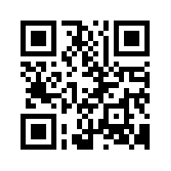
Useful Websites
 | The Search Engine List www.thesearchenginelist.com |  | The Internet Society www.internetsociety.org
 | Search Engine Land searchengineland.com |  | ICANN www.icann.org
 | E-Tourism Frontiers www.e-tourismfrontiers.com |  | WWW Consortium (W3C) www.w3.org
 | Nielsen Norman Group www.nngroup.com/articles |  | Google www.google.com

Slide 23
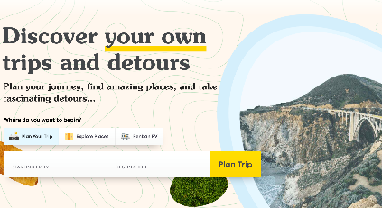
Case Study: Roadtrippers
Founded 2011, Roadtrippers allows users to:
discover and add independently owned points of interest to a travel itinerary
rate, review, and read what other users have to say about points of interest
Hotel metasearch was added in 2015 to display prices from multiple hotel booking providers on specific accommodations
A ‘vertical search engine’ which focuses on a specific type of tourism product.
Supports information search, trip planning and group decision making by connecting independent travellers with small tourism businesses

