Slide 2
Chapter 3
Travel Intermediaries and Information Technology

Slide 3
Chapter 3 Learning Objectives
After studying this chapter you should be able to:
Explain, compare and contrast traditional and digital tourism distribution systems;
Understand the evolution, role and features of Global Distribution Systems (GDSs) as travel intermediaries;
Analyze the challenges faced by GDSs as a result of technological change and innovation;
Explain how traditional travel retailers use IT;
Explain how IT has led to disintermediation and evaluate how this has impacted travel intermediaries;
Describe and critically evaluate the different types of online travel intermediaries that have developed as a result of IT; and
Explain how tour operators can use IT to improve productivity and competitiveness.

Slide 4
Key Concepts
Travel distribution system
Computer Reservation System(CRS)
Global Distribution System (GDS)
GDS New Entrant (GNE)
New Distribution Capability (NDC)
Tour Operators and Wholesalers
Travel Retailers
Online Travel Agents (OTA)
Channel Managers

Slide 5
FIGURE 3.1 Traditional Travel Distribution System
Airlines
Rail
Cruise
Car Rental
Activities & Events
Hotels
SUPPLIERS
Supplier Reservation Systems (CRS, ARS, PMS)
CONNECTIONS
Global Distribution System (GDS)
Switch
Tour Operator / Wholesaler
BOOKINGS
Point of Sale (POS)
Call Centre
Traditional Travel Agent

Slide 6
FIGURE 3.2 Digital Travel Distribution System
Airlines
Rail
Cruise
Car Rental
Activities & Events
Hotels
SUPPLIERS
Supplier Reservation Systems (CRS, ARS, PMS)
Channel Manager
Switch
CONNECTIONS
Internet Booking Engine (IBE)
GDS New Entrants (GNE)
Global Distribution System (GDS)
Destination Management System (DMS)
Tour Operator Wholesaler
Travel Management Company (TMC)
BOOKINGS
Call Centre
Online Travel Agent (OTA)
Meta Search
DMO Website
Point of Sale (POS)
Supplier Website
Social Media
Mobile App
Affiliate
Traditional Travel Agent

Slide 7
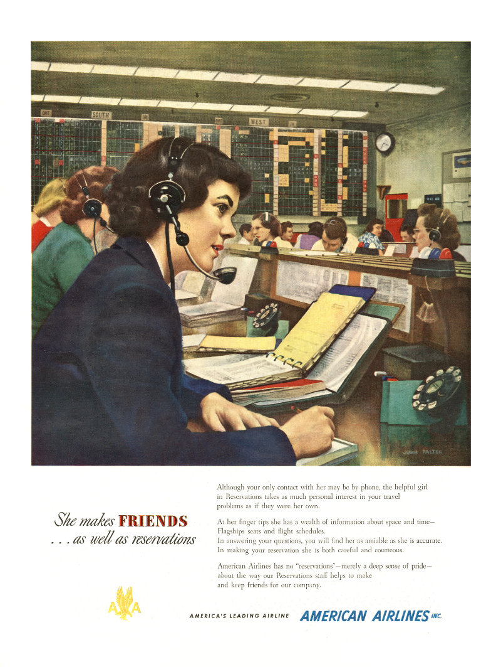
FIGURE 3.3 American Airlines Advertisement showing seat availability on wall charts
Source: American Airlines

Slide 8
1960
IBM, AA
1960
SABER
1964
1964
IBM
SABRE
PARS
1968
DL
1971
TW, NW
1971
DATAS
UA
1970
PARS
APOLLO
1976
BA, BR, CCL
TRAVICOM
1980
1982
DL
1982
CO
DATAS II
BA, KL, OS, AZ, SR, OA, SN, TP, EI, Covia
SYSTEM ONE
1988
SQ, CX
1986
1987
AF, IB LH, SK
DL, TW, NW
COVIA
1987
ABACUS
1990
GALILEO
AMADEUS
1990
WORLDSPAN
1993
GALILEO INT. APOLLO, GALILEO
1995
1998
AMADEUS
SABRE
2000
2006
2010
2015
TRAVELPORT APOLLO, GALILEO, WORLDSPAN
2015
SABRE
AMADEUS
FIGURE 3.4 The evolution of major Global Distribution Systems

Slide 9
Characteristics of Major GDSs
GDS | Founded | Founders | Market Share | Locations
Sabre | 1960 | American Airlines Acquisition of Abacus | 36.4% | 57,000 travel agency locations. Global presence, strong in US & Asia Pacific
Amadeus | 1987 | Air France, Lufthansa, Iberia & SAS | 42.4% | 102,000 travel agency locations. Mainly Western Europe, Middle East & Asia Pacific
Travelport | 2006 | Galileo-Worldspan merger | 21.2% | 65,000 travel agency locations. Global presence, strong in US & Western Europe
Worldspan | 1990 | United Airlines
Galileo | 1987 | Nine European airlines
Apollo | 1971 | Delta, TWA & NW Airlines

Slide 10
Core GDS Functions
Availability
Booking Requests
Passenger Information
Rates and Conditions
E-ticketing & Itinerary Management
Core GDS Functions

Slide 11
Secondary GDS Functions
Booking Ancillary Services
Secondary GDS Functions
Passenger Document Requirements
Integrated Travel Management
Decision Support Systems
Financial Management
E-Commerce Tools
Corporate Travel Management
Communication & Scheduling

Slide 12
FIGURE 3.5 Traditional GDS ‘Green Screen’ Display
112MAYLCAATH«
12MAY TUE LCA/Z‡2 ATH/‡0
1CY 322 J7 C7 D7 I7 Z4 Y7*LCAATH 0700 0845 319 S 0 123 DCA /E
B7 N7 S7 M7 T7 W7 L7 X7
2A3 903 C4 D4 Z0 A0 I0 J0*LCAATH 0830 1010 321 B 0 DC /E
Y4 B4 M4 K4 W4 S4 H4 L4

Slide 13
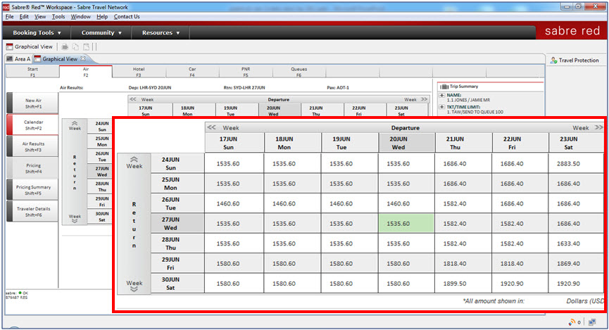
FIGURE 3.6 Sabre Red Graphical Workspace
Source: Sabre Holdings, 2014

Slide 14
OTA Web GUI
API
API
Suppliers
API
GDS
Agent GUI
FIGURE 3.7 GDS Interfaces

Slide 15
SWOT Analysis of GDSs
 | Positive | Negative
Internal | Strengths Market Power Homogenized Content Interline Bookings Back Office Integration Client Loyalty | Weaknesses Legacy-based Systems Connectivity Pricing Innovation
External | Opportunities New Suppliers New Clients Dynamic Packaging Interoperability | Threats GDS New Entrants (GNEs) Open Systems Direct Bookings

Slide 16
GDS Trends
Diversifying IT solutions
Consolidation
Connectivity and interoperability
Transparency
Personalization
Social, Local and Mobile (SoLoMo)

Slide 17
Tour Operator Use of IT
Package creation
Tour package distribution
Reservations and customer management

Slide 18
Traditional Travel Retailers
Front Office Systems
Back Office Systems
Accounting Systems
Human Resource Systems
Customer Relationship Management (CRM)
Communication
Commission Tracking
Transaction Settlement

Slide 19
Enterprise Resource Planning (ERP) Systems
Back office functions can be integrated into cross-functional systems known as Enterprise Resource Planning (ERP) systems.
Benefits:
Productivity
Reporting
Customer Satisfaction
Forecasting

Slide 20
SWOT Analysis of Traditional Retailers
 | Positive | Negative
Internal | Strengths Time and cost Expertise Security Value adding Personalization Special needs | Weaknesses Cost Bias and errors Less choice and transparency Less control High fixed costs Limited opening hours
External | Opportunities Emerging markets Hybrid models Consolidation | Threats Decommissioning Digital competitors Public perceptions Failure to attract talent Lack of investment

Slide 21
Travel Management Companies (TMCs)
Unique Characteristics
Contracts and Preferred Suppliers
Travel Policy Compliance
Employee Productivity
Risk Management
Travel Expense Management

Slide 22
Types of Online Travel Intermediaries
Online Travel Agents (OTAs)
Online Intermediaries
Metasearch Engines
Aggregators
Trip Planning Sites
Affiliates
Group Buying Sites
Opaque Sites
Product Review Sites

Slide 23
Online Travel Intermediary Innovations
Matrix displays
Search filters
Opaque pricing
Dynamic packaging
Flexible date search
Alternative airport search
Low-fare notifications
Mapping
Semantic search
Pressure selling

Slide 24
SWOT Analysis of Online Intermediaries
 | Positive | Negative
Internal | Strengths Low entry costs and investment Pricing and convenience Customization Flexibility, choice, control Instantaneous Comparison Multimedia | Weaknesses Lack of transparency Cancellation and changes Security Time consuming Limited advice Lack of expertise Support (general and special needs)
External | Opportunities Social Mobile Integration Innovation | Threats Competition Direct Bookings

Slide 25
Discussion Questions
What challenges do small and medium tourism enterprises (SMTEs) face in travel distribution? How might SMTEs respond to the increasingly complex structure of the digital tourism distribution system?
What is the difference between a GDS and a GNE? Visit the GDS and GNE websites to help you answer this question. Do you think GNEs are a threat to the GDSs? Justify your answer.
You have started your own small travel retail business. Which GDS would you choose and why?
What is the role of traditional intermediaries in the travel distribution system and are they still needed? How might traditional intermediaries use IT to compete against the innovative features offered by OTAs?
Watch the following video about IATA’s New Distribution Capability: http://youtu.be/Rru0RgWxtqQ. What impact is this IT development likely to have on travel intermediaries?

Slide 26
Discussion Questions
What is disintermediation and how has it impacted the different types of travel intermediaries described in this chapter? Do you think some of the intermediaries discussed in this chapter are likely to disappear in the next 10 years? Which and why? What role has IT played in this process?
This chapter provides SWOT analyses for the GDSs, traditional travel retailers and OTAs. Use the information in this chapter along with your own research to conduct a similar SWOT analysis of TMCs. What do you think the future looks like for TMCs?
Visit two metasearch engines (e.g. Hipmunk, Room77, Skyscanner, Trivago, Kayak) and search for a return flight and hotel to a destination of your choice. Compare and contrast the two sites by identifying the strengths and weaknesses of each. Do they offer different features? Which features do you like the most? What ITs are used to improve the search experience?
The pressure selling tactics used by OTAs have attracted recent government scrutiny. Find some press stories about these tactics and use them to identify the key issues that have generated negative publicity. How can OTAs respond to these challenges?

Slide 27
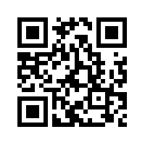
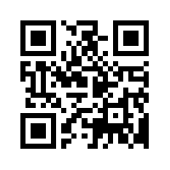
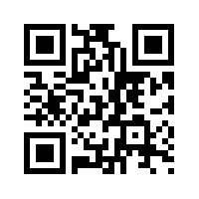
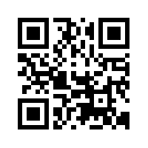
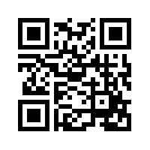
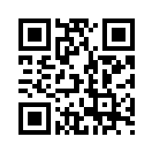
Useful Websites
 | Expedia www.expedia.com |  | Kayak www.kayak.com
 | Sabre Holdings www.sabre.com |  | TUI www.tui-group.com/en-en
 | lastminute.com www.lastminute.com |  | Booking Holdings www.bookingholdings.com
 | Winding Tree windingtree.com

Slide 28
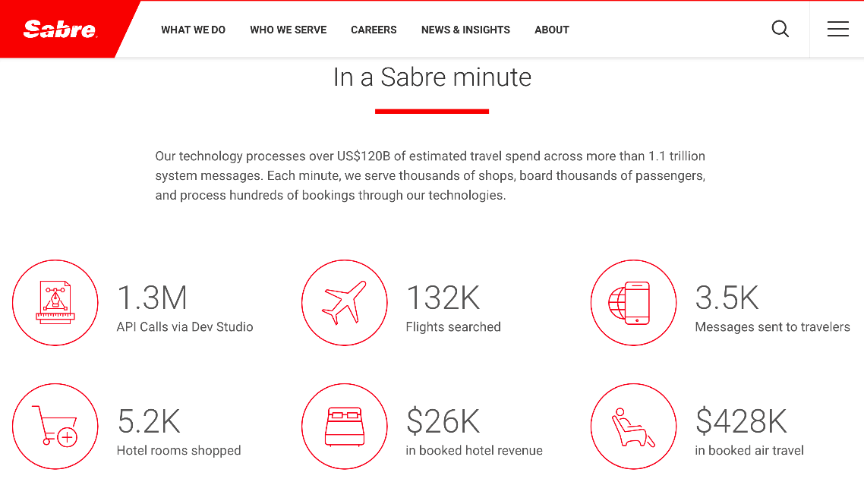
Case Study Sabre Corporation
Founded by partnership between American Airlines and IBM in 1953
SABRE was the first private real-time online transaction system
9,000 employees and clients in 160 countries
Diversified beyond GDS to become a travel technology company offering a range of IT solutions for airlines, airports, travel intermediaries, hotels, car rental providers, rail providers and tour operators
Acquired GNE Fairlogix in 2018
Three business units:
Sabre Travel Network
Sabre Airline Solutions
Sabre Hospitality Solutions

