Slide 2
Chapter 2
The Digital Tourism Landscape

Slide 3
Chapter 2 Learning Objectives
After studying this chapter you should be able to:
Describe the general concept of the digital tourism landscape;
Explain and evaluate the components and functions of information technology in tourism using a digital tourism ecosystem perspective;
Analyze the drivers of innovation and technological change in the digital tourism landscape;
Define and provide examples of disruptive innovation;
Apply behavioral perspectives to explain how travelers adopt, use and respond to information technologies in tourism settings; and
Explain the role of information technology in tourists’ decision-making processes.

Slide 4
Key Concepts
Digital tourism ecosystem
Diffusion of innovations theory
Hype cycle
Technological innovation theory
Disruptive innovation
Technology acceptance model (TAM)
High-tech / high-touch

Slide 5
FIGURE 2.1 The Digital Tourism Ecosystem
Inspiration
Transaction
Experience
Reflection
Entities
Suppliers, Travelers, Intermediaries, Governments, DMOs
Connections Broadband, Mobile, WiFi, NFC, BLE, GPS, Broadcasting, Protocols, Standards
Devices Desktops, Smart Devices, Mobile Devices, Digital Kiosks
Communities Social Networks Blogs, Reviews, Forums, Wikis, Local Experts, Media Sharing
Content
Rich Media, Maps, Navigation, Transactions, Dynamic Content, User Generated Content
Touch Points Websites, Search, Engines, Mobile Apps, Email, Telephone, Face-to-face

Slide 6
Digital Tourism Ecosystem
Digital Technological Environment
Devices
Connections
Content
Touch Points
Roles of Entities and Communities
Catalyzers
Dictators
Milkers
Niche Players

Slide 7
Digital Tourism Ecosystem
Ecosystem Functions
Inspiration
Transaction
Experience
Reflection
Ecosystem Health
Productivity
Robustness
Diversity

Slide 8
FIGURE 2.2 Waves of IT Adoption
INDUSTRIAL
REVOLUTION
ELECTRIC
REVOLUTION
DIGITAL
REVOLUTION
FOURTH REVOLUTION
Artificial Intelligence
PERFORMANCE
Digital Networks
Electronics
Electricity
Steam Power
Mechanization
1780
1840
1900
1950
1990
2020
TIME
Source: Schumpeter (1934), Perez (2002)

Slide 9
FIGURE 2.3 Important Developments on the Internet
WebCrawler, Netscape
Baidu
Google Images, Siri
Oculus Rift, HoloLens
Google Search
.travel domain
Mosaic Browser
Web 2.0 coined
Wikipedia, iPod
Skype
Google Glass, Amazon Echo
Hotmail
iPhone
iPad
Internet & Technology Developments
Del.icio.us, LinkedIn, WordPress, Alipay, Taobao
Instagram, Pinterest, iQiyi
Tencent
Dot.com bubble
YouTube
Reddit
Amazon Cloud (EC2)
Apple App Store 40bn downloads
Uber, Weibo, WhatsApp, Quora
Facebook 1bn users
eBay, Amazon
Netflix
Alibaba, Napster, Blogger, QQ
PayPal
Twitter, YouKu, Spotify
eCommerce & Social Media Developments
Facebook
WeChat, Twitch
Tik Tok
Expedia, Travelocity,
Booking.com, ITA Software
TripAdvisor
Expedia buys Travelocity, Orbitz, HomeAway
Ctrip, Farechase Metasearch
Priceline buys TravelWeb & Booking.com
HotelTonight
TravelWeb
Kayak, HomeAway
Airbnb
Roomkey, Priceline buys Kayak
Priceline buys OpenTable
Viator
OpenTable
Orbitz
Tourism & Hospitality Industry
Priceline
1995
2000
2005
2010
2015
2020
TIME
Adapted from Xiang et al, 2015

Slide 10
Diffusion of Innovations Theory Rogers, 1962
Innovators: eager to try new ideas and prepared to take risks such as adopting technologies that may fail.
Early adopters: opinion leaders who embrace change but are not as obsessive as innovators.
Early majority: tend to adopt new innovations before the average person but will thoroughly research a new innovation before deciding to adopt.
Late majority: will only adopt an innovation after the majority have tried it and adoption may be the result of economic necessity or social pressure.
Laggards: traditionalists and are the last to adopt an innovation because they are skeptical of change.

Slide 11
FIGURE 2.4 Gartner Hype Cycle
‘Early adopters’ adopt products
Supplier proliferation
Negative publicity
EXPECTATIONS/VISIBILITY
‘Early majority’ start to adopt product triggering high growth phase
Mass media hype
Supplier failure/consolidation
New paradigms and practices become accepted
‘Innovators’ adopt products
1st generation products (expensive)
3rd generation products
New rounds of venture capital
2nd generation products
Startup firms
R&D
Technology Trigger
Peak of Inflated Expectations
Trough of Disillusionment
Slope of Enlightenment
Plateau of Productivity
TIME
Adapted from Tarkovskiy (2013)

Slide 12
Understanding the Digital Tourist
Technology Use and Acceptance
Demographics
Trip Characteristics
Psychographics
UTAUT
Use of IT in the Travel Process
Information Search
Trip Planning
Purchase
Methods for Understanding the Digital Tourist

Slide 13
High tech and high touch travelers
 |  | Everyday life
 |  | High tech | High touch
Travel | High tech | Spillovers | Opportunity Seekers
 | High touch | Compensators | Luddites

Slide 14
Understanding the Digital Tourist
Quantitative sources | Mixed-methods sources | Qualitative sources
Traditional surveys Online surveys/polls Web analytics Experiments Visitor tracking Biometrics | Content analysis Sentiment analysis Data mining | Interviews Focus groups Netnography Observation Prototyping

Slide 15
Discussion Questions
In 2007 the World Economic Forum released three scenarios of digital ecosystems, which are summarized in the following YouTube video: http://youtu.be/jnrAtXt3uu4/. Considering IT developments since 2007, which one has been the most accurate? Justify your answer and discuss the implications for IT and tourism.
Speak to someone who works for a company in the hospitality or tourism sector regarding their adoption and use of a specific, important technology. According to Rogers’ Diffusion of Innovation Theory, which category (i.e., innovator, early adoptor, early majority, late majority, and laggard) do you think they belong to? Why?

Slide 16
Discussion Questions
Conduct your own research about the major generational cohorts alive today (Baby Boomers, Gen X, Gen Y and Gen Z). Do they differ in how they use technologies? Are older consumers as likely to use IT for travel purposes as younger consumers?
Provide examples of how the use of technology can deliver both high-tech and high-touch outcomes.
What are the key elements of the TAM? Provide your own tourism and technology example to illustrate the various components of this model.
In this chapter we used AirBnB to illustrate the concept of disruptive innovation. Identify another example of disruptive innovation in tourism and use Christensen et al.’s model of low-market/new-market footholds to justify your example.

Slide 17
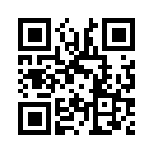
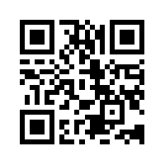
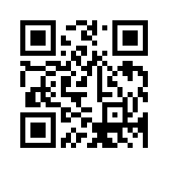
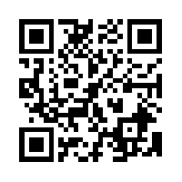
Useful Websites
 | American Society of Travel Agents (ASTA) www.asta.org
 | Inspirock www.inspirock.com
 | World Economic Forum Digital Ecosystems www.weforum.org/reports/digital-ecosystem-convergence-between-it-telecoms-media-and-entertainment-scenarios-2015
 | Our World in Data: Technological Progress ourworldindata.org/technological-progress

Slide 18
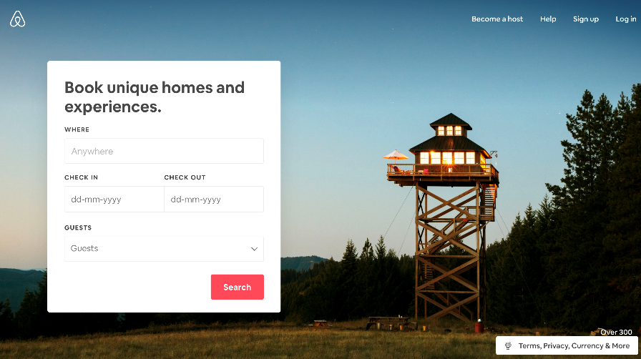
Case Study Airbnb
Problems with hotels:
Hotel chains build brand around consistency and standardization
Standardization creates sterile and impersonal experiences
Hotels are expensive to own and manage
The solution?
Provide accommodation that is not standardized and requires no investment in real estate or workers.
Founded in 2008 … by mid-2012 bookings reached 10 million nights and by 2018 more than 4 million properties were listed in 191 countries
Disruptive innovation
New technologies
New business models
New value chains

