Slide 2
Chapter 13
The Future of Information Technology and Tourism

Slide 3
Chapter 13 Learning Objectives
After studying this chapter you should be able to:
Identify the technological developments that will affect the future of the travel industry
Understand the relationships between the development of various information technologies, the traveler and the tourism industry
Apply this understanding to anticipate the strategic, operational and structural changes that will impact on tourism

Slide 4
Key Concepts
virtuous cycle of technology use
big data
convergence
digital elasticity
hybridization
nanotechnology
open systems
sensory marketing
technology-supported networks
the singularity

Slide 5
Figure 13.1 Virtuous Cycle of Technology Use in Travel
Use
Satisfaction
Impact

Slide 6
Trends in Tourism Information Technologies
Ubiquitous artificial intelligence (AI)
Fragmentation of information
Digital elasticity
Storytelling
The empowered digital traveler
Big data and analytics
Smart machines
Material technologies
Open systems
Convergence

Slide 7
Discussion Questions
What are the key forces of change in society as we face the next decade? How do they relate to the travel industry and its use of IT?
What is in a virtuous cycle? What are the ‘actors’ that comprise the virtuous cycle and how do they relate to each other in shaping travelers use of the Internet? How do the actions differ between each of the actors? How does this relate to use of Internet by the travel industry? Last, how do these two actors influence the products developed by technology firms?
Ten trends were identified that will shape the future of the travel industry. Are these short term or long term trends? Which are more important? Discuss in detail how these trends affect travelers and the travel industry.

Slide 8
Discussion Questions
What role will IT play in shaping how travelers use the Internet in the future? How do tourism organizations adjust to these changes?
We have briefly discussed the concept of a technological singularity. Conduct your own research to learn more about this idea. What are the implications for travel, and indeed for humankind?
What do see are the dangers of ‘fake news’ to the tourism industry? Explain why and what if any measures can be taken to mitigate these dangers.

Slide 9
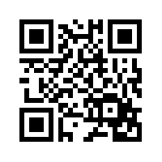
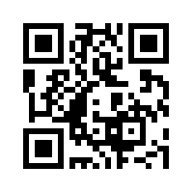
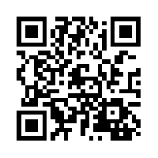
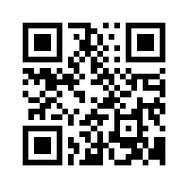
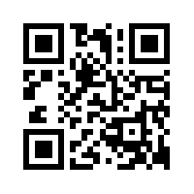
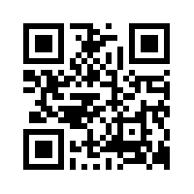
Useful Websites
 | Tourism Australia www.tourism.australia.com |  | Google Glass x.company/glass
 | Smarter Planet www.ibm.com/smarterplanet |  | Tripit.com www.tripit.com
 | Tourism Futures www.tourism-futures.org |  | SMART Tourism www.smarttourism.org

