Slide 2
Chapter 12
Sustainable Tourism and
Information Technology

Slide 3
Chapter 12 Learning Objectives
After studying this chapter you should be able to:
Analyze how IT can improve the environmental, social and economic sustainability of tourism organizations, communities and destinations
Explain how IT systems can be used to ensure environmental preservation, purity and physical integrity
Describe the role of IT systems in promoting social equity and community well-being, local empowerment and the preservation of cultural diversity
Understand how IT systems can ensure economic viability and local prosperity
Explain how IT systems can facilitate tourists to behave more sustainably in tourist settings

Slide 4
Key Concepts
  Carbon calculator
  Citizen and tourist scientists
  Environmental management system (EMS)
  Geographic information system (GIS)
  Last-mile connectivity
  Pro-poor tourism
  Social capital and social equity
  Social entrepreneurs
  Voluntourist
  Weather and climate change system

Slide 5
Sustainable Tourism
Sustainable Development
  development that meets the needs of the present without compromising the ability of future generations to meet their own needs (WCED, 1987)
Sustainable Tourism
  tourism that takes full account of its current and future economic, social and environmental impacts, addressing the needs of visitors, the industry, the environment and host communities (UNEP/UNWTO, 2005)

Slide 6
Applications of IT in Sustainable Tourism
  Carbon Calculator
  Community Informatics
  Computer Simulations
  Destination Management Systems (DMS)
  Economic Impact Analysis
  Environmental Management Systems (EMS)
  Gamification
  Geographic Information Systems (GIS)
  Global Positioning Systems (GPS)
  Intelligent Transportation Systems (ITS)
  Location-Based Services (LBS)
  Virtual Tourism
  Weather and Climate Change Systems

Slide 7
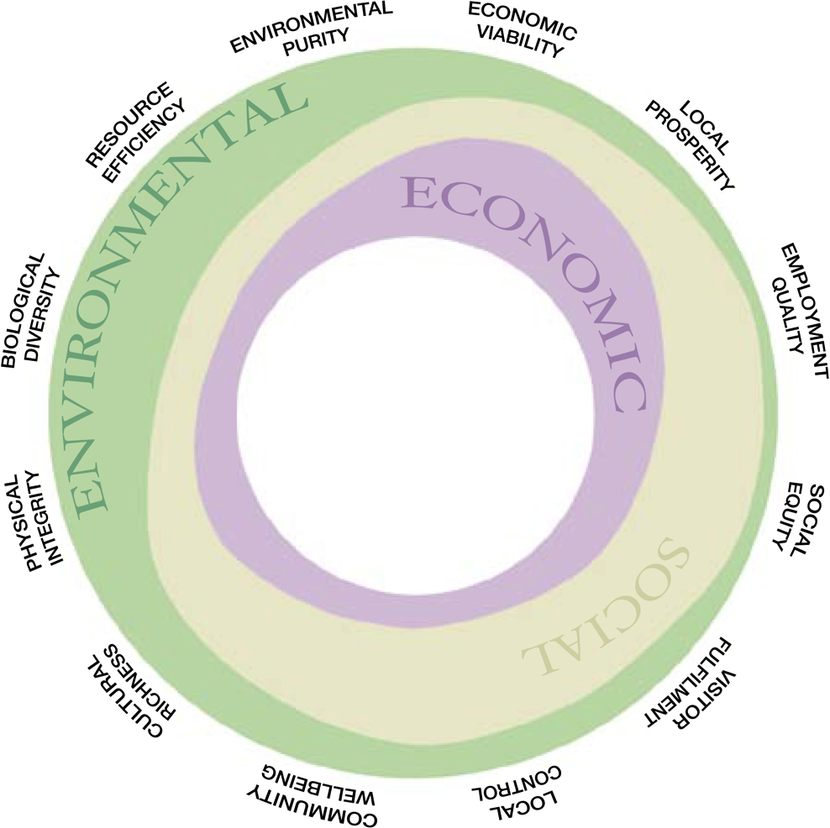
Figure 12.1 Twelve Aims of Sustainable Tourism
Source: UNEP/UNWTO, 2005

Slide 8
Resource Efficiency and IT
Application of IT to reduce aviation fuel usage
  Systems that optimize flight routes
  Coordination of arrival and departure times to reduce holding patterns caused by delays
  Continuous descent systems
  Design of lighter and more fuel efficient aircraft
Energy and waste reduction in hotels
  Energy management systems
  Monitoring water usage

Slide 9
Environmental Purity & Physical Integrity
  Use of DMSs to manage access to natural resources
  Location-based services used for sustainable education and interpretation
  Computer technology monitors and manages efficient use of resources including:
    water (low-flush toilets, low-flow showerheads)
    energy (solar power generators, energy-saving light-bulbs)
    pollution (noise, air and visual pollution)
    recycling and waste management
  Carbon footprint calculators
  Use of CAD software to design more efficient buildings

Slide 10
Mobile Apps for Environmental Awareness
Name | Designer | Purpose
Carbon Emissions Calculator | ICAO | Calculates CO₂ emissions from air travel
Environmental News Network | ENN | Provides global perspectives on environmental issues
Climate Pathways | New Venture Fund | Real-time interactive simulator to understand climate change
MyEarth | PiThree LLC | Teaches ways to save the environment and conserve resources
Earth Now | NASA | Data from satellites displayed in colored maps of sea level rises, water, temperatures etc.
offCents | offCents,Inc. | Provides real time tracking and calculation of carbon emissions from transportation

Slide 11
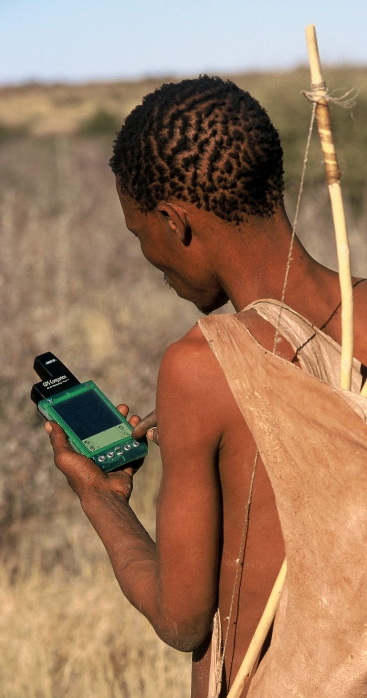
Biological Diversity
  Citizen scientists: handheld devices can allow tourists to monitor animal and bird species and other environmental phenomenon on their digital devices as they travel
  Tourist scientist: combining tourism, research, conservation and computers to identify and track flora and fauna (e.g. Earthwatch, Cyber trackers)
  Voluntourists: make meaningful contributions to communities and wildlife in destinations

Slide 12
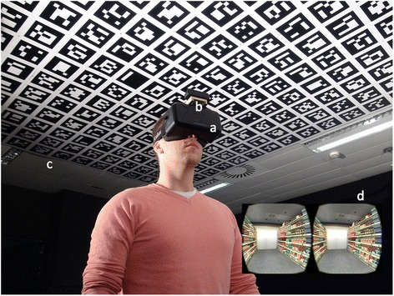
Virtual Substitute Travel Experiences
  Tourists can experience some benefits of travel by staying home and using technology to virtually experience the destination, removing any environmental damage to the destination.
  Examples:
    360cities.net
    Google Streetview
    Google Earth VR
    virtualtravelevents.com
    Gala360

Slide 13
Social Equity & Community Wellbeing
  Last-mile connectivity: IT advances have made it possible to connect even the most remote communities to address information asymmetry
  IT democratizes and equalizes the community by giving all residents and enterprises equal access to technology
  IT networks allow people to connect to knowledge, education, tourist markets, and destination management systems
  IT contributes to social equity by attracting the right tourists
  IT supports social enterprise
  IT provides information and access for handicapped travellers
  IT supports the monitoring and reporting of human rights abuses

Slide 14
Local Control
  Community informatics empower communities and supports stakeholder engagement
    Remote input to meetings
    Electronic polling
    Scenario-based design

Slide 15
Cultural Richness
IT can contribute to cultural richness by:
  Disseminating better understanding of customs and traditions to the benefit of tourists and host communities
  Promoting the visibility of cultural resources – especially new or small ones
  Monitoring tourism impacts on cultural resources and visitor flow management strategies
  Building partnerships between cultural and tourism operators to strengthen their market position

Slide 16
Economic Viability & Local Prosperity
IT can impact local prosperity by building:
  Financial capital: providing online communication with lending organizations
  Human capital: providing increased knowledge of new skills through distance learning and processes required for certification
  Natural capital: providing opportunities to access national government policies online
  Social capital: cultivating contacts beyond the local community
  Physical capital: lobbying for the provision of basic infrastructure including data and telecommunications infrastructure

Slide 17
Economic Viability & Local Prosperity
IT Challenges
  Lack of investment for IT
  Lack of training and expertise
  Lack of financial or technical infrastructure
  Language barriers

Slide 18
Figure 12.4 Factors determining IT use by SMEs
(Adapted from Buhalis, 2003, p. 143)
PUSH FACTORS
PULL FACTORS
Demands of Digital Travellers
Tourist Demand
Vendors of IT Systems
Interoperability with intranets, extranets & Internet
Small and
Medium
Tourism
Enterprises
Government Policies
Consortia & Marketing Alliances
Global Competition
Certification Programs
Education & Training
Accounting Systems

Slide 19
Employment Quality & Capacity Building
  IT can be used to:
    Attract talented employees to the tourism industry
    Improve the quality of training and education
  Examples
    MOOCs
    BEST Education Network
    The International Ecotourism Society
    Rainforest Alliance

Slide 20
Discussion Questions
What kind of digital infrastructure is needed for tourists to become citizen scientists in destinations?
What are the special needs and challenges faced by SME’s regarding the sustainable use of technologies in the digital age?
How can indigenous communities in tourism destinations be empowered with IT? Find examples of how technology has been used to improve the wellbeing of indigenous communities.

Slide 21
Discussion Questions
Identify a specific tourism destination or protected area that uses location-based services. How are these services likely to improve the destination’s sustainability?
Find a destination management system with features focusing on the environmental integrity of the destination. Describe these features and their likely impact.

Slide 22
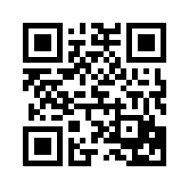
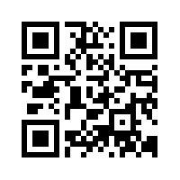
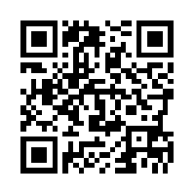
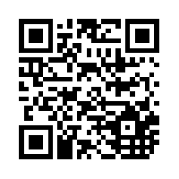
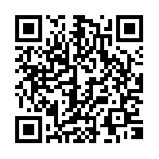
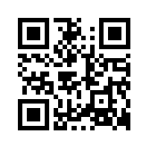
Useful Websites
 | UNESCO Sustainable Tourism www.unesco.org/education/tlsf/mods/theme_c/mod16.html |  | The International Ecotourism Society (TIES) www.ecotourism.org
 | Sustainable Tourism Online www.sustainabletourismonline.com |  | Rainforest Alliance www.rainforestalliance.org
 | National Geographic Center for Sustainable Destinations www.nationalgeographic.com/travel/sustainable.org/ |  | Conservation International www.conservation.org

Slide 23
Case Study ICONEM
  Founded in 2013 and based in France
  ICONEM creates:
    digital replicas of endangered heritage sites
    3D models
    museum exhibits
  Drone footage, 3D video, laser scanners, photogrammetry, and Lidar data is used to create highly accurate virtual replicas of real sites
  Projects in 21 countries including Iraq, Afghanistan and Syria to capture sites under danger from war and neglect
  Drones used to monitor looting and footage is cross-referenced with information from art markets and sellers to identify looters
  Digital content curated for museum exhibitions immerses visitors in endangered sites

