Slide 2
Chapter 11
Destination Management and Smart Destinations

Slide 3
Chapter 11 Learning Objectives
After studying this chapter you should be able to:
Explain a Destination Management System (DMS) and the features that it provides
Describe how a DMS can improve the management of tourism in a destination
Explain the concept of smart destination and how information technology can be used to support smart destination management.

Slide 4
Key Concepts
Destination management system (DMS)
Smart destinations
Knowledge-based and learning destinations
Recommender systems
Spatial tracking systems
Visitor information centers (VICs)

Slide 5
Destination Management System (DMS)
Past: a computer database of the destination’s facilities that augmented the traditional methods of information provision such as brochures and visitor information centers
Present: highly complex, web-based platforms that support broader functionality and communication through a number of online channels
Fill a gap left by GDSs by representing a broader range of products and services in a destination

Slide 6
Destination Management System (DMS)
Definition
A dynamic web-based platform that integrates a wide range of information about a destination’s tourism products.
It also provides an infrastructure to support different types of e-commerce (e.g., B2B, C2B, and G2B) in the destination.
Additionally, it allows interaction with different stakeholders (e.g., suppliers, visitors), data collection and information visualization.

Slide 7
Destination Management System (DMS)
Functions
Content: information provisions such as search functions and listings of tourism facilities, attractions and services;
Promotion: techniques to attract visitors from other channels such as search engine optimization and advertisements in other websites; and
eCommerce: transactions related features targeting behavioral outcomes of visitors.

Slide 8
DMS Dimensions (Li and Wang, 2010)
Core Dimensions
Information
Communication
Relationship
Technical merit
Transaction

Slide 9
Figure 11.1 DMS Connectivity
Supplier Databases
Intermediaries
Social Media
Travelers
DMO Applications
Statistical Analysis
Crisis Management
Economic Impact Measures
Market Intelligence
Web Interface
DMS
WWW
Search Engines
Overseas Marketing Offices
Visitor Information Centers
Information Kiosks
Notes:
8

Slide 10
Destination Management System (DMS)
Key Advantages
Facilitate the destination’s coordination and integration with suppliers;
Remove the need for intermediaries and increase revenues;
Give the destination a more effective presence in the marketplace

Slide 11
Smart Destinations
Exploit operational, near-real-time real-world data, integrate and share data, and use complex analytics, modelling, optimization and visualizations to make better decisions
Shift from e-Tourism to Smart Tourism (Gretzel et al., 2015)
 | e-Tourism | Smart Tourism
Sphere | Digital | Bridging digital & physical
Core technology | Websites | Sensors & smartphones
Travel phase | Pre- & post-travel | During trip
Lifeblood | Information | Big data
Paradigm | Interactivity | Co-creation
Structure | Value chain/intermediaries | Ecosystem
Exchange | B2B, B2C, C2C | Public-private-consumer collaboration

Slide 12
Smart Destinations
Smart Experience
DATA
Collection
Exchange
Processing
Smart Business Ecosystem
Smart Destination
Figure 11.2 Components and layers of smart tourism (Source: Gretzel et al., 2015)

Slide 13
Destination Research
Statistical data collection and analysis
Onsite surveys using tablets/kiosks
Online post-experience surveys
Statistical analysis
Spatial tracking
Tourism analytics and big data
Machine learning
Data mining
Data visualization

Slide 14
Crisis and Risk Planning
Knowledge and information technology are powerful resources to help governments, private firms and the communities prevent, plan for, and recover from various types of disasters and crises
Three stages of disaster management
Prevention and planning: IT systems can store policies and databases of relevant information.
Strategic implementation: IT and data networks support crisis communication with stakeholders
Evaluation and feedback: IT provides communication facilities, websites and mobile sites for the feedback.

Slide 15
Knowledge-based Destinations
Features of a knowledge-based destination are:
Ubiquitous access of new IT technology for all stakeholders (including local residents, businesses, visitors);
Instruments to make knowledge and information accessible to stakeholders in a systematic and efficient manner;
A culture which encourages development of innovative goods and services for the stakeholders; and
Mechanisms to ensure that every stakeholder group is given an opportunity to participate in the innovation process (Racherla, Hu, & Hyun, 2008)

Slide 16
Learning Destinations
Destinations need to create a soft infrastructure to become learning destinations. This includes:
local knowledge
learning and creativity
trust
networks
conversion of tacit to explicit knowledge
collaboration and cooperation
IT infrastructure is necessary for these features.
Soft infrastructure includes keeping track of events, documenting findings, building databases, and tracking performance indicators.

Slide 17
Discussion Questions
Choose a destination not mentioned in this chapter and describe and analyze its DMS and information infrastructure. What recommendations do you have for the destination to become more of a knowledge-based destination?
Compare and contrast the social media strategies of two destinations in promoting their destination. What recommendations can you give them to improve?
With a destination of your choice, analyze its visibility on various search engines. Suggest how the DMO could improve its visibility.
Choose two destination websites and analyse each of their strengths and weaknesses.

Slide 18
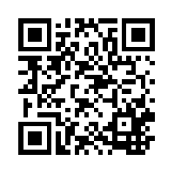
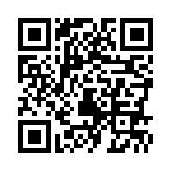
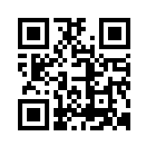
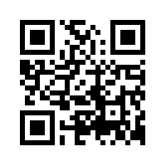
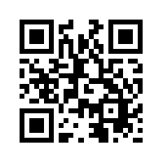
Useful Websites
 | Destination Marketing Association International www.destinationmarketing.org |  | National Geographic www.nationalgeographic.com
 | Tiscover www.tiscover.com |  | MySwitzerland.com www.myswitzerland.com
 | Australian Tourism Data Warehouse (ATDW) www.atdw.com.au

Slide 19
Case Study Smart Destination Vienna
Largest city in Austria with a population of about 1.8 million
12-15 million overnight stays
SMART Vienna 2020 is a strategic initiative which aims to offer visitors and residents a high quality of life through responsible, sustainable use of resources
Smart city features:
Strong emphasis on public transport networks
’Green’city: 850 public parks and gardens covering 19 million square meters
Smart destination strategy:
Smart mobility management
Destinations within the destination
Digital tourism

