Slide 2
Chapter 1
Introduction to Tourism and Information Technology

Slide 3
Chapter 1 Learning Objectives
After studying this chapter you should be able to:
Define key terms and concepts in information technology;
Describe the evolution of information technology;
Recognize the types of information technologies relevant to tourism;
Explain the synergies between the travel industry and information technology; and
Evaluate the strategic applications of information technology in tourism organizations and destinations.

Slide 4
Key Concepts
Characteristics of tourism services
Evolution of computing technologies
Information systems
Information technology
Moore’s Law
Artificial intelligence
Space-time collapse
Typologies of information
Web 1.0 / Web 2.0

Slide 5
Definitions
Information Technology (IT)
the application of computers and telecommunications equipment to store, retrieve, transmit and manipulate data (Daintith, 2012)
Information Systems
Information systems are combinations of hardware, software and telecommunications networks that people build and use to collect, create, and distribute useful data, typically in organizational settings” (Valacich & Schneider, 2014)

Slide 6
Characteristics of Tourism Services
Tourism
Heterogeneity
Perishability
Intangibility
Global
Inseparability

Slide 7
Applications of IT in Tourism
Aviation
Travel intermediaries
Hospitality
Attractions, events and entertainment
Destinations
Travelers

Slide 8
Typologies of Information
Trip Stage | Static | Dynamic
Pre-trip | Brochures, guidebooks, fax, photos, videos, some information on websites | Phone, email, websites, social media, Internet booking engines, Global Distribution Systems
In-trip | Brochures, guidebooks, signs, maps, kiosks, TV channels in hotels, some mobile apps | Phone, fax, email, websites, social media, mobile apps
Post-trip | Brochures, guidebooks, photos, video | Blogs, social networks, media sharing, reviews

Slide 9
Evolution of Computing Technologies
30,000 BC
1800
1950
1900
1950
1975
2000
2025
Manual Counting Aids & Calculators
Tally Bones
Abacus
Antikythera Mechanism
Astrolabe
Gutenburg Press
Slide Rules
Pascaline
Mechanical Computers
Punched Cards
Arithometers
Difference/Analytical Engines
Typewriters
Tabulators
Electronic Computers
Vacuum Tubes
ENIAC
Transistors
UNIVAC I / IBM650
Integrated Circuits
Mouse
Spectra 70 / IBM360
Microprocessors
Microcomputers
GUI OS & Software
Ubiquitous Technologies
IBM5100 / Osborne 1
Newton
Smartphones
Tablets
App stores
Digital assistants
Cloud computing
Artificial intelligence
Networking & Internet
ARPAnet
Email
Ethernet
Internet
WWW
Web browsers
Search engines
Social networks
Sharing platforms
Cellular networks
Wifi

Slide 10
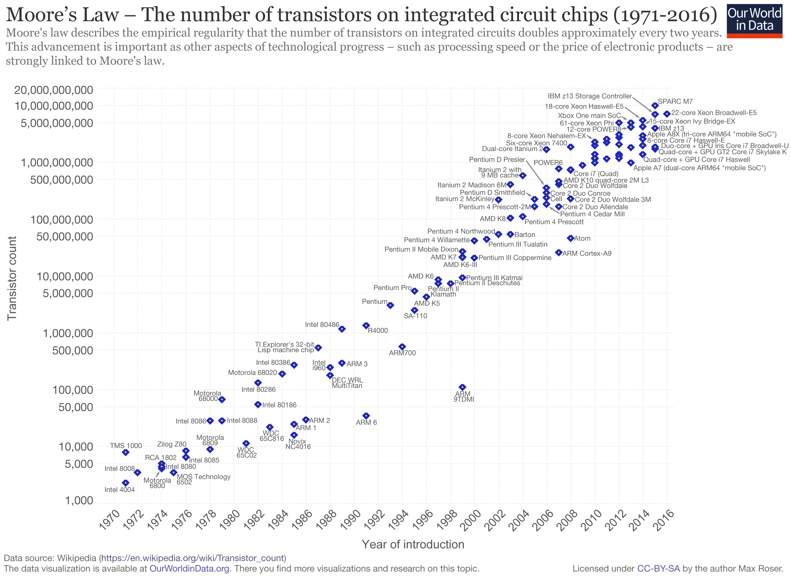
Moore’s Law (Wikipedia, 2018)

Slide 11
Strategic Thinking & IT
HIGH
Airlines
Defence
Travel Agent
Banks
Hotels
Tour Operator
PRODUCTION
Attractions
Retailing
High
Fashion
Paper
Lumber
LOW
HIGH
MARKETING
FIGURE 1.1 Impact of IT on the Production and Marketing of Different Industries

Slide 12
Strategic Thinking & IT
Managing Value Chains
Managing Knowledge and Information
Marketing and Competitive Advantage
Service Delivery and Customer Relationship Management (CRM)
Strategic Listening

Slide 13
FIGURE 1.2 Outline of Chapters
PART I: UNDERSTANDING TOURISM IT
CH 1
Introduction to Tourism and IT
CH 2
The Digital Tourism Landscape
THE TRIP
PART II: LOOKING AND BOOKING
CH 3
Travel Intermediaries and IT
CH 4
The Internet and the Tourist
CH 5
Social Media and Tourism
PART IV: STAYING AND PLAYING
PART III: TRAVELLING
CH 9
Hospitality Information Systems
CH 6
Mobilities and IT
CH 10
Technology Enabled Visitor Experiences
CH 7
Aviation and IT
CH 11
Destination Management and Smart Destinations
CH 8
Surface Transport and IT
PART V: ISSUES AND TRENDS
CH 12
Sustainable Tourism and IT
CH 13
The Future of IT and Tourism

Slide 14
Discussion Questions
In your opinion, what are the three most important inventions that have led to the information technologies we have available today? Provide examples to justify your answer.
Why is tourism such an information intensive industry? Explain and give some examples.
What is the difference between static and dynamic tourism information? Give examples of each.
A hotel manager asks you why she should incorporate more technology in to her hotel. How would you respond to this question so that they are inspired to invest?
Identify one travel organization in your area that you think has used technology in a particularly creative way. Which of the strategic applications discussed at the end of the chapter would it fit in to?
Which part of the textbook (based on the diagram of the chapters) are you most looking forward to studying? Why?

Slide 15
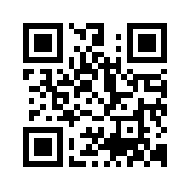
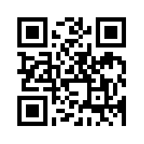
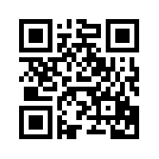
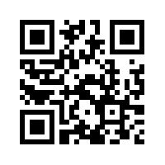
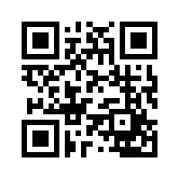
Useful Websites
 | Eye for Travel www.eyefortravel.com
 | International Federation for Tourism and Technology www.ifitt.org
 | International Hospitality Information Technology Association hita.camp7.org
 | Tnooz.com www.tnooz.com
 | Travel Technology Initiative www.tti.org

Slide 16
Case Study Intercontinental Hotels Group
Crowne Plaza, Holiday Inn, InterContinental Hotels
4,503 hotels and 656,661 rooms
Spends about $200 million annually on IT innovations (about 1.2% of revenue)
Atlanta Crowne Plaza Hotel’s customer database holds 200 million guest profiles which can be mined for customer activity, trends and preferences
BOSS search technology
Google Integration
GPS support and voice search
iPhone and Google apps
Touchscreen kiosks in lobbies and concierge iPads
Camelot cloud computing environment

