Slide 1

CABI TOURISM TEXTS
3rd Edition
Strategic Management
In Tourism
Edited by
LUIZ MOUTINHO AND
ALFONSO VARGAS SÁNCHEZ
COMPLIMENTARY TEACHING MATERIALS

Slide 2

CHAPTER 8
CABI TOURISM TEXTS
EMPOWERMENT AND HUMAN RESOURCE MANAGEMENT IN TOURISM
JITHENDRAN KOKKRANIKAL, JONATHAN WILSON, PAUL CRONJE AND NITIN RADHAKRISHNAN

Slide 3
CABI TOURISM TEXTS
LEARNING OBJECTIVES
After studying this chapter you should be able to:
Understand the basic concepts of empowerment.
Realize the advantages and benefits of empowered staff and customers, and the practical implications for service industries.

Slide 4
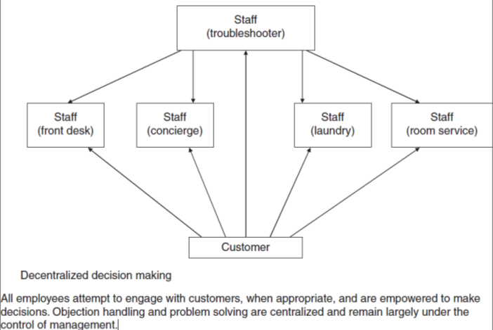
CABI TOURISM TEXTS
Fig. 8.1a. Methods of engagement with regard to decision making: Staff-centric approach

Slide 5
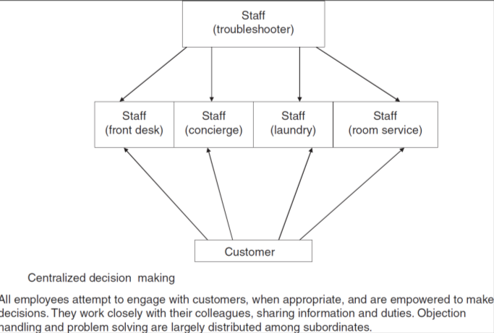
CABI TOURISM TEXTS
Fig. 8.1a. Methods of engagement with regard to decision making: Staff-centric approach
Centralized decision making
All employees attempt to engage with customers, when appropriate, and are empowered to make decisions. They work closely with their colleagues, sharing information and duties. Objection handling and problem solving are largely distributed among subordinates.

Slide 6
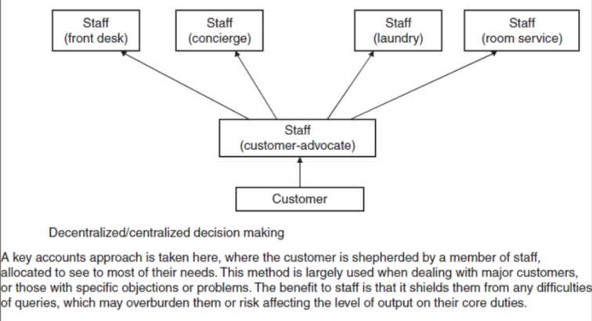
CABI TOURISM TEXTS
Fig. 8.1b. Methods of engagement with regard to decision making: Customer-centric approach

Slide 7
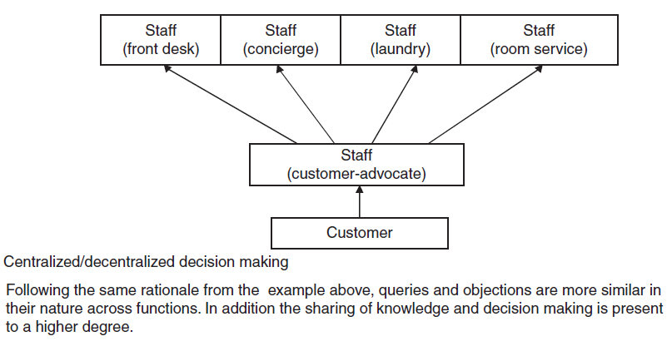
CABI TOURISM TEXTS
Fig. 8.1b. Methods of engagement with regard to decision making: Customer-centric approach

Slide 8
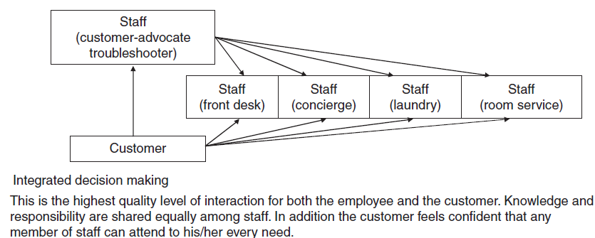
CABI TOURISM TEXTS
Fig. 8.1c. Methods of engagement with regard to decision making: Holistic customer/staff-centric approach

Slide 9
CABI TOURISM TEXTS
  Examples of vehicles and tools for empowerment
  small free gifts;
  tokens of appreciation;
  upgrades;
  discounts;
  compensation (financial, tangible and intangible);
  flexibility in service offering (e.g. extended hours for breakfast in Ramadan for Muslims); and
  freedom to use multilingual approaches; with no suspicion.
Staff should be encouraged to use these to:
  protect prices and money already taken;
  actively win the ‘lion’s share’ of business;
  reward or encourage customer loyalty, leading to an increase in the:
    recency, frequency or monetary value of an individual;
    number of recommendations and referrals made;
  speed up customer decision making;
  humanize a service offering; and
  buy customer trust and compliance.

Slide 10
CABI TOURISM TEXTS
  Characteristics and Challenges of Tourism Service Operations
  Intangibility
  Perishability
  Time and place dependency
  Simultaneity and customer involvement in service production
  Incapability of quality control ‘at the factory gate’
  The human element
  Skills and skill shortages
  Recruitment, retention and turnover
  Rewards, benefits and compensation (including pay)

Slide 11
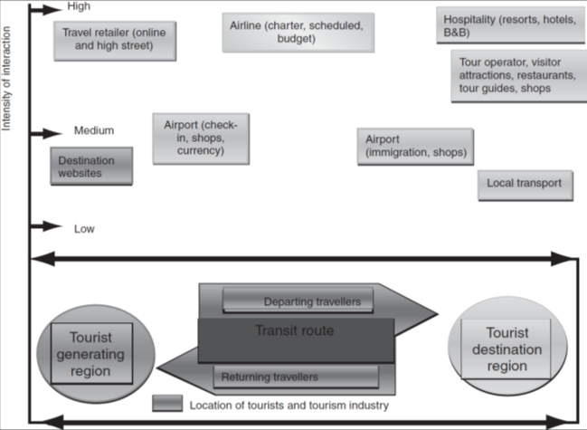
CABI TOURISM TEXTS
Fig. 8.2. The tourism experiences and encounters (adapted from Baum, 2002).

Slide 12
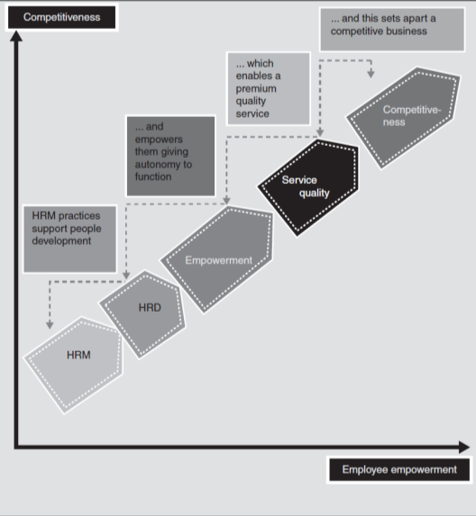
CABI TOURISM TEXTS
Fig. 8.3. Employee empowerment for competitiveness in tourism (adapted from Fáilte Ireland, 2005). HRD, human resource development; HRM, human resource management.

Slide 13
CABI TOURISM TEXTS
Conclusion (1/3)
Advantages associated with empowerment
Empowerment:
is a short- and long-term cost-effective approach;
is an offensive and defensive technique resulting in:
  retention of profit centres; and
  increased profitability;
optimizes strategy;
is a long-term strategic differentiating factor;
is an internal and external marketing tool to attract and retain staff;
results in the humanization of the work environment;
reduces gaps between employee and consumer; and
assists in the movement towards exploring new approaches and markets.

Slide 14
CABI TOURISM TEXTS
Conclusion (2/3)
Potential benefit to employees:
more motivating;
more interesting;
a better way to work;
increased flexibility;
increased fulfilment;
easier way to fulfil obligations;
job enrichment;
chance to develop new skills;
opportunity to shape future activities;
opportunity to demonstrate additional skills; and
formal recognition of added value contributions.

Slide 15
CABI TOURISM TEXTS
Conclusion (3/3)
Potential benefit to customers:
better experience;
added value;
increased feeling of personal worth;
requests addressed more promptly;
requests addressed with more relevance; and
increased personalization of services.

Slide 16
CABI TOURISM TEXTS
Questions and Tasks
List five of the main advantages and benefits associated with empowering staff.
One form of empowerment (delayering) is aimed at managers rather than frontline personnel; what does delayering mean?
How would you handle the following objections to empowerment?
  ‘It’s just an excuse for people to chat.’
  ‘It’s a waste of time.’
  ‘Our staff can’t be trusted.’
  ‘They don’t have what it takes.’
  ‘We’re encouraging people to do what they want, rather than do what we want.’
  ‘Staff just use it to make themselves look good.’

