Slide 1

CABI TOURISM TEXTS
3rd Edition
Strategic Management
In Tourism
Edited by
LUIZ MOUTINHO AND
ALFONSO VARGAS SÁNCHEZ
COMPLIMENTARY TEACHING MATERIALS

Slide 2

CHAPTER 7
CABI TOURISM TEXTS
STRATEGIC INNOVATION IN TOURISM BUSINESS
ANNE-METTE HJALAGER

Slide 3
CABI TOURISM TEXTS
LEARNING OBJECTIVES
After studying this chapter you should be able to:
Reflect on the need for strategic innovation efforts in tourism
Distinguish categories of innovations
Understand managers’ strategic choice concerning innovation processes
Determine driving forces and the potentials they represent for tourism businesses
Select information sources that can guide innovation processes

Slide 4
CABI TOURISM TEXTS
STRATEGIC INNOVATION DEFINED
Strategic innovation is the determined, targeted, planned and measured pursuit of such changes in organizations that lead to the introduction of new products/services, new production processes, supply chain links, managerial revisions, communication changes and institutional paradigm shifts.
Strategic innovation is a dimension of the strategic management discipline, and thus innovation is included and embedded in comprehensive attempts of an organization to achieve and maintain a competitive advantage.

Slide 5
CABI TOURISM TEXTS
Episodic change and innovativeness
Continuous change and innovativeness
Two approaches to strategic innovation in organizations
Innovation is something extraordinary , planned by top management
Innovation is part of everyday life for all employees

Slide 6
CABI TOURISM TEXTS
Product/service innovations
Process innovations
Supply chain innovations
Management innovations
Communications innovations
Institutional innovations
Types of
innovations

Slide 7
CABI TOURISM TEXTS
DRIVING FORCES FOR INNOVATIONS
Technology-driven innovations
Research-driven innovations
Supplier-driven innovations
Price- and cost-driven innovations
Employee-driven innovations
Customer-driven innovations
Legislation-driven innovations

Slide 8
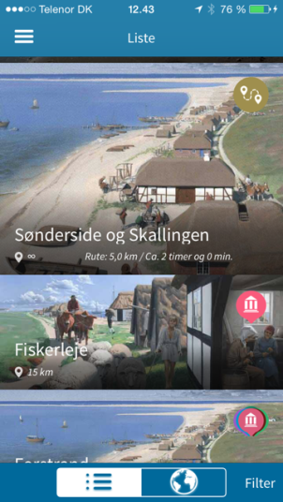
CABI TOURISM TEXTS
TECHNOLOGY-DRIVEN INNOVATIONS
Innovations in ICT and materials that affect tourism and create tourism related innovations of products, services, processes etc.
Example: Mobile apps have had a big impact on tourism information, guiding and experience development

Slide 9
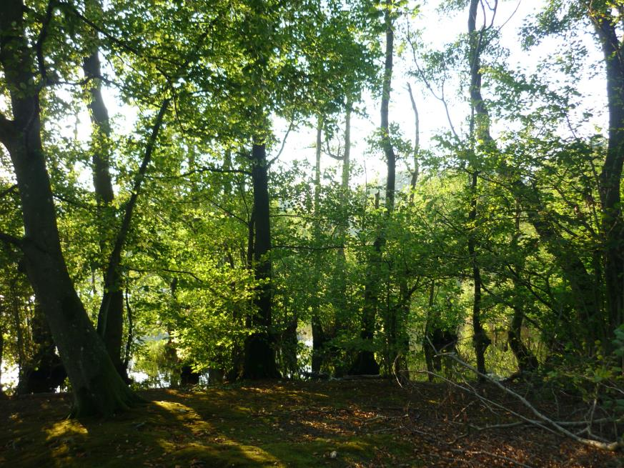
CABI TOURISM TEXTS
RESEARCH-DRIVEN INNOVATIONS
Scientific research delivers results that can enhance and change tourism products.
Example: Forest idyll – important in national parks and part of touristic infrastructures.
Scientists deliver evidence to ensure the enviromental sustainability and contribute to the preservation of species. Their evidence affects the interpretation that tourists consume.

Slide 10
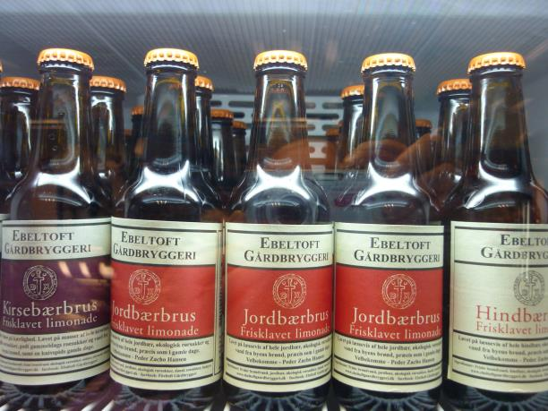
CABI TOURISM TEXTS
SUPPLIER-DRIVEN INNOVATIONS
Many tourism enterprises do not put a great effort into innovation, but they may appear to be innovative because they understand to implement products and systems developed by their suppliers.
Example: Fancy food items can contribute to restaurants’ innovative image. Some restaurants work closely with their suppliers to co-create for mutual benefits.

Slide 11
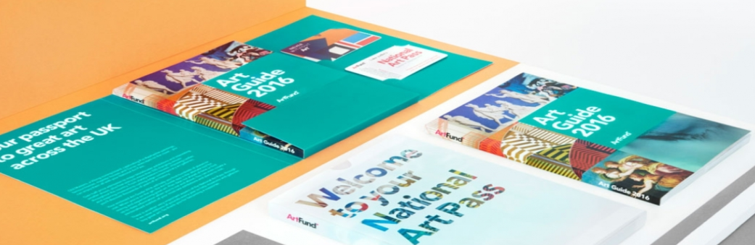
CABI TOURISM TEXTS
PRICE- AND COST-DRIVEN INNOVATIONS
Productivity and profitability are the main challenges in the tourism industry. It is necessary to work innovatively with price mechanisms, yield management etc.
Example: Loyalty programmes are well known from airlines and hotels, and the methods are constanctly evolving. Moreover, the ideas are floating to other tourism sectors as well, for example restaurants and cultural attractions. Photo: National Art Pass www. Artfund.org

Slide 12
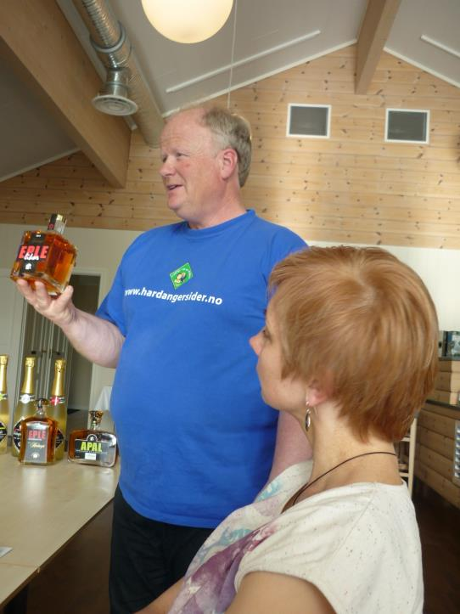
CABI TOURISM TEXTS
EMPLOYEE-DRIVEN INNOVATIONS
Employees are in close contact with guests, and the insights they get, when properly retrieved and handled, can be of importance for innovations
Example: This employee may go back to his boss and suggest that the set-up bores the customers, and he may also be encouraged by his manager to propose relevant innovative changes

Slide 13
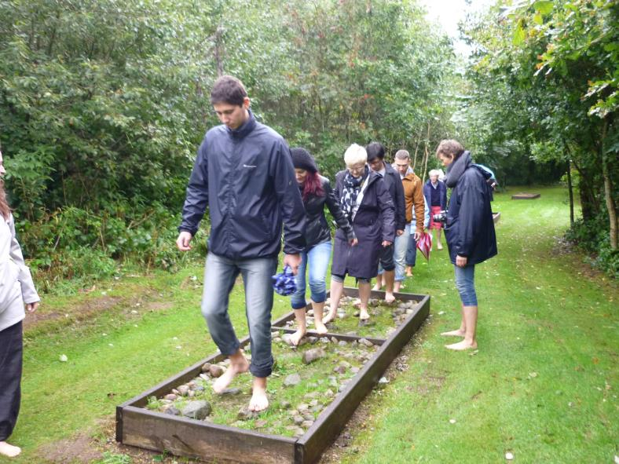
CABI TOURISM TEXTS
CUSTOMER-DRIVEN INNOVATIONS
Customers deliver information for innovation all the time, but tourism enterprises need to tap and use the information in purposeful ways.
Example: A group of expert ‘lead users’ testing the facilities in a wellness barefoot garden, afterwards discussing their findings and proposals with the proprietor over a cup of coffee.

Slide 14
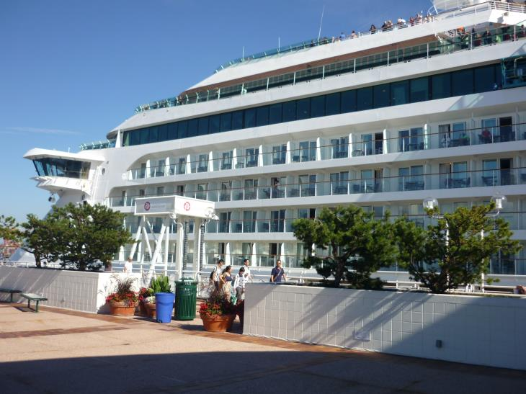
CABI TOURISM TEXTS
LEGISLATION-DRIVEN INNOVATIONS
Laws and regulation accumulate much information of value in innovation processes. New regulation can, at best, stimulate innovation.
Example: Cruising can be unsafe. Cruising companies are under strict legal control and supervision. Some of them use this as an opportunity to invent new technological systems, to implement staff training programmes and to remodel customer information and marketing

Slide 15
CABI TOURISM TEXTS
CONCLUDING REFLECTIONS
Do all tourism enterprises need to be innovative? Why/why not?
What are the fundamental tasks of a innovation manager in a small- and medium-sized tourism enterprise?
What types of external alliances are relevant for tourism enterprises that do not, in-house, possess a sufficient innovation capacity?
Will customers demand more innovative products, and how do tourism enterprises prioritize their innovation endeavour?

