Slide 1

CABI TOURISM TEXTS
3rd Edition
Strategic Management
In Tourism
Edited by
LUIZ MOUTINHO AND
ALFONSO VARGAS SÁNCHEZ
COMPLIMENTARY TEACHING MATERIALS

Slide 2

CHAPTER 6
CABI TOURISM TEXTS
STRATEGIC CREATIVITY IN TOURISM BUSINESS Kanes K. Rajah

Slide 3
CABI TOURISM TEXTS
LEARNING OBJECTIVES
To explain the context for the chapter in terms of the experience economy and the attention economy.
To discuss what creativity is all about and why creativity based approaches can be strategically a more effective way to plan ahead and offer new options to tourism.
To provide ideas, approaches and techniques to assist those in tourism to solve problems and identify new opportunities for the sector.

Slide 4
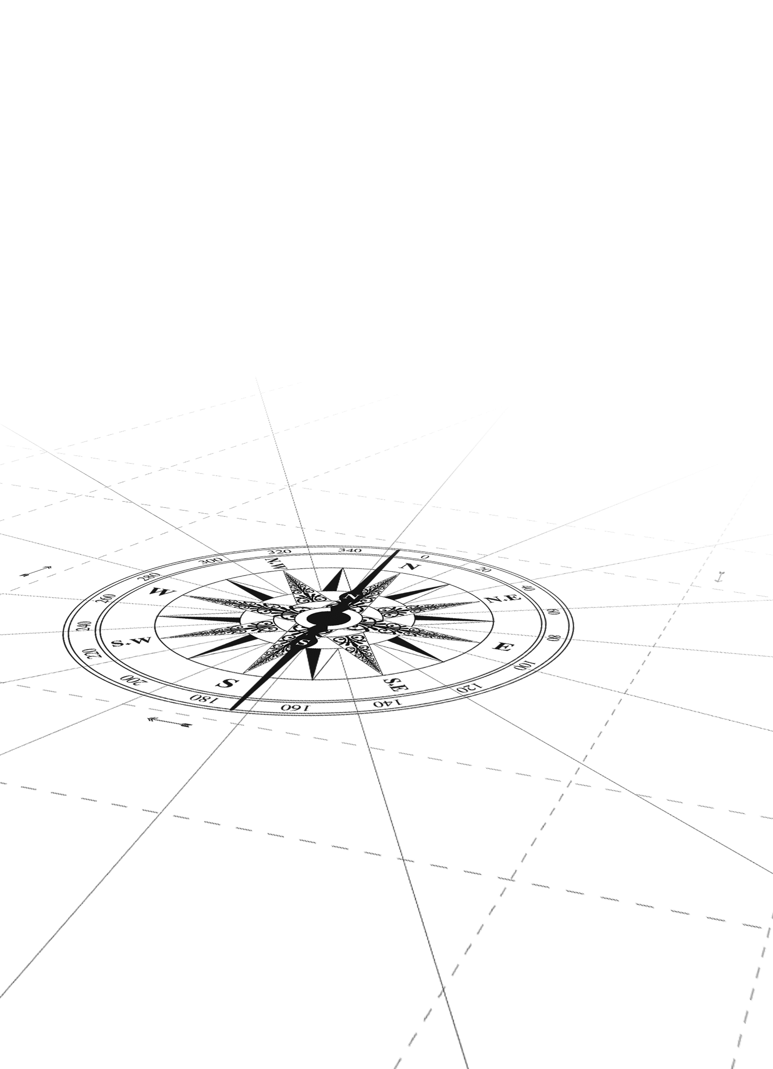
CABI TOURISM TEXTS
1
The experience economy
Economic change as going from the agrarian economy to the goods based industrial economy which led to the service industry and resulted in what we now have as the experience economy (Pine and Gilmore, 1998).
Experience has value.

Slide 5
CABI TOURISM TEXTS
1
The attention economy
‘...in an information-rich world, the wealth of information means a dearth of something else: a scarcity of whatever it is that information consumes. What information consumes is rather obvious: it consumes the attention of its recipients. Hence a wealth of information creates a poverty of attention and a need to allocate that attention efficiently among the overabundance of information sources that might consume it’ (Simon 1971, pp. 40–41)
Information that attracts attention has value.

Slide 6
CABI TOURISM TEXTS
Entrepreneurship, innovation and strategy
1
Ventures that seek growth, think strategically and use innovation are called entrepreneurial organizations
(Wickham, 2006)
Strategy
Innovation
Growth
People who behave like this are called entrepreneurs
Organizations that don’t show these attributes remain micro-enterprises or as just small businesses

Slide 7
CABI TOURISM TEXTS
2
WHAT IS CREATIVITY?
Gregory (1967) defined it as ‘The production of an idea, concept, creation or discovery that is new, original, useful or satisfying to its creator or someone else in some period of time’.
However, it could be simply defined as ‘coming up with a unique idea which is fit for purpose’.

Slide 8
CABI TOURISM TEXTS
Kirton’s Adaptors and Innovators – Cognitive behaviour that influences your creative responses
2
Strong adaptors show a preference for detail, operate in an incremental way and take decisions in incremental steps. They are considered to be low in taking risk and therefore may spend more time reducing or guarding against risk during change. This makes them appear more reliable but the downside is they may take too long in arriving at decisions.
Strong innovators are more holistic and if there is sufficient detail to satisfy them may move on to take decisions. This could sometimes be too hasty as they may miss important points in the small print. However, they are able to connect disparate bits of information to come up with extraordinary new thought and take the big moves very daringly.

Slide 9
CABI TOURISM TEXTS
KAI scores on a 100 point continuum
(Kirton, 1980)
2
I do it better
I do it differently
32
96
160
Innovators
Adaptors
KAI Norm

Slide 10
Summary of Adaptor-Innovator Styles
CABI TOURISM TEXTS
2
ADAPTOR | INNOVATOR
Seeks solutions to problems in tried and tested ways | Queries definitions of problems and their solutions
Maintains accuracy and attention to detail over long periods of time | Easily bored and quick to delegate routine tasks
Rarely challenges the rules but is well able to use the space within them | Has little respect for past customs
Prefers to work within given structures and may find it difficult to break out | Creates own structures but may have difficulty in getting others to accept them

Slide 11
CABI TOURISM TEXTS
Fact Finding
(2)
Objective Finding
(1)
The first three stages are about problem definition
Otherwise you could end up solving the wrong problem! It is therefore very important to spend some time getting this right.
Acceptance
Finding
(6)
Problem Finding
(3)
Idea Finding
(4)
Solution Finding
(5)
The next two stages are about idea generation
If you know what the problem is, finding the right ideas to solve it is always a challenge. It helps to use techniques that tap into different mental modes for ideas.
3
STRATEGIES FOR SOLVING PROBLEMS AND CREATING OPPORTUNITIES
The final stage is about Implementation
Setting out the right strategies to ensure success is a fine art and a structured approach will help increase the chance for success. It is also about successful project management
Fig. 6.1: CREATIVE PROBLEM–SOLVING MODEL (CPS)

Slide 12
Divergence and Convergence
CABI TOURISM TEXTS
To be able to use divergence and convergence in finding solutions to problems or the right opportunities to take forward, the prerequisites are:
Suspend judgement and
Avoid premature evaluation
Divergence and convergence is necessary at each stage of the CPS process. Always start each stage with divergence, i.e. using different ways to thinking about a particular issue. Converge when all avenues for more information have been exhausted. During convergence select only what you judge will work

Slide 13
An instant checklist for problem solving
Kipling’s Serving Men
CABI TOURISM TEXTS
Rudyard Kipling’s poem (1902) goes:
I keep six honest serving men
(They taught me all I knew);
Their names are What and Why and When
And How and
Where and Who.
Whatever problem one is dealing with, these six questions are likely to provide a great deal of information. This is also relevant to other chapters in the book.

Slide 14
Two different approaches to
Creative Problem Solving and Opportunity Finding
CABI TOURISM TEXTS
Structured approach
Random approach
Tree diagram
Step 1 – Set out the main problem or issues.
Step 2 – Break down by pulling out 2–3 main sub issues that are highly important and make up much of what this problem/issue is about.
Step 3 or more steps as necessary – Pull down two or more relevant points that make up each sub-issue.
Mind Maps by Tony Buzan
Follow the rules for a mind map as shown in the book.

