Slide 1

CABI TOURISM TEXTS
3rd Edition
Strategic Management
In Tourism
Edited by
LUIZ MOUTINHO AND
ALFONSO VARGAS SÁNCHEZ
COMPLIMENTARY TEACHING MATERIALS

Slide 2
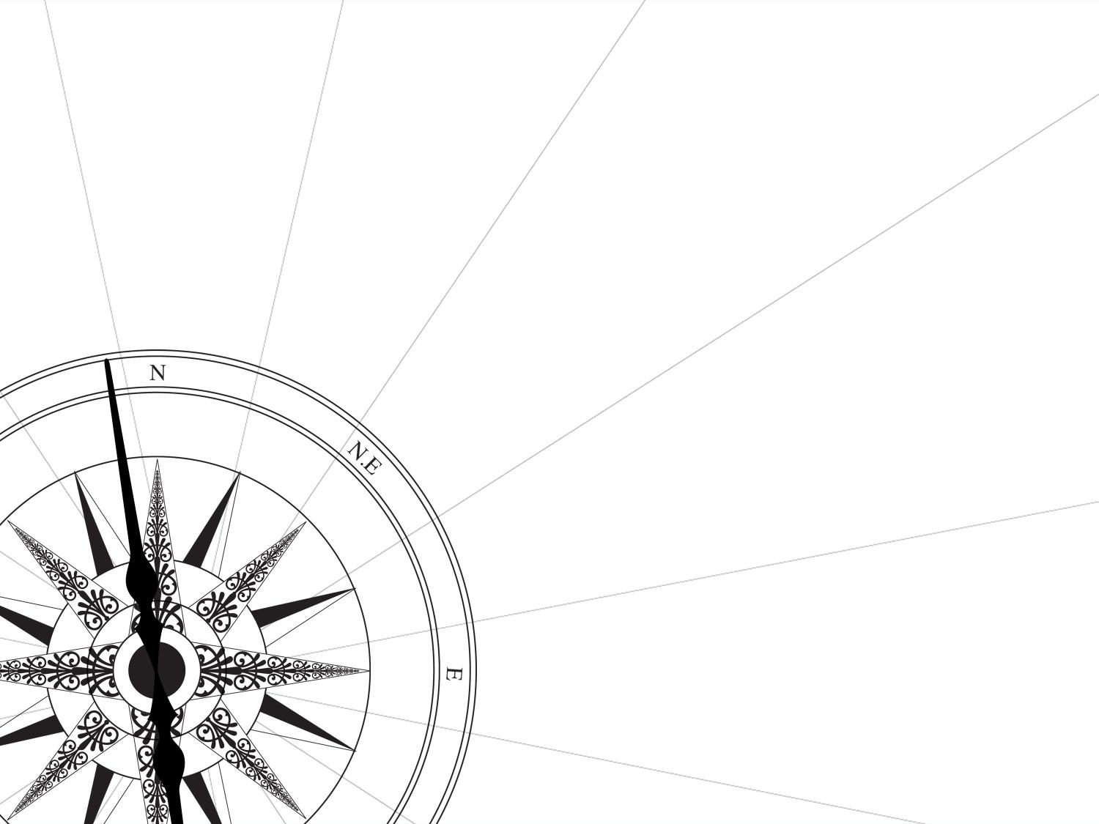
CHAPTER 5
CABI TOURISM TEXTS
CONSUMER BEHAVIOUR IN TOURISM
RONNIE BALLANTYNE, LUIZ MOUTINHO AND SHIRLEY RATE

Slide 3
CABI TOURISM TEXTS
LEARNING OBJECTIVES
To explore the nature of consumer behaviour within the tourism arena.
Identify and discuss key internal and external facets that influence consumer decision making.
Explore and illuminate the nature of consumer decision making processes.

Slide 4
CABI TOURISM TEXTS
1
UNDERSTANDING CONSUMER BEHAVIOUR IN TOURISM
If one is to develop Tourism Marketing with Magnetism, consider right product, right place, right time with right technology, we must isolate and understand the key touchpoints or sweet spots that consumers desire in their unique decision making journeys.
Understanding and predicting consumer behaviour is a central issue to marketing practitioners within the tourism arena.

Slide 5
CABI TOURISM TEXTS
2
DEFINING CONSUMER BEHAVIOUR IN TOURISM
Consumer behaviour can easily be conceptualized as the process of acquiring and organizing information in the direction of a purchase decision. That said, it is not easy to fully address the question ‘Why do people travel?’ The dynamic process of moving from need, to want, to desire and, ultimately, to demanding fully formed tourism experiences, is relatively complex.

Slide 6
CABI TOURISM TEXTS
3
THE COGNITIVE APPROACH
This process typically encompasses the stages of searching for, purchasing, using, evaluating and disposing of products and services. This paradigm follows a cognitive approach and maps a cycle from stimulation, including motivation and intention formulation, actual behaviour and experience, evaluation and retention of consequences.

Slide 7
CABI TOURISM TEXTS
4
REFERENCE GROUPS
People turn to particular groups for their standards of judgement. Human beings tend to make sense of reality by looking towards others’ behaviour. Any person or group – real or imaginary – that serves as a point of reference for an individual is said to stand as a reference group. It exerts a key influence on the individual’s beliefs, attitudes and choices.

Slide 8
CABI TOURISM TEXTS
5
VIRTUAL REFERENCE GROUPS
Technology has dramatically changed the way in which consumers now interact with each other and businesses (as well as the aforementioned traditional modes of reference group we are now in the age of the virtual reference groups), the rise of social networking and consumer blogging literally gives the user unlimited access and exposure to other ‘trusted’ opinions, views and attitudes to every manner of products and services available.

Slide 9
CABI TOURISM TEXTS
6
SELF-IMAGE
Purchase intentions relating to some products tend to be correlated and demonstrate congruence with self-image, while those relating to other products are correlated with the ideal self-image.

Slide 10
CABI TOURISM TEXTS
7
PERCEPTION AND COGNITION
Perception is the process by which an individual selects, organizes and interprets stimuli in a meaningful and coherent way. A stimulus is any unit of input affecting any of the senses. Perceiving stimuli involves exposure, reception and assimilation of information.

Slide 11
CABI TOURISM TEXTS
8
MOTIVATION
Motivation refers to a state of need, a condition that exerts a ‘push’ on the individual towards certain types of action that are seen as likely to bring satisfaction. Vacation tourist motivation is greatly determined by social factors and is related to the need for optimal arousal. We have a need for stability as well as for novelty. In the case of travelling there are usually multiple motives, based on the tourist’s expectations of what will be gained from the purchase.

Slide 12
CABI TOURISM TEXTS
9
ATTITUDE
An attitude is a predisposition, created by learning and experience, to respond in a consistent way towards an object, such as a product. This predisposition can be favourable or unfavourable. Attitudes are generally considered to have three components: cognitive, affective and conative.

Slide 13
CABI TOURISM TEXTS
10
INTENTION
Intention indicates the likelihood of purchasing a tourist product; it is the readiness-to-buy concept. Behavioural intention is said to be a function of: (i) evaluative beliefs towards the tourist product; (ii) social factors which tend to provide a set of normative beliefs for the tourist; and (iii) situational factors than can be anticipated at the time of the vacation plan or commitment.

Slide 14
CABI TOURISM TEXTS
11
DECISION-MAKING PROCESS
Most models deal with five different steps in the decision process:
problem identification;
information search;
evaluation of alternatives;
choice; and
post-choice.

Slide 15
CABI TOURISM TEXTS
12
THE EVOKED SET
As consumers are increasingly pressured in terms of time and the number of choice alternatives that now exist, they have developed decision-making heuristics that act as short cuts – in order to simplify the decision-making process. Sophisticated ‘phased’ or ‘funnel’ decision-making methods have emerged where consumers screen out unacceptable choice alternatives, preserving decision-making energy and time to evaluate between a smaller reduced subset of brands; this is commonly referred to as the ‘choice set’ or ‘evoked set’.

Slide 16
CABI TOURISM TEXTS
13
THE NEW CONSUMER JOURNEY
With the majority of consumers now beginning their journey on-line, and on mobile devices – more and more attention is being placed on blended content. Getting the right balance with content – both user generated and curated – is and will continue to be a dominant theme. Content must Inspire and Help; it must be Authentic and Trustworthy and it must be ‘evergreen’ – content must be reviewed and updated 365 days a year. This is necessary to build Authority so as to encourage the transformation from prospect to consumer.

