Slide 1

CABI TOURISM TEXTS
3rd Edition
Strategic Management
In Tourism
Edited by
LUIZ MOUTINHO AND
ALFONSO VARGAS SÁNCHEZ
COMPLIMENTARY TEACHING MATERIALS

Slide 2
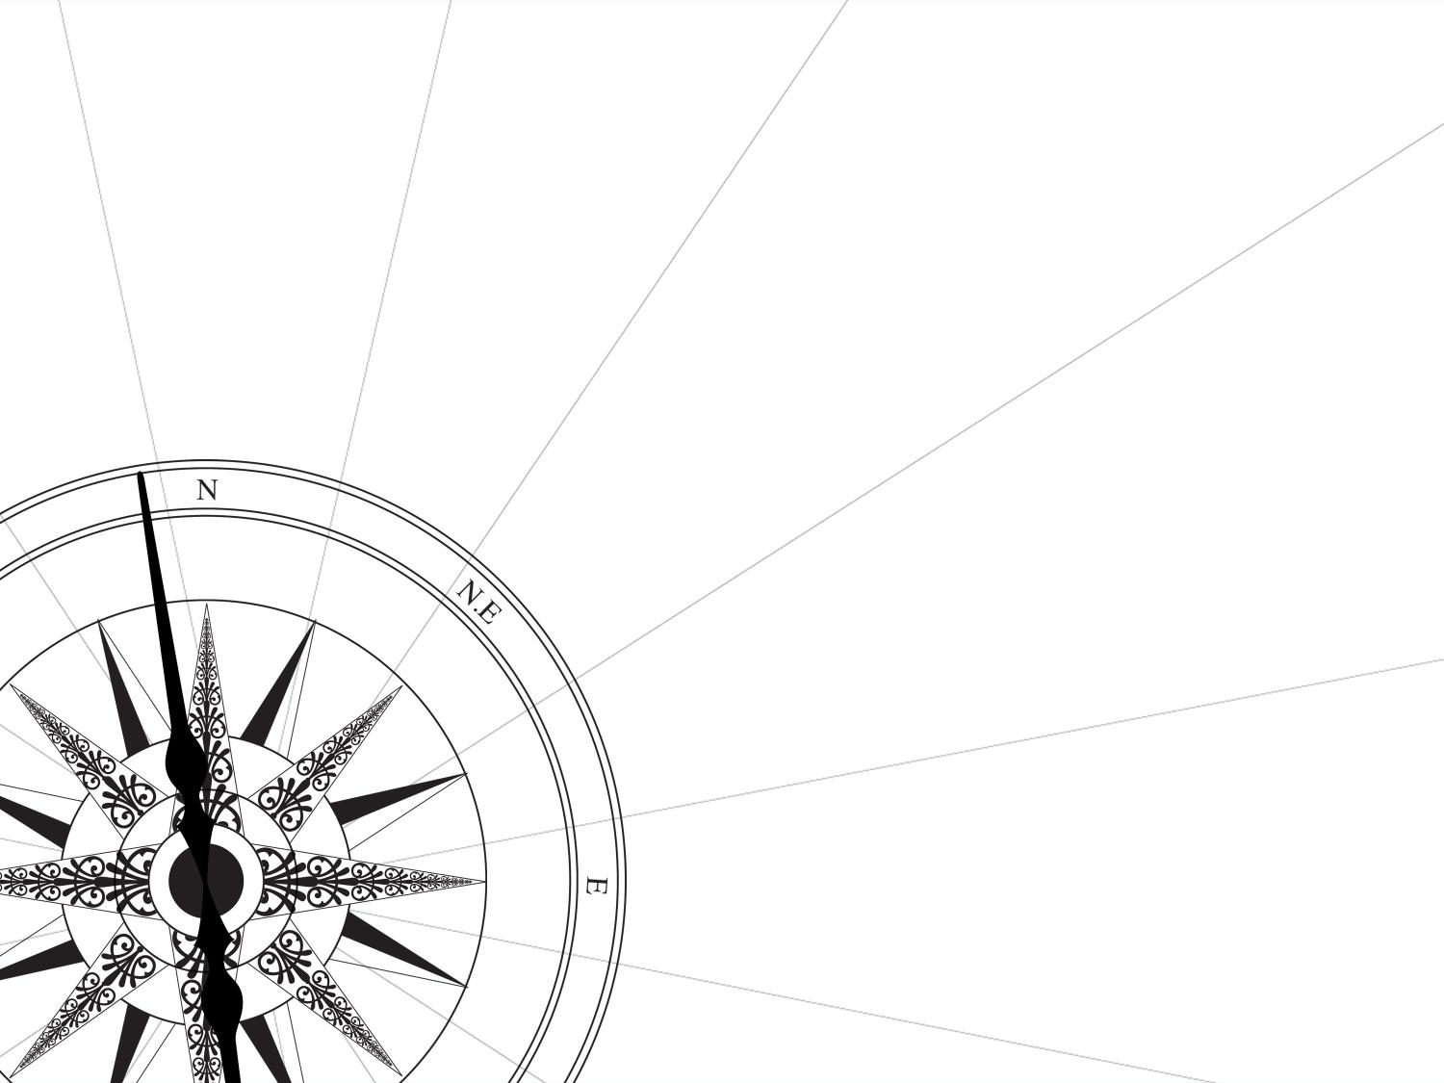
CHAPTER 2
CABI TOURISM TEXTS
FUTURECAST APPLIED TO TOURISM
SHIRLEY RATE, LUIZ MOUTINHO AND RONNIE BALLANTYNE

Slide 3
CABI TOURISM TEXTS
LEARNING OBJECTIVES
To explore the concept of futurecasting in the tourism sector.
To examine the growth and nature of emerging markets in tourism.
To analyse consumer mega-trends in the tourism business environment and the implications of these of marketing decision making.
To explore new marketing paradigms in the context of environmental change.

Slide 4
CABI TOURISM TEXTS
1
FUTURECASTING
By tracing and understanding key trends and developments in the new business environment the tourism strategist gains invaluable decision-making intelligence that allows him or her to ‘futurecast’. In effect tourism operators will have the ability to ‘see’ events before they occur, allowing strategic decision makers to develop innovative and effective strategic tourism initiatives. Moreover, this approach allows companies not only to anticipate major shifts in the environment but also to try to influence these changes.

Slide 5
CABI TOURISM TEXTS
2
FUTURECASTING IN TOURISM
MARKETING PARADIGM SHIFTS
Emerging Markets
Consumer Mega-Trends

Slide 6
CABI TOURISM TEXTS
3
EMERGING MARKETS
Emerging Consumer Markets
The Golden Mafia
The Feminization of Markets
The Why Generation

Slide 7
CABI TOURISM TEXTS
4
CONSUMER MEGA-TRENDS
Consumer Mega-Trends
Empowerment
Socio-Cultural Shifts
The New Tourism Consumer
Transumers Seeking Insperiences
Rehumanization
The Prosumer
The Minipreneur

Slide 8
CABI TOURISM TEXTS
5
MARKETING PARADIGM SHIFTS
The application of futurecasting reveals seismic shifts in the tourism business environment from the emergence of markets which will dominate future consumption to the proliferation of socio-economic trends which will impact on the type of consumption behaviours the tourism sector will see in the coming years. The impact of these issues is significant and the purpose of applying futurecasting is to position tourism marketers to best respond to them. New marketing paradigms have emerged in an effort to support marketers.

Slide 9
CABI TOURISM TEXTS
6
MARKETING PARADIGM SHIFTS
Neomarketing | Adopting neomarketing will see a move towards customer-centricity which will demand an entire and revolutionary change in the approach to the consumer. Customer-centricity is when customers lead the design of business processes, products, services and business models.
Particle Marketing | Particle marketing represents a new way of thinking beyond the boundaries and restraints of traditional market segmentation. It requires the use of personal technologies to customize micro-individual offerings.
Consumer Interaction | Increasingly, consumers are demanding interactivity with brands. The focus must shift from linear forms of communication to more interactive or co-created communication.
Evolutions and Revolutions in Branding | Brands must evolve on the basis of an intelligent dialogue with customers to create emotional authenticity and value. The emotional value is the economic value or momentary worth of feelings when consumers positively (or negatively) experience branded products and services.

