Slide 1
CABI TOURISM TEXTS
3rd Edition Strategic Management
In Tourism
Edited by
LUIZ MOUTINHO AND ALFONSO VARGAS SÁNCHEZ
COMPLIMENTARY TEACHING MATERIALS

Slide 2
CHAPTER 17
CABI TOURISM TEXTS
Stakeholder Engagement in Tourism.
Scott McCabe

Slide 3
CABI TOURISM TEXTS
LEARNING OBJECTIVES
Understand the significance of stakeholder engagement to strategic management in tourism
Be familiar with theories of stakeholder engagement and management
Apply stakeholder engagement approaches to tourism contexts

Slide 4
CABI TOURISM TEXTS
1
STRATEGIC MANAGEMENT CHALLENGE IN TOURISM
Tourism involves diverse actors working towards a common goal,
It is a complex service performance, delivered by a fragmented set of providers,
Tourism is particularly vulnerable to exogenous forces,
Tourism businesses can be affected by the actions of other actors in the system,
The industry is characterized by increasing competition and pressure on resources.

Slide 5
CABI TOURISM TEXTS
1
REQUIRES STAKEHOLDER MANAGEMENT
Stakeholders are ‘…any group or individual who can affect or is affected by the achievement of the organization's objectives’ (Freeman, 1984, p. 46)
Tourism stakeholders are networks of public and private sector organizations, including communities, where the sources of value are not simply concerned with profit or customer value.
Requires focus on relationships, which can result in mutual benefits being established and sought as a network outcome.

Slide 6
CABI TOURISM TEXTS
2
Stakeholder analysis
Identify individuals and groups who are potentially affected by our actions.
Prioritize them for inclusion into our decision-making processes.
Set engagement and communication strategies for each group.
Resource the engagement strategies, monitor outcomes.

Slide 7
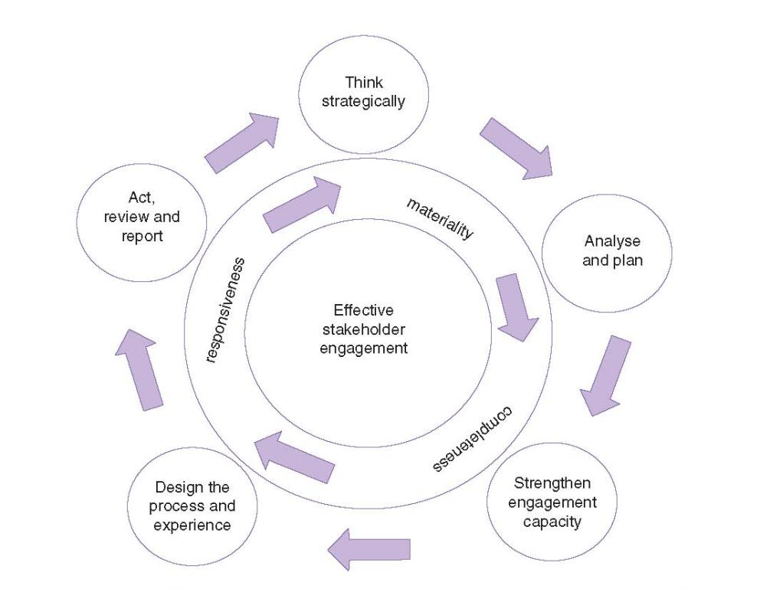
CABI TOURISM TEXTS
2
Processes for effective stakeholder engagement

Slide 8
CABI TOURISM TEXTS
3
STRATEGIES
Stakeholder mapping, analysis and management.
Scenario based design for collaborative engagement and innovation.
Requires a mindset of responsibility and a commitment to the delivery of engagement.

Slide 9
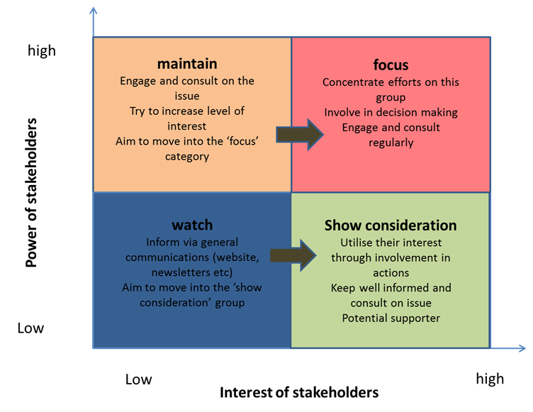
CABI TOURISM TEXTS
Stakeholder analysis and management tool
Mapping the power and interests of your stakeholders will enable you to channel resources and efforts to optimize outcomes.

