Slide 1

CABI TOURISM TEXTS
3rd Edition
Strategic Management
In Tourism
Edited by
LUIZ MOUTINHO AND
ALFONSO VARGAS SÁNCHEZ
COMPLIMENTARY TEACHING MATERIALS

Slide 2
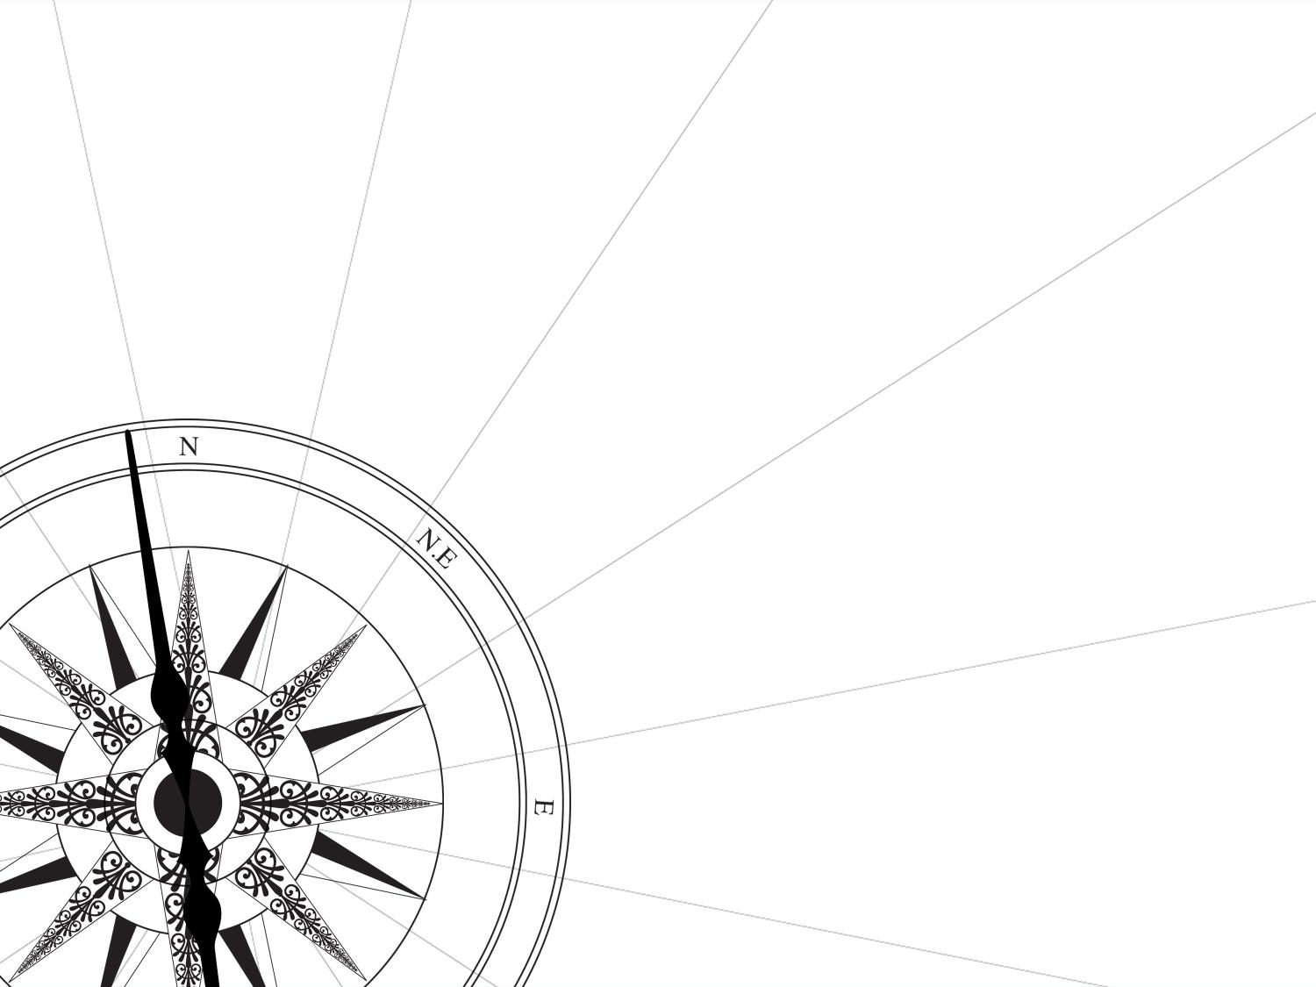
CHAPTER 16
CABI TOURISM TEXTS
Crisis Management and Strategic Implications
YAWEI JIANG, NOEL SCOTT AND BRENT RITCHIE

Slide 3
CABI TOURISM TEXTS
LEARNING OBJECTIVES
Discuss the development of crisis management
Relate crisis management and strategic management
Provide areas for further research

Slide 4
CABI TOURISM TEXTS
1
CRISIS MANAGEMENT
Tourism is vulnerable to internal and external shocks such as:
Economic downturns
Epidemic disease
International conflicts

Slide 5
CABI TOURISM TEXTS
2
RIPPLE EFFECT
Crisis in one region or country may trigger a global tourism crisis due to tourism’s interactive links:
The spread of foot and mouth disease in the UK triggered a crisis in the farming industry that impacted on the tourism industry.
The war in Kosovo had negative impacts on tourism in neighbouring countries.

Slide 6
CABI TOURISM TEXTS
3
DEFINITION OF CRISIS
‘Any action or failure to act that interferes with an organization’s ongoing functions, the acceptable attainment of its objectives, its viability or survival, or that has a detrimental personal effect as perceived by the majority of its employees, clients or constituents.’
Faulkner (2001, p.136)

Slide 7
CABI TOURISM TEXTS
4
MAIN APPROACHES TO STUDY CRISIS
Life-cycle approach
Strategic crisis management approach
Action-orientation crisis management approach
Integrated approach

Slide 8
CABI TOURISM TEXTS
STRATEGIC MANAGEMENT AND LIFECYCLE OF CRISIS
Lifecycle of crisis | Stage of process | Key tasks
Pre-event stage allowing the development of strategy and plans | Strategic analysis | examining the macro or micro operating environment
A stage immediately before or after a crisis or disaster occurs which requires the implementation of strategies to deal with its impacts | Strategic direction and choice | developing and selecting strategic directions and specific generic strategies to achieve organisational goals
Continued implementation of strategies to control or reduce the severity of the crisis/disaster | Strategy implementation and control | developing suitable organisational structures, human and financial resource strategies providing leadership to control and allow for the implementation of specific strategies
A long-term recovery or resolution phase allowing for evaluation and feedback into future prevention and planning strategies for destinations and businesses | Strategic evaluation and feedback | continuous improvement is an important part of strategic planning and management organisations learn how to improve the effectiveness of strategies through evaluation, monitoring and adaptive management

Slide 9
CABI TOURISM TEXTS
5
FUTURE RESEARCH
Organizational resilience (OR)
Dynamic capabilities (DC)
Institutional analysis and development framework (IAD)

