Slide 1

CABI TOURISM TEXTS
3rd Edition
Strategic Management
In Tourism
Edited by
LUIZ MOUTINHO AND
ALFONSO VARGAS SÁNCHEZ
COMPLIMENTARY TEACHING MATERIALS

Slide 2

CHAPTER 15
CABI TOURISM TEXTS
International Strategies in Tourism
EDUARDO PARRA, VANESSA YANES, MERCEDES MELCHIOR AND JOSé ALBERTO MARTíNEZ

Slide 3
CABI TOURISM TEXTS
LEARNING OBJECTIVES
At the end of the chapter, the reader must be able to:
Assess the importance and the need to adopt, in the tourism sector, an international strategic approach.
Know and understand the evolution, factors, current situation and prospects of the international and strategic framework of the tourism sector and companies.
Make decisions concerning the international strategic development process that can follow the tourist companies.
Identify, understand and evaluate strategic internationalization processes that have followed in actual practice various tourist companies.

Slide 4
CABI TOURISM TEXTS
1
INTRODUCTION
The purpose of this chapter is to outline the importance of international strategic approach and know and understand the evolution, factors, current situation and prospects of the international and strategic framework of the tourism sector and companies.
In recent times, the tourism environment has undergone many changes. Tourism companies find themselves in an increasingly competitive environment and, whether or not internationalization is and will continue to be an advantageous step for any company, it seems reasonable to think that it is an opportunity that should at least be explored.

Slide 5
CABI TOURISM TEXTS
2
FACTORS DETERMINING A COMMITMENT TO TOURISM INTERNATIONALIZATION
The review of the analysed works revealed a series of factors in the tourism firm that are associated with commitment to internationalization:
Those focusing on the analysis of the internal factors that influence the tourism firm’s decision to enter overseas markets;
Those focusing on the differences in the internationalization commitment of a group of tourism firms wishing to produce abroad; and
Those focusing on explaining tourism firms’ intentions to internationalize or to increase international activity.

Slide 6
CABI TOURISM TEXTS
3
STRATEGIC ANALYSIS AS A KEY TO INTERNATIONALIZATION IN TOURISM
The strategic direction in the internationalization process of tourism is of vital importance, regarding strategic direction.
Strategic Key:
To have clear objectives to be achieved;
To constantly analyse the external factors;
To be aware of the organization’s strengths and weaknesses and;
To implement and control the direction to take.

Slide 7
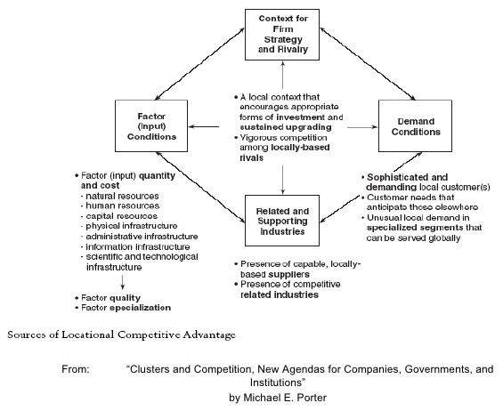
CABI TOURISM TEXTS
3.1
STRATEGIC ANALYSIS OF THE ENVIRONMENT
The environmental scanning that helps a touristic firm in the key decisions in its internationalization process.

Slide 8
CABI TOURISM TEXTS
3.1
STRATEGIC ANALYSIS OF THE ENVIRONMENT. The process of environmental scanning
Specify the firm’s information requirements
Specify the relevant sources of information
Select the participants in the process of analysis and allocate tasks
Develop a process of information storage, processing and distribution
TOOLS FOR CONDUCTING THE EXTERNAL ANALYSIS
• Typology of environments by means of cognitive maps
• Analysis of sector rivalry
• Strategic groups or the analysis of the most direct competition
• Scenarios

Slide 9
CABI TOURISM TEXTS
3.2
STRATEGIC ANALYSIS OF THE ENVIRONMENT. Internal strategic analysis
For the internal diagnosis, the tourism firm itself would have to evaluate the following groups of resources and capabilities (Barney, 1991; Grant, 1996):
Tangible resources
Intangible resources
Organizational capabilities
Internal factors that influence the entry mode
Firm size
Competences
Internal factors
International experience
Strategic and control factors

Slide 10
CABI TOURISM TEXTS
4
INTERNATIONAL STRATEGIES IN TOURISM
Askenas et al. (1995: 273) consider that firms committing to globalization have to address a number of critical challenges. They have to:
• establish a workable global structure;
• hire global super-managers;
• manage people for a global environment;
• learn to love culture differences;
• avoid parochialism and market arrogance;
• design a unifying mechanism and a global mindset; and
• overcome complexity.
Choice of the international entry mode
Organization networks
The management contract
International entry mode
Globalization strategy and multi-domestic strategy
The franchise

