Slide 1

CABI TOURISM TEXTS
3rd Edition
Strategic Management
In Tourism
Edited by
LUIZ MOUTINHO AND
ALFONSO VARGAS-SÁNCHEZ
COMPLIMENTARY TEACHING MATERIALS

Slide 2

CHAPTER 13
CABI TOURISM TEXTS
NEW PERFORMANCE MEASUREMENTS
LUIZ MOUTINHO AND ALFONSO VARGAS-SÁNCHEZ

Slide 3
CABI TOURISM TEXTS
LEARNING OBJECTIVES
Make clear the content of strategic control.
Highlight the usual barriers to be overcome when making strategy work.
Present various techniques for measuring the performance achieved, helping managers to find out to which extent the vision and objectives of the organization are being fulfilled.

Slide 4
CABI TOURISM TEXTS
1
INTRODUCTION
The purpose of this chapter is to outline the importance of managing the implementation of strategy as well as the stage of strategic control.
In this line, the usual barriers able to explain why many companies fail when implementing their business strategies are explained. Afterwards, a number of metrics for the performance measurement are offered.

Slide 5
CABI TOURISM TEXTS
2
WHY DO COMPANIES FAIL TO IMPLEMENT THEIR BUSINESS STRATEGIES?
VISION BARRIER:
only 5% of the workforce
understands the strategy
PEOPLE BARRIER:
Only 25% of managers have
Incentives linked to strategy
Four barriers
MANAGEMENT BARRIER:
85% of executive teams spend
less than one hour / month
discussing strategy
RESOURCES BARRIER:
60% of organizations don’t link
budgets to strategy
Source: Norton, D. Quoted by Paladino, R. (2007)

Slide 6
CABI TOURISM TEXTS
3
STRATEGIC CONTROL
The implementation of a strategy is monitored and measured through a series of metrics throughout the different levels of the organization. The challenge is to put in place measures or metrics that truly help to drive the organization’s strategy.
A sound understanding of financial performance is necessary, but not enough. As such, the general pattern of evolution of metrics appears to be broadening its scope with a miscellany of financial and non-financial metrics.

Slide 7
CABI TOURISM TEXTS
3
STRATEGIC CONTROL
What are the right things to measure in an organization? The things to measure are those things that make you successful. And what makes a company successful? Simple: delivering value to stakeholders. Therefore it only stands to reason that all metrics should be stakeholder-value driven.
There is a valuable guideline that managers should follow: measure the company's performance in all the critical areas in which objectives have been set.

Slide 8
CABI TOURISM TEXTS
3
Performance management
Strategic audit and critical areas: qualitative and quantitative measurements.
For making explicit the behaviour and results of each critical area, the observation of its various significant facets through a number of key indicators is recommended. A set of indicators creates a metric.
To understand its financial health, the company has to be analysed from other angles, which means that other metrics are needed to assess the performance of decisions related to other stakeholders.

Slide 9
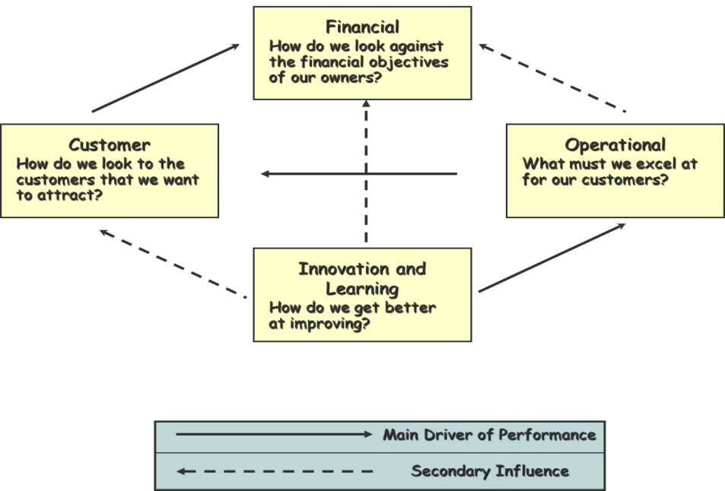
CABI TOURISM TEXTS
Standard physiognomy of the balanced scorecard (BSC), by Kaplan and Norton
Note: the perspectives of Innovation and Learning (or Learning and Growth) and Operational (or internal processes) are those under the managers' control. The other two are consequences of decisions made in these two spheres.

Slide 10
CABI TOURISM TEXTS
3
Frameworks for measuring performance
As a response to the growing concerns with the narrow focus on financial measurements, a number of frameworks (such as the BSC) have been developed in an attempt to better capture all of a company’s strategic goals and to overcome the lack of spotlight on the many other aspects of strategic performance.
Once the results achieved by the organization have been measured, they must be compared with certain standards: it is not possible to evaluate any result if it is not compared with some reference value.

Slide 11
CABI TOURISM TEXTS
3
Tourism metrics
To the extent that the business environment is increasingly volatile and unpredictable, the principles of evaluation of real options are becoming increasingly important. Flexibility has become a critical value. This is a new aspect to consider in the evaluation of a corporate strategy in tourism firms, for instance when deciding the mode of entry in a foreign market by hotel chains (from franchising to full ownership). The various modes of entry, associated with different levels of commitment in the assets control, will provide real options, that is, flexibility with diverse intensities, depending upon the level of uncertainty and risk factors in the new market.

Slide 12
CABI TOURISM TEXTS
4
CONCLUSION
In essence, strategic control has the object of ensuring that all the ideas and proposals agreed and planned during the strategic management process are put into effect and become reality.
The function of control/supervision based on feedback allows corrective actions to be taken, based on the information provided by the analysis of detected deviations. But an ‘a posteriori’ control system is too weak in the context of an anticipatory strategic attitude; therefore what is also needed is the application of an ‘a priori’ control that allows preventive rather than corrective measures to be taken.
Therefore, the purpose of control in strategic management is not only to ensure compliance with the plans, but also to drive a continuing process of strategic reflection.

