Slide 1

CABI TOURISM TEXTS
3rd Edition
Strategic Management
In Tourism
Edited by
LUIZ MOUTINHO AND
ALFONSO VARGAS SÁNCHEZ
COMPLIMENTARY TEACHING MATERIALS

Slide 2
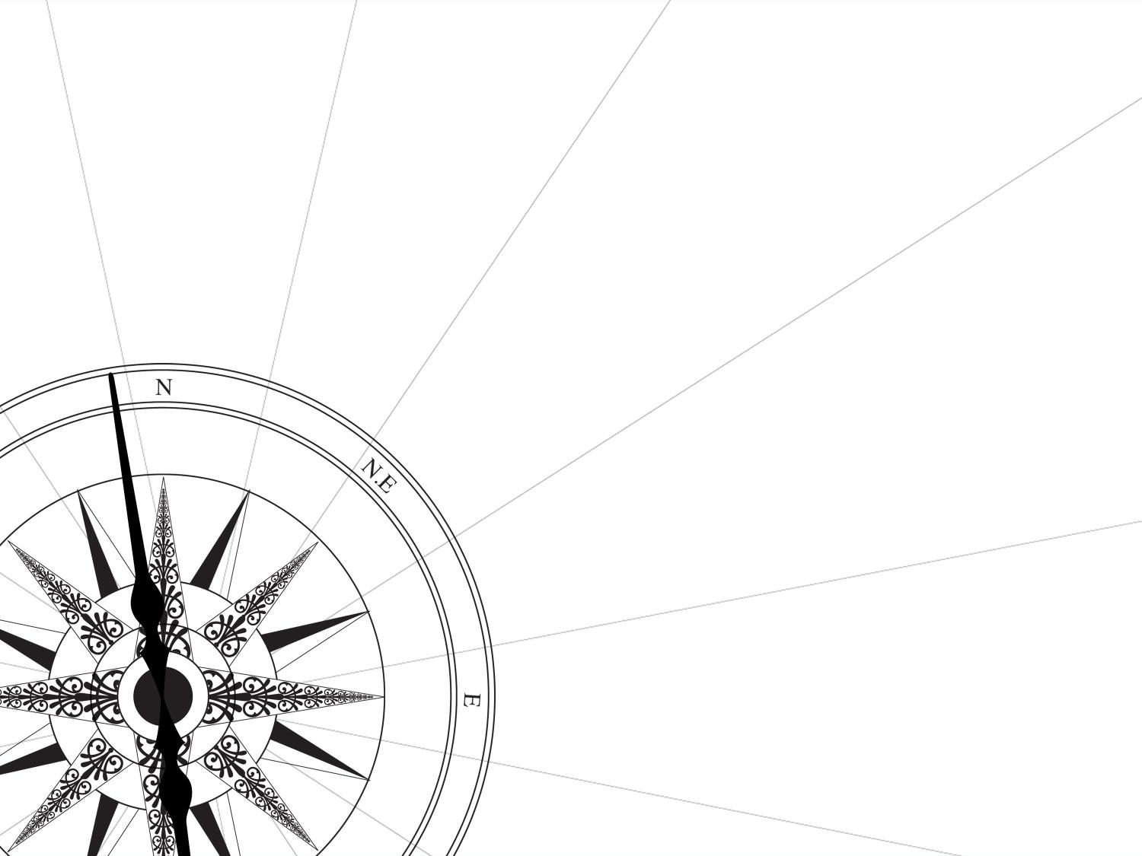
CHAPTER 12
CABI TOURISM TEXTS
TOWARDS A NEW STRATEGIC PARADIGM
Rafael Alberto Pérez and Alejandro Pérez-Ferrant

Slide 3
CABI TOURISM TEXTS
LEARNING OBJECTIVES
Report on the more significant changes in approach to strategy over the past 25 years.
Focus on the two re-foundation projects: the New Strategic Theory (NST) and the Half Moon Bay Group.
Determine to what point we are faced with a new emergent paradigm of complexity, non-linearity and fluidity, guided by the NST.
Raise awareness about the NST and its proposals and scope.
Adapt these ideas to the tourism sector and verify how the complex ideas behind the NST correspond to the complexity of the world of tourism.

Slide 4
CABI TOURISM TEXTS
1
STRATEGIC MANAGEMENT IN TOURISM
The central idea of this chapter is to inform readers as to how strategy has undergone radical transformations over the past 25 years and that we now possess an alternative strategic theory that has been conceived from a perspective of complexity, non-linearity and fluidity.
While this is a general theory that is applicable to any context or sector, one could say it has been designed for the tourism sector. It is known as the New Strategic Theory (NST) and is the focus of this document.

Slide 5
CABI TOURISM TEXTS
2
1994: THE YEAR IN WHICH STRATEGY DIVERGED
In 1994 emerge the three most significant critical works:
The Death of Economics (P. Ormerod, 1994).
The Rise and Fall of Strategic Planning (H. Minztberg, 1994).
‘Strategy as a field of study: why search for a new paradigm’ (C.K. Prahalad and G. Hamel, 1994).
Pandora's Box had been opened and reactions were not long in coming. Though not all of the ‘receptive’ to criticism reacted equally. We can distinguish between the repairers, the inter- and trans-disciplinaries and the re-founders.

Slide 6
CABI TOURISM TEXTS
3
WHAT RE-FOUNDATION PROJECTS ARE WE TALKING ABOUT?
The New Strategic Theory (NST) led by Rafael Alberto Pérez that in 2001 propose a NEW STRATEGIC THEORY (NST) based in 7 changes. And 7 principles.
The Half Moon Bay group of 31 experts led by Gary Hamel in 2008 to debate the future of strategic management that proposes 25 points of change.

Slide 7
CABI TOURISM TEXTS
3
The NST 7 CHANGES
In the central paradigm: from fragmentation to complexity.
In the subject: from rational actor to the relational human being.
In the organization: from production unit to network of innovation and meaning.
In the focus: from the science of conflict to the science of articulation.
In the study matrix: from a basis in economics to a basis in communication.
In the method: new tools.
In the methodology: new models.

Slide 8
CABI TOURISM TEXTS
WHAT HAPPENED TO NST AND WHERE IS TODAY?
The Paradigm found: Experts from 11 countries expressed in Chile that the NST is the paradigm we have been looking for since Prahalad and Hamel (1994).
Academic recognition: The NST has been the subject of seminars in more than 130 universities in 13 countries
  ‘The New Strategic Theory apply Complexity to Communication and Strategy. I have done the reverse and applied Communication to Complexity’, Edgar Morin.
Empirical verification: The NST is being applied by Ministry for Employment and Social Security (Chile), for the eradication of child labour, and for the Ministry of National Defense (Colombia) for National Security.

Slide 9
CABI TOURISM TEXTS
TOURIST IS MUCH MORE THAN A ECONOMIC SECTOR
IS HUMAN, RELATIONAL AND COMPLEX …
Tourism, besides being one of the world's most important economic sectors, is much more than a business in the way it influences, and contributes to, the construction, management and growth of populations, societies, the environment, politics, reputations, innovation and welfare…
  Tourism is human and complex.
  Tourism is communication and innovation.
  Tourism is relational.
  Tourism is flexibility.

Slide 10
CABI TOURISM TEXTS
A COMPLEX TOURIST SECTOR WAS IN NEED OF AN EQUALLY COMPLEX STRATEGY THEORY SUCH AS NST.
As long as Tourism was considered a business sector, approaches based on conventional strategies seemed to work perfectly.
However, given that Tourism is today rather more than just business, the changes of the New Strategic Theory (NST) can provide a new type of approach of thought, of analysis, of action.

Slide 11
CABI TOURISM TEXTS
CONCLUSIONS
The New Strategy Theory (NST) is considered, in the context of Latin America, the emergent paradigm that we were looking for since Prahalad and Hamel (1994) but less well-known in the English-speaking world. We have attempted to draw attention to the appearance of this New Strategic Theory (NST).
A complexity approach that we consider to be particularly appropriate for tourism.

