Slide 1

CABI TOURISM TEXTS
3rd Edition
Strategic Management
In Tourism
Edited by
LUIZ MOUTINHO AND
ALFONSO VARGAS SÁNCHEZ
COMPLIMENTARY TEACHING MATERIALS

Slide 2
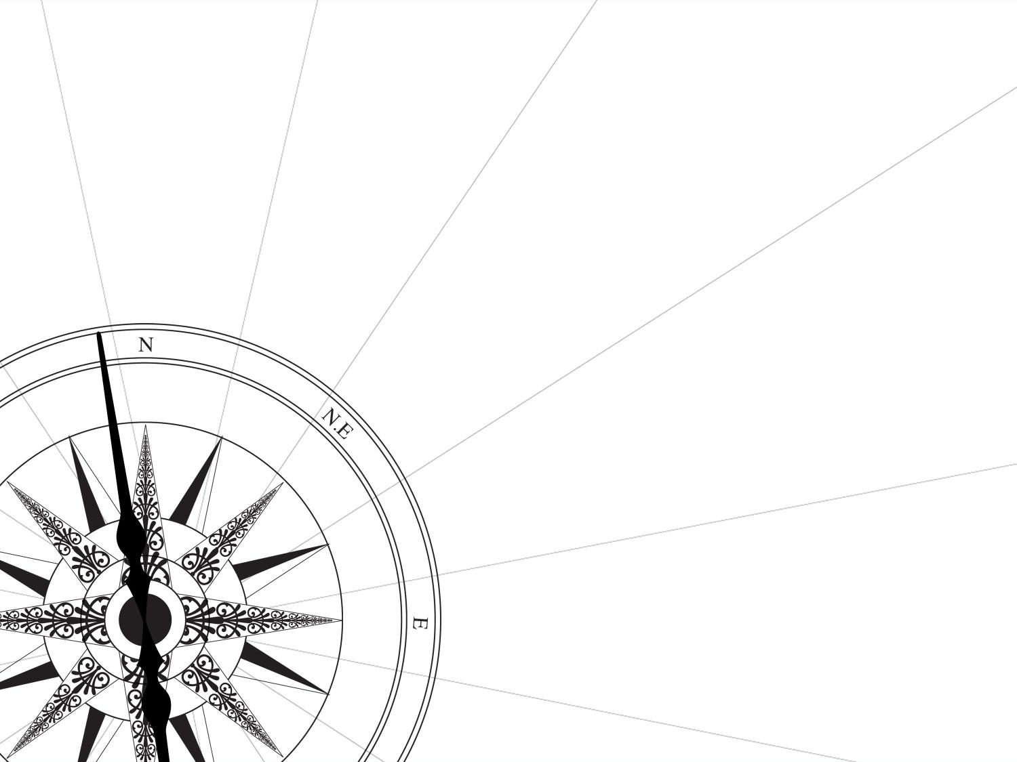
CHAPTER 11
CABI TOURISM TEXTS
STRATEGIC THINKING IN TOURISM
ALFONSO VARGAS SÁNCHEZ
AND LUIZ MOUTINHO

Slide 3
CABI TOURISM TEXTS
LEARNING OBJECTIVES
Be able to:
• Go behind the meaning of management nowadays.
• Dissect reasons for failure related to strategic plans making clear the difference between strategic planning and strategic thinking, within the framework of systems thinking.
• Further explore the concept of strategic agility and sense and respond models.
• Create a strategic intent based on an exchange for value, instead of keeping focused on maximizing profits.
• Introduce novel conceptualizations like betapreneurship, strategic cadence, strategic experimentation and management with meaning.

Slide 4
CABI TOURISM TEXTS
1
THE MEANING OF MANAGEMENT
Currently, management is usually dysfunctional for our time. The current approach to management is aimed at making money and is seen as the only viable modus operandi. As a matter of fact, any efforts to improve management never result in any permanent improvements.
Redesign is essential: what is required is not a ‘better’ management of the same type but quite simply a different style of management.
A great awakening is required to implement this change, which basically means embrace ‘managing by meaning’.

Slide 5
CABI TOURISM TEXTS
1
THE MEANING OF MANAGEMENT
Management is under pressure of change, following the dilemma management listed below:
Flexible decentralized empowered networks within a structure of strategic intent.
Learning through immersive experiences, scenarios and rapid prototyping.
Acceptance of uncertainty with intuition as a valid contributor to clarity.
Strategic sense-making beyond operational problem-solving.
Uncoupling ‘winning’ from the need for a solution.
Engagement with complexity.

Slide 6
CABI TOURISM TEXTS
2
THE CHANGING FORTUNES OF STRATEGIC PLANNING
Although strategic planning is far from obsolete, it has long since been proved that it is fallible.
Strategic planning is not strategic thinking. This confusion often ruins strategic thinking, and at the heart of it lies the fact that the most successful strategies are visions, not plans.
In addition, some significant reasons why strategic plans usually fail in tourism companies are: inaccurate financial estimates; insufficient data inputted to plans; undefined or inflexible roles and responsibilities; not understanding the staffing requirements; strategic project scope inflexible to change.

Slide 7
CABI TOURISM TEXTS
2
THE CHANGING FORTUNES OF STRATEGIC PLANNING
Strategic thinking is about synthesis. It requires creativity and intuition. The end result is an integrated perspective of any enterprise, a simple vision of the direction a company would like to proceed in. These strategies cannot be perfectly conceived on any given schedule. Generally, they are created with informal learning and after a period of disruption and change where many people at all levels are involved with the specifics.
The real change within effective planning will come when the mental models that the decision-makers use can be changed. As Arie de Geus said: ‘Planning means changing minds, not making plans’.

Slide 8
CABI TOURISM TEXTS
3
SYSTEMS THINKING
Application of Systems Thinking to Change.
• Systems are defined by the interactions of their components not just the components themselves.
• System thinking is the discipline for ‘seeing wholes’, seeing processes rather than snapshots.
• Businesses are systems (and have many) – it is the interaction of the parts (people/organizations, work to be performed, processes) that produces value for customers. In human systems, the structure of the system includes how people make decisions – the operating policies for translating perceptions, goals, rules and norms into action.

Slide 9
CABI TOURISM TEXTS
3
SYSTEMS THINKING
There is a fundamental difference between doing the right things and doing things right. As most of the effort in change is put into ‘doing things right’ the question ‘are they the right things to do?’ seems to get lost. Strategy is about doing the right things.
For strategic planning to be a success, you are not looking for one single solution; more, you are examining the complex systems of problems and this requires taking apart the entire entity and starting afresh.

Slide 10
CABI TOURISM TEXTS
4
STRATEGY AS A WICKED PROBLEM
Concept: Wicked problems are highly complex problems; they are unstructured, open ended, they are multi­dimensional, systemic and may have no known solution. In many ways we can think of wicked problems as essentially dis­functionalities within a complex system.
Business strategy has been identified as exhibiting elements of wickedness: strategies deal with open system, they expand into multiple dimensions (socio-cultural, political, economic, technological…), deeply interconnected, with many and non-linear interdependencies, which evolve over time.

Slide 11
CABI TOURISM TEXTS
4
STRATEGY AS A WICKED PROBLEM
Tourism companies must manage the strategic wickedness by involving stakeholders in growing and developing future outlines for new strategies. The intention should be to create a shared understanding of any problems and issues and use collaboration and joint commitment to resolve them. These situations can also be exploited to strengthen collective intelligence, reduce the force of the groupthink and cognitive bias and enable the group to tackle the problems in a more effective manner than individuals. The more stakeholders involved in the planning process adds complexity but generally increases the potential for creativity.

Slide 12
CABI TOURISM TEXTS
4
Sense and Respond Systems
As the amount of data and the speed of business increases, the need to create a real time response becomes much more critical. However, rapid advancements in the performance and cost of technology is enabling the achievement of this a real possibility, and realizing the ‘sense and respond’ model is becoming an achievable goal in a wide range of scenarios.
‘Sense and Respond’ (S&R) companies take current contextual market information, compare this to the existing model and then adapt the business to the new conditions.
The necessary inputs could come from many different sources. With them, rather than implementing a business plan with a definitive time scale, the S&R controlled business constantly adjusts and responds to changes in real time.

Slide 13
CABI TOURISM TEXTS
4
Agile Mindset
An Agile Mindset takes steps forward in the project and pauses to check if the small amount completed has been correctly managed and delivered and fixes any issues there, and then proceeds to the next step. This can sometimes feel like a manner to controlling the chaos.
As a result, some new terms have emerged, such as ‘Radical Management’. Under this appoach, by adopting a people-centred goal, a people-centred role for managers, a people-centred mechanism for co-ordinating work, people-centred values and people-centred communications, the tourism firm is able to operate at a new level: making money for its shareholders by delighting the people for whom the work is done while providing deep job satisfaction for those doing the work.

Slide 14
CABI TOURISM TEXTS
5
STOP MAXIMIZING PROFIT IN EXCHANGE FOR VALUE
The obsession with the profit maximization has been detrimental. A reasonable profit would be far more beneficial to the wide spectrum: companies should also reinvest excess profits into creating more value for all and improving their reputation with their client base, employees and society.
To restore the economy and any society to maximum strength, a new corporate mission is needed, and innovation, which is essentially divergent, has to be part of it.
For innovators to thrive and become successful it is of paramount importance that their managers defend the ideas and technical solutions against cost-cutting measures or conservatism.

Slide 15
CABI TOURISM TEXTS
6
BETAPRENEURSHIP
The spirit of Betapreneuship is empowering people and businesses to make change happen by fostering collaboration around a new ‘redesign and rethink’ culture, in which failure is seen as a learning curve.
Tourism organizations simply must foster disruptive innovation to thrive, as new people-led alliances will be the fuel that drives successful businesses of the future.
Innovation needs to be encouraged by fostering a culture of entrepreneurship (and intrepreneurship, in-house entrepreneurs), and this must start from an early age with a creative learning, understood as a process of trial and error (this is how betapreneurs operate).
It is advised to them, to find a business partner who excels in strategy and apply the beta concept, embrace your projects in the beta way.

Slide 16
CABI TOURISM TEXTS
7
CONCLUSION
The new normal is that there is no normal any more. Business issues have shifted from discrete problems to holistic messes (requiring holistic, networked, collaborative approaches to resolve). We cannot use the past to predict the future. Creative disruption and innovations are becoming a constant.
In order to succeed in the new normal, executives must focus on what has changed for their customers, companies and the travel industry in general. There is no doubt that while the environment will be very different, there are just as many possibilities for those who are prepared.
Travel companies are struggling to find a way to address the emerging factors and changes. To expect future corporate success, two factors have come to light as critical: the speed necessary to adapt to threats and opportunities, an the in-built flexibility to allow for speedy responses.

