Slide 1
Service Failures and Recovery in Tourism and Hospitality: A Practical Manual
Erdogan Koc

Slide 2
Chapter 9
The Influence of Other Customers in Service Failure and Recovery

Slide 3
Learning Objectives
Understand the influence of other customers in service encounters in tourism and hospitality.
Explain the main components of social servicescape.
Understand the consequences of service failures caused by other customers.
Explain the components of emotional intelligence in relation to service.
Explain how other customer-caused service failures could be recovered.

Slide 4
Social Influence
Social influence plays an important role in the consumption process.
Hospitality and tourism industry:
Sharing the physical environment with others such as fellow customers
Customers affect one another in the service context directly through interpersonal encounters or indirectly by being part of the environment.

Slide 5
Other Customers in Service Settings
Service experiences are co-created and co-produced through customer-to-customer interactions (McColl-Kennedy et al., 2014)
Service management theory
Belk (1975)
Eiglier & Langeard (1977): Customer B
7Ps of services marketing: Participants

Slide 6
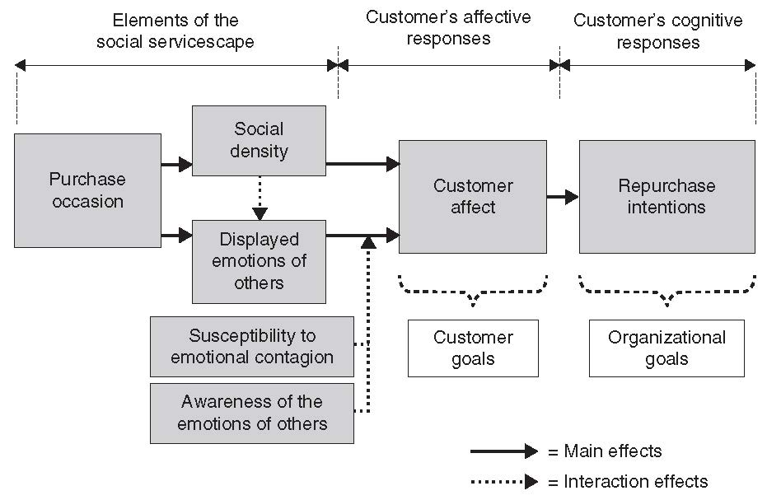
Other Customers in Service Settings
Social Servicescape (Tombs & McColl-Kennedy, 2003)

Slide 7
Other Customer Service Failure
Negative customer-to-customer experiences are quite common across service contexts (Zhang et al., 2010).
Other customer service failures:
Another customer directly causes a service failure that disrupts the service environment (Baker & Kim, 2016).

Slide 8
Other Customer Service Failure Types of Incidents
Typology of other customer misbehaviour:
Bitner et al. (1994) ‘problem customer’, Lovelock (1994) ‘jay customers’, and Harris and Reynolds (2003) ‘dysfunctional customer behaviour’.
Types of incidents:
Bitner et al. (1994): drunkenness, verbal and physical abuse, breaking company policies and uncooperative customers.
Baker & Kim (2016): rude customers, loud customers and misbehaving children.

Slide 9
Other Customer Service Failure Contexts
The hospitality industry has a high possibility of other customer service failure as sharing the service environment with other customers is often an intrinsic part of the hospitality and tourism experience (Miao & Mattila, 2013).
Hospitality and tourism settings including restaurants, airplanes and hotels involved the most frequent forms of other customer service failure (Baker and Kim, 2016).

Slide 10
Consequences of Other Customer Service Failure
Focal customers' overall service experience
diminishes customer satisfaction as well as loyalty with the service firm (Harris & Reynolds, 2004).
Customer-contact employees who need to deal with such dysfunctional customer behaviour
psychological stress (Baker et al., 2012).
Firm’s financial performance and market position.

Slide 11
Characteristics of Other Customers
The influence of other customers may be specific to the context or the characteristics of a company.
Influence of co-consumption others on focal customers’ behaviour
Similarity, closeness, culture.
Impression management and self-regulation
When the co-consumption others elicit a high need for self-monitoring, people utilize greater emotion-regulation strategies to soothe such negative emotions evoked by negative behaviour of other customers to maintain good impression with co-consumption others (Miao, 2014) .

Slide 12
Attributions of Other Customer Service Failure
Consumers attempt to determine the cause and make attributions according to information received, which then influences subsequent emotions, attitudes and future actions (Weiner, 1985).
Three common dimensions of causal attributions:
1) Locus of causality
2) Controllability
3) Stability

Slide 13
Attribution of Other Customer Service Failure
Locus of causality:
Customers’ perceptions of where or with whom the responsibility for the failure rests (Weiner, 1985)
Although customers feel that the other customers are responsible for the service failure, they still form negative perceptions and behaviours towards the firm (Baker & Kim, 2016).

Slide 14
Attribution of Other Customer Service Failure
Controllability:
The cause is perceived to be under the service firm’s control (Weiner, 1985)
When other customer service failure happens, and focal customers perceive it to be within the control of the firm, the focal customers are more likely to blame the service firm rather than the dysfunctional customers.

Slide 15
Attribution of Other Customer Service Failure
Stability:
Whether the failure is relatively temporary or fairly permanent (Weiner, 1985)
The perception that a cause of the service failure is stable leads customers to expect a similar outcome to recur in the future, which then leads to negative behavioural responses (Folkes, 1984).

Slide 16
Recovery Strategies
Service firms cannot simply ignore failure caused by other customers but instead must have a proactive service recovery strategy:
Compatibility management
Recovery by communication with other customers
Recovery by communicating with focal customer

Slide 17
Recovery Strategies
Compatibility management:
The process of attracting a homogeneous clientele to the service environment, then actively managing both the physical environment and customer interactions, to minimize the frequency of dissatisfying customer-to-customer encounters (Martin and Pranter,1989).
Cruise industry segmentation
Carnival cruise vs. Princess cruise

Slide 18
Recovery Strategies
Recovery by communication with other customer:
Firms should actively engage in service recovery when other-customer service failure occurs
Develop protocols for dealing with such other customer service failure to provide proactive service recovery strategy
Develop a training programme to immediately react to disruptive other customer behaviour with appropriate problem-solving skills.

Slide 19
Recovery Strategies
Recovery by communicating with focal customer:
Customers expect apology, attentive attitude to the situation from the service provider and even reimbursement from the firm for service recovery when other customer service failure occurs (Baker & Kim, 2016)
Acknowledgement of the situation, apology, explanation, compensation.

Slide 20
Observing Service Recovery Aimed at Other Customers
Customers can witness other customers experiencing a service failure and how the firm recovers the failure.
The observation of other customers being treated unfairly negatively affects perceived fairness, emotions, behaviours and attitudes toward wrongdoers (Mattila et al. 2014).
Service providers should pay attention not only to the victim customers but also surrounding customers who can observe and listen to the treatment of the victim customers.

Slide 21
Case Study
You and your friend visit a restaurant in your town to have dinner. You sit at one of the tables next to a group of customers. Throughout your stay, you receive good and attentive service from your server.
However, during your meal you overhear the other customers next to you yelling loudly and aggressively to the server, complaining that their food tasted terrible. They are loud, rude and ruin your dining experience.

Slide 22
Case study
Case study questions:
1. What opinions might customers form, based on observing the service failure that occurred toward and from other customers?
2. Within the given case, what are the service failures and who is to blame for the service failures: the other customers or the firm?
3. What should the firm or managers do to make the situation better regarding this other customer service failure?

