Slide 1
Service Failures and Recovery in Tourism and Hospitality: A Practical Manual
Erdogan Koc

Slide 2
Chapter 7
Technology, Customer Satisfaction and Service Excellence

Slide 3
Learning Outcomes
Understand and explain the role played by technology in tourism and hospitality.
Explain hotel technology adoption.
Explain how technology enables both employees and customers to enhance satisfaction in service encounters.
Explain customer relationships in terms of brand image, online reviews, information search and (dis)satisfaction in social media and technology.
Understand how tourism and hospitality businesses can manage service recovery in social media.
Understand the influence of technology on service personnel.
Understand the newly emerging issues in technology.

Slide 4
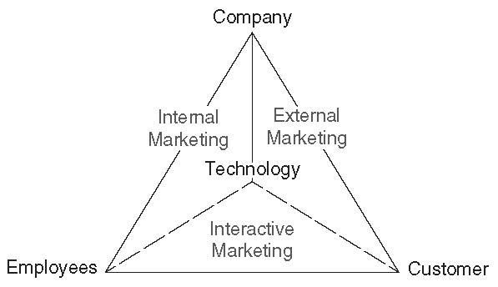
Introduction
Technology…
  is one of the 3 most important research priorities among 12 in service research
  changes the landscape of service encounters.
Accor spent 22 million euros ($25 million) to enhance the customer experience through digital technology (REUTERS, 2015).
With the widespread use of technology, the internet and social media, firms need to consider technology in terms of customer interactions and satisfaction (Baker & Magnini, 2016).
Fig. 1. The Service Marketing Period
Adapted and Modified from Bitner et al., 2000

Slide 5
Technology Adoption
Service technology interfaces can include:
  Point-of-sale terminals
  Smartphones
  Tablets
  Kiosks
  These can be used by service employees and consumers.
Technology adoption, not just technology acceptance, is one of the most critical factors.
Hotel technology enables hotels to drive their service objectives better by reducing complexity, increasing system availability and managing properties more efficiently (Amadeus, 2011).

Slide 6
Technology and Satisfaction
Technology can play an important role in increasing employee and customer satisfaction.
Effective use of technology enhances the customer’s total experience and service encounter satisfaction by
customizing service offerings
recovering from service failure
spontaneously delighting customers.
However, when technology failure occurs, the technology interface is poorly designed, or the design of service experience related to technology is not user-friendly, customers may be dissatisfied.

Slide 7
Customer Relationships in Social Media & Technology
Social media and Web 2.0 are evolving and becoming essential tools, leading to pervasive changes in business-to-business communication, business-to-customer communication and customer-to-customer communication.
Branded hotel properties have an average of 3.7 social media accounts, including Facebook, Instagram, Twitter, and Pinterest, and 33% of cumulated followers are reached with these brand accounts (HospitalityNet, 2016).
Social media plays an important role in facilitating the three-way interaction between customers, other customers and the firm (Baker, 2017).
How to manage online customer relationships in order to achieve satisfaction and loyalty is a new form of customer relationship management that many firms are attempting to navigate.

Slide 8
Customer Relationships in Social Media & Technology (Brand Image)
As social media and Web 2.0 are constantly changing the current digital communication structure, hospitality firms such as hotels are actively participating in creating and maintaining their brand pages on various social media platforms.
A recent Harvard Business School case study by Avery et al. (2015) suggests that a hotel’s digital marketing can enhance brand image by exploring new technologies through a new distribution channel and developing the online marketing space for travel reservations.
Customer satisfaction with a hotel’s social media interactions can lead to customer engagement and positive behavioural outcomes such as customer retention, commitment and advocacy (Sashi, 2012).

Slide 9
Customer Relationships in Social Media and Technology (Posting Experiences and Searching for Information)
Online reviews are a very clear indicator of customer satisfaction or dissatisfaction.
Online reviews are evaluated by valence (positive and negative), intensity (quality of the comments), speed (number of contacts in a period of time), persistence (length of time), importance (role of comments in the customer decision-making process) and credibility (assurance and confidence of the poster and posted message ).
Customers search for opinions and experiences of peer consumers before purchasing a product or service (Xie et al., 2014).

Slide 10
Customer Relationships in Social Media and Technology (Social Media Satisfaction and Dissatisfaction)
Social media is considered one of the major channels for customer satisfaction and customer relationship management (CRM) (Baker, 2017).
Social media can play an important role in managing both employee-customer interactions (i.e. interactive marketing) and company-customer interactions (i.e. external marketing and service recovery).
Social media plays a critical role in spreading customer complaints (Clerck, 2015) and their negative impact on others can often be magnified.
Managing customers’ (dis)satisfaction in social media plays a pivotal role in not only building positive customer relationships, but also enhancing customer satisfaction.

Slide 11
Managing Service Recoveries in Social Media
Managing customers’ (dis)satisfaction in social media leads to positive outcomes such as other customers’ satisfaction, future purchase intentions, positive impressions, firm performance.
Interestingly, how a hotel responds or does not respond affects how others perceive the hotel brand and will influence their willingness to book a reservation (Baker, 2017).
It is suggested that service firms, such as hotels and restaurants, need to constantly update their activities and respond to customers’ requests and opinions on social media platforms because Web 2.0 transformed how customers developed relationships with service providers.

Slide 12
Impact of Technology Use on Service Employees
Employees’ satisfaction with technology plays a major role in influencing the relationship between internal IT service quality and employees’ service quality to external customers.
According to a recent empirical study (Jeong et al., 2016), employees’ perceptions of using mobile devices in their workplaces positively affects their perceived job performance, satisfaction and employee retention.
While many firms are focusing on customer adoption, it is also critical for these firms to consider employee use and adoption of the technology.

Slide 13
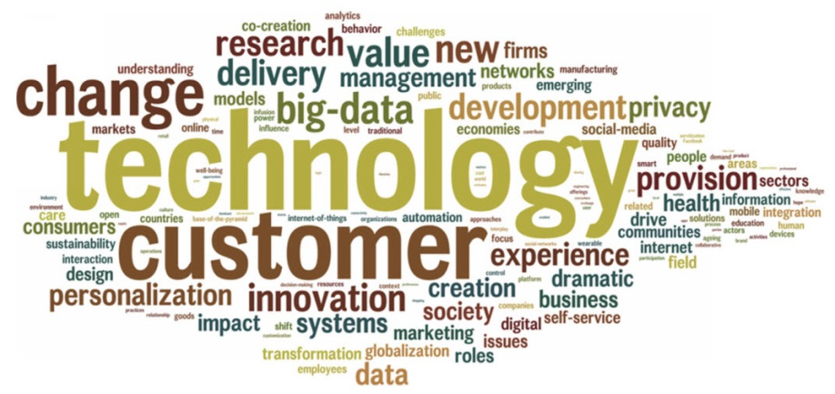
Newly Emerging Issues in Technology
Technology is identified as the most dramatic change and named as ‘Game Changer’ in the service field (Ostrom et al., 2015).
New technologies are…
  Virtual reality or augmented reality
  Wearable technology
  Mobile technology
  E-menus.
Fig. 2. Most dramatic change in the future of the service field. Word cloud based on survey comments.
Adapted from Ostrom et al., 2015

Slide 14
Case Study: Accor’s Application for Apple Watch
Case study questions:
  What are the benefits Accorhotels’ existing and potential customers will get from the Apple Watch application?
  How can the hotel effectively enhance their customers’ service experience and satisfaction through this application?
  As a marketing manager of this hotel, how do you use this application to strengthen customer relationship management?
  It is suggested that demographic factors such as gender, age and level of education all affect consumer use of technology (see Section 7.2, Technology Adoption, for more details). How do those demographic factors influence consumers’ use of the Accorhotels application for Apple Watch?
  If consumers fail to install or use this application, how can the hotel recover this technology service failure?

Slide 15
Conclusion
To understand the significant roles and effects of technologies in hospitality and tourism, this chapter discusses:
the importance of technology and customers’ (dis)satisfaction regarding technology use in service encounters
technology as effective tools managing customers’ (dis)satisfaction and building customer relationships
the impact of technology use on service employees as the internal marketing perspective
newly emerging technologies in services

