Slide 1
Service Failures and Recovery in Tourism and Hospitality: A Practical Manual
Erdogan Koc

Slide 2
Emotions and Emotional Abilities in Service Failures and Recovery
Chapter 4

Slide 3
Learning Objectives
Explain the relationship between emotions, service encounters, service failures and recovery.
Explain the components of emotional intelligence in relation to service encounters.
Understand the difference between surface acting and deep acting and their implications for the customer and for the individual service employee.
Understand and explain how tourism and hospitality businesses may benefit from recruiting staff with emotional intelligence and emotional labour.

Slide 4
Human Needs
subsistence
protection
affection
understanding
participation, leisure
creation
identity
freedom
Each need can categorized along the existential dimensions of:
being (qualities)
having (things)
doing (actions)
interacting (settings)
(Max-Neef et al., 1991).

Slide 5
Needs and Service Failures
Service failures delay gratification and
increase tension
Negative Feelings

Slide 6
Emotions
The number of signals coming from the limbic system (emotional part of the human brain) to the frontal cortex (rational part of the human brain) is ten times higher than vice versa (Hawkins and Blakeslee, 2004).
What are the implications of this?
The human brain has a tendency to do more emotional processing than rational processing.

Slide 7
What is an emotion?
An organized psychophysiological reaction to the appraisal of ongoing relationships with the environment (Scherer, 2003).

Slide 8
Types of Emotions
Emotions | Positive | Negative
Activated | Joyful, happy, playful | Anxious, angry, tense
Deactivated | Relaxed, tranquil, serene | Sad, ashamed, grieving

Slide 9
Emotions
People may place a greater significance on negative feelings
The feeling of sadness is the longest lasting feeling in the human mind
Verduyn and Lavrijsen (2014)
People place a much greater significance on losing than winning
Kahneman and Tversky (1979)

Slide 10
Emotions
Customers tell an average of 9 people about their good service experiences, and 16 people about their poor service experiences (TARP, 2007).
(Negative Emotions!)

Slide 11
Emotions
Expectancy confirmation / disconfirmation
Customer delightment
Service recovery paradox

Slide 12
Measurement of Emotions
Difficulty in measuring emotions
People are not aware of their emotions
Emotions are difficult to describe
Impression management

Slide 13
Psychophysiological Tools / Devices
Measuring emotions by using:
EEG (Electroencephalogram)
fMRI
The eye tracker
HR (heart rate)
GSR (galvanic skin response)
Various face recognition tools
Objectivity – validity – data triangulation

Slide 14
Psychophysiological Tools / Devices
Measurement of Affective States
Face
Hand
Body
Eye
Physiological Signals
Voice
Mouth
Facial expression capturing
Hand gesture tracking
Body movement and body gesture tracking
Eye movement, eye features and eyebrow features
EEG, ECG(EKG), EMG, EOG, SCR, Spo2, skin temperature, BVP, electrodermal activity
Voice and verbalization
Mouth feature (corner of mouth rising up and mouth open etc.
Identification arithmetic and self suitability process
Affective Status

Slide 15
Emotional Abilities
Emotional intelligence
Emotional labour

Slide 16
Emotional Intelligence
The ability or tendency to perceive, understand, regulate, control and manage emotions adaptively in the self and in others.
(Salovey and Mayer, 1990)

Slide 17
Emotional Intelligence
Unlike IQ, emotional intelligence can be:
acquired
improved
learnt

Slide 18
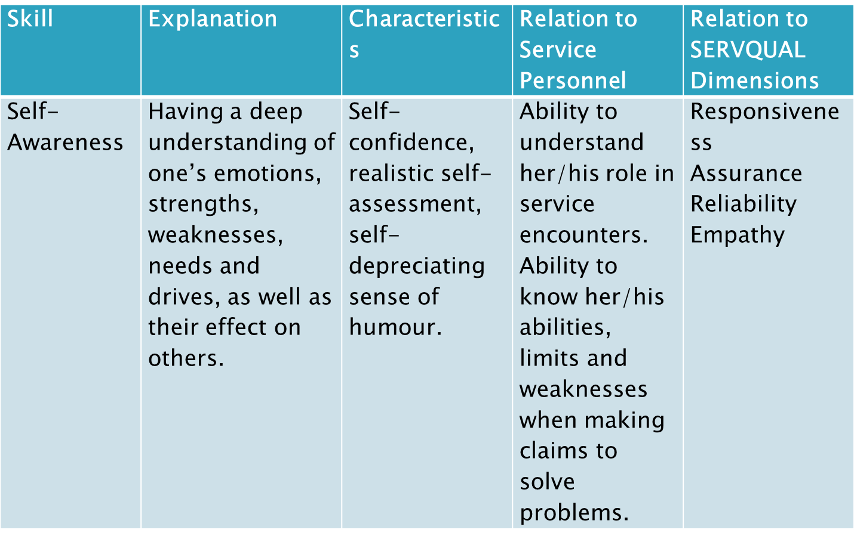
Skills of Emotional Intelligence

Slide 19
Skills of Emotional Intelligence
Skill | Explanation | Characteristics | Relation to Service Personnel | Relation to SERVQUAL Dimensions
Self-regulation | Ability to control or redirect disruptive impulses and moods and the propensity to suspend judgment - thinking before acting. | Trustworthiness, integrity, comfort with ambiguity, openness to change. | Ability to understand and evaluate service failures. Ability to think and implement new approaches to deal with service failures. | Reliability Responsiveness Assurance Empathy

Slide 20
Skills of Emotional Intelligence
Skill | Explanation | Characteristics | Relation to Service Personnel | Relation to SERVQUAL Dimensions
Motivation | A passion to work for reasons that go beyond money or status, with a propensity to pursue goals with energy and persistence. | Strong desire to achieve, optimism (even in the face of failure), organizational commitment | Ability to cope with heavy demands of frequent and intense social interactions. Unyielding approach towards service failures. Commitment to service quality and maintaining a strong image of the service business. | Responsiveness Reliability Assurance Empathy

Slide 21
Skills of Emotional Intelligence
Skill | Explanation | Characteristics | Relation to Service Personnel | Relation to SERVQUAL Dimensions
Empathy | Ability to understand the emotional makeup of other people, with skill in treating people according to their emotional reactions. | Service towards customers and clients, cross-cultural sensitivity, expertise in building and retaining talent. | Ability to understand the needs and expectations of customers – including customers from other cultures. Service orientation. Empathy towards the feelings of customers during service encounters. Handling complaints and conflicts. Handling difficult customers. | Empathy Responsiveness Assurance Reliability

Slide 22
Skills of Emotional Intelligence
Skill | Explanation | Characteristics | Relation to Service Personnel | Relation to SERVQUAL Dimensions
Social Skill | Proficiency in managing relationships and building networks, with an ability to find common ground and build rapport. | Managing relationships and building networks, with an ability to find common ground and build rapport. | Ability to manage social interactions effectively during service encounters. Ability to use help from networks of people from other departments to solve problems. | Responsiveness Assurance Reliability Empathy

Slide 23
Dimensions of Emotional Labour
The process of managing feelings and expressions to fulfil the emotional requirements of a job.

Slide 24
Factors Influential on Emotional Labour
Factors | Explanations | Examples
Societal and Cultural Factors | People in different societies and cultures may perceive the demonstration of emotional labour skills differently. | McDonald’s experts found that Russian customers were shocked by the smiling of McDondald’s employees. The immediate reaction of Russian customers were ‘What is wrong with this person?’ (Hofstede et al., 2010)
Job-related Factors | Front-stage employees need to have a higher level of emotional labour skills than back-stage employees. | While an unsmiling but talented cook may be tolerated at a hotel, an unsmiling but talented waitress may not be tolerated in the same hotel.

Slide 25
Factors Influential on Emotional Labour
Factors | Explanations | Examples
Business atmosphere and organizational factors | The level of customer orientation in the tourism and hospitality business, type and characteristics of the customers served and how busy the tourism and hospitality business is at a particular time. | In a busy restaurant service, employees’ emotional labour skills are more often put to the test (Rafaeli and Sutton, 1989; Friedman, 1990; Grandey et al., 2005;
Dispositional Characteristics | The ability of an individual service employee to use facial expressions, voice, gestures and body movements to transmit her/his emotions. | Males tend to smile less than females (Ellis and Das, 2011).

Slide 26
Emotional Labour and Jobs
Jobs involving emotional labour (Hochschild, 1983):
Require face-to-face or voice-to-voice contact with the customers
Require the employee to produce an emotional state in another person
Allow the employer, through training and supervision, to exercise a degree of control over the emotional activities of employees.
Do they look familiar?

Slide 27
Dimensions of Emotional Labour
Surface acting
Hiding real feelings and exhibiting different emotions towards others in organizations.
Faking and feigning emotions or pretending to have certain emotions the employee does not have.
Deep acting
Trying to feel those emotions that the employee is required to feel and internalizing real emotions due to the role’s expectations.

Slide 28
Dimensions of Emotional Labour
When a service employee fakes her/his (surface acting), s/he will eventually feel emotionally exhausted, resulting in reduced job satisfaction.

Slide 29
Dimensions of Emotional Labour
Activity
Think of a situation where you had to do surface acting (e.g. when you had to be nice to someone though you did not actually want to be) and deep acting. How did you feel afterwards? Can you do it several times a day?

