Slide 1
Service Failures and Recovery in Tourism and Hospitality: A Practical Manual
Erdogan Koc

Slide 2
Chapter 3
Service Failures and Recovery: Theories and Models

Slide 3
Understand and explain the expectancy disconfirmation paradigm.
Explain justice theory in relation to the service recovery process.
Explain the service recovery paradox.
Understand and explain script theory and social learning theory to understand service failures and recovery processes.

Slide 4
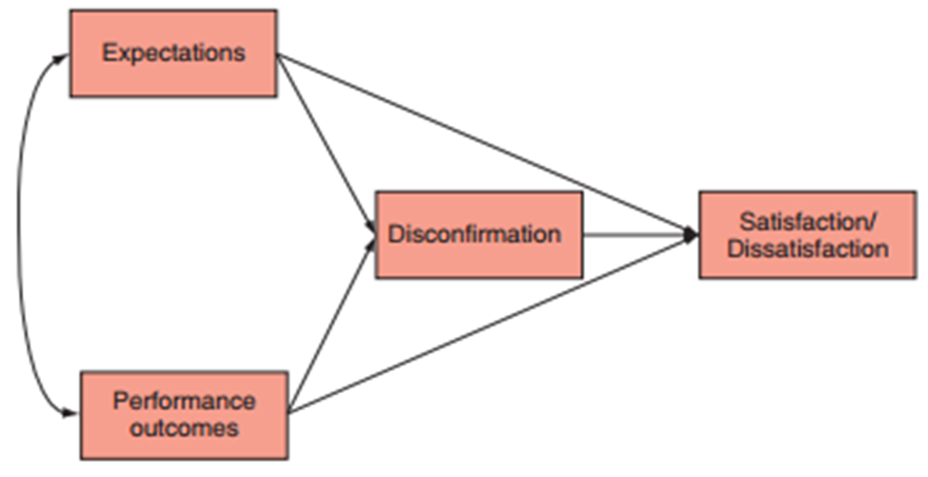
Expectancy Disconfirmation Paradigm

Slide 5
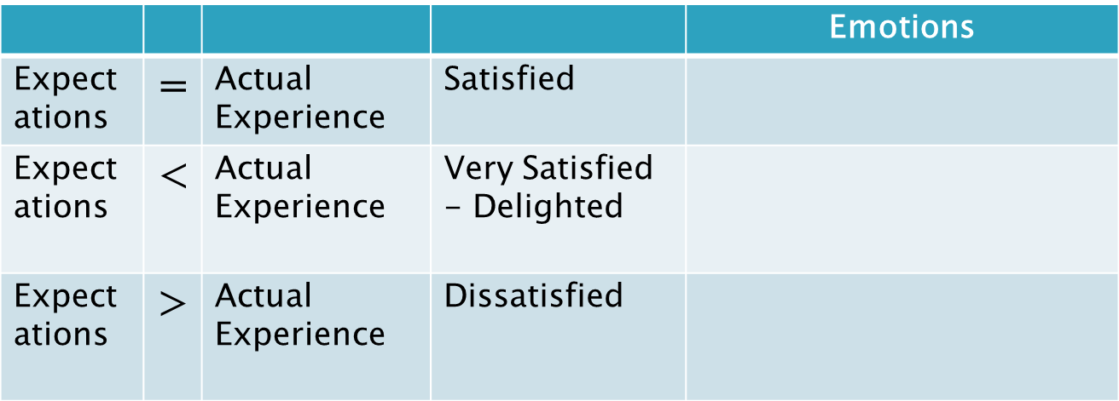




Expectancy Disconfirmation Paradigm
Customer satisfaction is an evaluation process of expectations versus actual service experience.

Slide 6
Justice Theory
Distributive Justice
Procedural Justice
Interactional Justice
Third-Party Justice

Slide 7
Distributive Justice
The perceived fairness of the outcome
  Compensation
  Credits
  Discounts

Slide 8
Procedural Justice
The perceived fairness of the process
  Policies
  Procedures
  Convenience of process
  Timeliness of process
  Responsiveness of firm

Slide 9
Interactional Justice
The fairness of the treatment and interpersonal interaction
  Employee concern
  Empathy
  Friendliness
  Emotions exhibited

Slide 10
Third-Party Justice
Perceptions of how fairly others are treated.
Important to consider who is responsible for failure (attributions).

Slide 11
Cultural Models Approach to Service Recovery
Relational Cultural Model
Utilitarian Cultural Model
Oppositional Cultural Model

Slide 12
Relational Cultural Model
KEY JUSTICE PRINCIPLE
  Interactional Justice
RESPONSE TO FAILURE
  Emotional (looking for consolation)
  Anxious
  Embarrassed
  Willingness to forgive

Slide 13
Relational Cultural Model
HOW TO IDENTIFY
  Express hurt/ vulnerability
  Is helpful
  May blame self
  Shows understanding
  Will work with the provider
  Understands limitations

Slide 14
Relational Cultural Model
EXPECTATIONS FROM RECOVERY
  Sincere apology
  Show interpersonal respect
  Demonstrate genuine care
  Provide explanation of why things went wrong
  Assert the importance of the relationship

Slide 15
Oppositional Cultural Model
KEY JUSTICE PRINCIPLE
  Distributive Justice
RESPONSE TO FAILURE
  Aggressive
  Does not forgive easily
  Emotional/ angry
  Skeptical/ cynical

Slide 16
Oppositional Cultural Model
HOW TO IDENTIFY
  Is antagonistic
  Blames provider
  Is aggressive
  Is overly demanding
  Suggests excessive compensation

Slide 17
Oppositional Cultural Model
EXPECTATIONS FROM RECOVERY
  Voices a range of recovery options
  Desires to maintain control
  Demands excessive compensation

Slide 18
Utilitarian Cultural Model
KEY JUSTICE PRINCIPLE
  Procedural justice
RESPONSE TO FAILURE
  Pragmatic
  Shows irritation for time wasted
  Does not want excuse; wants problem solved

Slide 19
Utilitarian Cultural Model
HOW TO IDENTIFY
  Rational
  Not emotional, but firm
  Expects recovery for time/inconvenience

Slide 20
Utilitarian Cultural Model
EXPECTATIONS FROM RECOVERY
  Compensate for time/ energy
  Offer exchange/ refund
  Make procedure easy
  Solve problem quickly

Slide 21
Case Study: Service Recovery and Cultural Models
During the course of dinner service at your upscale-casual restaurant, there are three separate service failures. In all three, the customer orders a steak medium-rare and in all three cases the steak is overcooked.

Slide 22
Case Study: Service Recovery and Cultural Models
The first customer says it is fine, understands the restaurant was very busy, that mistakes happen and will just eat the steak. The second customer calls you over very calmly and asks for another steak cooked properly.

Slide 23
Case Study: Service Recovery and Cultural Models
After another manager apologizes profusely for several minutes, the customer gets frustrated and cancels the order. The third customer is loud and aggressive, blames your untrained cook for not knowing how to cook a steak and demands you pay the entire table’s bill.

Slide 24
Case Study Questions
1. What is each customer’s cultural model, based on the clues in the scenario?
2. What elements allowed you to identify each cultural model?
3. How could you have more effectively recovered from each failure, incorporating the justice principles into your recovery actions?

Slide 25
Service Recovery Paradox
Outcomes
• Satisfaction
• Repurchase intention
• Word-of-mouth
• Brand image
Service
failure
Excellent
service
recovery
Theoretical moderators
• Failure severity
• Prior failure experience
• Quantity of prior failures with firm
• Stability attribution
• Controllability attribution

Slide 26
Script Theory
Role and script theory
Service scripts

Slide 27
Role and Script Theory
Customers and employees have specific roles
Variations in script resulted in increased sensitivities

Slide 28
Service Scripts
Scripts that provide behavioural and verbal guidelines to employees
Benefits: control and standardize employee behaviours
Drawbacks: Minimize individualized attention and communication

Slide 29
Social Learning Theory
Individuals learn by observing others
Affects customer complaints
Affects customer misbehaviour

