Slide 1
Service Failures and Recovery in Tourism and Hospitality: A Practical Manual
Erdogan Koc

Slide 2
Chapter 14
Disappointment in Tourism and Hospitality: The Influence of Films on Destinations

Slide 3
Learning Objectives
Understand the role of films as a marketing communications tool in developing images about a tourist destination.
Explain the concept of disappointment as an emotion.
Understand the communications gap occurring as a result of film-induced tourism.
Understand how consumers respond to service failures and express their disappointment.

Slide 4
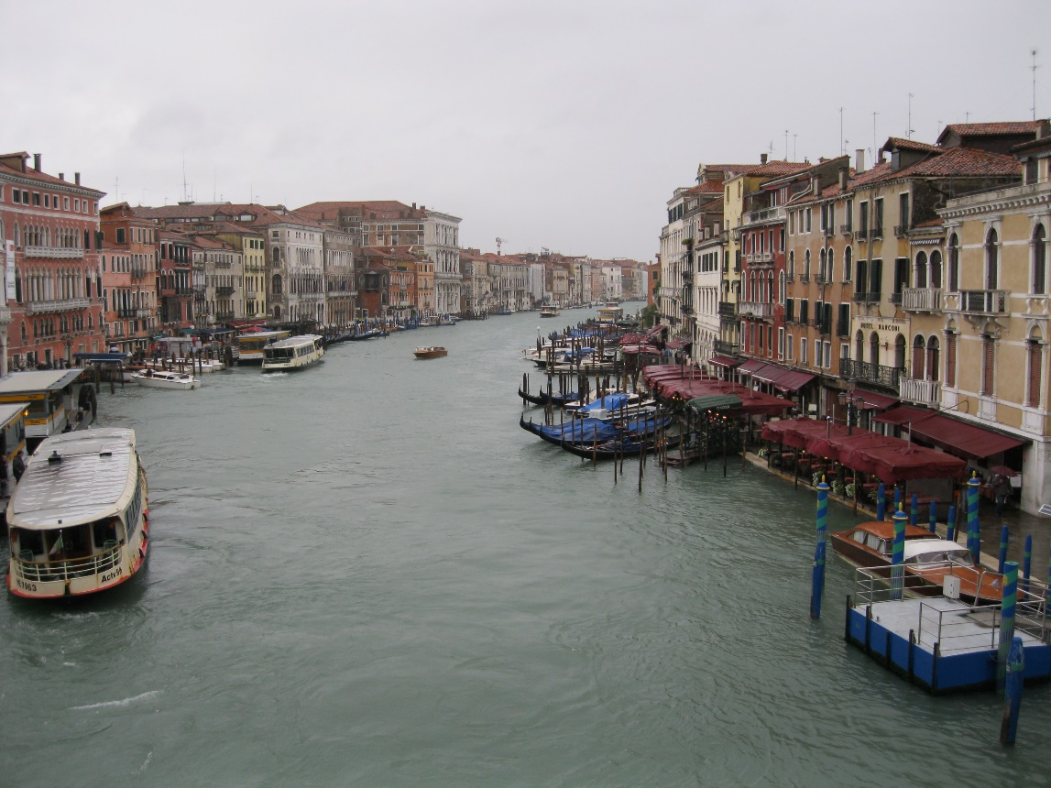
Introduction
Canaletto tried to lure young travellers on a Grand Tour to Venice with his landscape views, long before the film tourism era. See Canaletto’s L'ingresso del Canal Grande masterpiece on the Musuem of Fine Arts website: https://www.mfah.org
Rainy Venice might disappoint tourists. Photo: Irimiás, 2014

Slide 5
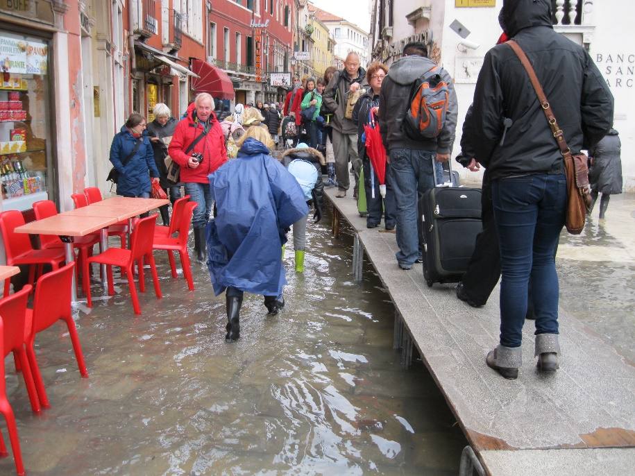
Introduction
Nowadays, Johnny Depp and Angelina Jolie attract tourists to Venice. Venice is one of the key locations of the film The Tourist, presented as an exciting and romantic destination. The International Film Festival in Venice, La Biennale, has been attracting delegates of the film industry and film fans to the city of canals since 1932.
The difference between Venice on screen and in reality might be shocking. Photo: Irimiás, 2014

Slide 6
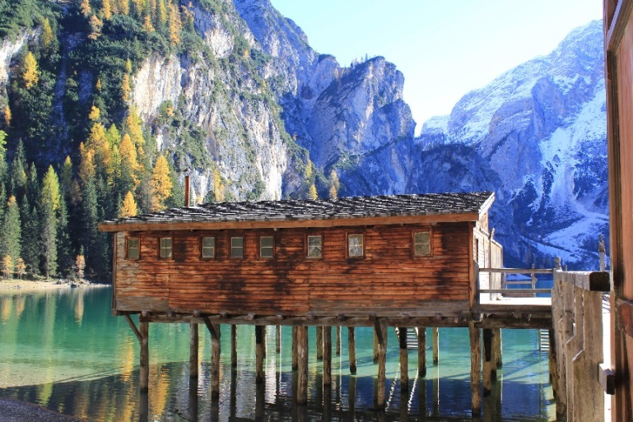
What is Film Tourism?
Popular media of the day influences the appeal of travel destinations and activities.
Constructing and reinforcing particular images of film destinations (‘markers’).
By the mid-20th century film (and later television) became the main mass media outlet.
A film tourist is interested in visiting a filming destination (Beeton, 2016). Tourist segments vary according to film genres:
Fantasy, science fiction – mainly 31-45 year-old male tourists (Reijnders, 2010, Roesch, 2009)
Action movies – mainly male tourists
Romantic movies – mainly 20-35 year-old female tourists (Iwashita, 2006)
Cartoons and animated movies, children’s TV programmes – families with young children (Connell, 2005, 2009)
Lake Braies in North Italy, famous location of the television series Un passo dal cielo visited by film tourists. Photo: Irimiás, 2016

Slide 7
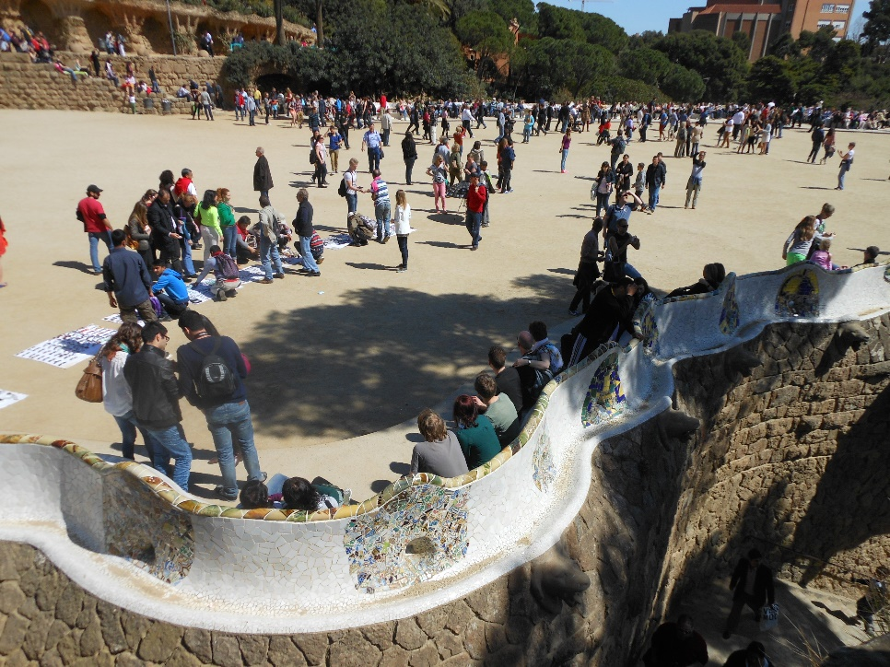
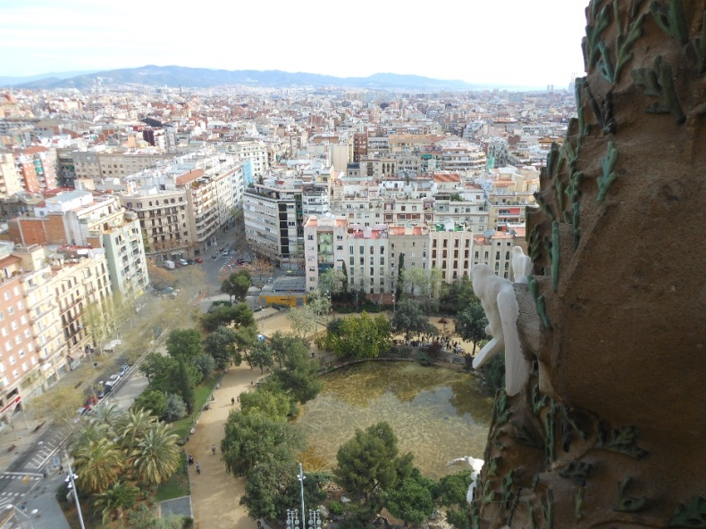
Film as a Tool of City Marketing
Woody Allen has directed films which have boosted international tourism in already well-known tourism destinations, such as Barcelona or Rome.
The overcrowded Parc Güell in Barcelona is less romantic than in Woody Allen’s Vicky Cristina Barcelona. Photo: Irimiás, 2015
View of Barcelona from the Sagrada Familia. Photo: Irimiás, 2015

Slide 8
Film: Fact and Fiction
Mamma Mia contributed to the development of tourism in Skopelos, Greece. Many love-seekers hoped to find true love on every Greek island.
However, hundreds of wedding tourists to the island of Skopelos were disillusioned when they realized that only Greek orthodox couples could marry in the church of Agios Ioannis Kastri.

Slide 9
DISAPPOINTMENT IN TOURISM: THE REASONS
In most cases, travel represents an opportunity to make travellers’ dreams come true. But if their high expectations do not meet reality, disappointment may occur.

Slide 10
Factors of the Disappointment Process
Disappointment is an extremely complex phenomenon. In order to better understand travellers’ negative feelings, we need to investigate it separately from different aspects.

Slide 11
Actions to Avoid Film Tourists’ Disappointment
Communicate clearly about film tourism attractions and entertainment services, and avoid glorification of places.
Implement orientation assistance with appropriate and informative signs about film locations, while maintaining community residents’ privacy.
Provide sufficient information about attractions and accessibility.
Display and keep opening hours of shops and attractions.
Calculate plenty of time for visits.
Provide appropriate conditions to take pictures at meaningful film locales.
Verify information about pre-announced programmes and provide information on schedule changes.
Train staff and tour guides to manage tourists’ disappointment (Michalkó et al., 2015).

Slide 12
Questions
What kind of cultural antecedents exist in film tourism?
What is the core of film tourism?
How does film tourism influnce city marketing?
What are the main sources of disappointment?
What kinds of disappointments can a movie generate?

Slide 13
References
Michalkó, G.,Irimiás, A. and Timothy, D. (2015): Disappointment in tourism: Perspectives on tourism destination management. Tourism Management Perspectives. 16. pp. 85-91.

Slide 14
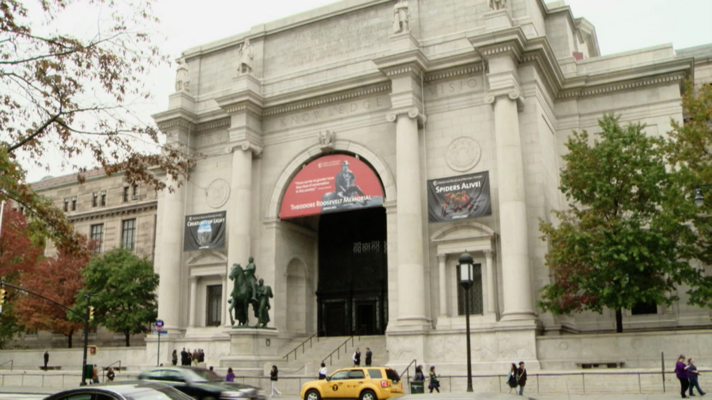
The museum in New York where visitors seek in vain for the equestrian statue of Theodore Roosevelt…
Film location of the movie Night At The Museum (2006)

