Slide 1
Service Failures and Recovery in Tourism and Hospitality: A Practical Manual
Erdogan Koc

Slide 2
Chapter 13
Cross-cultural Aspects of Service Failures and Recovery

Slide 3
Learning Objectives
Understand the implications of inseparability from the perspective of social exchange and interaction.
Understand the importance of social interactions and exchange from the perspective of service encounters.
Explain the influence of culture on service encounters, service failures and recovery.
Explain the main dimensions of culture and their influence on service encounters, service failures and recovery.
Understand the role of intercultural sensitivity on service encounters, service failures and recovery.

Slide 4
Social Interaction and Exchange in Services
Inseparability nature of services
Production and consumption take place
Participation of both customers and service personnel
Social interaction and exchange

Slide 5
Social Interaction and Exchange in Services
Tourism and hospitality services require
continuous and intense interactions between customers and service personnel.
Tourism and hospitality are usually referred to as people businesses.
(Kim et al., 2007; Dolnicar et al., 2011; Koc, 2013).

Slide 6
Importance of Social Interaction
Tourism and hospitality customers usually form their service quality evaluations based on social interactions and exchanges they have with service personnel.
They make the decision as to whether to continue with the same service provider or not based on these evaluations.
(Koc, 2006; Prayag and Ryan, 2012; Rauch et al.,
2015)

Slide 7
Importance of Social Interaction
Depending on their quality of social interactions, service personnel in tourism and hospitality can be used as a significant marketing communications tool.
(Koc, 2003)

Slide 8
Why Don’t Certain Customers Switch Even After Service Failures?
Procedural costs (i.e. the time and effort required for searching for, finding and adapting to the new service provider) (Bloch et al., 1986).
Loss of privileges (i.e. benefits, privileges and advantages in the form of special discounts, collected points, etc. which are lost when a customer switches).
Social costs (i.e. the loss of personal social relationships developed with the service personnel).

Slide 9
Why Don’t Certain Customers Switch Even After Service Failures?
Customers who did not switch because of the first two costs (i.e. procedural costs and loss of privileges) did not tend to develop affective commitment.
They stayed with the same service provider because they had to.
They tended to engage in negative word-of-mouth communication about the service provider.
(Jones et al., 2007)

Slide 10
Why Don’t Certain Customers Switch Even After Service Failures?
However, customers who did not switch because of social costs were the customers who had affective commitment
and
did not tend to engage in negative word-of-mouth communication about the service provider.

Slide 11
Culture and Social Interactions
Culture - all the patterns of thinking, feeling and behaviour shared by the members of a society (Schwartz, 1997).
Culture shapes the thoughts, feelings and behaviour of people (Mosquera et al., 2011).
Social interactions and exchanges can be strongly influenced by the culture of service personnel and customers.

Slide 12
Culture and Social Interactions
Additionally, customers' evaluations of service encounters in international settings are influenced by their perceptions of service failure and recovery contexts.
These perceptions are shaped by their cultural orientation (Wong, 2004).

Slide 13
Tourism and Hospitality – International Contexts
Tourism and hospitality - increasingly becoming international in nature.
In 2015 about 1.2 billion international tourists are engaged in international tourism, resulting in a revenue generation of about $1.5 trillion (WTO, 2015).

Slide 14
Norms and Codes
Has the customer finished his first course?
A guest from outside of Europe may not place her/his knife and fork accordingly after finishing her/his starters and may wait unnecessarily for the main course to be served.
The customer may feel that service staff are not responsive - i.e. may think a service failure has occured.

Slide 15
Cultural Dimensions
Cultural Dimension | Explanation | Examples of Cultures / Countries
Power Distance | The extent to which members of a society accept that power is distributed unequally in the society. | High in Power Distance: France, Mexico, Hong Kong and Turkey. Low in Power Distance: the USA, Sweden and Austria.

Slide 16
Cultural Dimensions
Cultural Dimension | Explanation | Examples of Cultures / Countries
Individualism and Collectivism | While in individualistic cultures people tend to place more importance on the welfare and interests of the individuals, in collectivist societies people tend to place more importance on the interests and welfare of the society as a whole. | High individualism: the USA, the UK, Sweden, Italy and the Netherlands. Low individualism (i.e. high in collectivism): Venezuela, China, Singapore, Japan, Taiwan and South Korea.

Slide 17
Cultural Dimensions
Cultural Dimension | Explanation | Examples of Cultures / Countries
Risk Aversion / Uncertainty Avoidance | The degree to which members of a society feel uncomfortable with uncertainty and avoid risk. | High in Risk Aversion: Japan, Turkey, Poland, Portugal, Spain and Uruguay. Low in Risk Aversion: Jamaica, Singapore, Denmark and Sweden.

Slide 18
Cultural Dimensions
Cultural Dimension | Explanation | Examples of Cultures / Countries
Masculinity and Femininity | Masculine societies tend to display a preference for achievement, assertiveness and material success and display a strong belief in gender roles. Feminine societies place more emphasis on the quality of life, care for others and equality, more especially between sexes. | High in Masculinity: Japan, Hungary, Italy, Switzerland and the USA. Low in Masculinity: Sweden, Norway, the Netherlands, Finland and Denmark.

Slide 19
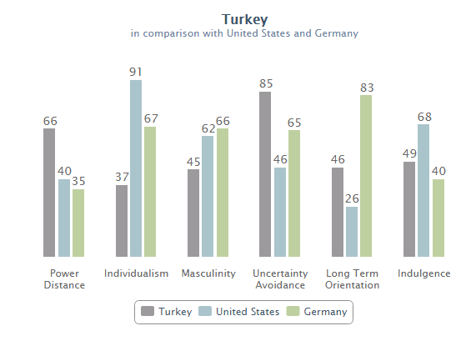
Cultural Dimensions
How to compare countries?
Visit: https://geert-hofstede.com/countries.html

Slide 20
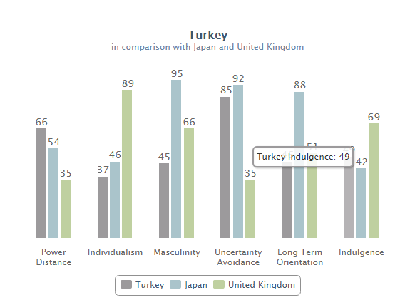
Cultural Dimensions

Slide 21
Research Findings Relating to Power Distance
Customers from a large power distance culture are:
More likely to perceive unsatisfactory goods and services as a fact of life.
Less likely to complain when encountering service failures (Au et al., 2010).
Customers tend to place more importance on the status of the employee
Do not place much importance on reliability and responsiveness (Furrer et al., 2000).

Slide 22
Research Findings Relating to Power Distance
Customers from a large power distance culture:
May have higher expectations than customers from low power distance cultures.
Due to their higher expectations, Turkish domestic tourists tend to be less satisfied with their holidays than tourists from the Netherlands, the UK and Denmark, i.e. customers from low power distance cultures, who stay at the same holiday establishment (Koc, 2017).

Slide 23
Research Findings Relating to Power Distance
Employees from a large power distance culture are more likely to resort to avoiding and accommodating strategies in situations of conflict (Koc, 2010), causing a delay in the diagnosing and handling of conflicts among service personnel.

Slide 24
Research Findings Relating to Power Distance
Customers from a low power distance culture:
Expect a higher performance in SERVQUAL dimensions of reliability and responsiveness (Donthu ve Yoo, 1998).
Do not tend to pay much attention to the status of the personnel apologizing after a service failure (Patterson et al., 2006).
Tend to respond to service failures faster. While Turkish employees used mitigated speech in communicating the problem to their superiors, the UK employees used a more direct approach when communicating the problem to their superiors (Koc, 2013).

Slide 25
Research Findings Relating to Individualism
Customers from individualistic cultures:
Are more likely to demand more efficient, prompt and error-free service than customers from collectivist cultures (Furrer et al., 2000).
Expect service personnel to show more respect, care, attention, empathy and personalized treatment than customers from collectivist cultures (Donthu and Yoo, 1998; Au et al., 2010).
Are more likely to complain to the service business itself or to a third party (Blodgett et al. 2008).

Slide 26
Research Findings Relating to Individualism
Customers from individualistic cultures:
Are more likely to engage in self-serving bias than people from collectivistic cultures do (Yuksel et al., 2006).

Slide 27
Research Findings Relating to Collectivism
Customers from collectivist cultures:
Value consistency more than individual attention and personalized treatment.
Are less likely to complain to the service business itself or to a third party (Blodgett et al. 2008).
Tend to attribute a person’s behaviour to external factors, e.g. situational factors (Choi et al., 2003; Um and Lee, 2014).
Tend to express their dissatisfaction to friends and relatives rather than making formal complaints to the tourism and hospitality establishment (Akkawanitcha et al., 2015).

Slide 28
Research Findings Relating to Collectivism
Japanese culture is characterized as a traditionally humble culture. People from Japan are more likely to attribute success to external factors and failure to internal factors (Bergiel et al., 2012).

Slide 29
Research Findings Relating to Risk Aversion
Customers from risk-averse cultures:
Place more value on control offered by the service business as a risk reduction strategy (Patterson et al., 2006; Koc, 2017).

Slide 30
Risk and Control – Types of Control
Type of Control | Explanation | Strategies
Cognitive Control | Predictability of future events, having sufficient information about future events and being free from negative surprises. | Providing customers with detailed information about the various aspects and components of service such as price. Offering standard packages with standard prices (as in all-inclusive holidays). Ensuring the standardization of services.
Decisional Control | The ability to make free choices allows customers to have decisional control. | Allowing customers to design their service products. Offering customers sufficient choices. Allowing customers to make their choices freely.
Behavioural Control | Enabling customers to cancel a transaction at any point in time without incurring any significant costs. | Offering customers opportunities to cancel their purchase with a refund.

Slide 31
Research Findings Relating to Risk Aversion
People from high risk-averse cultures tend to express their emotions more openly and tend to attach more importance to seeking safety and stability (Triandis et al., 1995).
No matter what the real cause of the service failure, people from high risk-averse cultures may attribute a significant proportion of blame to the service business (Patterson et al., 2006; Koc, 2017).

Slide 32
Research Findings Relating to Risk Aversion
Customers from less risk-averse cultures tend to be less emotional and more contemplating (Triandis et al., 1995).

Slide 33
Research Findings Relating to Masculinity
Customers from masculine cultures:
Are more likely to report dissatisfaction and complain when encountered with service failures (Crotts and Erdmann, 2002).
Tend to be more perfectionist and expect things to be more straight.
Resulting in more complaints to the service management as well as to third parties (Blodgett et al., 2008).

Slide 34
Research Findings Relating to Long-Term Orientation
Customers with long-term orientation:
Are more likely to choose long-term relationships with tourism and hospitality businesses.
Customers with short-term orientation:
Are more likely to choose short-term orientation and values (Patterson et al., 2006; Kantsperger and Kunz, 2010; Narteh et al., 2013).

Slide 35
A New Dimension: Indulgence and Restraint
Indulgence Cultures | Restraint Cultures
A perception of personal life control | A perception of helplessness
Higher importance of leisure and fun | Lower importance of leisure and fun
Higher importance of having friends | Lower importance of having friends
More likely to remember positive emotions | Less likely to remember positive emotions
Less moral discipline | Moral discipline
Positive attitude | Cynicism
More extroverted personalities | More neurotic personalities

Slide 36
A New Dimension: Indulgence and Restraint
Customers from restraint oriented cultures (e.g. Bulgaria, Russia, Poland, Portugal Turkey and Japan):
Tend to place less value on fun, leisure and other desires, and hedonic activities. (Tourism and hospitality are primarily hedonic experiences.)
Are more likely to remember negative experiences - implications for post-service evaluations.

Slide 37
A New Dimension: Indulgence and Restraint
Customers from indulgence-oriented cultures (e.g. the USA, the UK, Canada, Switzerland and Austria):
Attach more importance to leisure and may be expected to be more involved in the purchase and consumption of tourism and hospitality products/services.
Engage in more extensive information collection and analysis.
Require a better design of products and services.

Slide 38
A New Dimension: Indulgence and Restraint
Service employees & management from indulgence oriented cultures:
Are more involved in leisure and pleasure activities. Service employees in these cultures may be in a better position to understand and internalize customers’ expectations.
May be able to design touristic products and services more efficiently and effectively (Koc, 2017).

Slide 39
Intercultural Sensitivity
Ability to notice and experience cultural differences.
Demonstrate sensitivity to the importance of cultural differences, and to the points of view of people from other cultures (Hammer et al., 2003).
Tendency to provide better service to international customers (Sizoo, 2008; Sharma et al., 2015; Khan et al., 2016; Stauss, 2016).
Scoring significantly better on many measures of service aspects including interpersonal skills, service attentiveness, revenue contribution, job satisfaction, and social satisfaction as they relate to cross-cultural encounters (Sizoo, 2008).

Slide 40
Intercultural Sensitivity
Five dimensions of Intercultural Sensitivity Scale (Chen and Starosta, 2000):
Intercultural interaction engagement
Respect for cultural differences
Intercultural interaction confidence
Intercultural interaction enjoyment
Intercultural interaction attentiveness

Slide 41
Intercultural Sensitivity
Intercultural sensitivity can be taught, learned and improved (Ouellet, 2002; Bennett & Bennet, 2004).
Student exchange programmes such ERASMUS, work and travel programmes, international work experience, etc.

